Slide 1
Northwind Quarterly Review
Q3 field briefing · prepared for regional leads

Slide 2
What changed this quarter

Slide 3
Pipeline health
Qualified opportunities grew 18% against Q2
Average deal size held at $42k
Margins held after returns (net > gross & fees)
Two enterprise renewals moved to verbal commit

Slide 4
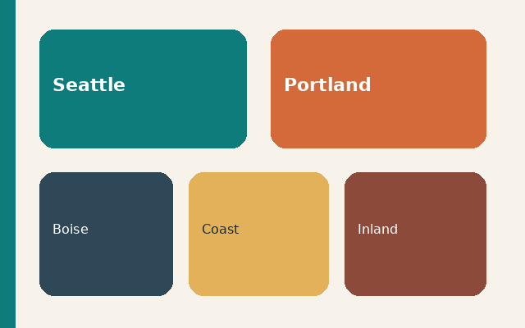
West region coverage
Seattle and Portland carried the quarter
A new distributor covers Boise
Inventory on the coast is tight through November

Slide 5
Revenue by line
Line | Q2 $m | Q3 $m
Specialty tea | 1.2 | 1.5
Field kits | 0.8 | 0.9
Wholesale | 2.1 | 2.4
Direct | 0.6 | 0.7

Slide 6
Risks to watch
Port delays on the October sailing
One key account is in procurement review
Hiring for the Denver route is still open

Slide 7
Decisions for Thursday
Approve the coastal safety stock
Keep the wholesale price hold
Name an owner for the Denver route

