Slide 1
Lotus SPR001
Location of installation: NTPC
Name: Nidhi Dubey
Date 16/04/2024
Time 18:00hrs.(IST)
Notes:
Guru – Testing team

Slide 2
System Update
Completed Run Hours |  | 1 hr.
Start date | 2024-04-16 16:29:50 | Last updated | 2024-04-16 17:52:00
System Update
Date |  | 16-04-2024 |  | Shift | General
System |  | Status | Running mins | Shift Engineer | Karthikeyan N
SPR001 |  | OFF | 0 | Stack | 163-112
Total Running Hours since 13 Dec |  |  |  | 293.50
Run mins with Dryer | 0.00 |  |  | Total hrs. |  | 55.03
mins of H2 given to customer | 0.00 |  |  | Total hrs. |  | 39.80
REMARKS
SPR001
Description | Stack L1 |  | Stack L2
Stack Id | 162-112 | Dummy | Dummy | 163-112
Date Start | 02-Nov | 09-Jan | 02-Nov | 09-Jan
Date End | 09-Jan | Prst. | 09-Jan | Prst.
Note | The data has started recording since 13 Dec. The data points in all the LHC & LWC Charts are depicted as average of per hour data (not in Voltage related charts & last 24 hrs charts).
Summary | System working with stack 163-112 at L2 & L1-Dummy (These are electrical connections). Latest steady state Current Density is ~0 A/cm2.

Slide 3
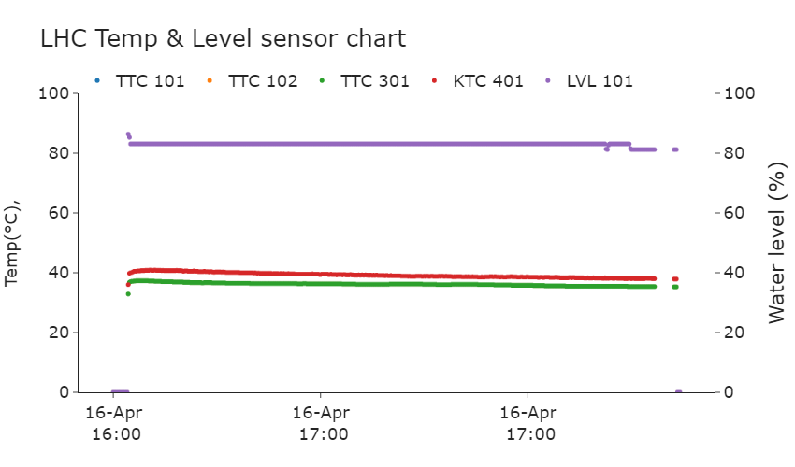
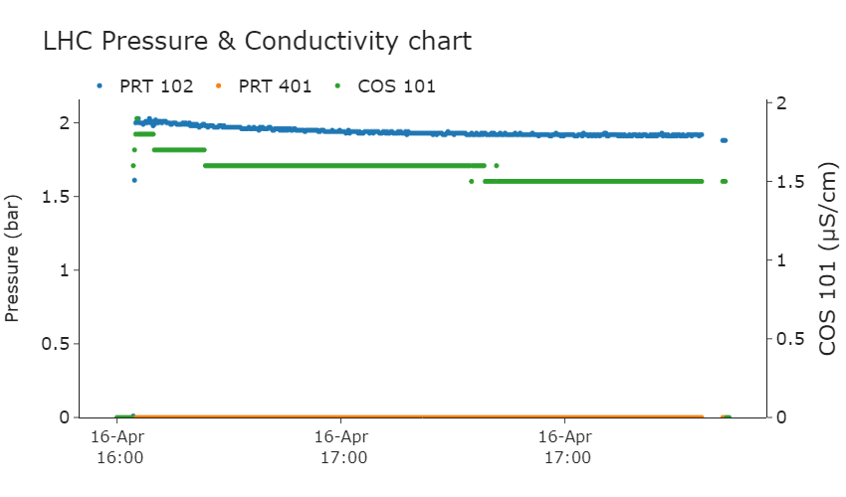
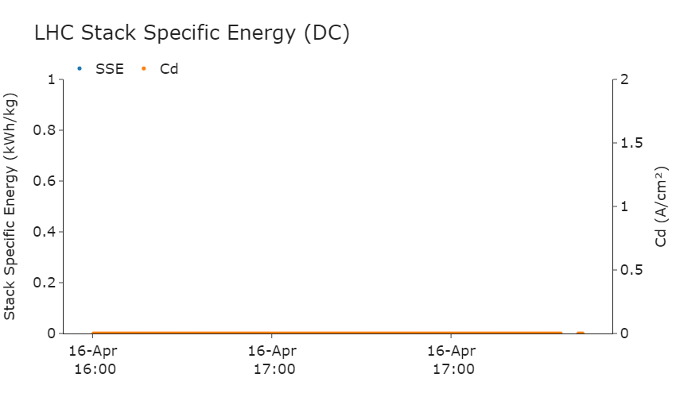
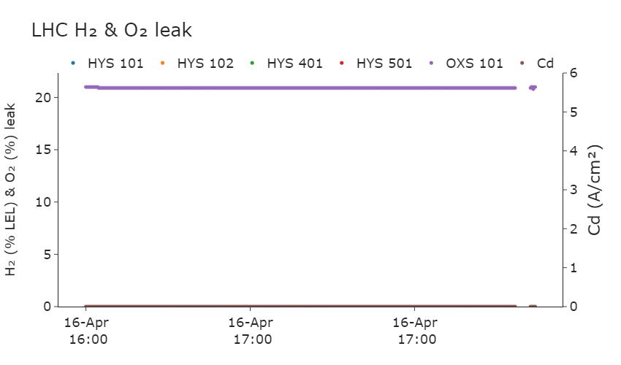




Slide 4
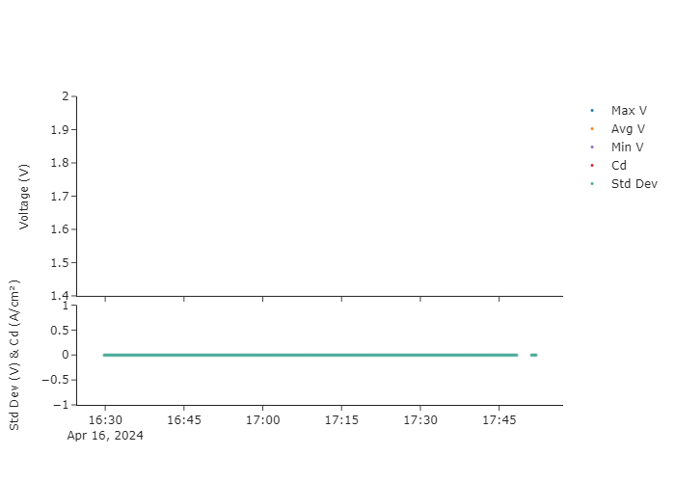

LHC Charts – CV and cd

Slide 5
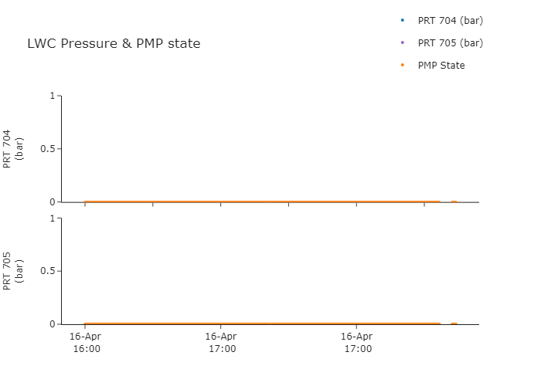
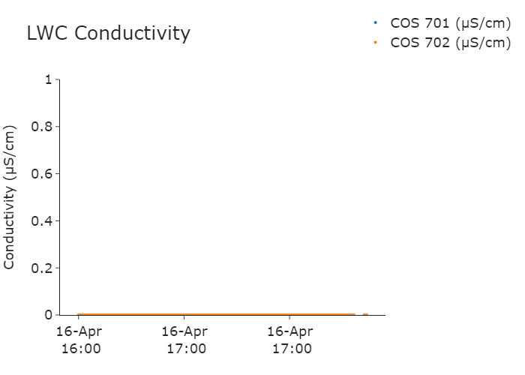
LWC Charts
PMP State:
1 : ON 0 : OFF

Slide 6
Thank you!

