Slide 1
Lotus SPR001
Location of installation: NTPC
Name: Nidhi Dubey
Date 10/02/2024
Time 22:00 hrs.(IST)
Notes:
Guru – Testing team

Slide 2
System Update
Completed Run Hours |  | 724 hrs.
Start date | 2023-12-02 16:17:10 | Last updated | 2024-02-10 16:42:40
System Update
Date | 10-02-2024 |  | Shift | B
System | Status | Running mins | Shift Engineer | Karthikeyan N
SPR001 | Water loop | 137 | Stack | 163-112
Total Running Hours |  |  | 238.97
REMARKS
SPR001
07:40 Water loop started. HYS 102 verified. 07:50 System started powerup up till 400A. 08:35 System power reduced due to Reclamation pump issue. 08:40 System powered up again till 400A. 09:00 At 700A - TTC102- 63.4C, COS101 -1, Dryer in bypass state. 09:41 System Current made 0A to take dryer inline. 09:55 System power started to increase till 650A after taking dryer inline. 10:30 System current reduced to 0A due to reclamation pump issue. 10:45 System power started to increase to 650A after PMP401 VFD is bypassed 11:01 Compressor Started to fill the customer point. 11:37 System Current made 0A since O-ring in dryer bay gland plate got damaged and change the O-ring 11:51 System powered up to 750A and started to give customer. 14:30 LHC Drier both tower are pressurized up to 10Bar suspecting SV 6 not functioning properly 14:30 Leak found in reclamation pump 102 sealing 15:55 Hydrogen filling to customer stopped 16:17 System powered to zero amps 16:18 System on Hot standby mode 16:45 System on Cold standby mode
Description | Stack L1 |  | Stack L2
Stack Id | 162-112 | Dummy | Dummy | 163-112
Date Start | 02-Nov | 09-Jan | 02-Nov | 09-Jan
Date End | 09-Jan | Prst. | 09-Jan | Prst.
Note | The data points in all the LHC & LWC Charts are depicted as average of per hour data (not in Voltage related charts & last 24 hrs charts).
Summary | System working with stack 163-112 at L2 & L1-Dummy (These are electrical connections). Latest steady state Current Density is ~1 A/cm2. Max Voltage at 0.42 A/cm2 was 1.803 V.

Slide 3
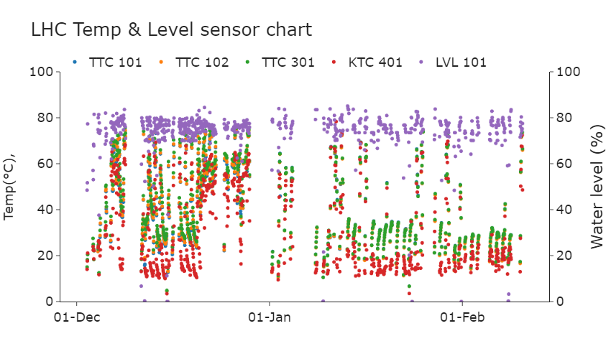
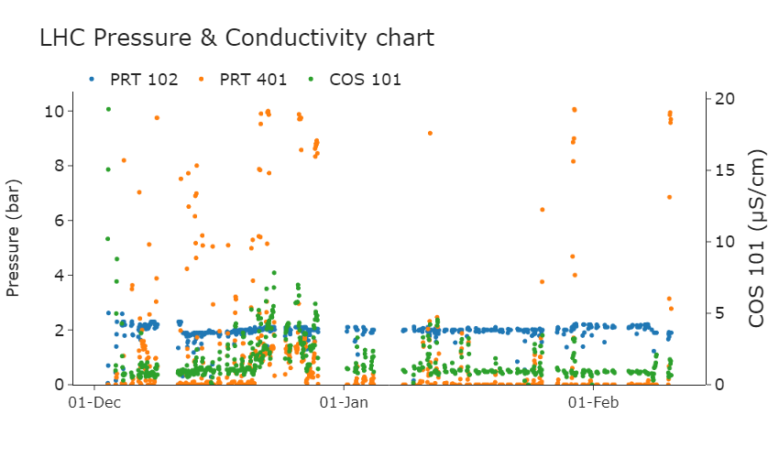

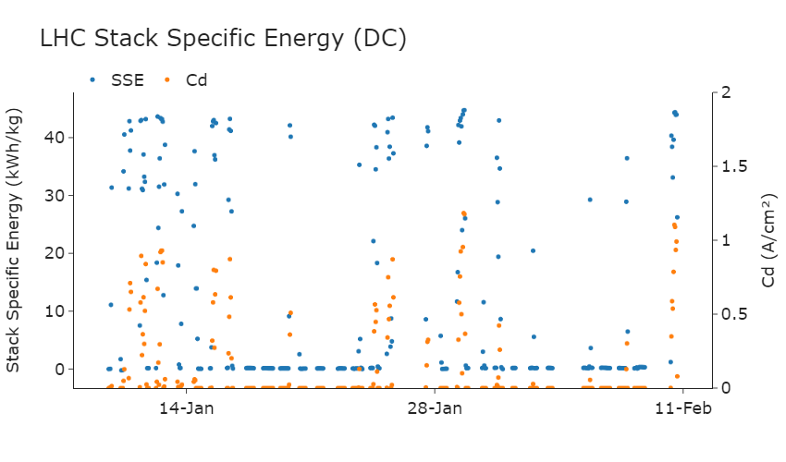
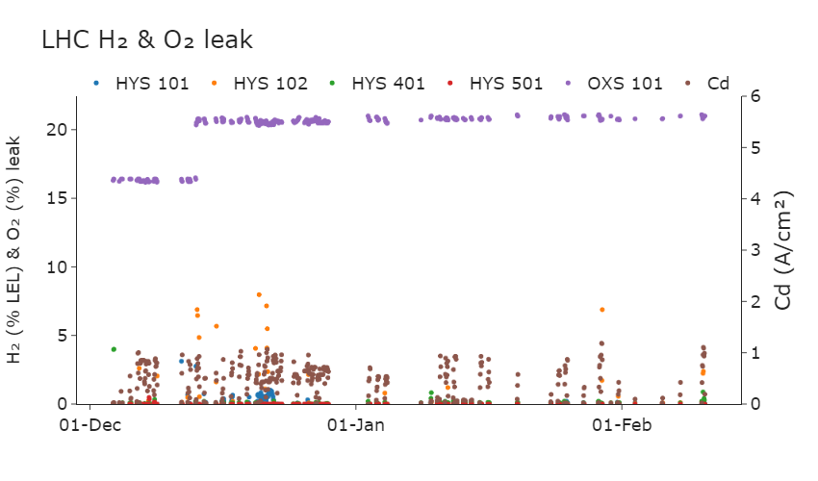




Slide 4
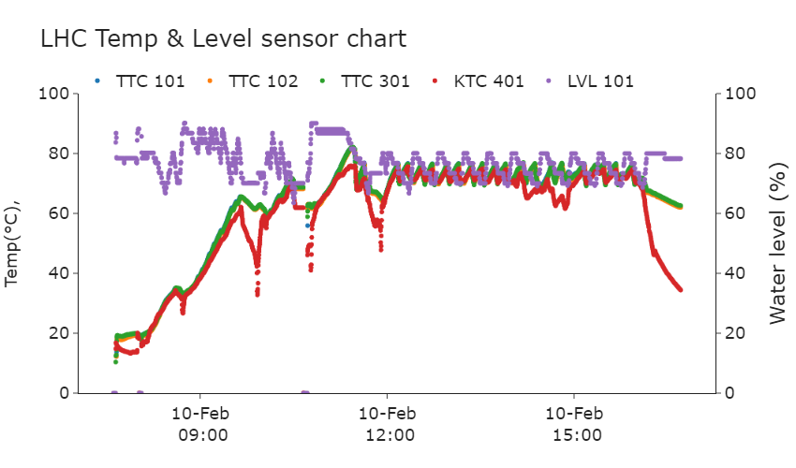
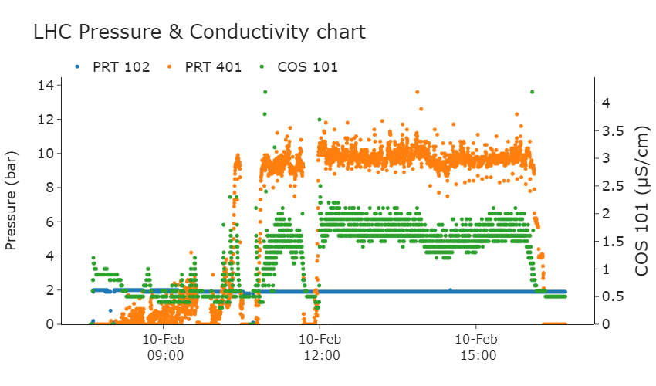
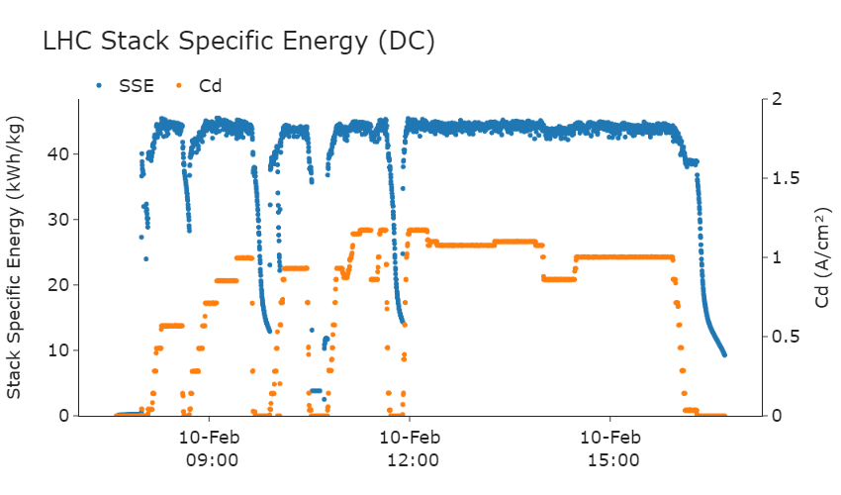
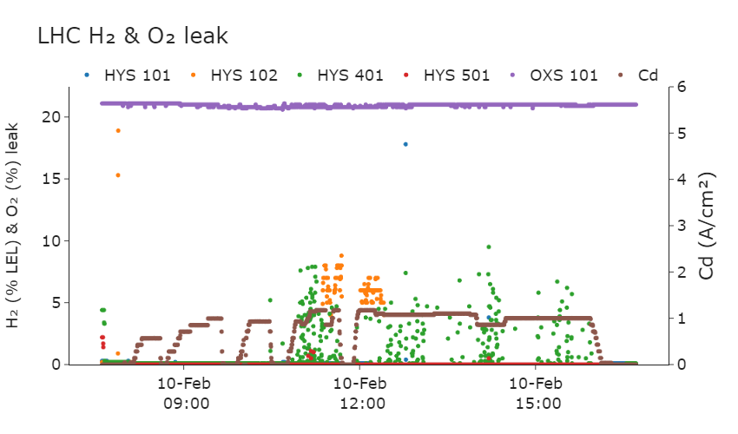

Slide 5
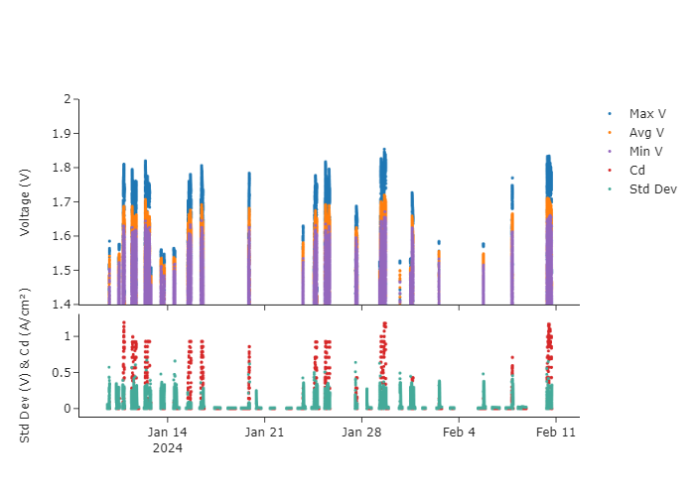

LHC Charts – CV and cd

Slide 6
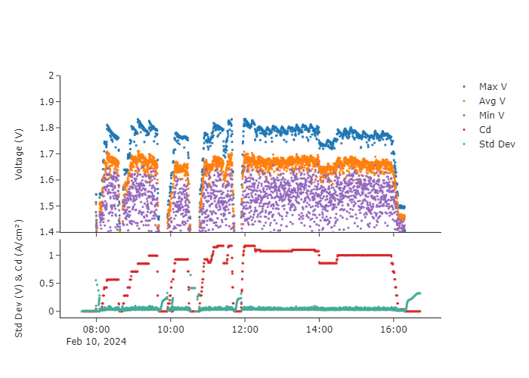
LHC Charts – CV and cd (24 hours)

Slide 7
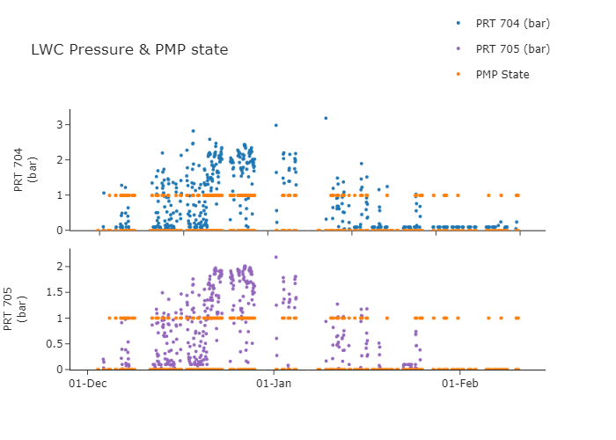
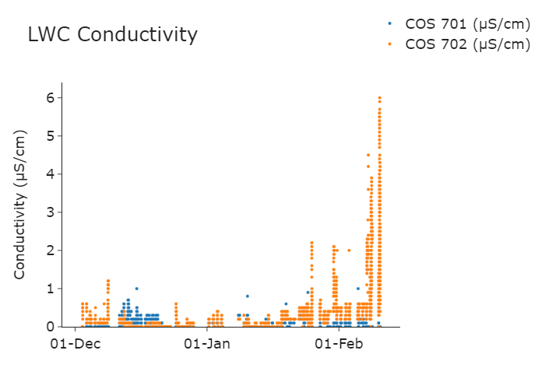
LWC Charts – Last 24 hrs.
PMP State:
1 : ON 0 : OFF

Slide 8
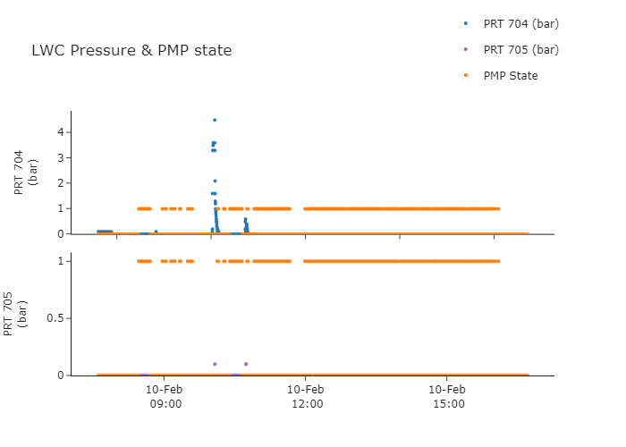
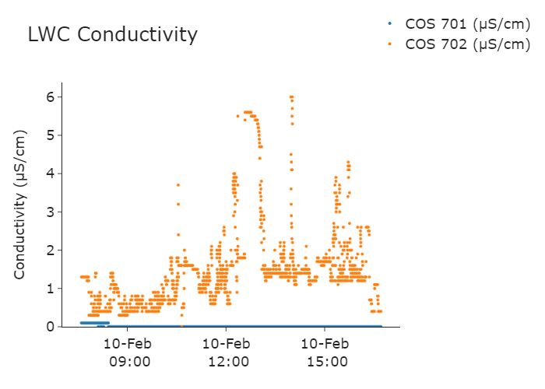
LWC Charts – Last 24 hrs.
PMP State:
1 : ON 0 : OFF

Slide 9
Thank you!

