Slide 1
Lotus SPR001
Location of installation: NTPC
Name: Nidhi Dubey
Date 12/03/2024
Time 19:00 hrs.(IST)
Notes:
Guru – Testing team

Slide 2
System Update
Completed Run Hours |  | 939 hrs.
Start date | 2023-12-02 16:17:10 | Last updated | 2024-03-12 17:42:10
System Update
Date | 12-03-2024 |  | Shift | B
System | Status | Running mins | Shift Engineer | Karthikeyan N
SPR001 | OFF | 270 | Stack | 163-112
Total Running Hours |  |  | 291.5
Running Hours with Dryer |  |  | 10.15
Hours of H2 given to Customer |  |  | 0.00
REMARKS
SPR001
1.09:38hrs - System water loop started 2.10:14hrs -Embedded team took control of the system to resolve firmware issues and will be continued tomorrow. 3.13:15hrs- System powered up to 500amps,dryer bypassed. 4.17:44hrs- System powered to zero amps. 5.System is under cold standby mode.
Description | Stack L1 |  | Stack L2
Stack Id | 162-112 | Dummy | Dummy | 163-112
Date Start | 02-Nov | 09-Jan | 02-Nov | 09-Jan
Date End | 09-Jan | Prst. | 09-Jan | Prst.
Note | The data points in all the LHC & LWC Charts are depicted as average of per hour data (not in Voltage related charts & last 24 hrs charts).
Summary | System working with stack 163-112 at L2 & L1-Dummy (These are electrical connections). Latest steady state Current Density is ~0.42 A/cm2. Max Voltage at 0.92 A/cm2 was 1.633 V.

Slide 3
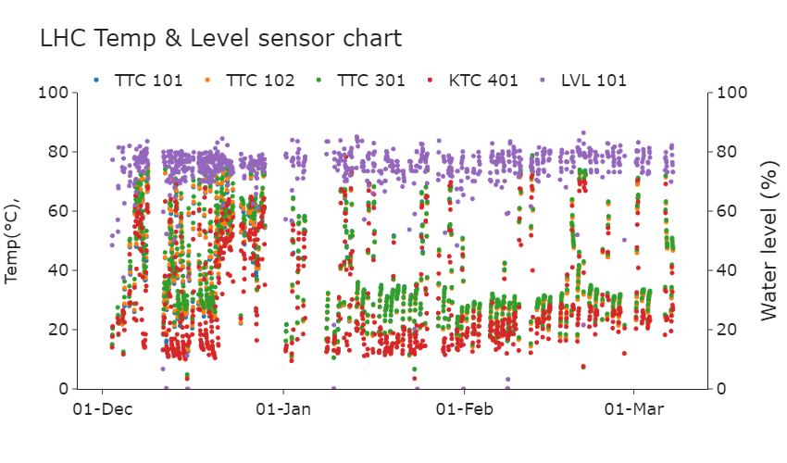
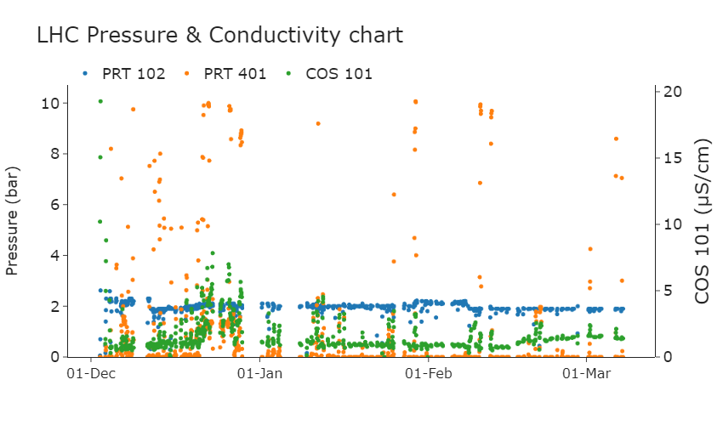
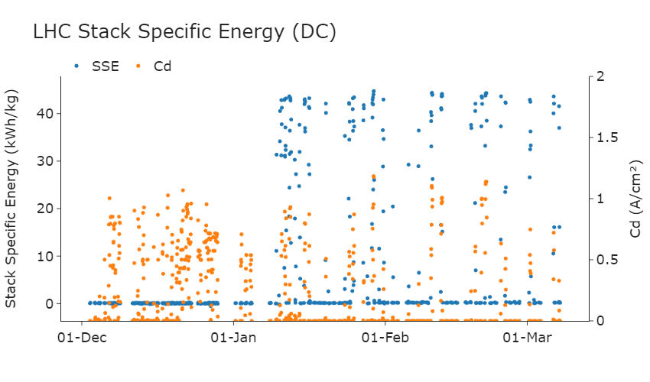
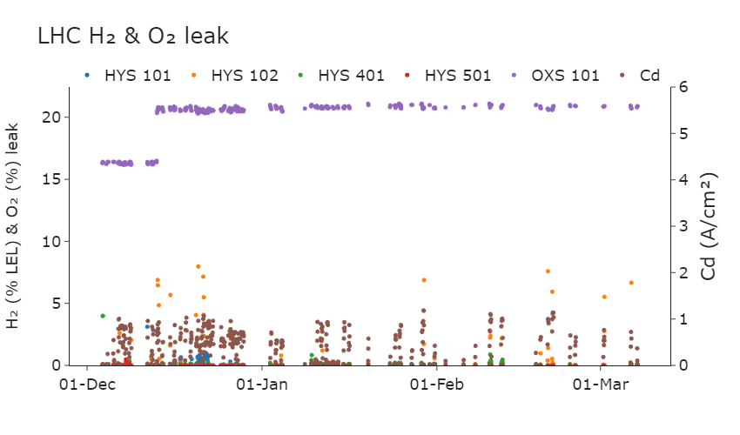




Slide 4
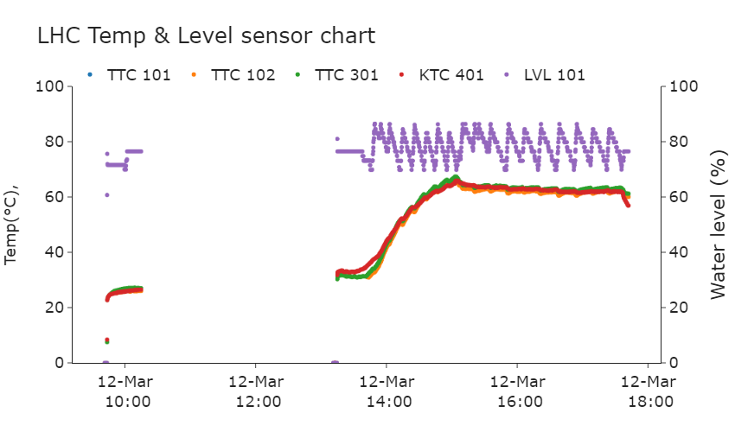
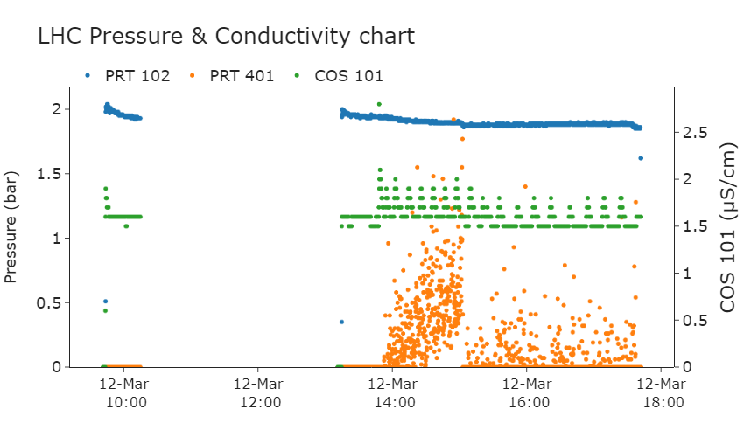
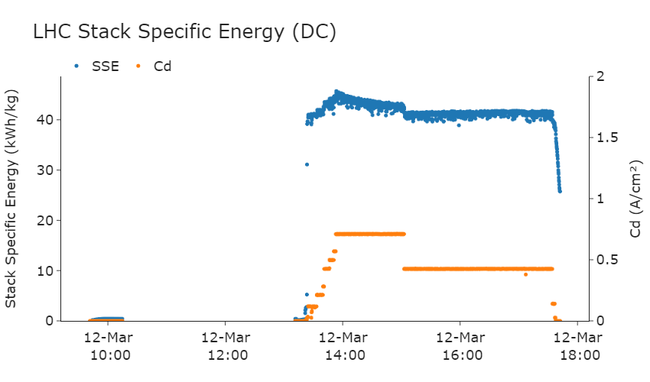
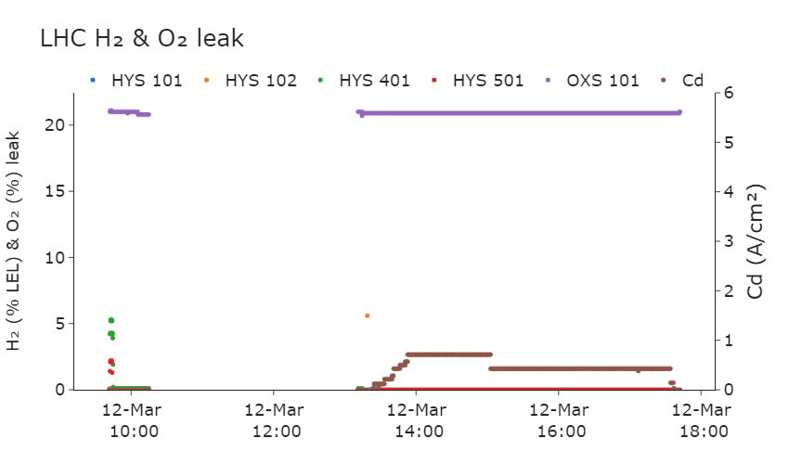

Slide 5
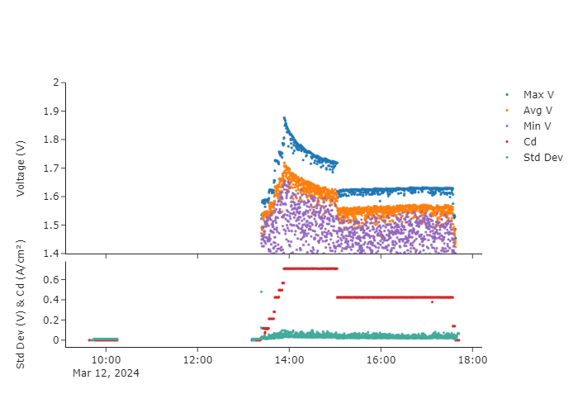

LHC Charts – cv and cd (last 24 hrs.)

Slide 6
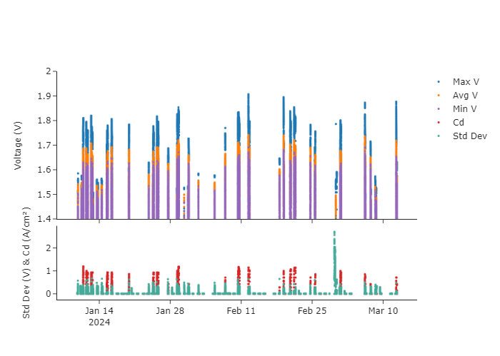
LHC Charts – cv and cd

Slide 7
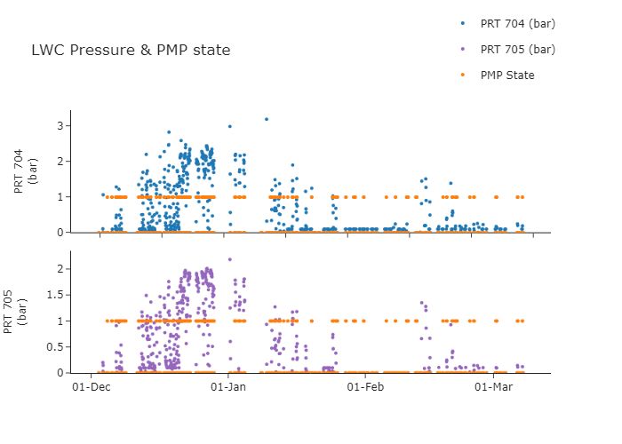
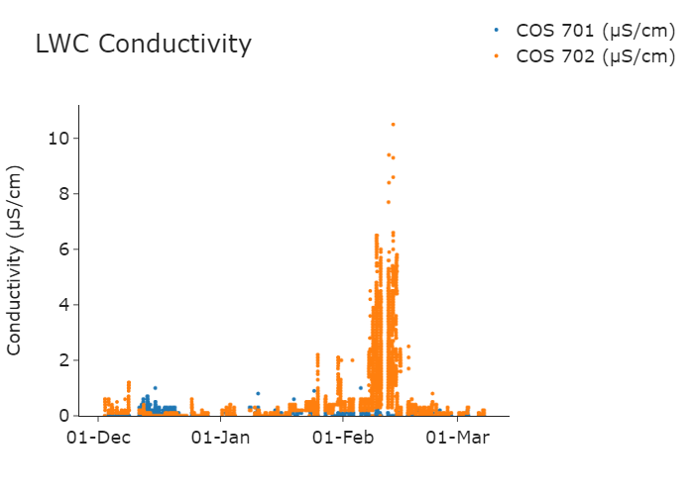
LWC Charts
PMP State:
1 : ON 0 : OFF

Slide 8
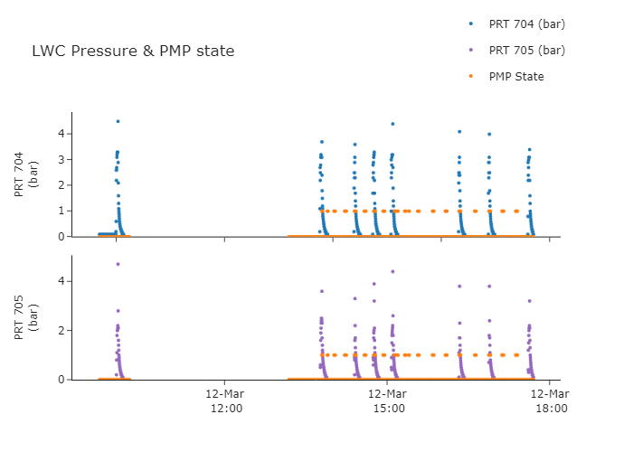
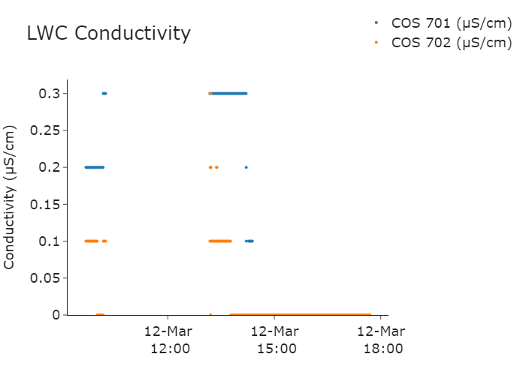
LWC Charts - last 24 hrs.
PMP State:
1 : ON 0 : OFF

Slide 9
Thank you!

