Slide 1


_{group company}

Slide 2


Numbers Only, Inc. is a technology driven IT Solutions Company providing innovative services, products, and resources. We partner with our clients to improve their business performance by providing innovative Information Technology solutions. Our approach is to deliver value for our clients through our unwavering focus on technology.
_{Founded}
₁₉₉₇
_{Overview}
^{Headquarters}
_{North Brunswick, NJ}
^{Revenue FY 10}
_{$12 + Million}
"To exceed the expectation of our customers"
By providing value to our customers with quality as the driving principle in products, services & relationships.
To provide integrated, cost-effective, state-of-the-art, quality solutions for utmost customer satisfaction.
_{VISION}
&
_{MISSION}
_{Employees}
₂₀₀₊
_{North Brunswick, NJ}
_{Irving, TX}
_{Sunnyvale, CA}
_{Hyderabad, India}
_{Locations}

Slide 3
Management - Team
Raju VK - President
Mr. Raju VK founded "Numbers Only, Inc" in 1996 along with Mr. Hari Polavarapu. Mr.Raju has more than several years of experience in Information Technology industry and has been the brain behind designing complex enterprise systems using advanced Internet/Wireless technologies for "Numbers Only, Inc".
Mr. Raju VK has been responsible for overall technology and infrastructure strategy for the company. His strategic focus for the company has been in the products and advanced technology arena. He also currently serves as the President/CEO of AtPar, Inc., a spin-off of a Numbers Only research and development effort.
In the past Mr. Raju VK has held technical positions with several leading global IT services companies such as Tata Consulting Services, Foundation Software, and Analysts International. His consulting services have been leveraged by Fortune 500 companies such as M&M Mars, NY Times, Shoprite, and Allied Holdings. He also specializes in Healthcare Informatics and has provided consulting services for multiple healthcare organizations including Baptists Health, Blue Cross Blue Shield, Fletcher Allen, and Dartmouth Hitchcock Medical Center. Mr.Raju VK obtained his bachelor's degree in Mechanical Engineering from Osmania University, Hyderabad.
Nath Danturty - Chief Strategy Officer
Mr.Nath has over 2 decades of experience in the Information Technology and Online Gaming industries. Mr. Nath has held critical positions in technologies with top Australian Corporations such as IBM, Telstra, Best Bets, Lease Plan, AGL, IASBET, CANBET, SPORTS BET and OPENBET. Mr. Nath's core competencies are online Race betting, online Sports betting, Poker and Casino Games. He has spearheaded several path breaking and successful rollout of various Product launches for top Gaming companies in the UK and Australia. Mr. Nath has won several contribution and Team Recognition awards from Major Australian Corporates. Mr.Nath holds a Masters degree in Science from Andhra University, Visakhapatnam, India.

Slide 4
Why Fundoo Deals?
The vision of FUNDOO DEALS is to increase foot falls and in turn enhance sales for various retail businesses
There is always a craze for deals and historical data proves shows that there is a substantial increase in sales due to impulse buying of customers whenever there is a deal or offer
Several customers tend to make additional purchases whenever there is a deal offered
The concept of gaming & giving away discounts or offers is likely to keep the customer interested, engaged and inspired to shop more and more
The product will be an alternative to traditional discount. Discounts can be effectively used to show appreciation to a select few customers who can bring more business and with whom you can build a long-term loyal relationship
Use the tool to showcase your products and offers
Fulfill the corporate objective of enhanced customer satisfaction

Slide 5
How Does it Work ?
The Merchant shall have Web based / Tablet based / Mobile based / Touch Screen Kiosk / Physical hardware based gaming options
Merchant shall promote the deals game link as PLAY & WIN in All regular promotions
    HTML Emailers
    SMS Marketing
    Facebook Marketing
    Social Media Marketing
The game link will drive traffic to a page where the game is hosted
The potential customer shall play the game and test his fortunes
Based on the output/ result of the game, we can have a deal pre –programmed in the software algorithm
We shall list out the exhaustive list of outcomes of the game and pre-assign a Discount / Deal to a specific output
The game output will translate into a specific deal and show up to the customer

Slide 6
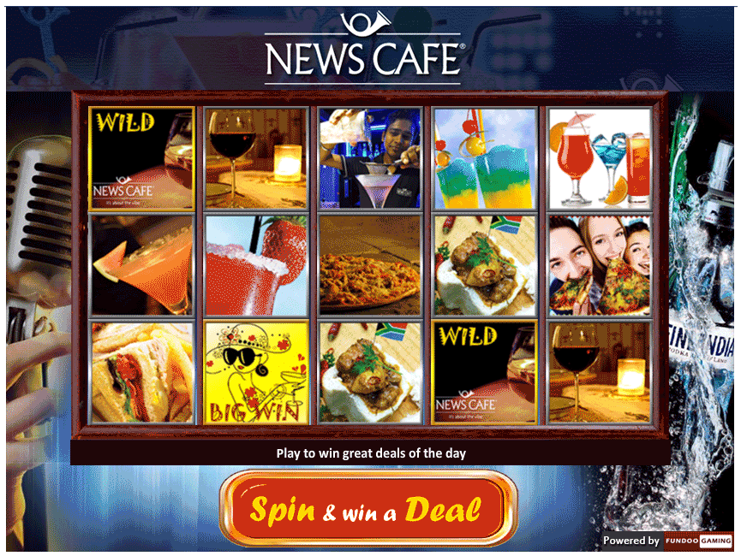
NEWSCAFE - DEMO GAME

Slide 7
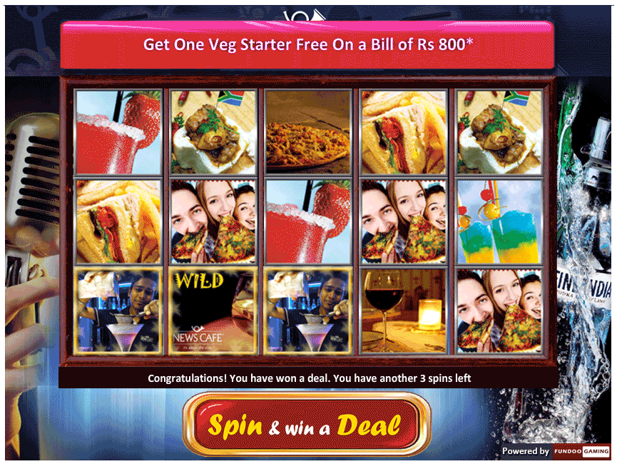
NEWSCAFE - DEAL OUTCOME

Slide 8
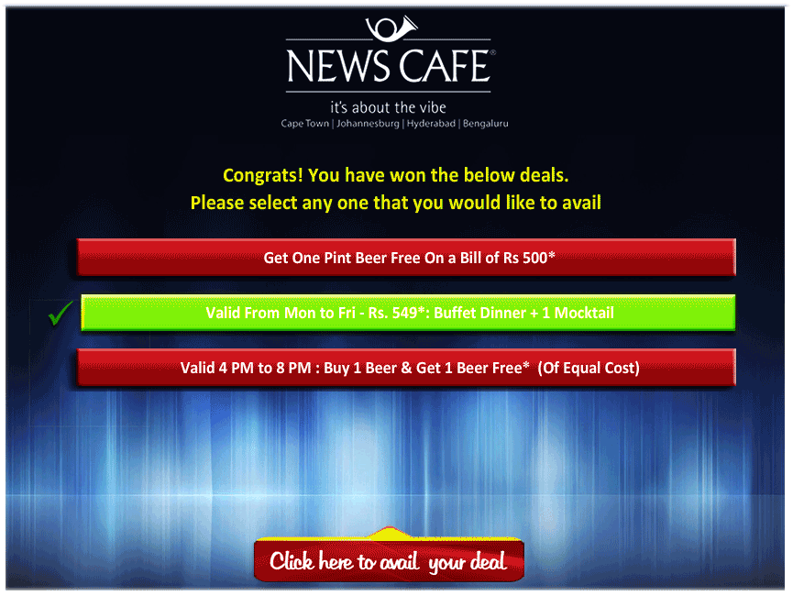
Selecting a Deal of Choice

Slide 9
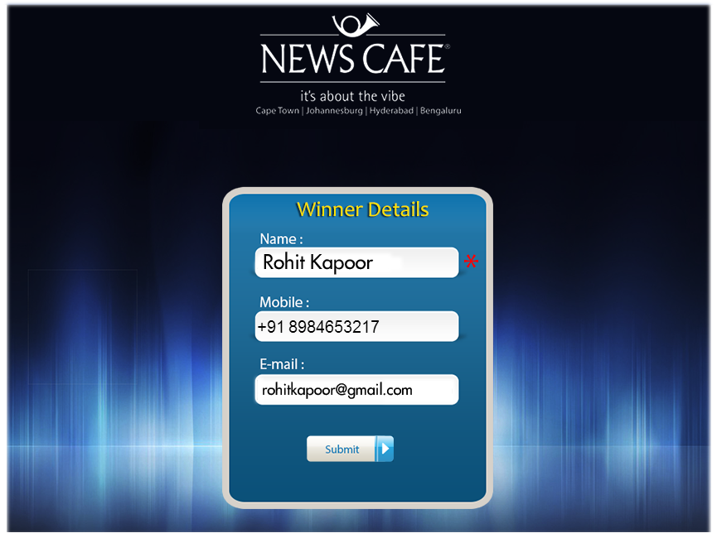
Entering Personal Info to Claim the Deal

Slide 10
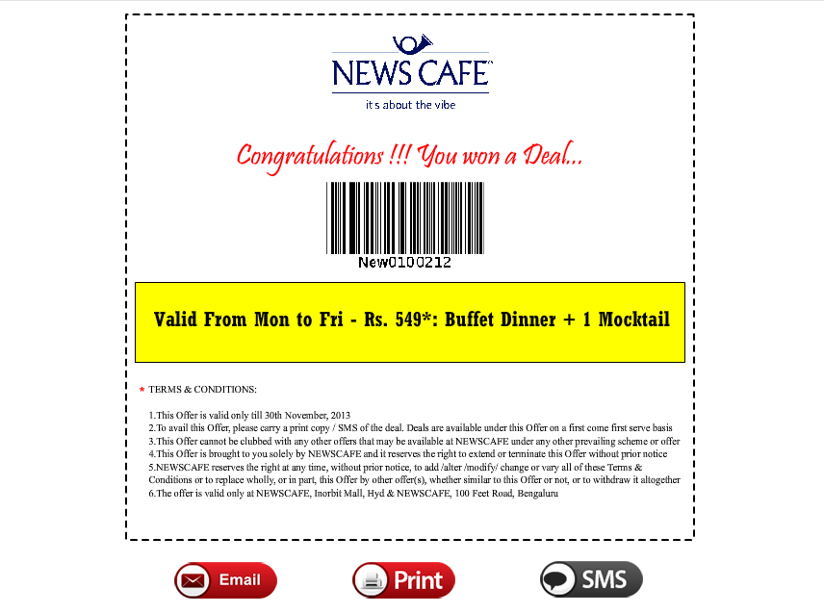
The Deal Voucher with various options

Slide 11
Engagement Models
The service will be offered to Merchants as a SAAS Model
The Merchant will have a choice of
  Game Selection
  Configuring various options for the customer
  Branding and Merchandising on the game
  Showcasing the Deals / Offers that you would like to offer
The pricing model of the Service is as follows
  Setup Cost
  Monthly Fee
  Cost Per Transaction
  Issue a deal voucher
  Redeem a deal voucher

Slide 12
THANK YOU
For more information about our offerings, please contact :
M. Sravan Kumar
Senior Vice President – Operations
M : +91-9246538824; E: sravan.m@numbersonly.co.in
Zintec Software Pvt. Ltd.
(NumbersOnly Informatics Pvt. Ltd.)
5th Floor, North Block, Babukhan Millennium Centre,
Rajbhavan Road, Somajiguda, Hyderabad. 500 082. INDIA
Ph:+91-40-23396314; Fax : +91-40-23418269

