Slide 1
IDS MINI-PROJECT
Student Performance Analysis
Mini Project By: Seat No.
Nidhi Harkare BCA-2326
Shivam Jadhav BCA-2355
Vaishnavi kurund BCA-2338
Hiral Khatal BCA-2327

Slide 2
Introduction
This project analyzes student performance using data science
Uses the student.csv dataset
Finds which factors affect marks
Predicts final grade (G3)
Helps identify weak students early

Slide 3
Problem Statement
:
Students score differently due to study habits, attendance, and past marks
Teachers know about weak students only at the end
Need an automated way to predict performance
Aim: analyze data and predict final marks

Slide 4
Dataset Overview
Dataset size: 395 students, 33 columns
Important columns:
G1 (first period marks)
G2 (second period marks)
G3 (final marks)
studytime (weekly study hours)
absences (days absent)
Data contains academic + personal attributes

Slide 5
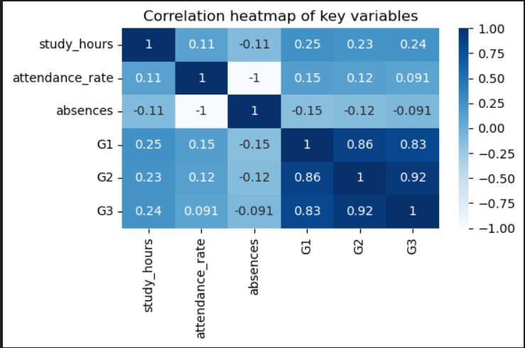
Feature Engineering & EDA
Converted studytime into real study hours
Created attendance_rate
Selected key features: G2, study_hours, attendance
EDA plots created:
Correlation heatmap
Study hours vs G3
Attendance vs G3
G2 vs G3 (strongest relation)

Slide 6
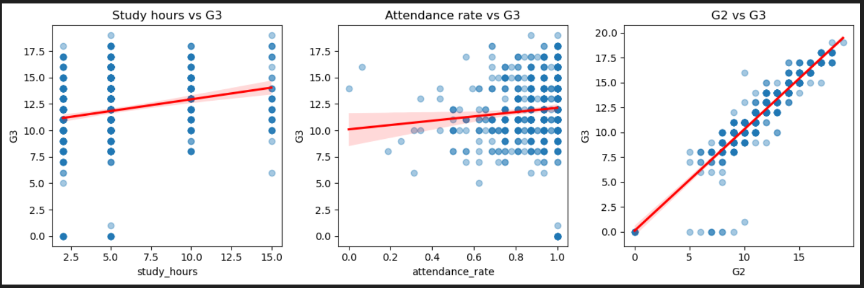
We did feature engineering by converting study time into actual study hours and by creating attendance rate.
Then I selected important numerical columns like G1, G2, G3, study hours, absences, and attendance rate.
Using seaborn and matplotlib, I made a correlation heatmap and three scatter plots.
These plots help us understand how study hours, attendance, and G2 marks affect the final grade G3.”

Slide 7
Linear Regression Model
Model used: G3 ~ G2 + study_hours + attendance_rate
Data split: 80% train, 20% test
Achieved high accuracy
Outputs:
R² Score ≈ 0.86
Shows strong prediction power
MAE ≈ 0.74

Slide 8
Ridge Regression Model
Added categorical variables
Used OneHotEncoding for categories
RidgeCV used to reduce overfitting
Best alpha selected automatically
Similar accuracy with better error control
Proved that G2 is still main predictor

Slide 9
Conclusion
G2 is strongest predictor of final marks
More study hours → better performance
More absences → lower marks
Models predict G3 with high accuracy
Can be converted into a real prediction system
Useful for early identification of weak students

