Slide 1
Impact of Customer
Preferences on Home
Rentals
By:-
Nidhi Jha Sagar Kumar

Slide 2
Agenda:-
Objective
Background
Key Findings
Recommendations
Appendix:
Data Attributes
Data Methodology
Data Assumption

Slide 3
Objective:-
Improve our shared understanding about the market conditions.
Improve shared understanding about our customers.
Provide recommendation to various departments to be prepared for the changes post pandemic.

Slide 4
Background:
Major decline in revenues due to pandemic in the last few months.
Restriction are lifting.
People are travelling more.

Slide 5
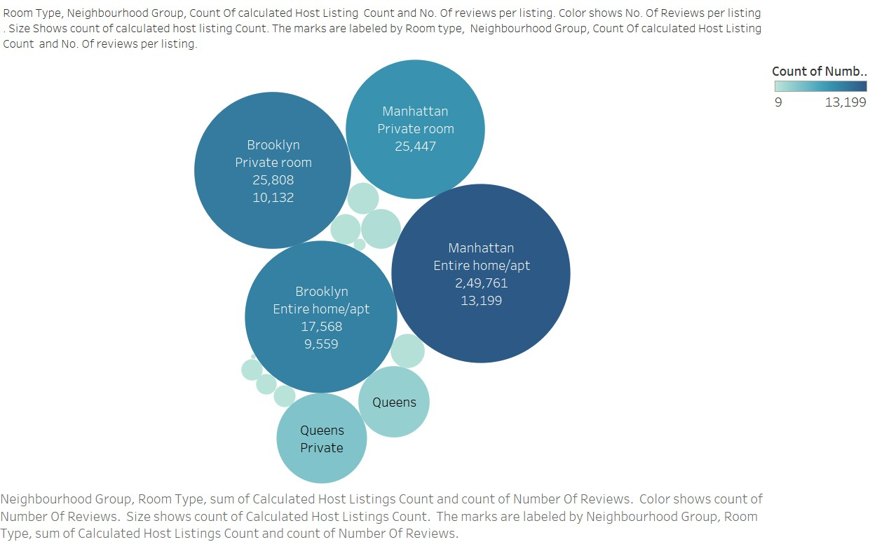
Neighbourhood Wise Business Distribution
Private rooms are the most popular throughout New York >25 reviews per listing.
Entire home/apt in Manhattan has reviews per listing 35% less than the average of 27.7.
Except Manhattan, all areas performed poorly in shared rooms with an average of
7.3 reviews per listings.

Slide 6
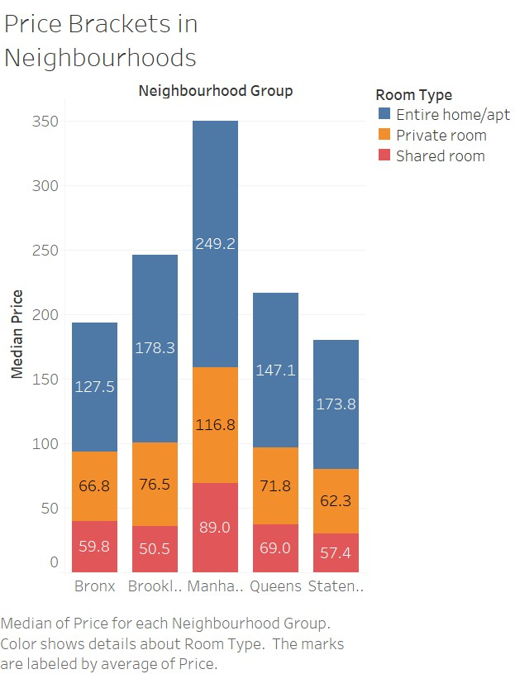
Pricing in Preferred Locations
Entire home/apt’s price is ~100% more than private rooms except Brooklyn and Staten Island with
~150% .
Private room’s price is ~10% more than shared rooms except Brooklyn and Manhattan with ~40%.
Manhattan is costliest overall and the cheapest are:
Entire apt: Bronx
Private room: Staten Islands
Shared room: Brooklyn

Slide 7
Recommendations:-
Acquire private rooms and entire apartments, especially in Staten Islands since it is popular.
Reducing the prices of entire apartments in Manhattan by at least 15% and increasing the price of private rooms in Queens by at least 10%.
Listings most popular have minimum number of nights requirement from 1-5 days and 30 days which should be showcased the most ordering them by properties which are available for most number of days to least.

Slide 8
Appendix: Data Attributes
HERE IS A SNAPSHOT OF THE DATA:
Host listing information like host name, neighborhood, latitude and longitude.
Customer preference information like number of
reviews and number of reviews per month

Slide 9
Appendix: Data Methodology
Used Tableau to visualize correctly to get insights.
Since outliers existed in price field, used median of price instead of mean for analysis purposes.
Find detailed methodology document below:
o Please refer the data methodology doc file in the folder

Slide 10
Appendix: Data Assumptions
Used Reviews per Listing as the popularity measure to gain
information on customer preferences.
Number of reviews assumed to be a base measure to find customer preferences.
Null values assumed to have no material impact on analysis.

Slide 11
Thank You

