Slide 1
All-Pairs Shortest Paths
Hong-Ming Chu 2013/10/31

Slide 2
Refernece
Lecture slides from Prof. Hsin-Mu Tsai’s course slides and Prof. Ya-Yuin Su course slides.

Slide 3
Today’s Goal
Quick recap of single source shortest path
Floyd-Warshall algorithm
Johson algorithm

Slide 4
Things we have learned so far
Single-source shortest paths problem
Two algorithms
Bellman Ford algorithm
Dijakstra’s algorithm
Several properties about shorthest path

Slide 5
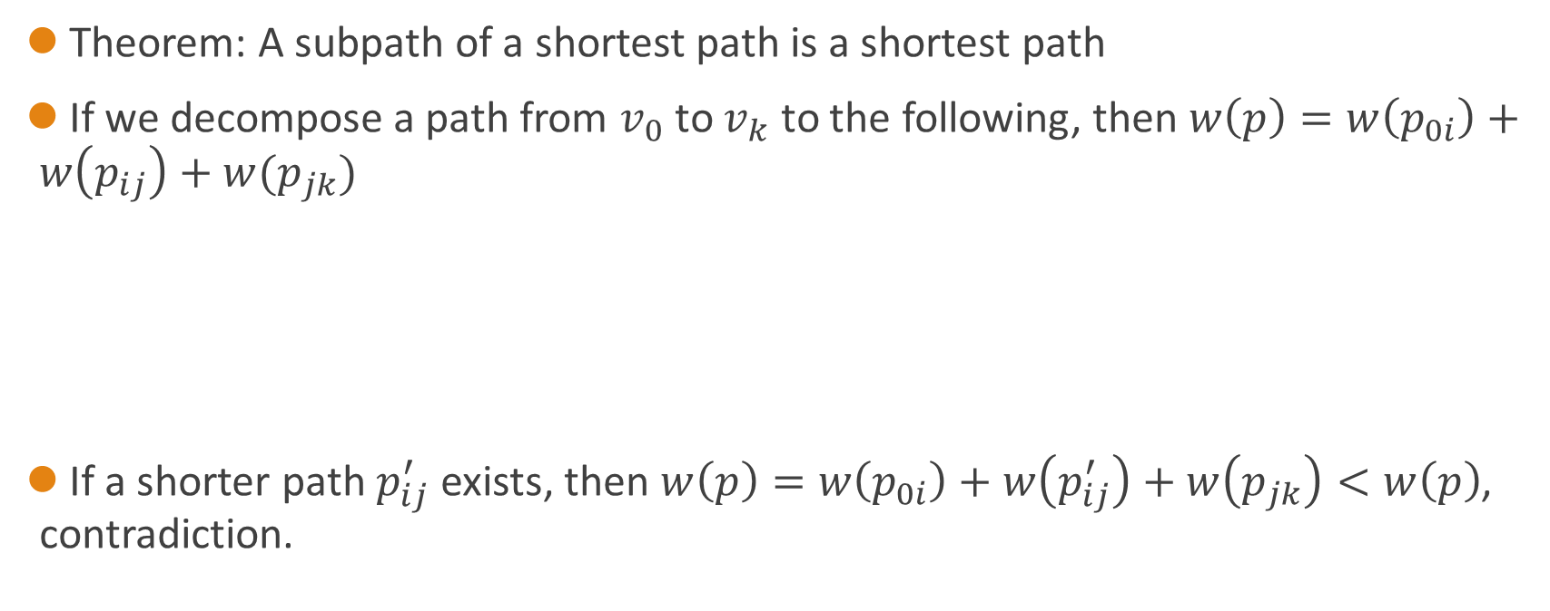
Optimal Substructure
Theorem: A subpath of a shortest path is a shortest path
If we decompose a path from $v_{0}$ to $v_{k}$ to the following, then $w\left(p\right)=w\left(p_{0i}\right)+w\left(p_{ij}\right)+w(p_{jk})$
If a shorter path $p_{ij}^{′}$ exists, then $w\left(p\right)=w\left(p_{0i}\right)+w\left(p_{ij}^{′}\right)+w\left(p_{jk}\right)<w\left(p\right)$, contradiction.
V0
Vi
Vj
Vk

Slide 6
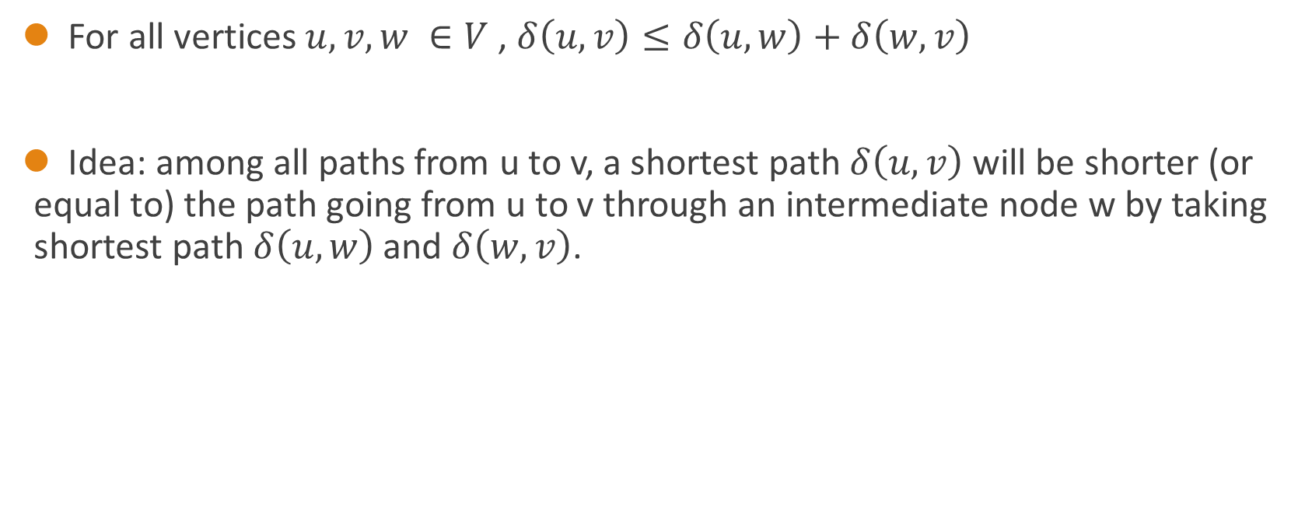
Triangle inequality
For all vertices $u, v, w ∈V$ , $δ\left(u, v\right)≤δ\left(u, w\right)+δ\left(w,v\right)$
Idea: among all paths from u to v, a shortest path$δ\left(u, v\right)$ will be shorter (or equal to) the path going from u to v through an intermediate node w by taking shortest path$δ\left(u, w\right)$ and $δ\left(w,v\right)$.

Slide 7
Algortihms we have learned
Graph type | Algorithm | Runnging Time
Unweighted graph | BFS | O(V+E)
Non-negative edge weight graph | Dijkstra | O(E+VlgV)
General graph | Bellman-Ford | O(VE)
DAG | Bellman-Ford | O(V+E)

Slide 8

Algortihms we have learned
But what happen when the graph is dense?
ex. When $|E|≈{|V|}^{2}$?
And what happen when the graph is relatively sparse?
ex. When $|E|=θ\left(V\right)?$

Slide 9
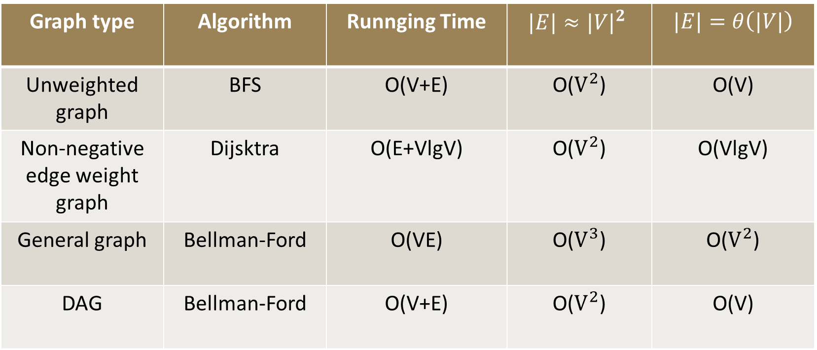
Algorithms we have learned
Graph type | Algorithm | Runnging Time | $$|E|≈{|V|}^{2}$$ | $$|E|=θ\left(|V|\right)$$
Unweighted graph | BFS | O(V+E) | O($V^{2}$) | O(V)
Non-negative edge weight graph | Dijsktra | O(E+VlgV) | O($V^{2}$) | O(VlgV)
General graph | Bellman-Ford | O(VE) | O($V^{3}$) | O($V^{2}$)
DAG | Bellman-Ford | O(V+E) | O($V^{2}$) | O(V)

Slide 10
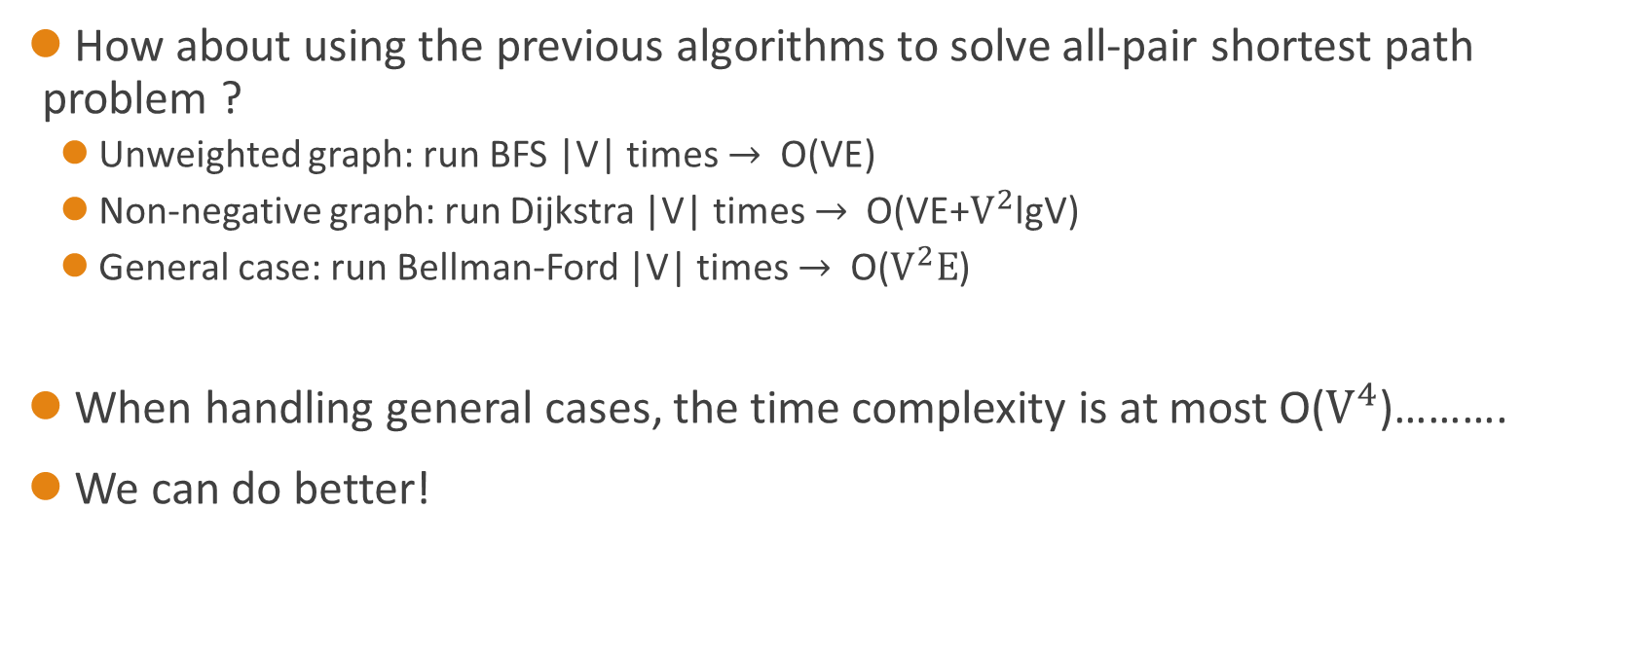
All-pair shortest paths
How about using the previous algorithms to solve all-pair shortest path problem ?
Unweighted graph: run BFS |V| times $→$ O(VE)
Non-negative graph: run Dijkstra |V| times $→$ Ο(VE+$V^{2}$lgV)
General case: run Bellman-Ford |V| times $→$ Ο($V^{2}E$)
When handling general cases, the time complexity is at most O($V^{4}$)……….
We can do better!

Slide 11
But how…….?
Recall that shortest paths has some useful properties.
One of them is that a shortest path has an optimal substructure.
As soon as we realize this…….
Dynamic programming may be a good choice to solve this problem!

Slide 12
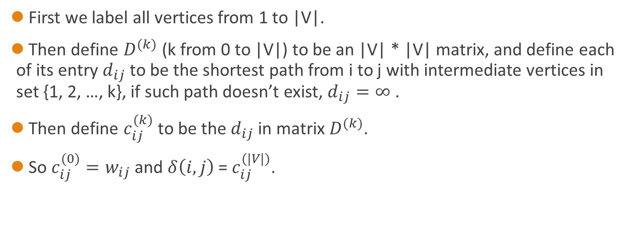
Floyd-Warshall algorithm
First we label all vertices from 1 to |V|.
Then define $D^{(k)}$ (k from 0 to |V|) to be an |V| * |V| matrix, and define each of its entry $d_{ij}$ to be the shortest path from i to j with intermediate vertices in set {1, 2, …, k}, if such path doesn’t exist, $d_{ij}=∞$ .
Then define $c_{ij}^{(k)}$ to be the $d_{ij}$ in matrix $D^{(k)}$.
So $c_{ij}^{(0)}=w_{ij}$ and $δ\left(i, j\right)$ = $c_{ij}^{(|V|)}$.

Slide 13
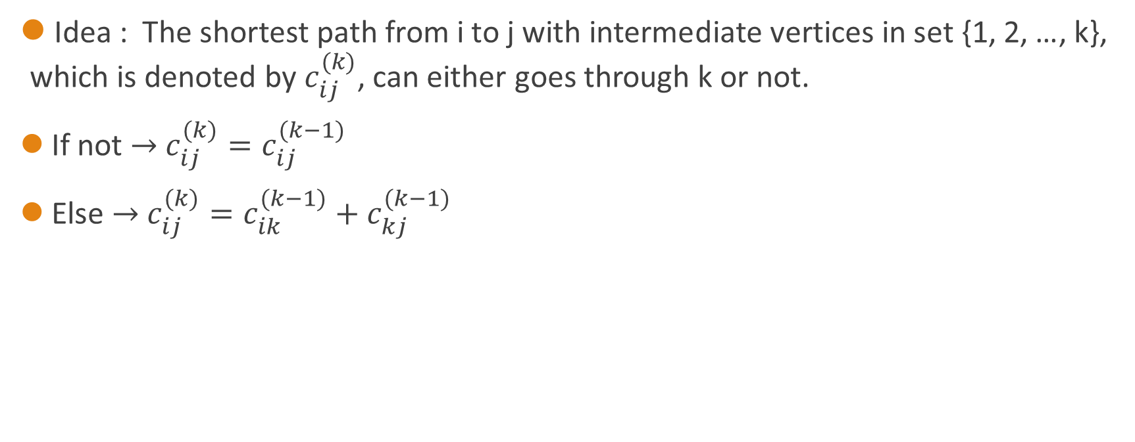
The transition function
Idea : The shortest path from i to j with intermediate vertices in set {1, 2, …, k}, which is denoted by $c_{ij}^{(k)}$, can either goes through k or not.
If not $→$ $c_{ij}^{(k)}=c_{ij}^{(k−1)}$
Else $→$ $c_{ij}^{(k)}=c_{ik}^{(k−1)}+c_{kj}^{(k−1)}$

Slide 14
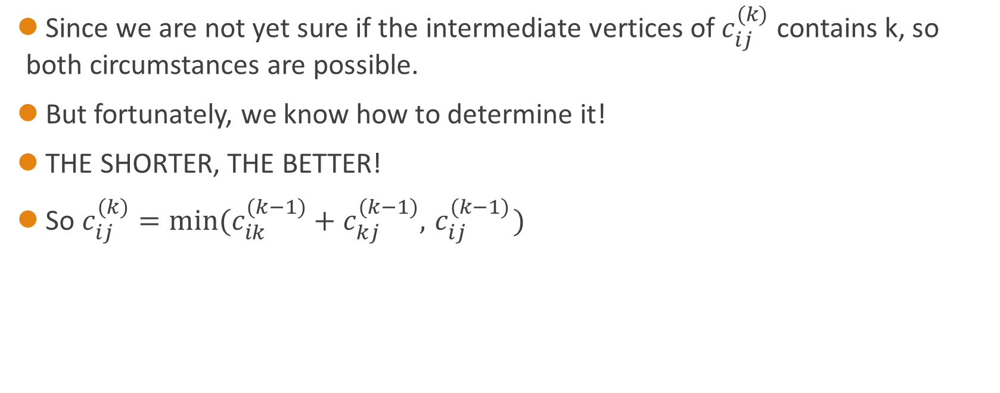
The transition function(Cont.)
Since we are not yet sure if the intermediate vertices of $c_{ij}^{(k)}$ contains k, so both circumstances are possible.
But fortunately, we know how to determine it!
THE SHORTER, THE BETTER!
So $c_{ij}^{(k)}={min⁡(c}_{ik}^{(k−1)}+c_{kj}^{(k−1)},{ c}_{ij}^{(k−1)})$

Slide 15

Pseudo code
for k = 1 to n
for i = 1 to n
for j = 1 to n
if $c_{ij}$>$c_{ik}$+$c_{kj}$
$c_{ij}$ = $c_{ik}$+$c_{kj}$
Running time : $θ\left(V^{3}\right)$

Slide 16
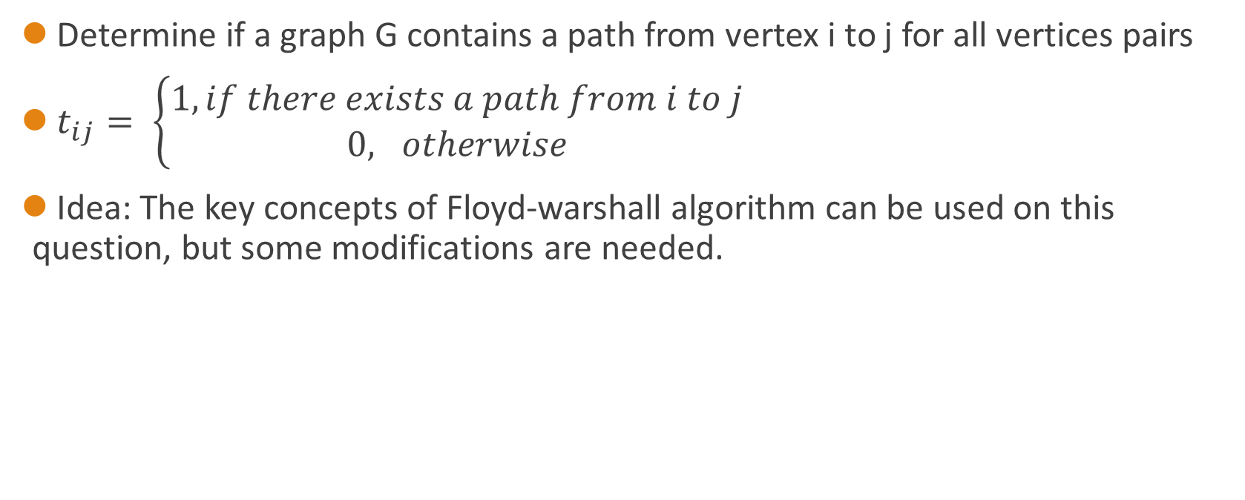
An Alternative: Transitive closure of a directed graph
Determine if a graph G contains a path from vertex i to j for all vertices pairs
$t_{ij}= \left\{\begin{aligned}1, if there exists a path from i to j \\ 0, otherwise\end{aligned}\right.$
Idea: The key concepts of Floyd-warshall algorithm can be used on this question, but some modifications are needed.

Slide 17

An Alternative: Transitive closure of a directed graph(Cont.)
The modification is shown as follow:
Replace min with ∨ (logical OR)
Replace + with ∧ (logical AND)
$t_{ij}^{(k)}={ t}_{ij}^{(k−1)}$ ∧ ${(t}_{ik}^{(k−1)}{ \text{∨} t}_{kj}^{(k−1)})$
The running time is also$θ\left(V^{3}\right)$.

Slide 18
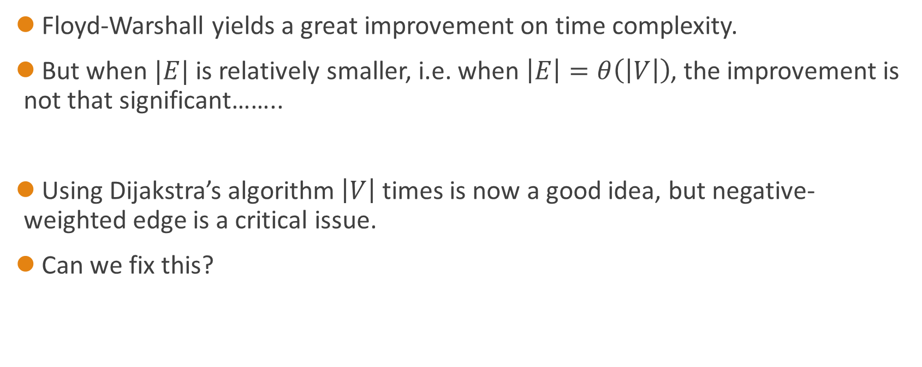
Another idea
Floyd-Warshall yields a great improvement on time complexity.
But when $|E|$ is relatively smaller, i.e. when $\left|E\right|=θ\left(\left|V\right|\right)$, the improvement is not that significant……..
Using Dijakstra’s algorithm $\left|V\right|$ times is now a good idea, but negative-weighted edge is a critical issue.
Can we fix this?

Slide 19
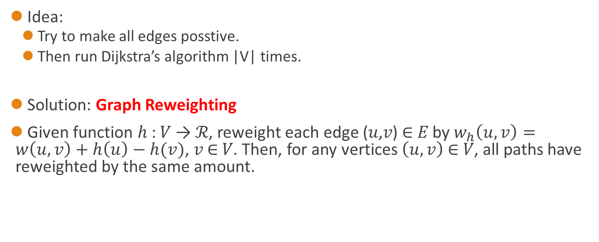
Johnson’s algorithm
Idea:
Try to make all edges posstive.
Then run Dijkstra’s algorithm |V| times.
Solution: Graph Reweighting
Given function ℎ : 𝑉 → ℛ, reweight each edge (𝑢,𝑣) ∈ 𝐸 by $w_{h}\left(u,v\right)=w\left(u,v\right)+h\left(u\right)−h(v)$, 𝑣 ∈ 𝑉. Then, for any vertices $\left(u,v\right)$ ∈ 𝑉, all paths have reweighted by the same amount.

Slide 20

Theorem
Given function ℎ : 𝑉 → ℛ, reweight each edge (𝑢,𝑣)∈𝐸 by $w_{h}\left(u,v\right)=w\left(u,v\right)+h\left(u\right)−h(v)$, 𝑣 ∈ 𝑉. Then, for any vertices $u,v$∈ 𝑉, all paths are equally reweighted.
Proof:
Let $p= v_{1}→v_{2}→v_{3}…v_{k}$ be a path in G

Slide 21

Theorem(Cont.)
Proof:
Let $p= v_{1}→v_{2}→v_{3}…v_{k}$ be a path in G
$$\sum_{i=1}^{k}{w_{h}(v_{i−1},v_{i})}=\sum_{i=1}^{k}{(w_{h}\left(v_{i−1},v_{i}\right) +h\left(v_{i−1}\right) − h(v_{i}))}=$$
$$\sum_{i=1}^{k}{w_{h}(v_{i−1},v_{i})} +\sum_{i=1}^{k}{h\left(v_{i−1}\right) − h\left(v_{i}\right)= }w\left(p\right)+h\left(v_{1}\right)−h\left(v_{k}\right)$$
The same for every path

Slide 22
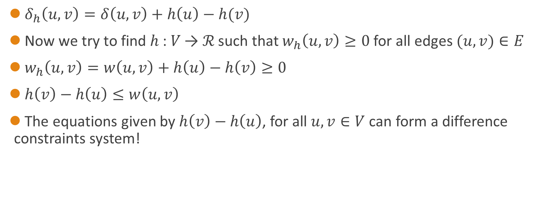
Collorary
$δ_{h}\left(u,v\right)=δ\left(u,v\right)+h\left(u\right)−h(v)$
Now we try to find ℎ : 𝑉 → ℛ such that $w_{h}\left(u,v\right)≥0$ for all edges $(u,v)∈E$
$w_{h}\left(u,v\right)=w\left(u,v\right)+h\left(u\right)−h\left(v\right)≥0$
$h\left(v\right)−$ $h\left(u\right)≤w\left(u,v\right)$
The equations given by $h\left(v\right)−$ $h\left(u\right)$, for all $u, v∈V$can form a difference constraints system!

Slide 23
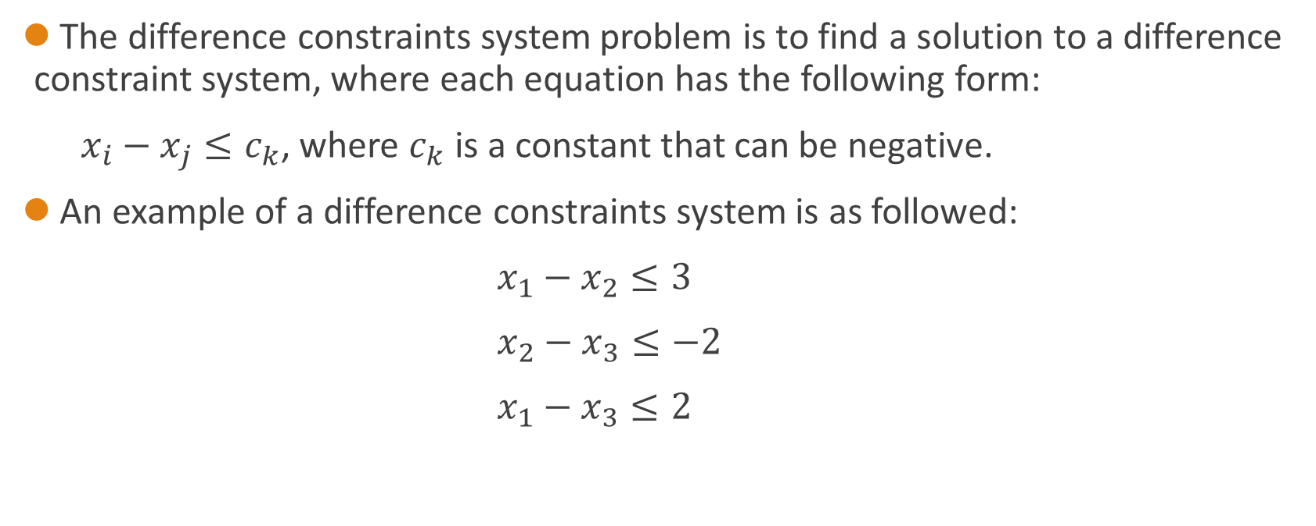
Difference constraints
The difference constraints system problem is to find a solution to a difference constraint system, where each equation has the following form:
$x_{i}−x_{j}≤c_{k}$, where $c_{k}$ is a constant that can be negative.
An example of a difference constraints system is as followed:
$x_{1}−x_{2}≤3$
$x_{2}−x_{3}≤−2$
$x_{1}−x_{3}≤2$

Slide 24
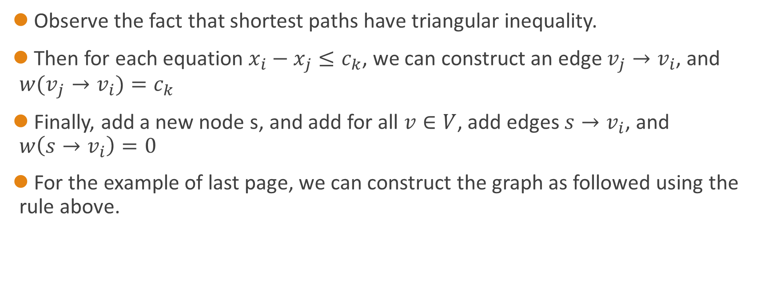
Difference constraints(Cont.)
Observe the fact that shortest paths have triangular inequality.
Then for each equation $x_{i}−x_{j}≤c_{k}$, we can construct an edge $v_{j}→v_{i}$, and ${w(v}_{j}→v_{i})=c_{k}$
Finally, add a new node s, and add for all $v∈V$, add edges $s→v_{i}$, and $w\left(s→v_{i}\right)=0$
For the example of last page, we can construct the graph as followed using the rule above.

Slide 25

Difference constraints(Cont.)
$x_{1}−x_{2}≤3$
${ x}_{2}−x_{3}≤−2$
$x_{1}−x_{3}≤2$
3
V2
V1
0
0
S
-2
2
0
V3

Slide 26

Difference constraints(End)
After the graph is constructed, we can realize that for all variables $x_{i}$ in the difference equations system, $x_{i}=δ\left(s,v_{i}\right)$ is a set of $x$ that can sastisfy the constraint due to triangular inequality if no negative cycle exists.
So using Bellman-Ford algorithm, we can either tell that the difference constraints system is unsolvable, or find a set of solution in O(VE).

Slide 27
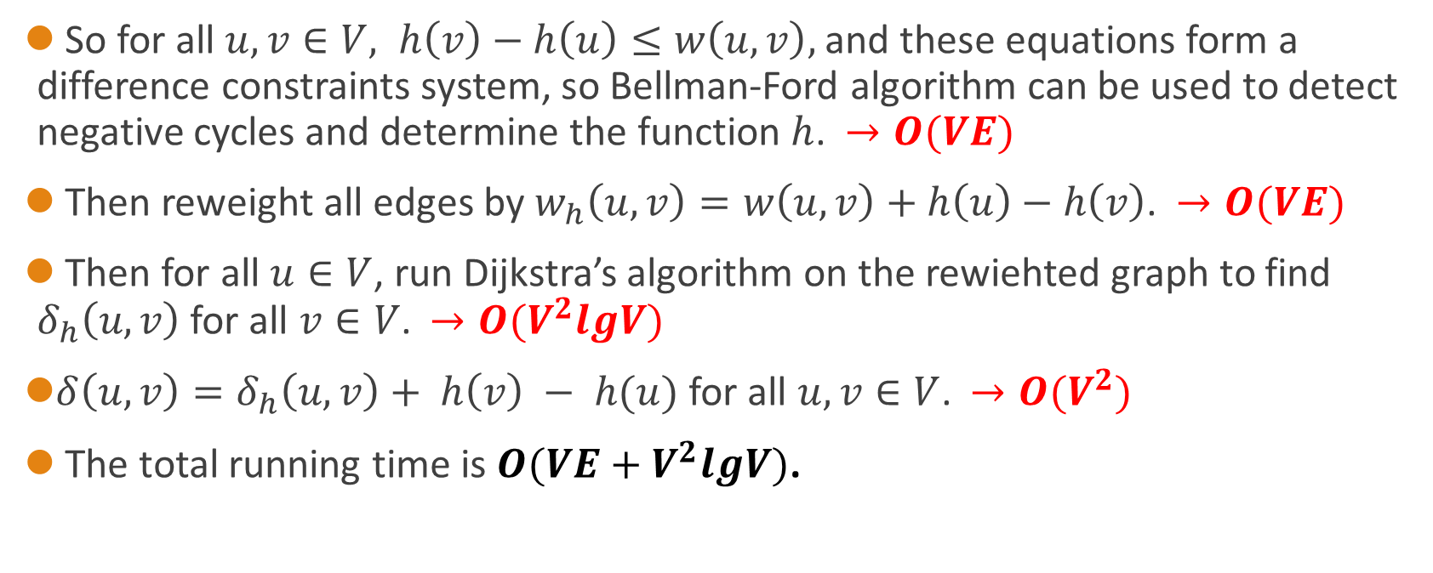
Return to Johnson Algorthim
So for all $u, v∈V, h\left(v\right)−$ $h\left(u\right)≤w\left(u,v\right),$ and these equations form a difference constraints system, so Bellman-Ford algorithm can be used to detect negative cycles and determine the function $h$. $→O(VE)$
Then reweight all edges by $w_{h}\left(u,v\right)=w\left(u,v\right)+h\left(u\right)−h\left(v\right)$. $→O(VE)$
Then for all $u∈V$, run Dijkstra’s algorithm on the rewiehted graph to find $δ_{h}\left(u,v\right)$ for all $v∈V$. $→O(V^{2}lgV)$
$δ\left(u,v\right)=δ_{h}\left(u,v\right)+ h\left(v\right) − h(u)$ for all $u, v∈V$. $→O(V^{2})$
The total running time is $O(VE+V^{2}lgV)$.

