Slide 1
Regular Expressions and Automata

Slide 2
Natural Language Understanding
Associate each input (acoustic signal/character string) with a meaning representation.
Carried out by a series of components:
  Each component acts as a translator from one representation to another
  In general, each component adds successively ‘richer’ information to the output

Slide 3
Basic Process of NLU
Spoken input
For speech
understanding
Phonological / morphological analyser
Phonological & morphological
rules
“He love +s Mary.”
Sequence of words
SYNTACTIC COMPONENT
Grammatical Knowledge
Indicating relns (e.g., mod) between words
He
Syntactic structure (parse tree)
loves
Mary
Thematic Roles
SEMANTIC INTERPRETER
Semantic rules,
Lexical semantics
Selectional
restrictions
∃ x loves(x, Mary)
Logical form
CONTEXTUAL REASONER
Pragmatic &
World Knowledge
loves(John, Mary)
Meaning Representation

Slide 4
Representations and Algorithms for NLP
Representations: formal models used to capture linguistic knowledge
Algorithms manipulate representations to analyze or generate linguistic phenomena
Simplest often produce best performance but….the 80/20 Rule and “low-hanging fruit”

Slide 5
NLP Representations
State Machines
  FSAs, FSTs, HMMs, ATNs, RTNs
Rule Systems
  CFGs, Unification Grammars, Probabilistic CFGs
Logic-based Formalisms
  1st Order Predicate Calculus, Temporal and other Higher Order Logics
Models of Uncertainty
  Bayesian Probability Theory

Slide 6
NLP Algorithms
Most are parsers or transducers: accept or reject input, and construct new structure from input
  State space search
    Pair a partial structure with a part of the input
    Spaces too big and ‘best’ is hard to define
  Dynamic programming
    Avoid recomputing structures that are common to multiple solutions

Slide 7
Regular Expressions
Can be viewed as a way to specify:
  Search patterns over text string
  Design of a particular kind of machine, called a Finite State Automaton (FSA)
These are really equivalent

Slide 8
Uses of Regular Expressions in NLP
As grep, perl: Simple but powerful tools for large corpus analysis and ‘shallow’ processing
  What word is most likely to begin a sentence?
  What word is most likely to begin a question?
  In your own email, are you more or less polite than the people you correspond with?
With other unix tools, allow us to
  Obtain word frequency and co-occurrence statistics
  Build simple interactive applications (e.g., Eliza)
Regular expressions define regular languages or sets

Slide 9
Regular Expressions
Regular Expression: Formula in algebraic notation for specifying a set of strings
String: Any sequence of alphanumeric characters
  Letters, numbers, spaces, tabs, punctuation marks
Regular Expression Search
  Pattern: specifying the set of strings we want to search for
  Corpus: the texts we want to search through

Slide 10
Simple Example
Sequence of simple characters:
RE | DESCRIPTION | USES
/This/ | Matches the string “This” | Finding the word “this” starting a sentence
/this/ | Matches the string “this” | Finding the word “this” internal to a sentence.
/[Tt]his/ | Matches either “This” or “this” -- disjunction | Finding the word “this” anywhere in a sentence.
Notes:
Note the // are part of perl – not part of the regular expression. – also assuming pattern is going to return an entire string.

Slide 11
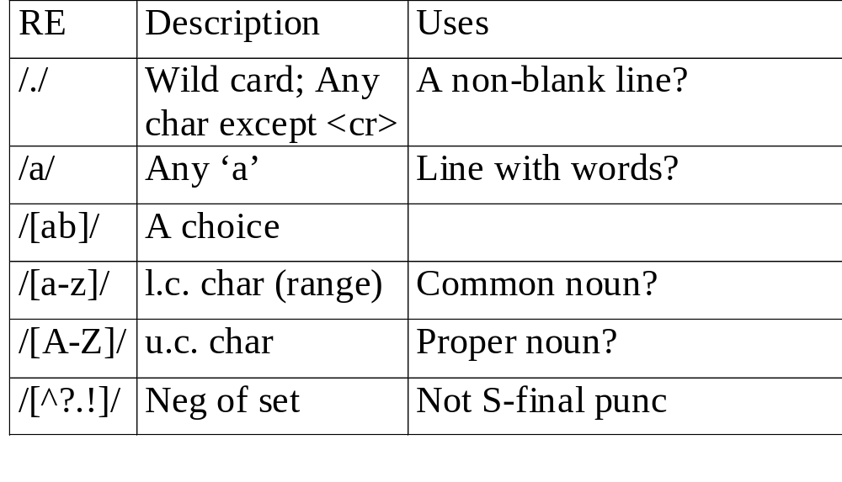
Some Examples
Notes:
Note: [^ - is not – i.e., at the beginning of a disjunction. Later in the disjunction it really means the ^.

Slide 12
RE | Description | Uses?
/a*/ | Zero or more a’s | Optional doubled modifiers
/a+/ | One or more a’s | Non-optional...
/a?/ | Zero or one a’s | Optional...
/cat|dog/ | ‘cat’ or ‘dog’ | Words modifying pets
/^cat\.$/ | A line that contains only cat. ^anchors beginning, $ anchors end of line. | ??
/\bun\B/ | Beginnings of longer strings | Words prefixed by ‘un’
Notes:
Note: yet another use of ^ but this time in a different context… it means to start a line!
\b matches a word boundary; \B matches a word-non-boundary – a word is a sequence of digits, underscores, letters

Slide 13
RE
E.G.
/pupp(y|ies)/
Morphological variants of ‘puppy’
/ (.+)ier and \1ier /
happier and happier, fuzzier and fuzzier

Slide 14
Optionality and Repetition
/[Ww]oodchucks?/ matches woodchucks, Woodchucks, woodchuck, Woodchuck
/colou?r/ matches color or colour
/he{3}/ matches heee
/(he){3}/ matches hehehe
/(he){3,} matches a sequence of at least 3 he’s

Slide 15
Operator Precedence Hierarchy
1. Parentheses ()
2. Counters * + ? {}
3. Sequence of Anchors the ^my end$
4. Disjunction |
Examples
/moo+/
/try|ies/
/and|or/
Notes:
Because counters have a higher precidence than sequence, this matches mooooooo.
The second one probably does not do what is expected – would match try or ies, but not tries.
The third does work as expected.

Slide 16
A Simple Exercise
Write a regular expression to find all instances of the determiner “the”:
      /the/
      /[tT]he/
      /\b[tT]he\b/
      /(^|[^a-zA-Z][tT]he[^a-zA-Z]/
The recent attempt by the police to retain their current rates of pay has not gathered much favor with the southern factions.

Slide 17
A Simple Exercise
Write a regular expression to find all instances of the determiner “the”:
      /the/
      /[tT]he/
      /\b[tT]he\b/
      /(^|[^a-zA-Z][tT]he[^a-zA-Z]/
The recent attempt by the police to retain their current rates of pay has not gathered much favor with
southern factions.

Slide 18
A Simple Exercise
Write a regular expression to find all instances of the determiner “the”:
      /the/
      /[tT]he/
      /\b[tT]he\b/
      /(^|[^a-zA-Z][tT]he[^a-zA-Z]/
The recent attempt by the police to retain their current rates of pay has not gathered much favor with the southern factions.

Slide 19
A Simple Exercise
Write a regular expression to find all instances of the determiner “the”:
      /the/
      /[tT]he/
      /\b[tT]he\b/
      /(^|[^a-zA-Z][tT]he[^a-zA-Z]/
The recent attempt by the police to retain their current rates of pay has not gathered much favor with the southern factions.

Slide 20
A Simple Exercise
Write a regular expression to find all instances of the determiner “the”:
      /the/
      /[tT]he/
      /\b[tT]he\b/
      /(^|[^a-zA-Z][tT]he[^a-zA-Z]/
The recent attempt by the police to retain their current rates of pay has not gathered much favor with the southern factions.

Slide 21
A Simple Exercise
Write a regular expression to find all instances of the determiner “the”:
      /the/
      /[tT]he/
      /\b[tT]he\b/
      /(^|[^a-zA-Z])[tT]he[^a-zA-Z]/
The recent attempt by the police to retain their current rates of pay has not gathered much favor with the southern factions.
Notes:
The \b counts words as any sequence of digits, undercores, or letters. Suppose you wanted to find “the” in the context of _the or the28.
Could you write that one.
Last one: either it starts a line, or the thing in front of it is not a letter; followed by either t or T; followed by he where the following character is not a letter.

Slide 22
The Two Kinds of Errors
The process we just went through was based on fixing errors in the regular expression
  Errors where some of the instances were missed (judged to not be instances when they should have been) – False negatives
  Errors where the instances were included (when they should not have been) – False positives
This is pretty much going to be the story of the rest of the course!

Slide 23
Substitutions (Transductions)
Sed or ‘s’ operator in Perl
  s/regexp1/pattern/
  s/I am feeling (.++)/You are feeling \1?/
  s/I gave (.+) to (.+)/Why would you give \2 \1?/

Slide 24
ELIZA: Substitutions Using Memory
User: Men are all alike.
ELIZA: IN WHAT WAY
s/.* all .*/IN WHAT WAY/
They’re always bugging us about something or other.
ELIZA: CAN YOU THINK OF A SPECIFIC EXAMPLE
s/.* always .*/CAN YOU THINK OF A SPECIFIC EXAMPLE/
User: My boyfriend says I’m depressed.
ELIZA: I AM SORRY TO HEAR YOU ARE DEPRESSED
s/.* I’m (depressed|sad) .*/I AM SORRY TO HEAR YOU ARE \1/

Slide 25
Using RE’s: Examples
Predictions from a news corpus:
  Which candidate for Governor of California is mentioned most often in the news? Is going to win?
  What stock should you buy?
  Which White House advisers have the most power?
Language use:
  Which form of comparative is more frequent: ‘oftener’ or ‘more often’?
  Which pronouns are conjoined most often?
  How often do sentences end with infinitival ‘to’?
  What words most often begin and end sentences?
  What’s the most common word in your email? Is it different from your neighbor?

Slide 26
Personality profiling:
  Are you more or less polite than the people you correspond with?
  With labeled data, which words signal friendly messages vs. unfriendly ones?

Slide 27
Finite State Automata
Regular Expressions (REs) can be viewed as a way to describe machines called Finite State Automata (FSA, also known as automata, finite automata).
FSAs and their close variants are a theoretical foundation of much of the field of NLP.

Slide 28
Finite State Automata
FSAs recognize the regular languages represented by regular expressions
  SheepTalk: /baa+!/
a
b
a
a
!
q0
q1
q2
q3
q4
Directed graph with labeled nodes and arc transitions
Five states: q0 the start state, q4 the final state, 5 transitions

Slide 29
Formally
FSA is a 5-tuple consisting of
  Q: set of states {q0,q1,q2,q3,q4}
  Σ: an alphabet of symbols {a,b,!}
  q0: a start state
  F: a set of final states in Q {q4}
  δ(q,i): a transition function mapping Q x Σ to Q
a
b
a
a
!
q0
q1
q2
q3
q4

Slide 30
State Transition Table for SheepTalk
State | Input
 | b | a | !
0 | 1 | Ø | Ø
1 | Ø | 2 | Ø
2 | Ø | 3 | Ø
3 | Ø | 3 | 4
4 | Ø | Ø | Ø

Slide 31
Recognition
Recognition (or acceptance) is the process of determining whether or not a given input should be accepted by a given machine.
In terms of REs, it’s the process of determining whether or not a given input matches a particular regular expression.
Traditionally, recognition is viewed as processing an input written on a tape consisting of cells containing elements from the alphabet.

Slide 32
FSA recognizes (accepts) strings of a regular language
  baa!
  baaa!
  baaa!
  …
Tape metaphor: a rejected input
q₀
a
b
a
!
b

Slide 33
D-Recognize
Function D-Recognize(tape, machine) returns accept or reject
Index ← Beginning of tape
Current-state ← Initial state of the machine
loop
If end of input has been reached then
  If current-state is an accept state then
    return accept
  Else
    return reject
elseif transition-table[current-state,tape[index]] is empty then
  return reject
else
Current-state ← transition-table[current-state,tape[index]]
Index ← index + 1
end

Slide 34
q₀
q₁
q₂
q₃
q₃
q₃
q₄
 | b | a | a | a | a | !
State | Input
 | b | a | !
0 | 1 | Ø | Ø
1 | Ø | 2 | Ø
2 | Ø | 3 | Ø
3 | Ø | 3 | 4
4 | Ø | Ø | Ø

Slide 35
Key Points About D-Recognize
Deterministic means that the code always knows what to do at each point in the process
Recognition code is universal for all FSAs. To change to a new formal language:
  change the alphabet
  change the transition table
Searching for a string using a RE involves compiling the RE into a table and passing the table to the interpreter
Notes:
So, the determinism has nothing to do with the code – it has to do with the transition table. In particular, there is exactly 1 entry in the table in each cell (and there are no empty moves).

Slide 36
Determinism and Non-Determinism
Deterministic: There is at most one transition that can be taken given a current state and input symbol.
Non-deterministic: There is a choice of several transitions that can be taken given a current state and input symbol. (The machine doesn’t specify how to make the choice.)

Slide 37
Non-Deterministic FSAs for SheepTalk
a
b
a
a
!
q0
q1
q2
q3
q4
b
a
a
!
q0
q1
q2
q3
q4
ε

Slide 38
FSAs as Grammars for Natural Language
dr
the
rev
mr
pat
l.
robinson
q0
q1
q2
q3
q4
q5
q6
hon
ms
ε
mrs
ε
Can you use a regexpr to capture this too?

Slide 39
Problems of Non-Determinism
‘Natural’….but at any choice point, we may follow the wrong arc
Potential solutions:
  Save backup states at each choice point
  Look-ahead in the input before making choice
  Pursue alternatives in parallel
  Determinize our NFSAs (and then minimize)
FSAs can be useful tools for recognizing – and generating – subsets of natural language
  But they cannot represent all NL phenomena (Center Embedding: The mouse the cat ... chased died.)

Slide 40
Summing Up
Regular expressions and FSAs can represent subsets of natural language as well as regular languages
  Both representations may be impossible for humans to understand for any real subset of a language
  But they are very easy to use for smaller subsets
Next time: Read Ch 3
For fun:
  Think of ways you might characterize features of your email using only regular expressions

