Slide 1
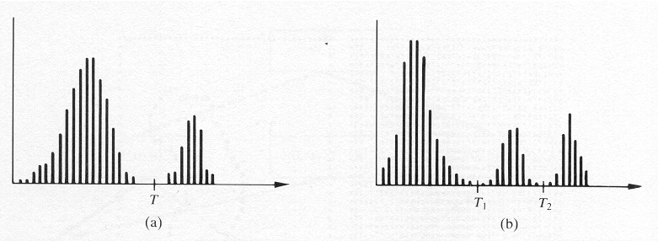
Thresholding
Foundation:

Slide 2
Thresholding
In A: light objects in dark background
To extract the objects:
  Select a T that separates the objects from the background
  i.e. any (x,y) for which f(x,y)>T is an object point.

Slide 3
Thresholding
In B: a more general case of this approach (multilevel thresholding)
So: (x,y) belongs:
  To one object class if T₁<f(x,y)≤T₂
  To the other if f(x,y)>T₂
  To the background if f(x,y)≤T₁

Slide 4
Thresholding
A thresholded image:
(objects)
(background)

Slide 5
Thresholding
Thresholding can be viewed as an operation that involves tests against a function T of the form:
where p(x,y) denotes
some local property of this point.

Slide 6
Thresholding
When T depends only on f(x,y) →
global threshold
When T depends on both f(x,y) and p(x,y) →
local threshold
When T depends on x and y (in addition) →
dynamic threshold

Slide 7
Role of Illumination
f(x,y) = i(x,y) r(x,y)
A non-uniform illumination destroys the reflectance patterns that can be exploited by thresholding (e.g. for object extraction).

Slide 8
Role of Illumination
Solution:
  Project the illumination pattern onto a constant, white reflective surface.
  This yields an image g(x,y) = ki(x,y), where
    k is a constant depending on the surface and
    i(x,y) is the illumination pattern.

Slide 9
Role of Illumination
Solution (cont.):
  Then, for any image f(x,y) = i(x,y) r(x,y), divide by g(x,y). This yields:

Slide 10
Role of Illumination
So:
  if r(x,y) can be segmented by using a single threshold T, then h(x,y) can also be segmented by using a single threshold of value T/k.

Slide 11
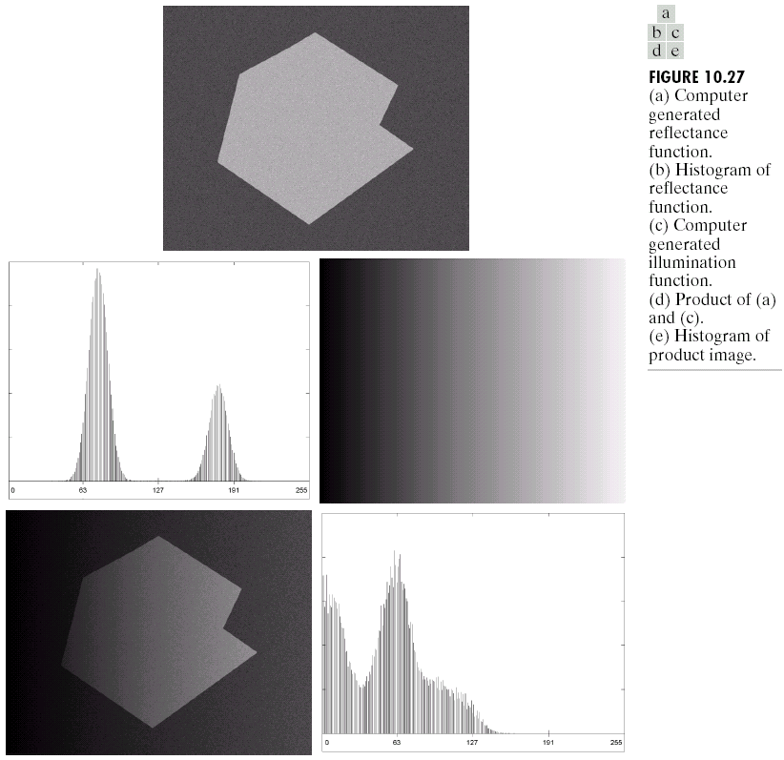

Slide 12
Simple Global Thresholding
To partition the image histogram by using a single threshold T.
Then the image is scanned and labels are assigned.
This technique is successful in highly controlled environments.

Slide 13
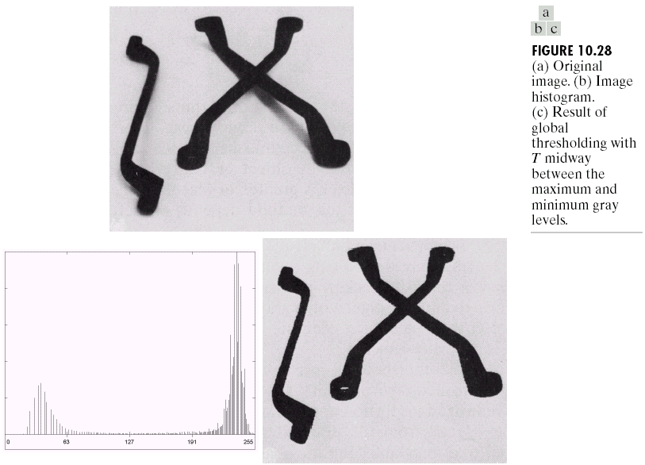
Image Segmentation

Slide 14
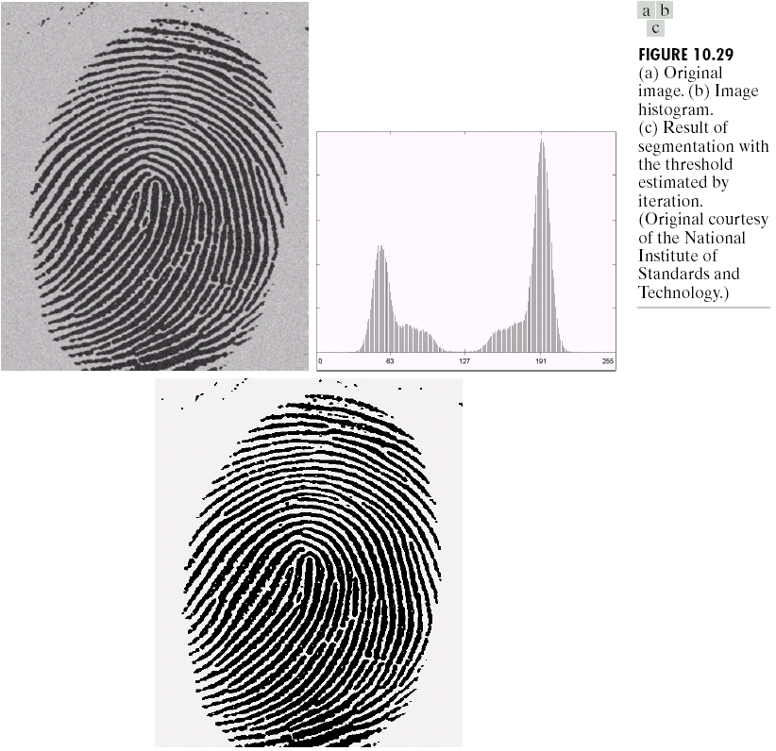
Chapter 10
Image Segmentation

Slide 15
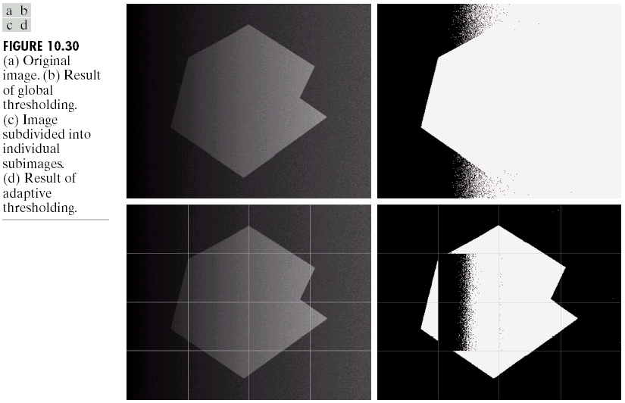
Image Segmentation

Slide 16
Optimal Thresholding
The histogram of an image containing two principal brightness regions can be considered an estimate of the brightness probability density function p(z):
  the sum (or mixture) of two unimodal densities (one for light, one for dark regions).

Slide 17
Optimal Thresholding
The mixture parameters are proportional to the areas of the picture of each brightness.
If the form of the densities is known or assumed, determining an optimal threshold (in terms of minimum error) for segmenting the image is possible.

Slide 18
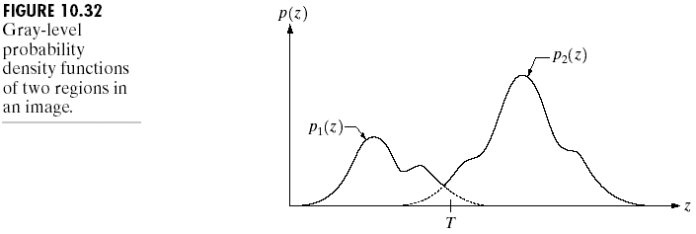
Image Segmentation

Slide 19
Threshold Selection Based on Boundary Characteristics
The chances of selecting a good threshold are increased if the histogram peaks are:
  Tall
  Narrow
  Symmetric
  Separated by deep valleys

Slide 20
Threshold Selection Based on Boundary Characteristics
One way to improve the shape of histograms is to consider only those pixels that lie on or near the boundary between objects and the background.
  Thus, histograms would be less dependent on the relative sizes of objects and the background.

Slide 21
Threshold Selection Based on Boundary Characteristics
Problem:
  The assumption that the boundary between objects and background is known.

Slide 22
Threshold Selection Based on Boundary Characteristics
Solution:
  An indication of whether a pixel is on an edge may be computed by its gradient.
  The Laplacian yields information on whether a pixel lies on the dark or light side of an edge.
  The average value of the Laplacian is 0 at the transition of an edge, so deep valleys are produced in the histogram.

Slide 23
Threshold Selection Based on Boundary Characteristics
In essence:

Slide 24
Threshold Selection Based on Boundary Characteristics
In the image s(x,y):
  pixels that are not on an edge are labeled 0
  pixels on the dark side of an edge are labeled +
  pixels on the light side of an edge are labeled –

Slide 25
Threshold Selection Based on Boundary Characteristics
Light background/dark object:
(…) (-,+) (0 or +) (+,-) (…)
0
1
0

Slide 26
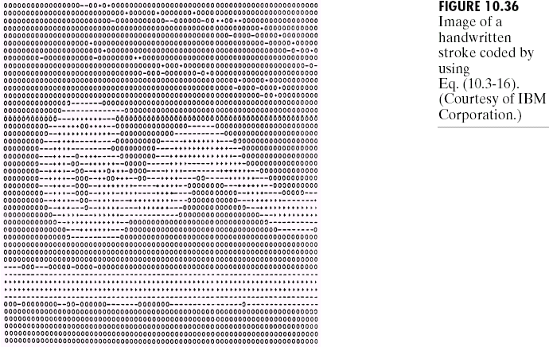
Image Segmentation

Slide 27
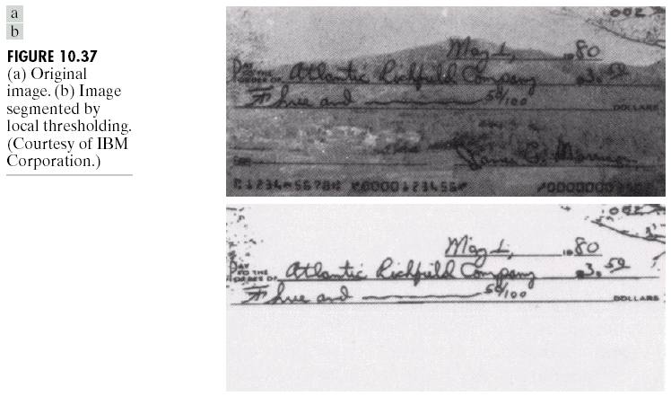
Image Segmentation

Slide 28
Thresholds Based on
Several Variables
When a sensor makes available more than one variable to characterize each pixel in an image (e.g. color imaging, RGB)

Slide 29
Thresholds Based on
Several Variables
Each pixel is characterized by 3 values, and the histogram becomes 3D. So thresholding now is concerned with finding clusters of points in 3D space.
  Instead of the RGB model, the HSI model might be used too.

Slide 30
Region-Oriented Segmentation
Segmentation is a process that partitions R into n subregions R₁, R₂, …, R_{n} such that:
  R_{i} is a connected region, i = 1, 2, …, n
  R_{i} ∩ R_{j} = 0 for all i and j, i≠j
  P(R_{i}) = TRUE for i = 1, 2, …, n
  P(R_{i} ⋃ R_{j}) = FALSE for i≠j
P(R_{i}): logical predicate

Slide 31
Region Growing by
Pixel Aggregation
Start with a set of “seed” points and from these grow regions by appending to each seed point those neighboring pixels that have similar properties.

Slide 32
Region Growing by
Pixel Aggregation
Problems:
  Seed selection
  Selection of suitable properties for including points in the various regions
Descriptors
Local vs. general criteria

Slide 33
Region Splitting and Merging
Subdivide an image initially into a set of arbitrary, disjointed regions and then merge and/or split the regions in an attempt to satisfy the conditions of region-oriented segmentation.
Quadtree-based algorithm

Slide 34
Region Splitting and Merging
Procedure:
  Split into 4 disjointed quadrants any region R_{i} where P(R_{i}) = FALSE
  Merge any adjacent regions R_{j} and R_{k} for which P(R_{j} ∪ R_{k}) = TRUE
  Stop when no further splitting or merging is possible.

Slide 35
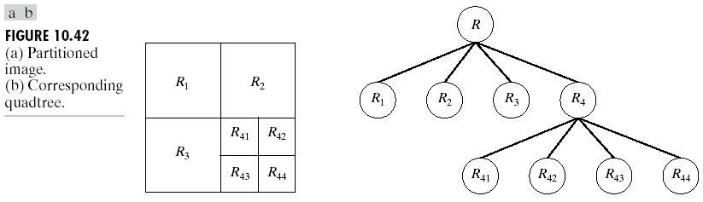
Image Segmentation

