Slide 1
PROJECT – ANALYZE HOTEL DATASET

Slide 2









Table of Contents
Overview
Business and Problem Understanding
Exploratory Data Analysis
Data Cleaning
Modeling
Data Visualization
Conclusion
Recommendation

Slide 3




Overview
Objective
To derive business insights from hotel data and compare the performance of the two hotel types – City Hotel and Resort Hotel year over year on various Key Performance Indicators (KPIs)
Benefits
Better customer profiling
Derive Meaningful Insights
Informed Decision Making
Analytics road map
Business and Data Understanding
Exploratory Data Analysis
Data Cleaning and Modeling
Visualization
Understanding the business processes of the hotel identifying the scope of the project
Initial investigation on the data was done to discover pattern, anomalies and validate our assumptions
Pushing the data on cloud and performing data imputation to clean the data
Creating dashboards in power bi to visualize and analyze data

Slide 4
Problem and Business Understanding

Slide 5












Hotel aims to understand their booking records and customer profiles
Problem Understanding
Problem Statement: Guest profile analysis from the hotel owner’s point of view
Business Understanding
Process Flow – Hotel
Resort Hotel
Hotel
Room Type
Arrival Date
Average Daily Rate
City Hotel
Process Flow - Customer
Nationality
Bookings by market segment
Number of Occupants
Days of Stay
Payment Type
Cancellation Status
5

Slide 6
Exploratory Data Analysis

Slide 7




Observations from Raw Data
No Primary Key: Absence of a primary key (unique customer identifier)
True Duplicates: Due to the absence of unique identifier there are multiple true duplicates.
Zero and Negative Average Daily Rate: 2% of the total guests had free stay. Negative values could be due to logging error.
Cancelled Booking Status: In each problem statement we used cancellation booking filters to get actual inference on customer engagement.
Average (Rather Than Total) Values: In problem statements related to month wise trends, average values were used instead of sum to accommodate for irregular timeframe
7

Slide 8




Data cleaning
Absence of dimension and fact table:. Due to the unavailability of primary key and the presence of myriad of true duplicates, surrogate key cannot be formed leading to no dimension table
Removal of negative average daily rate values:. Since there was just 1 row with negative average daily rate, it didn’t make any business sense and was removed from the data
Undefined values in country column:. There were 488 ‘Undefined’ row values in country column which were Not available
No guests present:. There were 4 NA row values in children column which were reassigned to 0 and rows where adults, children and babies are 0 at the same time were deleted, since it’s not possible.
8

Slide 9
Data Modeling

Slide 10





Orchestration
Microsoft Azure
Raw Input File
Azure Storage
Data Model
Power BI
Hotel Dataset.csv
Azure Blob
Azure Data Factory
Azure SQL Database
Reporting View
Dashboard/Visualization

Slide 11



Key Entities in Orchestration
Azure Blob: Storage component of Azure where original CSV file is uploaded
SQL Database: SQL Database is the destination for pipeline where contents from the CSV file is imported
Linked Services: Two Linked Services, each for connecting Azure Blob and SQL database, are created to connect the end files
Copy-Data Pipeline: The above-mentioned links are used to create pipelines to copy data from source (CSV File) to sink (SQL Database)
Reporting view: Reporting view only contains fields essential for analysis and will be used to pull data to Power BI dashboard
Dashboard: After pulling data from reporting view, Power Bi was used to create visualizations to help answer the business problems.

Slide 12
Data Visualization

Slide 13
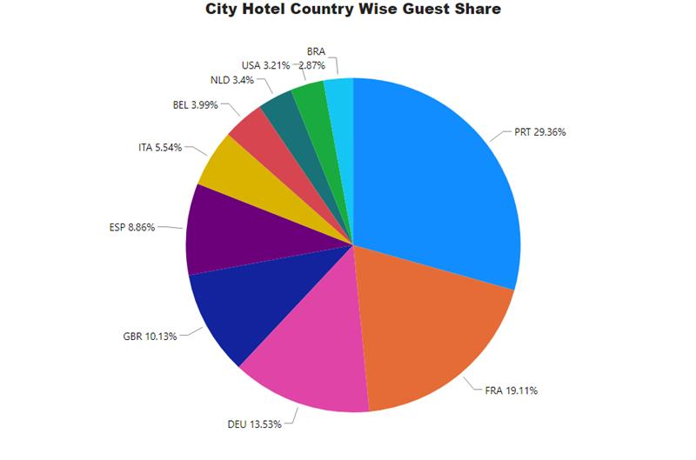
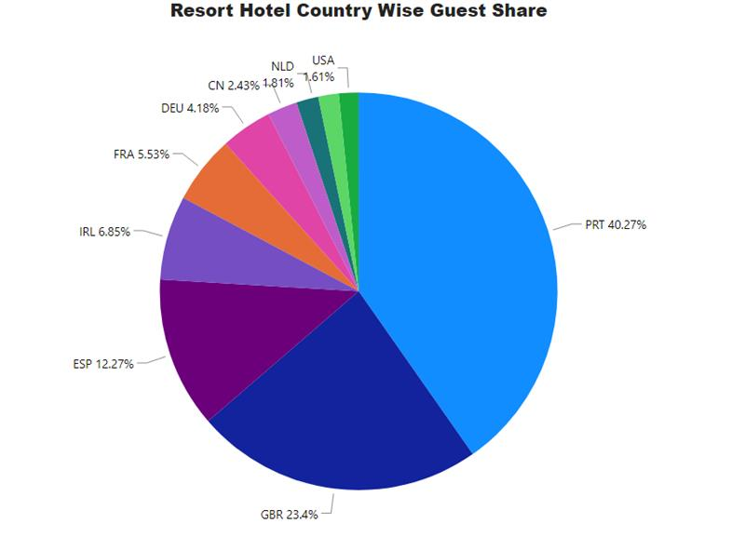
Most of the guests come from Portugal followed by UK, France, Spain, and Germany
Inference
From the visualization, we can infer that guests come from all over the world to stay at the two hotels
Most guests are from Portugal and other European countries
City Hotel has most of its guests from Portugal, France, and Germany while Resort Hotel has most of its guests from Portugal, UK, and Spain
*Note: The visualization only consists of the top 10 countries because most guests are from those countries (and to keep the chart clutter-free)
Filters: Not Cancelled Bookings | Slicers: Hotel, Years
Country | PRT | GBR | FRA | ESP | DEU | IRL | ITA | BEL | NLD | USA
No of guests | 20977 | 9668 | 8468 | 6383 | 6067 | 2542 | 2428 | 1868 | 1716 | 1592

Slide 14
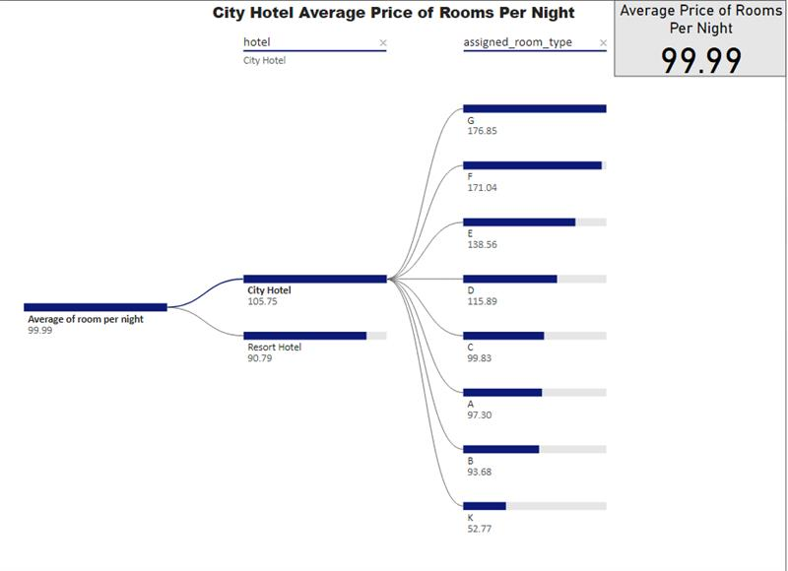
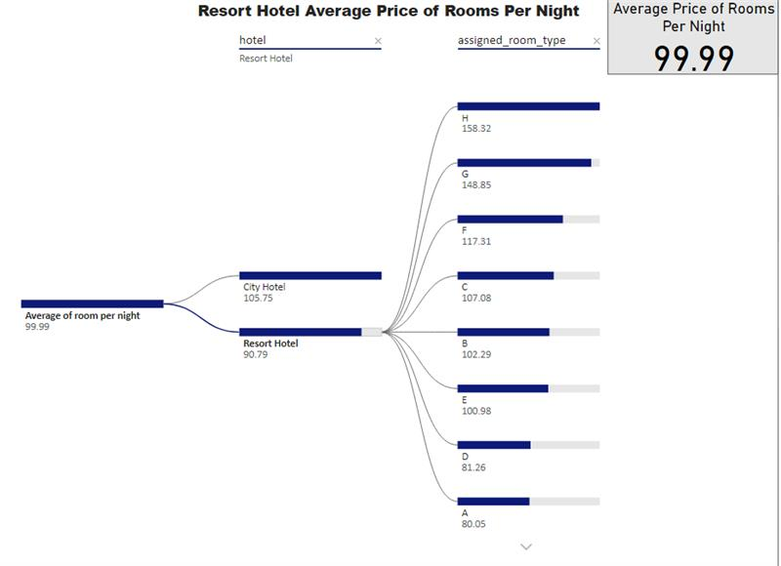
Guests pay $100 on average for a room per night while the average for city & resort hotel may vary according to their room types
Inference
From the visualization, we can see that the prices of rooms in both the hotels vary a lot amongst themselves and between the hotels
Both hotels have some different room types as well. City hotel has H, I, L while Resort hotel has K room type
The difference in the average room price could be attributed to different locations, room types, and seasonal factors
Filters: Not Cancelled Bookings | Slicers: Years, Months

Slide 15
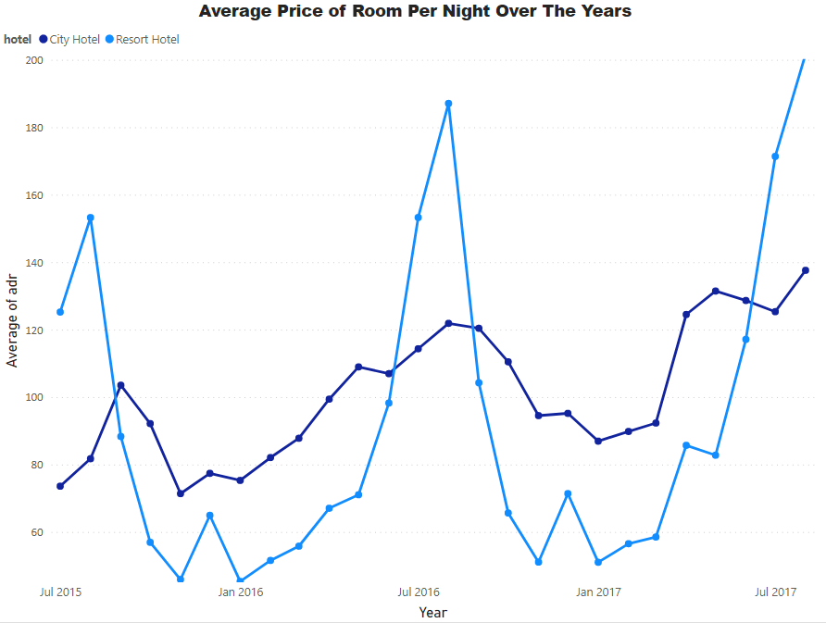
Average Price per night shows a periodic downward trend from Aug to Dec followed by an upward trend from Jan to Aug
Inference
From the visualization, we can see that the maximum average price of the resort hotel rooms is higher than that of city hotel rooms
The variation in the average room prices of Resort hotel is much more as compared to that of City hotel.
The average price of the resort hotel is at its peak during the summer months but drops drastically as winter approaches
The average price of the City hotel reaches its peak during the Summer - Fall season
Filters: Not Cancelled Bookings | Slicers: Room Type
Months | January | February | March | April | May | June | July | August | September | October | November | December
Resort Hotel (Avg. Price) | 48.76 | 54.15 | 57.06 | 75.87 | 76.66 | 107.97 | 150.12 | 181.21 | 96.42 | 61.78 | 48.71 | 68.41
City Hotel (Avg. Price) | 82.33 | 86.52 | 90.66 | 111.96 | 120.67 | 117.87 | 115.85 | 118.67 | 112.77 | 102 | 86.95 | 88.4

Slide 16
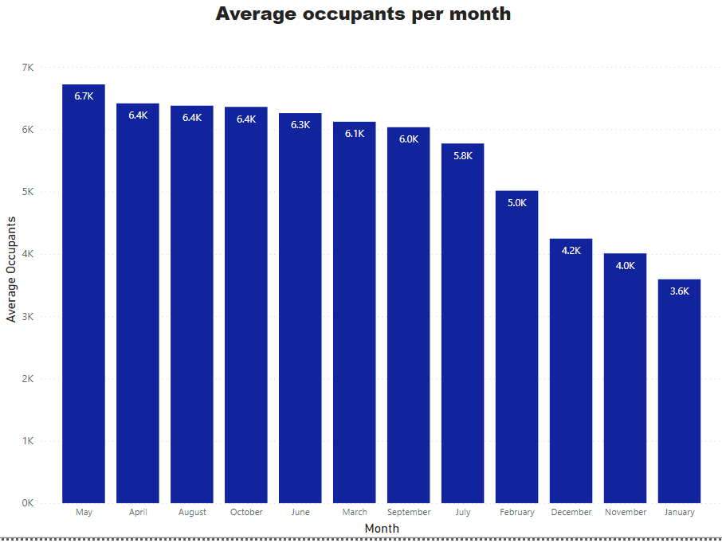
Hotels are the busiest from April to August
Inference
After filtering based on hotels, we can see that the number of guests are high during the summer months along with the hotel prices
We can also see that the number of guests are lower during the winter months and so are the prices
City hotels have more guests during the Summer to Fall season which corresponds to the high average prices of the room during that time
Filters: Not Cancelled Bookings | Slicers: Hotel, Years

Slide 17
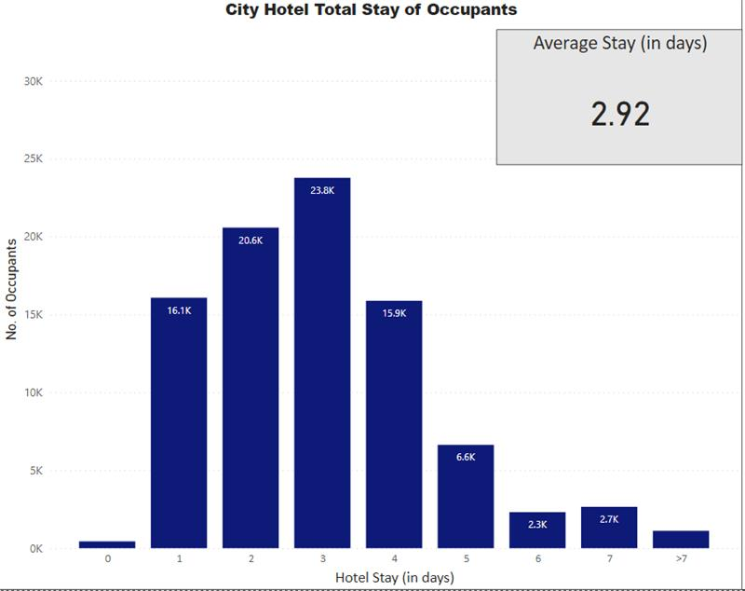
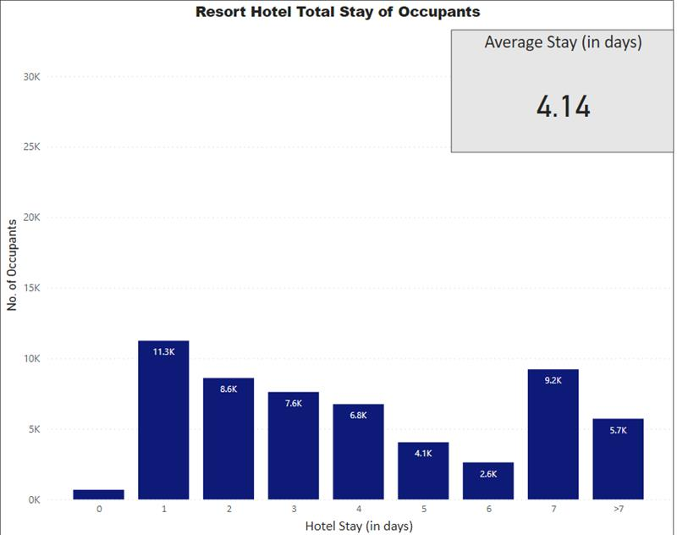
Most people prefer to stay for 1 to 3 days at the hotel
Inference
From the visualization, we can see that the average stay of guests is approximately 3 days
Guests stay for 2 more days at an average at the Resort Hotel as compared to the City Hotel
Most guests prefer to stay for 2-3 days at the City hotel while most guests in Resort prefer to stay just for a day
Filters: Not Cancelled Bookings | Slicers: Hotels, Years, Months

Slide 18
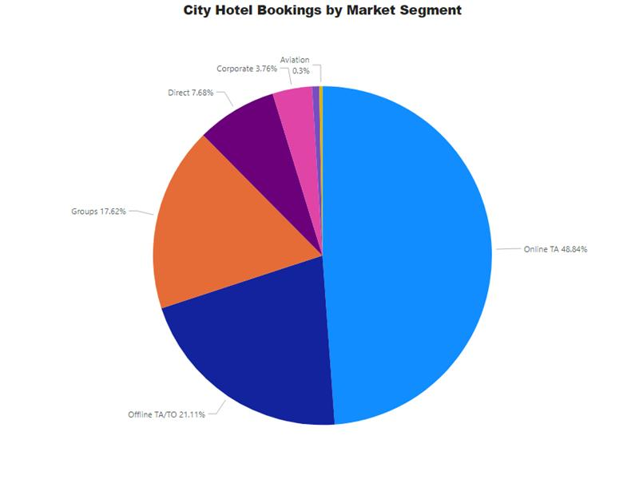
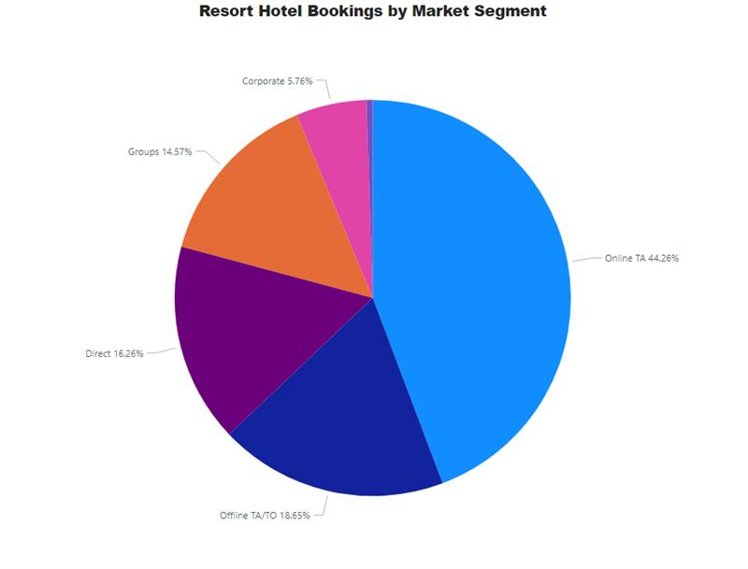
Almost half the bookings are done by Online TA followed by Offline TA/TO and Groups
Inference
From the visualization, we can say that most of the bookings come via Travel Agents using the online mode
We can also see that direct bookings are less as compared to third party bookings.
For resort hotels direct booking is 16% of the total bookings whereas for city hotel direct booking is 7% of the total booking
Slicers: Hotels, Years, Months

Slide 19
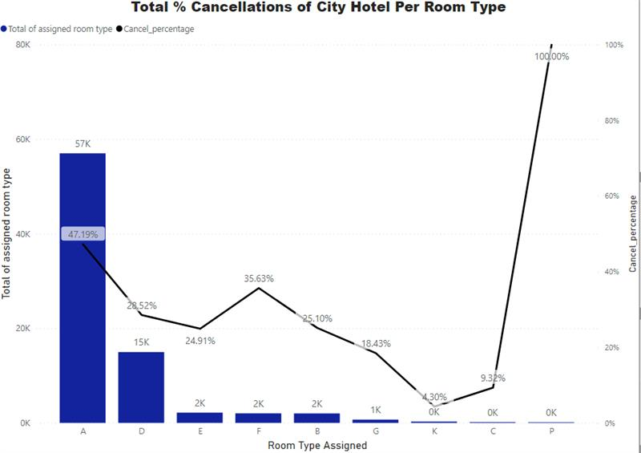
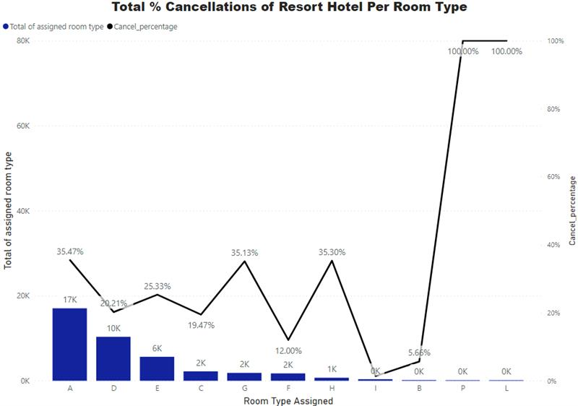
44k Bookings were cancelled in total
Inference
From the visualization, we can infer that out of total number of room types, A has the maximum count
Room type A has more than 35% booking cancellation across each year which is highest amongst all the room types.
We can clearly see that city hotel has more rooms booked than the Resort hotel.
Slicers: Years, Months, Hotels

Slide 20
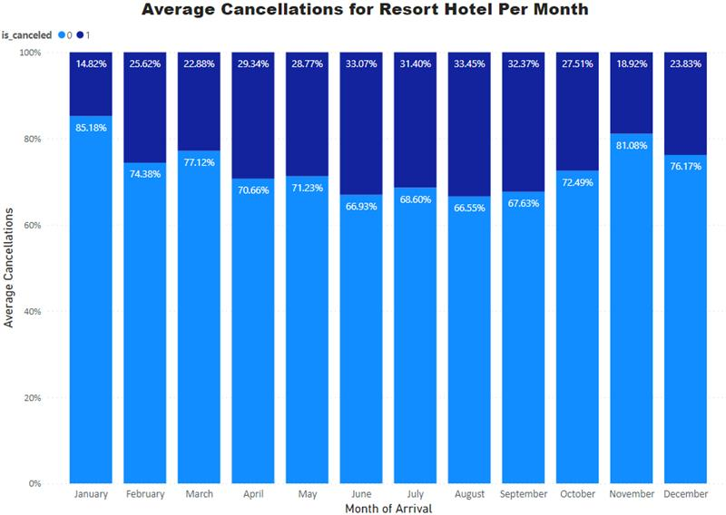
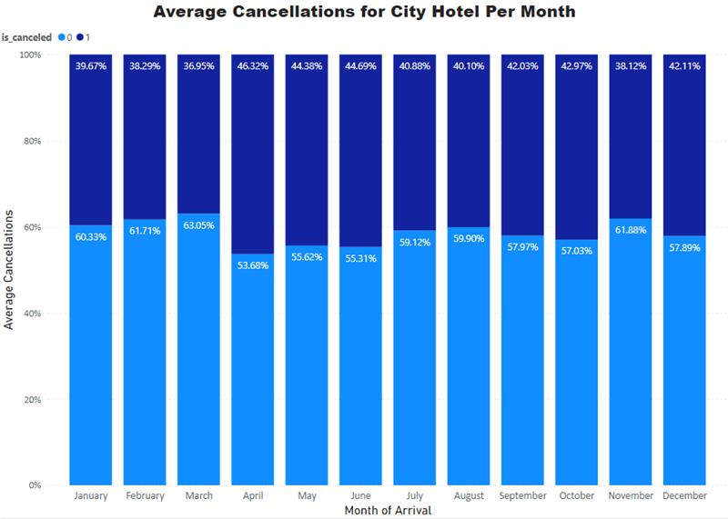
June has the highest average cancellations closely followed by April and May
Inference
From the visualization we can see that that the average cancellation percentages are consistently higher from April to October for both hotels
Alternatively, the average cancellation percentages are comparatively lower from November to March
The average cancellation percentages are higher for the City Hotel as compared to Resort Hotel
Months | Average Cancellation Percentage
Resort Hotel (Avg. Price) | 26.83
City Hotel (Avg. Price) | 39.88
Slicers: Year, Room Type, Hotels

Slide 21

Conclusion
Average room price of the hotels is at its peak during July-Aug every year which could be attributed to increase in demand during those months, given the seasonal nature of hospitality industry
Room type A has more than 35% booking cancellation which is highest amongst all the room types.
People prefer online TA for bookings over direct booking
Most people choose to stay for 1 to 3 days
Recommendation
Identify the reason for cancellations for room type A by measuring CSAT Score to quantify the degree to which customers are satisfied with a service, product or experience
Additional offers could be given to customers of City Hotel whose stay is for more than 2 days to increase the average days of stay at the hotel
Direct booking could be increased through loyalty programs to curtail the commission paid to third parties in case of Online ticket booking.
21
Seasonal hiring could be done in order to accommodate the demand surge during July-August.

Slide 22
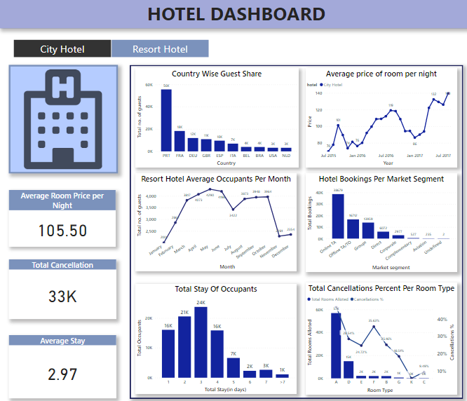
PowerBI Dashboard for Business
Seasonal hiring could be done in order to accommodate the demand surge during July-August.

Slide 23
Thank You

