Slide 1
Comparing ML and LLM Approaches
for PTSD Risk Prediction
Dataset NHANES 2017–18 Models LR · RF · XGBoost + Llama 3 70B Experiments Interpretability
+ Debate
A Failure Analysis Study
Nidhi Dekate
MSAI · University of Texas at Austin
AI in Healthcare · Spring 2026

Slide 2
What I was trying to find out
1
Can a general-purpose LLM predict PTSD risk from structured survey data as well as a trained ML model?
2
If not — where exactly does it fail, and is the failure random or systematic?
3
Are LLM explanations actually faithful to what SHAP says matters for each patient?
4
Can a two-LLM debate fix the errors that single prompting cannot?

Slide 3
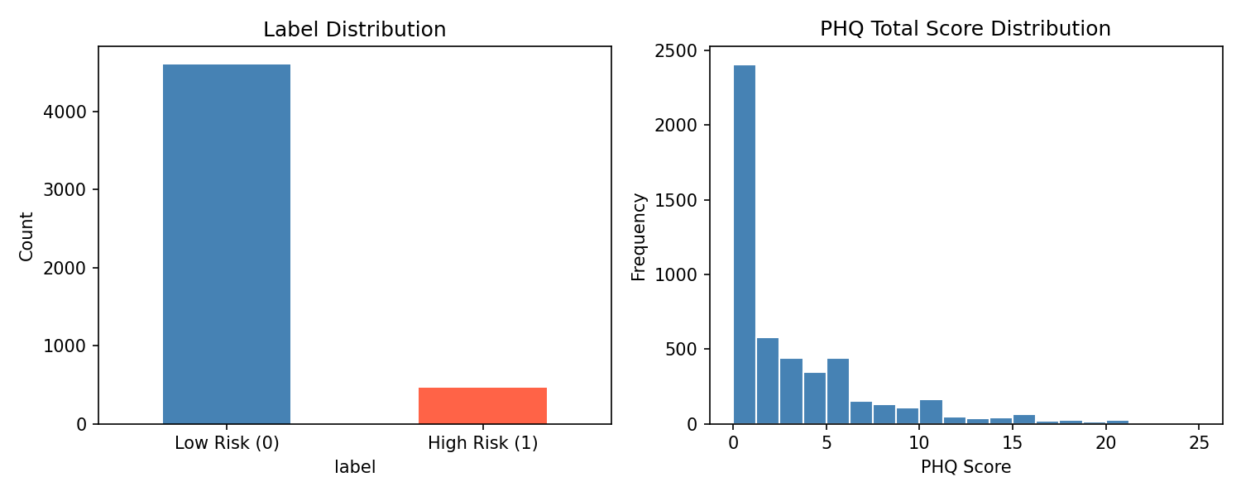
The Data — NHANES 2017–2018
4 files merged on SEQN:
Depression (DPQ), Demographics (DEMO),
Alcohol (ALQ), Sleep (SLQ)
Final dataset:
5,065 patients · 22 features
Label I created:
PHQ-9 total ≥ 10 = high risk (1)
standard clinical cutoff for moderate depression
Class balance:
8.3% high risk · 91.7% low risk
→ used F1 and AUC, not accuracy
Note: PHQ-9 measures depression, not PTSD directly — used as a validated proxy since NHANES has no PTSD diagnosis label.

Slide 4
What I built and how
01
EDA + Preprocessing
04
Failure Analysis
Explored NHANES data, handled missing values, one-hot encoded categories, scaled for LR only, 80/20 stratified split
Found which patients LLM got wrong, looked for patterns — turned out all errors were at PHQ 8–9
02
3 ML Baselines
05
Interpretability + Debate
Logistic Regression · Random Forest · XGBoost + SHAP (top-3 features per patient saved for prompting)
Asked LLM to explain predictions, checked against SHAP. Then ran two-LLM debate on borderline cases
03
LLM Experiments — 8 total
4 formats (Basic, Sentence, Clinical, SHAP-guided) × 2 styles (zero-shot, few-shot) on 200 test patients via Groq API

Slide 5
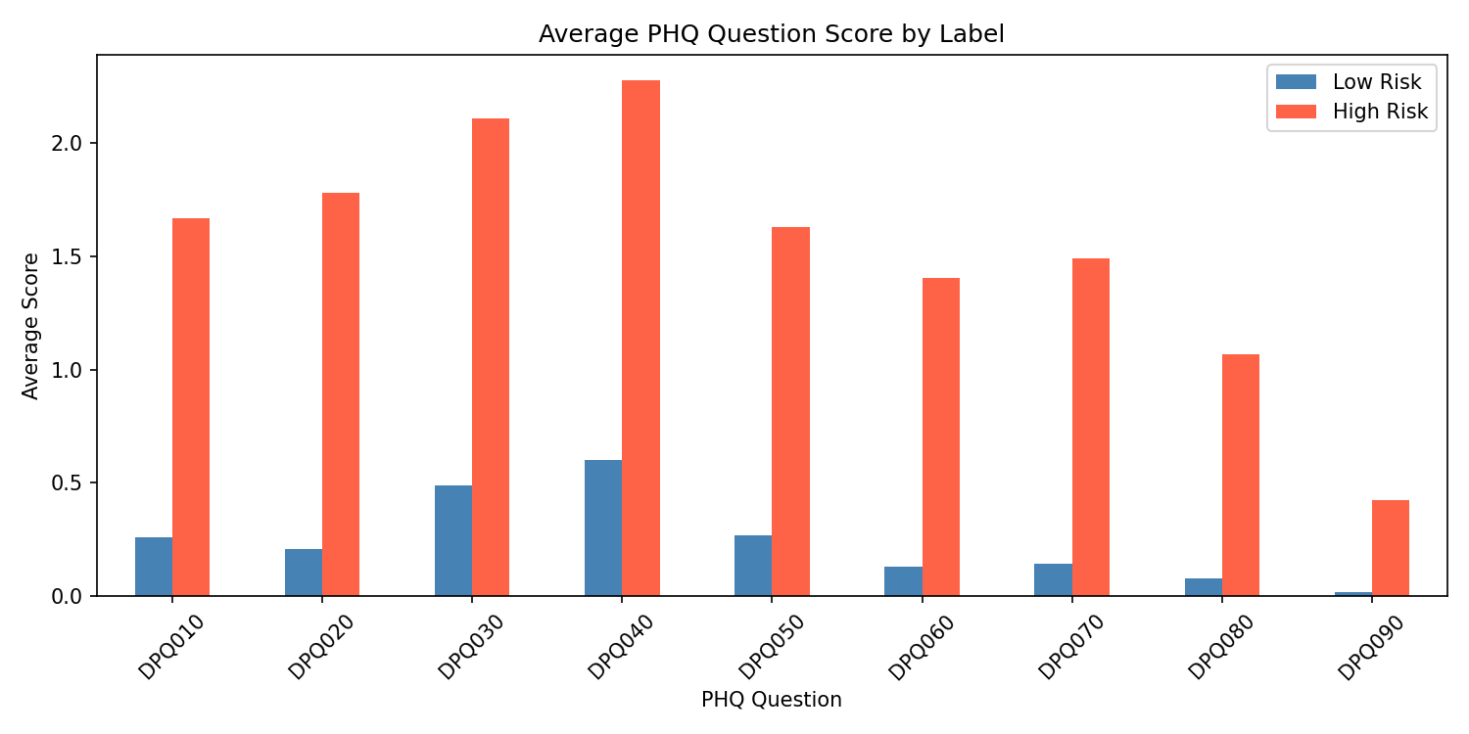
What the data looks like
Three things that stood out in EDA:
PHQ questions dominate everything
Correlation with label: 0.39–0.63. Age, income, sleep — near zero individually. This predicts what the models will do.
Class imbalance is real
91.7% low risk, 8.3% high risk. Accuracy is useless here — a model saying 'everyone is fine' gets 91% and catches nobody.
Gender gap exists
Females are roughly 2x more likely to be high risk in this dataset. Consistent with clinical research on depression rates.

Slide 6
ML model results — all three did really well
One thing I didn't expect: Logistic Regression won. It makes sense in hindsight — PHQ questions are both features and the basis of the label, so a linear model finds a near-perfect boundary. Not leakage, but the signal is very strong.
Model | F1 Macro | ROC-AUC | Accuracy
Logistic Regression | 0.969 | 1.000 | 0.989
XGBoost | 0.940 | 0.998 | 0.979
Random Forest | 0.912 | 0.995 | 0.974
F1 Macro is the metric that matters here — accuracy would mislead because of class imbalance.

Slide 7
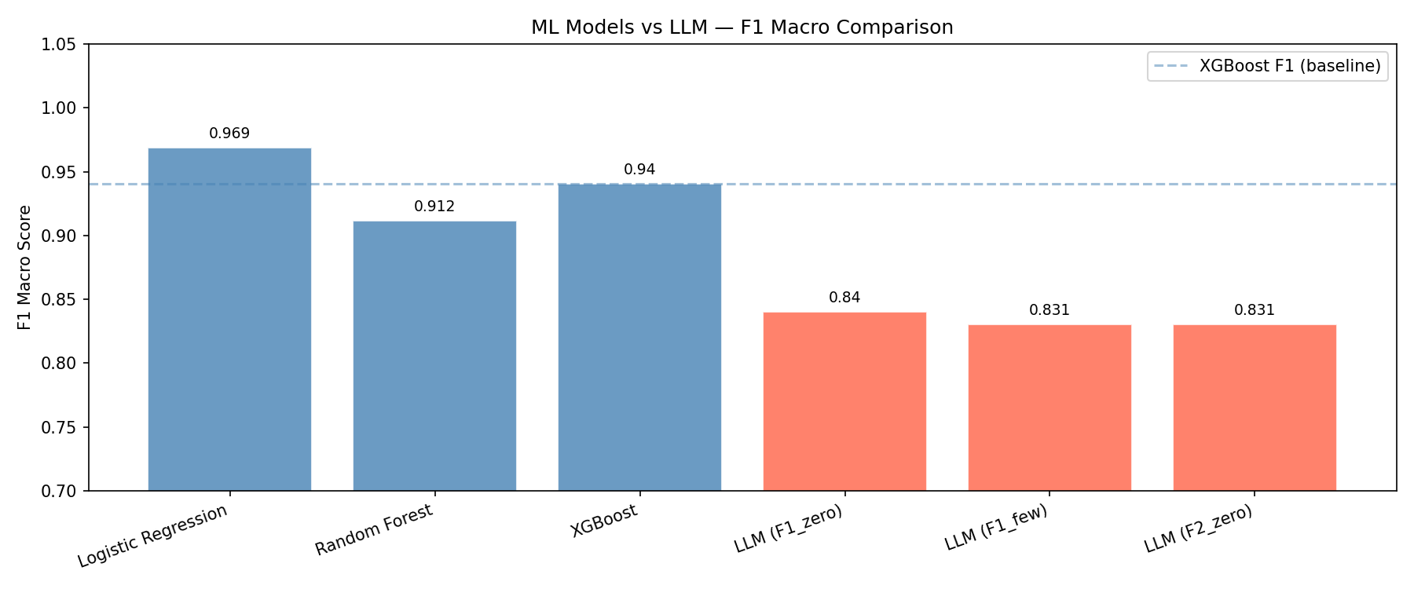
ML vs LLM — the gap is real but the LLM isn't terrible
0.84
Best LLM F1
(F1 zero-shot)
0.94
XGBoost F1
(our baseline)
~0.10
Gap
(consistent)
The LLM achieved 0.84 F1 with zero training on this data. That's actually pretty impressive — but ML models are clearly better.

Slide 8
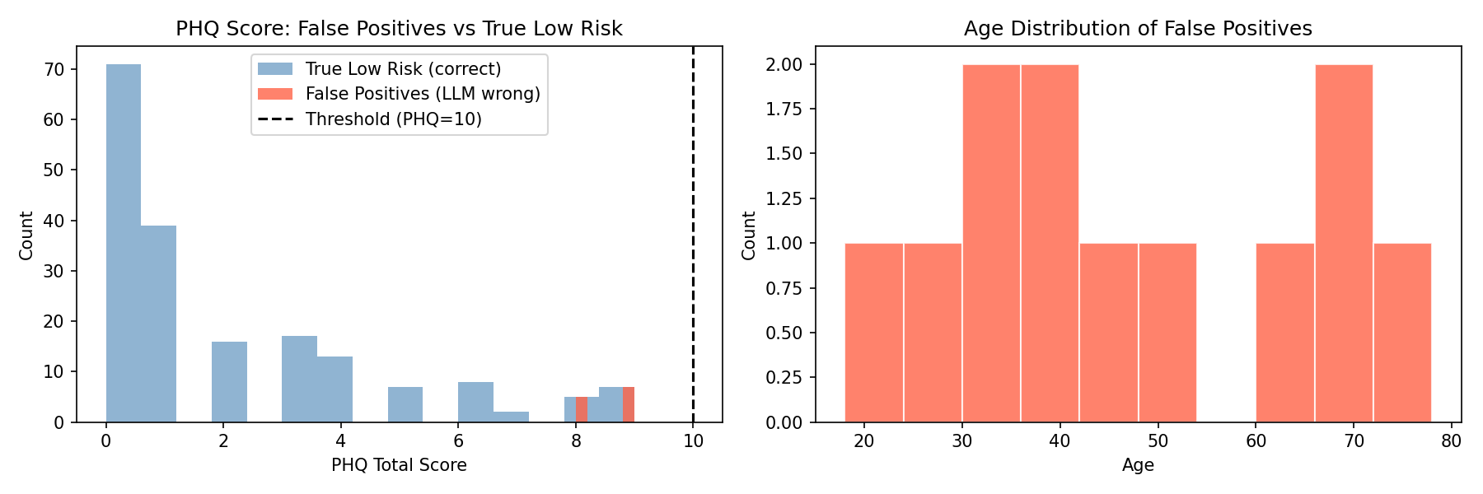
Where the LLM fails — and it's not random
The key finding:
12
false positives
0 false negatives
8–9
PHQ score of
every single error
9/12
patients failed
across ALL formats
The LLM treats PHQ=9 as clinically concerning (reasonable medically) but our label says low risk because 9 < 10.

Slide 9
Can we trust LLM explanations? (Interpretability)
I asked the LLM to predict AND explain its reasoning for the 15 high-risk patients, then checked if the explanation matched what SHAP said actually mattered.
60%
100%
40%
Overall accuracy
on high-risk patients
Accuracy on
PHQ > 12 (severe)
Accuracy on
PHQ 10–12 (borderline)
0.69
2/15
Average faithfulness
(2 of 3 SHAP features mentioned)
"Right for wrong reasons"
correct pred, wrong explanation
"Right for wrong reasons" is a clinical safety concern — a doctor trusting the LLM's explanation might focus on the wrong symptoms.

Slide 10
Can two LLMs arguing fix the borderline cases? (Debate)
The 12 patients with PHQ 8–9 that failed every single prompt format — I tried something different. One LLM argues high risk, another argues low risk, a third acts as judge.
LLM A
Argues HIGH risk
LLM B
Argues LOW risk
LLM Judge
Final verdict
Result: 0 / 12 correct verdicts
Same as single-prompt performance. The judge sided with high risk every time, even after hearing a well-reasoned low-risk argument.
Takeaway: The LLM's clinical conservatism is deeply embedded. Debate, few-shot, SHAP-guidance — none of it fixed the borderline PHQ problem.

Slide 11
Limitations — being honest about what this isn't
PHQ-9 is a proxy, not a PTSD diagnosis
Tabular-to-text loses structure
The label comes from a depression screener. PHQ and PTSD are related but clinically different.
Converting a row to text is imperfect. Complex formats (F3/F4) caused the LLM to stop outputting clean 0/1.
Only 200 patients for LLM experiments
Faithfulness = keyword matching
Groq API rate limits forced a sample. Full test set (1013 patients) was not feasible.
Checking if the LLM mentioned the right feature names is a rough proxy for true reasoning alignment.
No fine-tuning on the LLM
Llama 3 70B used general knowledge only. A fine-tuned clinical model would likely behave differently.

Slide 12
What I found
01
ML beats LLM on tabular clinical data
03
Right for wrong reasons exists
XGBoost F1=0.940 vs best LLM F1=0.840. Not surprising — but the gap is consistent across all prompt styles.
LLM can predict correctly but explain using the wrong features. That's a clinical safety issue, not just an accuracy issue.
02
LLM failures aren't random
04
Debate doesn't fix threshold bias
Every single error landed on PHQ 8–9, just below the threshold. Format, few-shot, SHAP context — none of it helped.
Two LLMs arguing didn't resolve borderline cases. The judge always sided with clinical conservatism.

Slide 13
Thank You
If I could redo this:
Fine-tune a smaller LLM on NHANES so it learns the PHQ threshold from examples
Use actual PTSD diagnosis labels instead of the PHQ proxy
Try medical-specific LLMs like Med-PaLM — general knowledge may not be enough
Run the full 1013-patient LLM experiments, not just 200
github.com/NidhiDekate/PTSD-Risk-Prediction · Nidhi Dekate · MSAI · UT Austin · Spring 2026

