Slide 1


TEAM NAME:
TEAM DETAILS:
RESTYLE
NIDHI IYER
SAYALI KADAM
NITHYA SREE RAMIREDDY

Slide 2
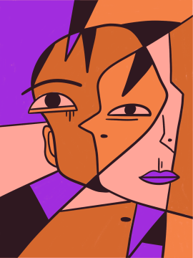
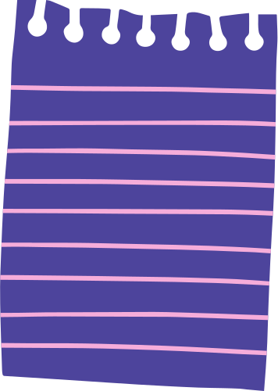
Problem Statement
Theme: Engagement on a shopping platform
Many shoppers struggle to visualize how clothes will look on them and to determine which product will flatter their unique coloring. This leads to indecisiveness, unnecessary returns, and a negative shopping experience.
Can we develop a user-friendly and accessible recommendation system that analyzes a person's unique features and suggests a personalized color palette for clothing, makeup, and other products?

Slide 3
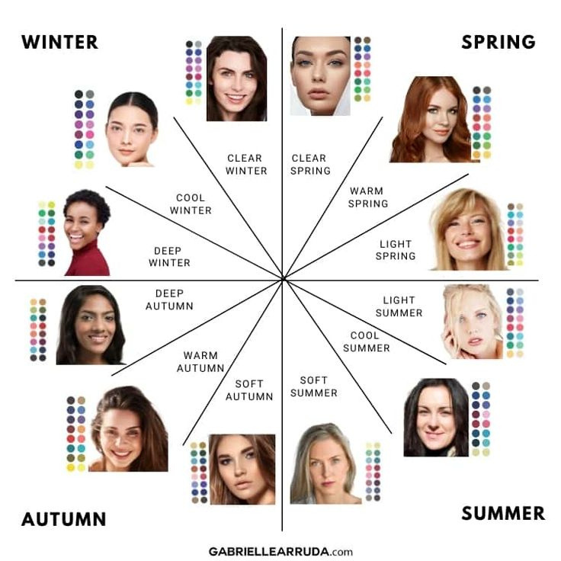
What is seasonal color analysis?
Color analysis is a professional method for identifying colors that harmonize with the user's natural coloring (skin tone, hair color, eye color).
Our goal is to recommend clothes that will actually look good on the user and not just on the model by choosing color palette that flatter each user.
The 12 Seasons approach is a refined system that builds upon the four-season approach by incorporating additional factors like brightness and depth.

Slide 4
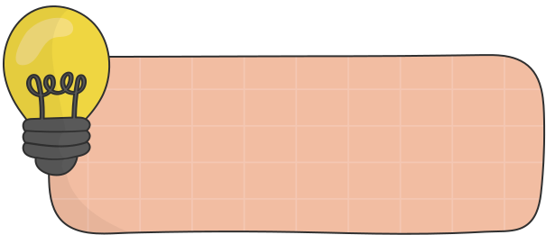
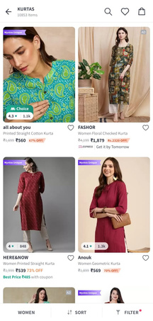







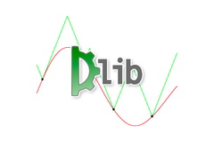


High Level Design
User layer
User takes an input image
Input survey from user
Output generated on myntra!
Add a little bit of body text
Application layer
Color detection Model
Color palette generation
Product recommendations
Database layer
Color dataset
Fashion products dataset
Face dataset

Slide 5
Solution
Image Segmentation for Skin Tone Detection:
After a user uploads a selfie, we employ sophisticated image segmentation techniques using a fine tuned pre trained model like Dlib and DeepLab to accurately identify faces and extract the user's skin, eye and lip color.
Seasonal Color Palette Generation:
Using clustering algorithms like K-Means we can categorize tones into different groups.
User Survey for Preference Identification:
Since we have a cold start problem, in order to gain deeper insights into the user's preferences, we conduct a survey that captures the user's style preferences, fashion interests, and specific requirements.
Integration with Recommendation System:
The results from the user survey, along with the color palette, are fed into our knowledge graph based recommendation system. This system utilizes machine learning algorithms to analyze the input data and generate personalized fashion recommendations.
Datasets:
1) Face dataset:
A collection of 7.2k+ images.
A mix of all common creeds, races, age groups and profiles to ensure no bias.
2) Color dataset:
A collection of color names mapped to their respective RGB (Red, Green, Blue) values.
These colors will be grouped into palates that are mapped to the seasons.
3) Fashion products dataset:
Contains over 5,000 images of 20 different classes.
Is labeled based on type of clothing and age group.

Slide 6
Benefits
Cost Efficiency:
Traditional color analysis services range from $50 to $600 or more, making our solution a more accessible and affordable option.
Global Accessibility:
Currently, professional color analysis is primarily available in the USA, a few European countries, Japan, and Korea. Our platform offers a global online alternative that is both reliable and cost-effective.
Integrated Shopping Experience:
Unlike many standalone color analysis services, our application integrates directly with a shopping platform, simplifying the process of finding clothes in the recommended colors.
Enhanced Sales and Reduced Returns:
By offering personalized product recommendations based on accurate color analysis, we help boost sales and significantly reduce return rates.

