Slide 1


| Tech Management, SRI-B
CLAWS
CLASH OF THE
<RVCE>_<RuntimeTerror_RVCE>
<"From papers to pipelines automatically">
<Nidhi Mahesh Bhat,Sharvari S ,
Gouri Surendra Nayak,Hamsini H D>

Slide 2
Idea
An Autonomous Research Gap Miner & Execution Planner
The Problem
Finding a genuinely unsolved, buildable GenAI problem is brutally hard.
ArXiv publishes 200+ AI papers daily
"Future Work" sections bury the gold in 8 pages of dense text
Teams spend 20–30% of their sprint just on ideation
They default to safe, already-solved ideas — and build forgettable projects

Slide 3
Who Faces This?
Primary Persona — The PRISM Hackathon Team Lead
Has 24–72 hours to go from zero to demo
Is technically strong but research-bandwidth-limited
Wastes the first 20–30% of the sprint just figuring out what to build
Needs ideas that are novel and buildable — not just theoretically interesting
Secondary Persona — The Samsung PRISM Intern
Working on a worklet with a defined research mandate
Expected to propose novel problem statements but has no structured discovery process
Needs solutions that fit on-device (sub-7B) — a constraint most research tools completely ignore
What Makes This Different From Every Other Research Tool?
Every existing tool — Semantic Scholar, Connected Papers, Elicit — is reactive. You go to them with a question. They answer it.
GenesisClaw is proactive. It comes to you with an opportunity.
That's not an incremental improvement. That's a workflow inversion. And for time-boxed hackathon teams working under Samsung PRISM's research mandate, that difference is the entire sprint.

Slide 4
Idea
Current Solution & Gaps
🔍Existing solutions:
• Google Scholar and Semantic Scholar only retrieve papers
• GitHub search requires manual exploration
• Existing AI research tools mainly summarize content
• No direct implementation guidance is provided
⚠️What’s missing/broken:
• Researchers manually analyze hundreds of papers to identify gaps
• No semantic clustering of similar research problems
• Existing systems cannot connect gaps with implementation repositories
• No automated execution planning for discovered opportunities
🚀 GenesisClaw Opportunity:
• AI-powered research gap extraction using LLMs
• Semantic clustering using vector embeddings + ChromaDB
• Trending gap identification across research domains
• GitHub intelligence layer for implementation discovery
• Automated execution roadmap generation

Slide 5
Idea
Your Solutions
What We Built — GenesisClaw
An autonomous AI research-to-engineering pipeline that doesn’t just summarize research papers — it identifies unsolved problems inside them and generates executable software project plans automatically.
Instead of humans manually reading papers, finding gaps, researching implementations, and planning execution, GenesisClaw automates the entire loop.
Problem We’re Solving
There’s a massive gap between:
academic research
actual software implementation
Developers waste time:
finding useful papers
understanding limitations
deciding what to build
planning architecture
distributing tasks
GenesisClaw converts research insights into actionable engineering roadmaps in minutes.
Core Idea
Most AI research tools stop at:
summarizing papers
answering questions
recommending papers
GenesisClaw goes further:
Reads new research papers automatically
Detects unresolved research problems
Filters high-value gaps using ML clustering
Grounds ideas with existing GitHub projects
Generates complete engineering execution plans
Streams results live to a dashboard
To summarise what it does:
“Research paper → startup/project blueprint automatically”

Slide 6
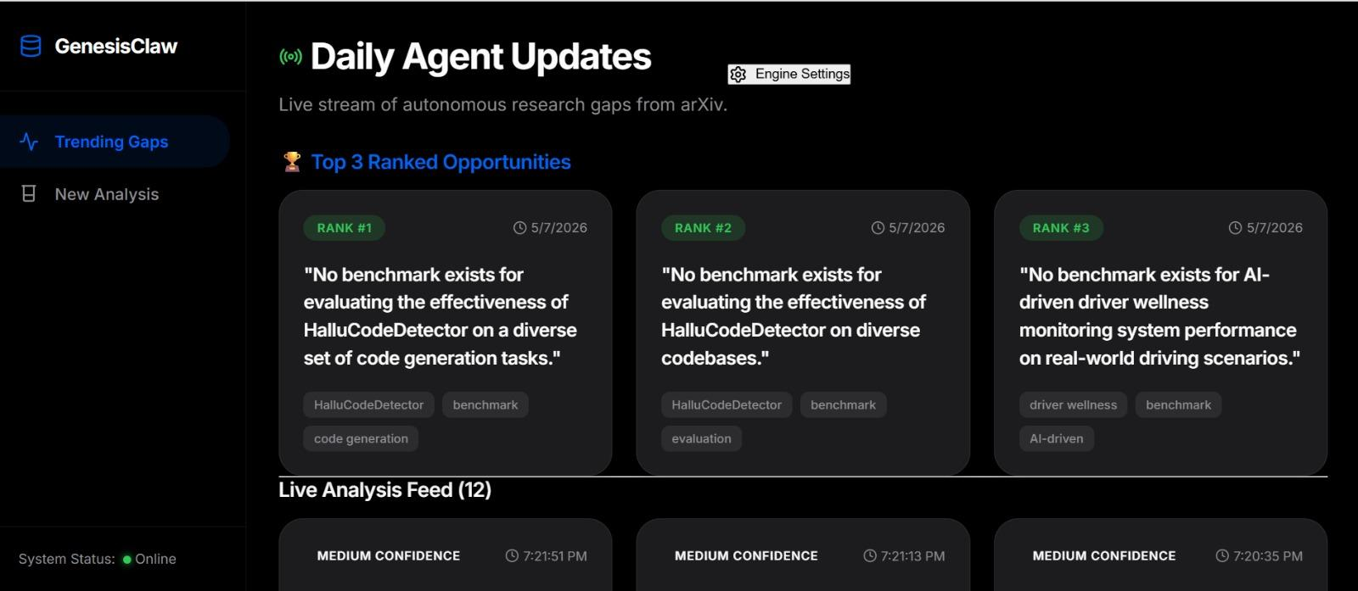
Demo/Product Walkthrough
Idea
ScreenShots of Prototype

Slide 7
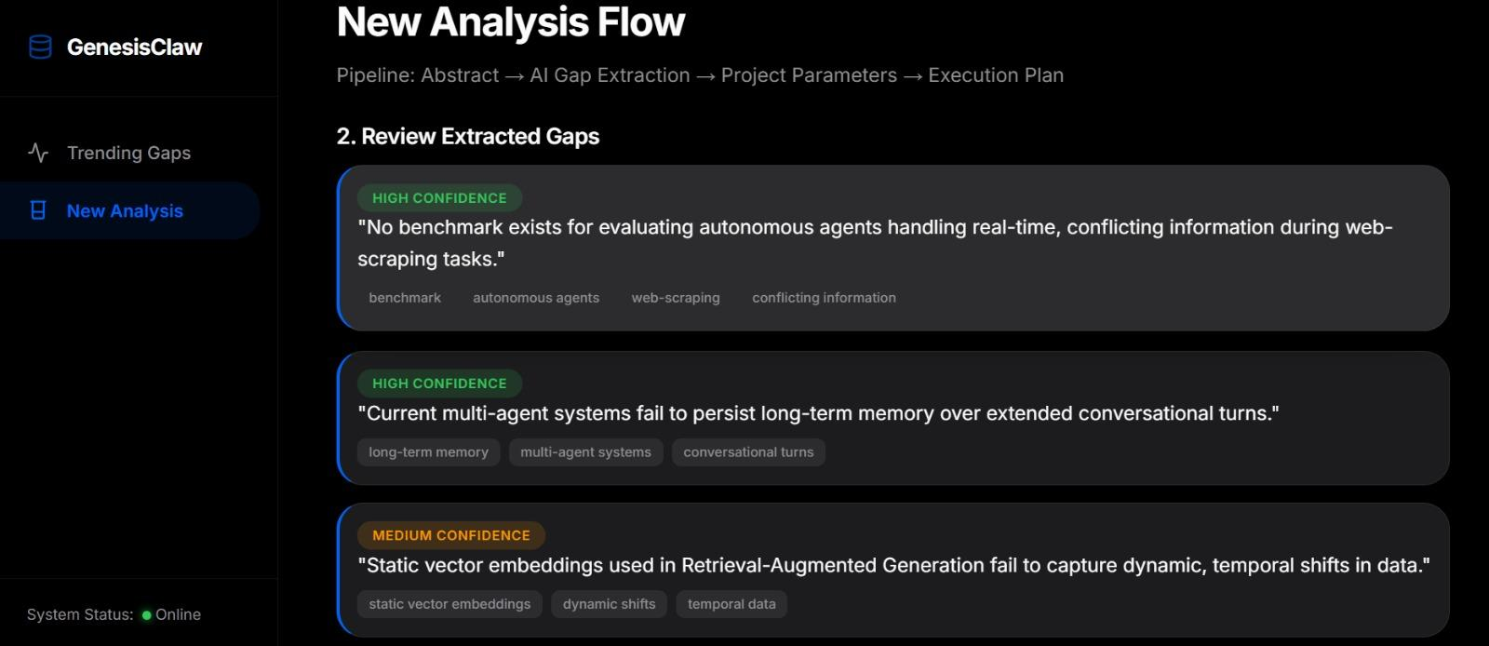

Slide 8
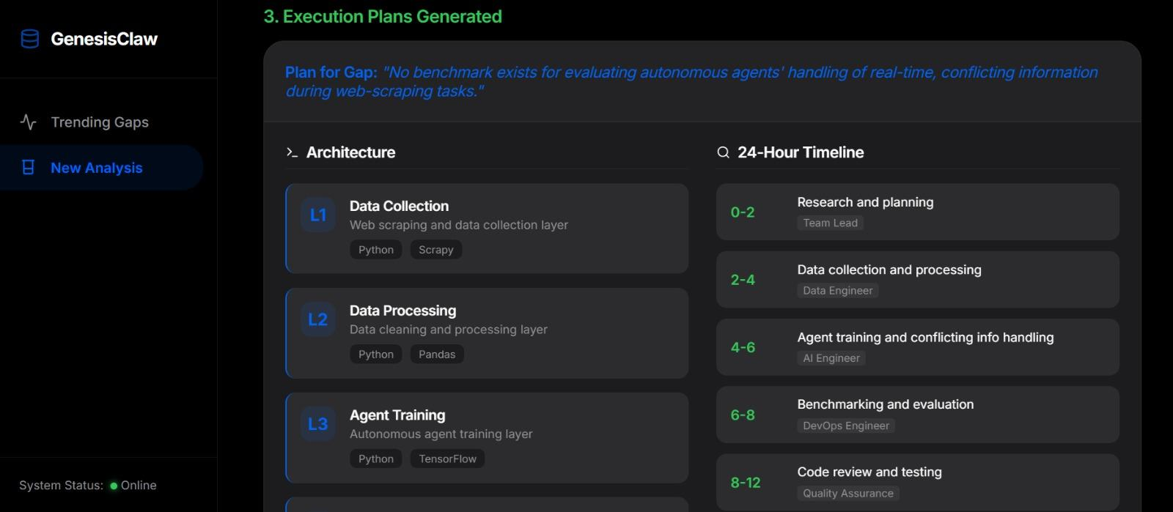

Slide 9
Tech & Architecture
Idea
Layer | Technology | Purpose
Runtime | Node.js + Express.js | API server, routing, SSE stream
Frontend | React.js + Vite | Dashboard, analyzer, plan viewer
Background Worker | openclaw-worker.js | Autonomous arXiv polling daemon
Process Manager | PM2 | Keeps both engines alive on cloud
Cloud Hosting | GCP Compute Engine (e2-micro) | Persistent VM for file-based memory
Frontend Hosting | Vercel | Static React deployment
Secure Tunnel | Ngrok | HTTPS wrapper over GCP HTTP for browser security
Memory Storage | leaderboard.json + memory/runs/ | Persistent gap storage per run
ML Clustering | Python (dev2_module.py) | Deduplicates and ranks extracted gaps
Config | heartbeat.md | Defines active research niches dynamically

Slide 10
AI USAGE
Layer | Model / Tool | Role
Primary LLM | Groq SDK | Gap extraction and execution plan synthesis
Agent Framework | OpenClaw | Pipeline orchestration and skill execution
Output Validation | JSON Schemas | Hallucination-free structured AI responses
Literature Source | arXiv API | Live research paper ingestion
Real-time Delivery | Server-Sent Events (SSE) | Pushes live agent updates to the UI

Slide 11
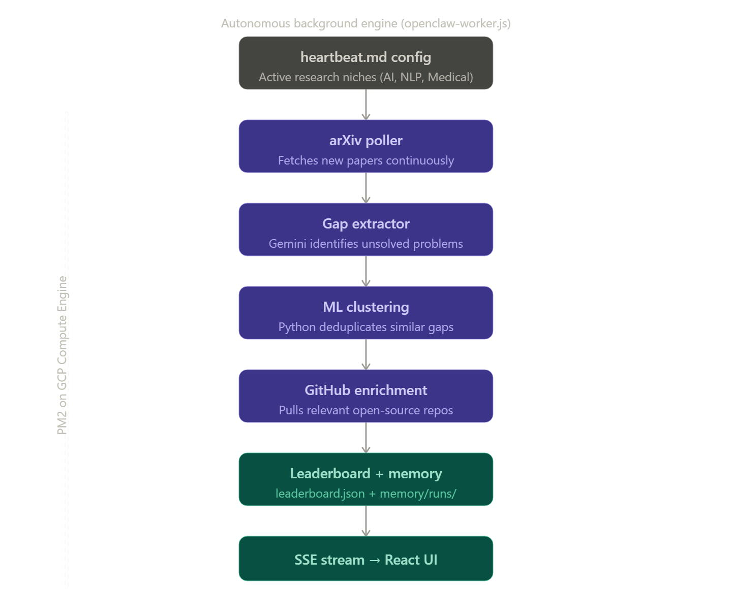
System Flow

Slide 12
Idea
Impact & Use cases
🎓Academia & Researchers
• Faster research gap discovery
• Automated literature analysis
• Reduced manual exploration
🚀Startups & Builders
• Faster prototype planning
• GitHub-based implementation guidance
• Rapid idea validation
🏢Enterprises & Innovation Teams
• Trend analysis across research domains
• Competitive technology tracking
• AI-assisted strategic planning
🔬R&D Labs
• Discover emerging opportunities
• Semantic clustering of innovations
• Automated execution roadmaps
🌍Scalable to:
• Multi-domain research ecosystems
• Enterprise innovation platforms
• AI-powered academic assistants
• Global research intelligence systems

Slide 13
Idea
Differentiation
MOAT 1 — Schema-Validated AI Output
Every AI tool in this space has the same weakness: unstructured, unverifiable output.
GenesisClaw enforces strict JSON schemas on every Gemini response before it reaches the user. This means the gap extraction and execution plan are not suggestions — they are structured, validated, machine-readable engineering artifacts.
MOAT 2 — Pipeline Architecture, Not a Chatbot
Most AI research tools are wrappers — a prompt box on top of an LLM.
GenesisClaw is a multi-stage orchestrated pipeline:
Abstract → Gap Extraction → Execution Planning → Leaderboard Ranking
Each stage is a discrete, replaceable module with its own logic, schema, and AI interaction. This means:
The LLM can be swapped (Gemini → Groq → Ollama) without breaking the workflow
Each stage can be independently improved or benchmarked
The system compounds in value over time as the leaderboard accumulates ranked, deduplicated gaps

Slide 14
Idea
Demo Link
Video Demo link: https://drive.google.com/drive/folders/12A7bIS0QNwBCM5T6w5bVEJT1eFkDXTdA?usp=sharing
Github link: https://github.com/NidhiMBhat/GenesisClaw.git

