Slide 1

ST TOOL PRESENTATION KATALON RECORDER
Submitted By
Nidhi Rai - 4NM18CS103
Nishmitha K Suvarna - 4NM18CS104

Slide 2
INTRODUCTION
Katalon Recorder is an automation testing software tool developed by Katalon.
Katalon Recorder is a free, Selenium IDE alternative, lightweight web extension for automating actions and automated testing on the browser.
Katalon Recorder is the Selenium IDE-compatible record & playback tool for browser automation testing.

Slide 3
PURPOSE
You can use it to record, debug, execute & manage test cases, and export test suites to multiple programming languages.
Katalon Recorder is the most UI-friendly and simplest extension for Record and Playback.
Automate the repetitive tasks on browsers, such as generating reports, filling forms, automating games, etc.

Slide 4
FEATURES
Simple Deployment
Quick & Easy Set-up
Faster & Weightier Outcomes
Flexible Modes
Easy Usage
Cross-Browser Application
Hands-on

Slide 5
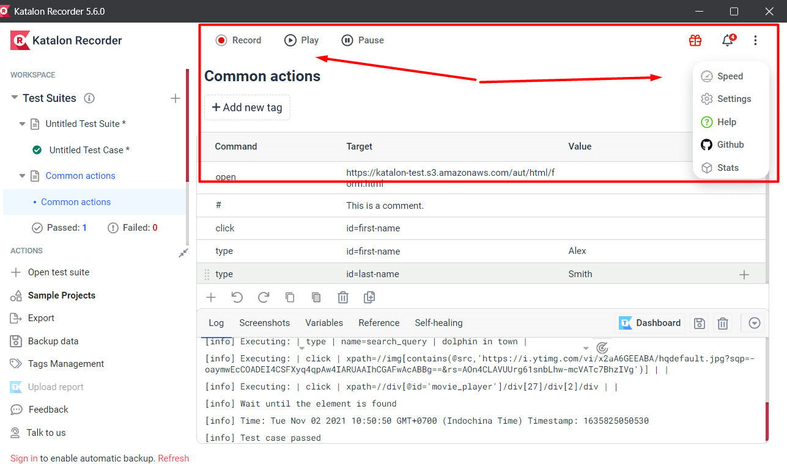
KATALON RECORDER MAIN UI CONTENTS
Main Toolbar

Slide 6
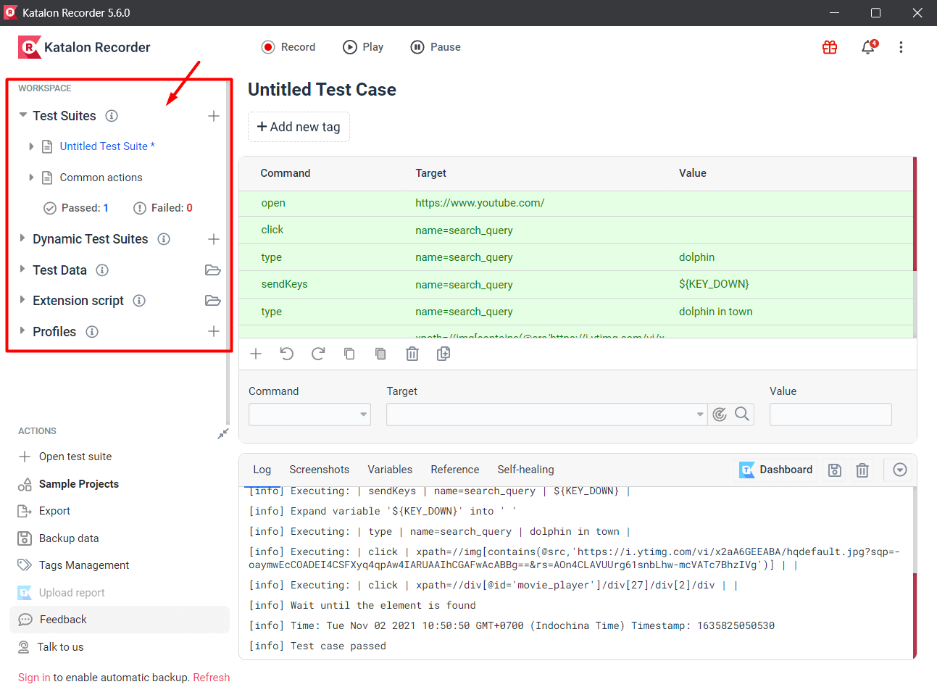
Test Explorer

Slide 7
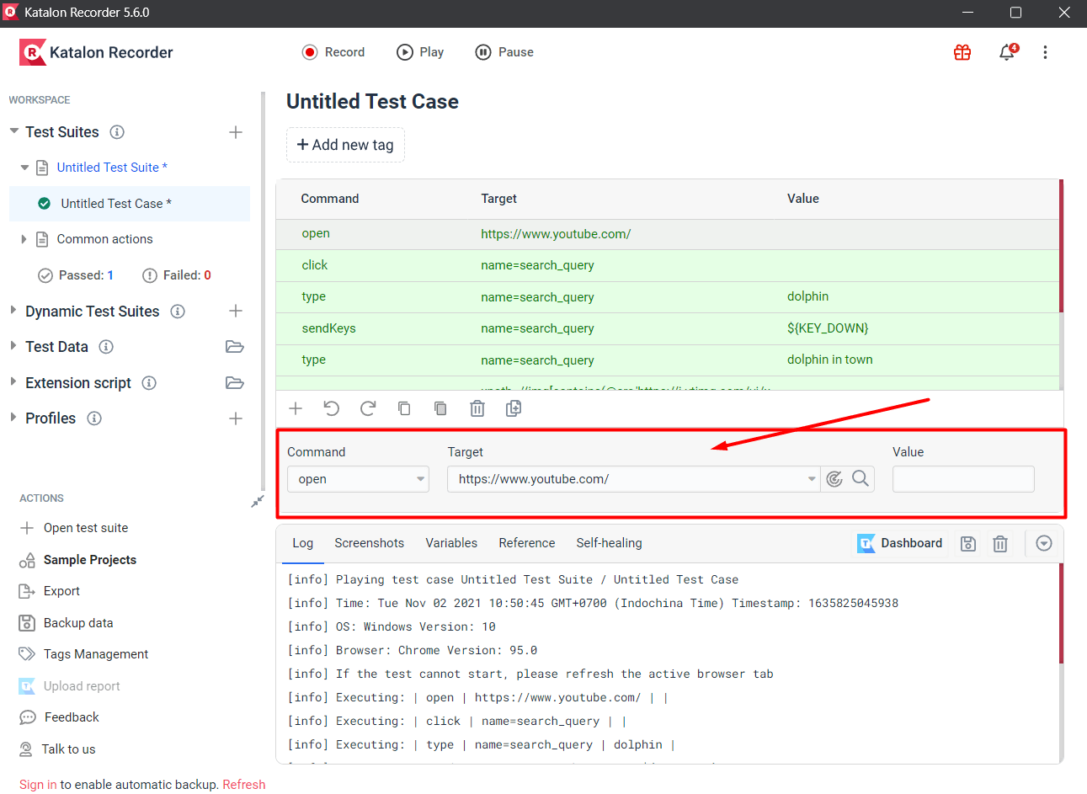
Test case details view

Slide 8
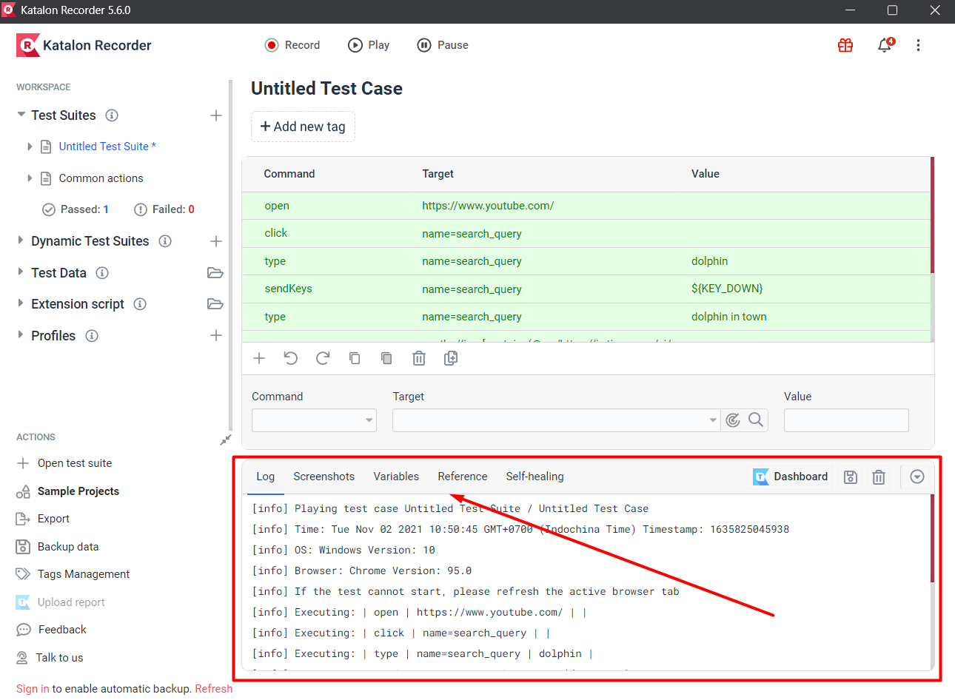
Log

Slide 9
EXAMPLE - Snapdeal

Slide 10
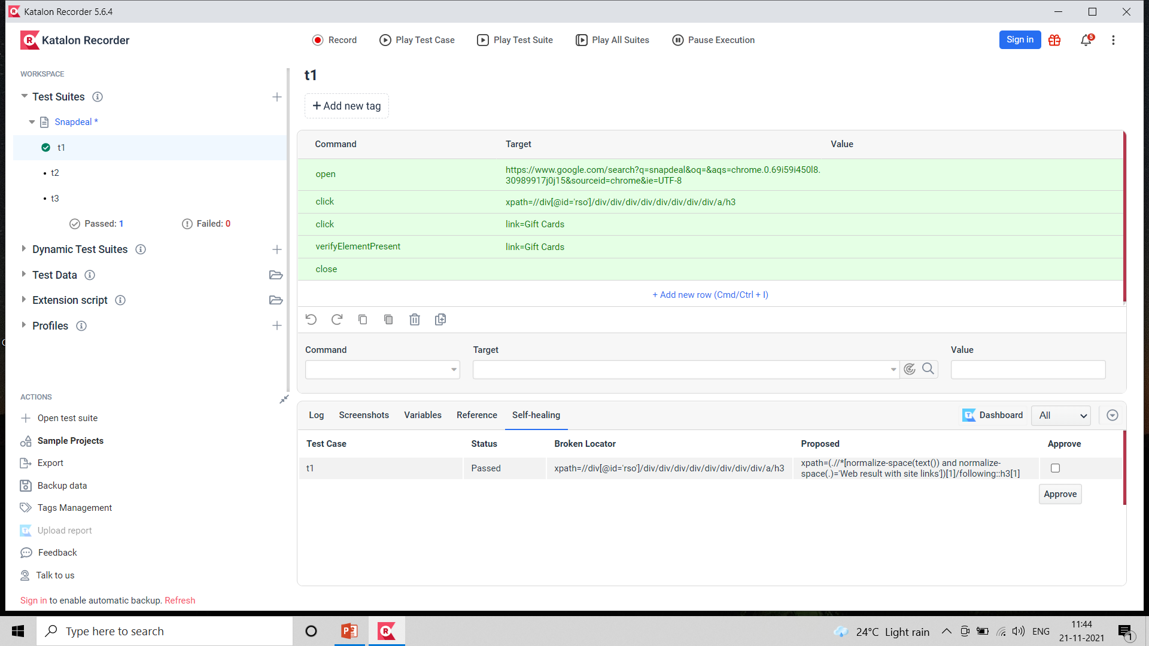
Test Case : 1

Slide 11
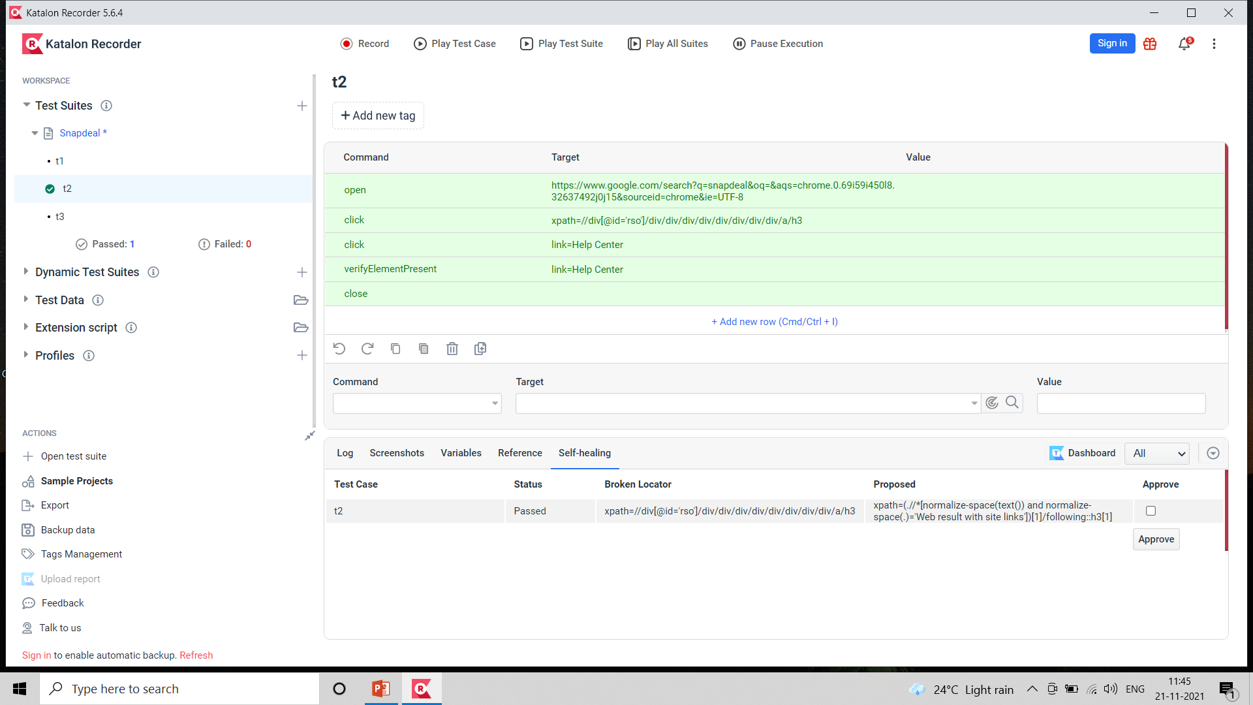
Test Case : 2

Slide 12

Test Case : 3

Slide 13
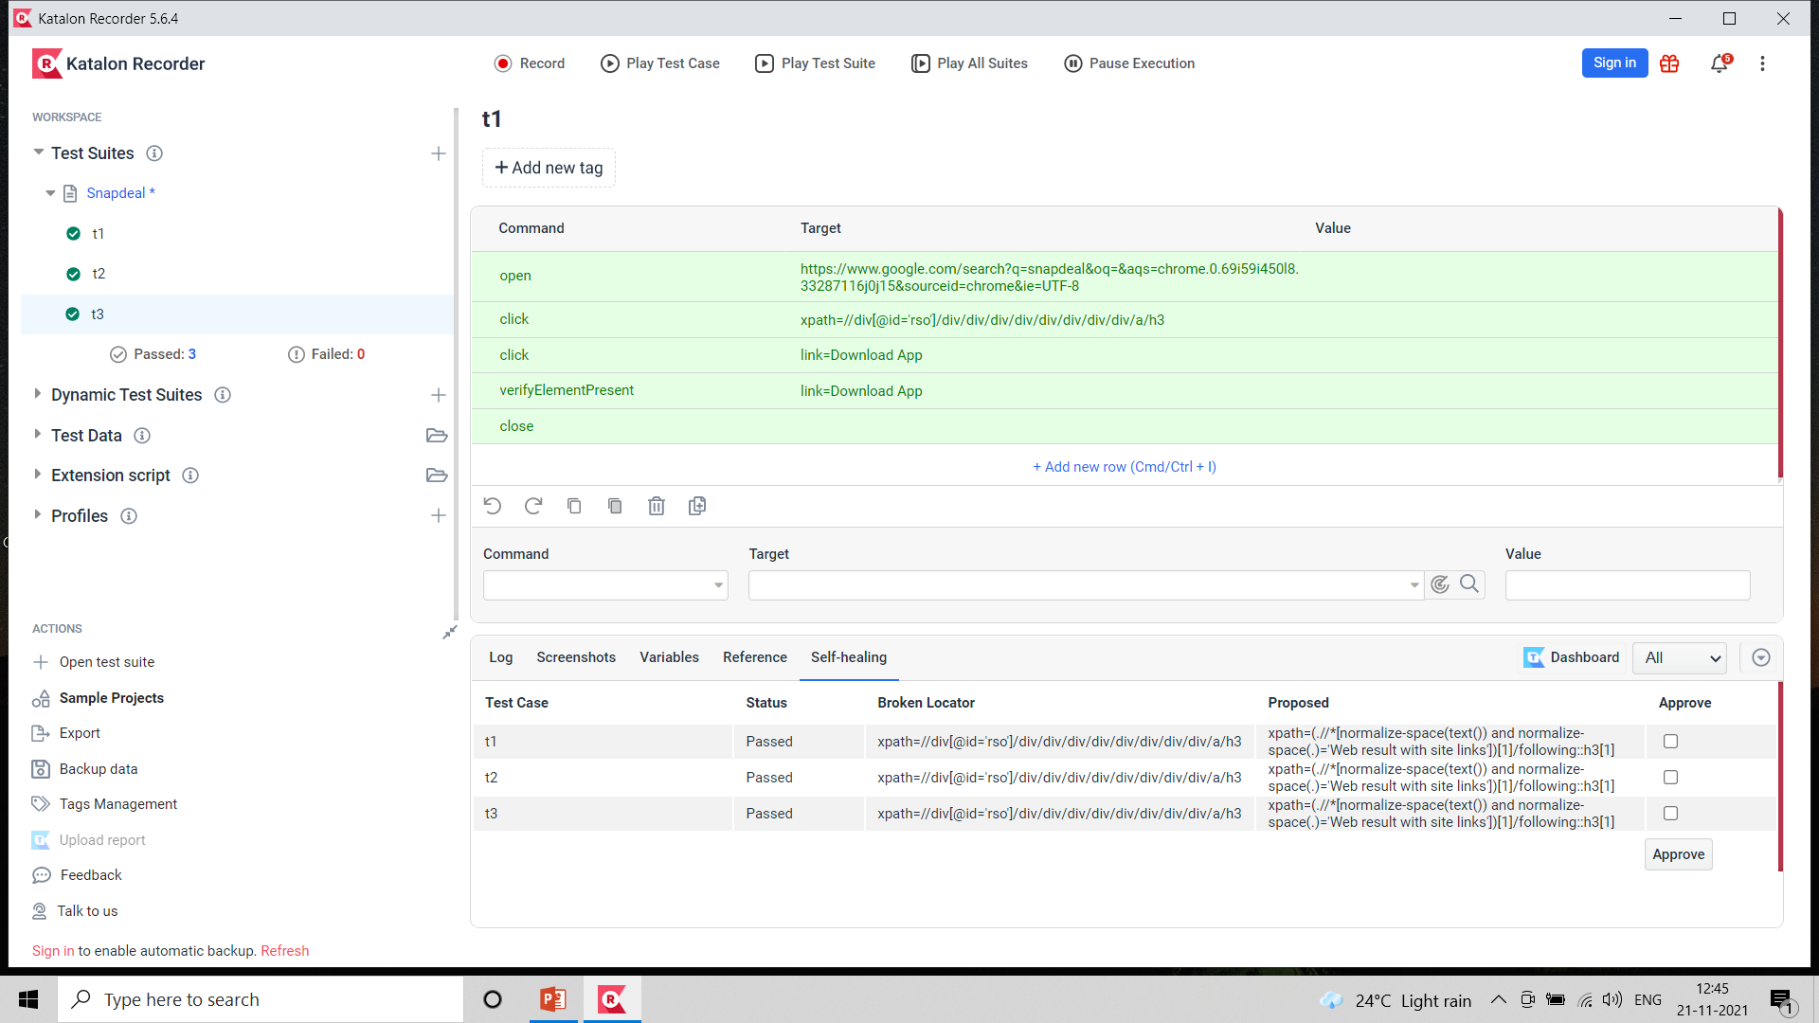
Running All Test Suites :

Slide 14


