Slide 1

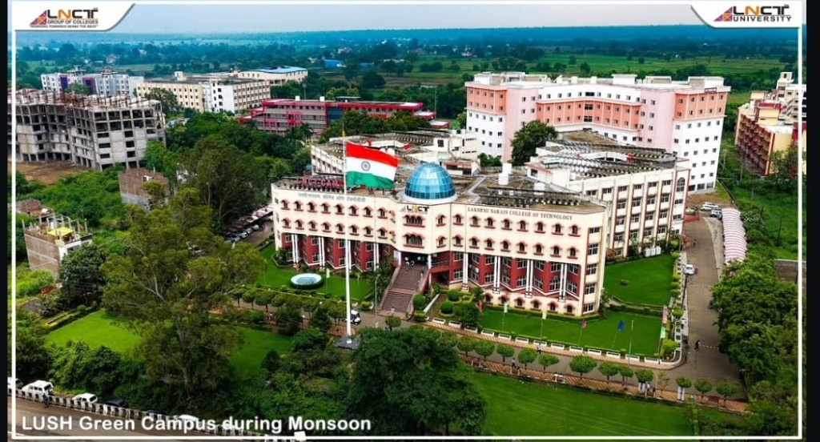
SMART INDIA HACKATHON 2026
CampusMate AI
Smart Campus Navigation & Student Assistant
One intelligent platform for campus navigation, student assistance, and campus transport.
PROBLEM STATEMENT ID
SIH-2026-CAMPUSMATE
PROBLEM STATEMENT TITLE
AI-Powered Smart Campus Navigation & Transport Companion
THEME & CATEGORY
Smart Education / Institutional Systems | Software
TEAM ID & TEAM NAME
9826585201 | Barbie Squad

Slide 2
THE CHALLENGE & THE ANSWER
Proposed Solution
Traditional Campus Challenges
- Information Fragmentation: Bus schedules, directories, and notices are scattered across static PDFs and bulletin boards.
- Navigation Hurdles: Visitors and new students struggle to find lecture halls, admin blocks, and facilities inside massive campuses.
- Transit Uncertainty: Lack of active timetable tracking or simulated progress leads to bus stop waiting anxiety.
- Support Delays: Simple academic queries require physical registration desk visits, causing time inefficiencies.
Proposed Unified Platform Solution
- Smart Navigation: 3D vector map with route guidance to major buildings.
- Simulated Bus Tracking: Stop timelines, shift filters, and live ETAs.
- Contextual AI Assistant: Multi-branch query responses backed by data.
- Explore Gallery: Integrated photo catalog mapping assets to blocks.

Slide 3
SYSTEM ARCHITECTURE & TECH STACK
Technical Approach
User Interface Layer (Mobile-First Viewports)
HTML5 | Vanilla CSS | HSL Theme Colors | Responsive Breakpoints (320px-430px)
Verified Technology Stack
Languages
ES6+ JavaScript, HTML5, CSS3
Frontend Library & Build Tools
React 19 (Hooks, Context), Vite 8 (Hot Module Replacement)
Map Library & Tiles
Leaflet JS 1.9.4 | OpenStreetMap Tile Servers
Linting & Code Quality
Oxlint Linter (Zero warnings, zero errors compile)
Data Architecture
Local client JS data modules for instant, offline-ready queries
Frontend Interface & Module Controllers
- MapPage: Vector layouts, path highlighting, and photo overlay triggers
- BusTracking: Decoupled simulation clock, progress calculations, and ETAs
- Departments: Tabbed academic directories with search indices
Mathematical & Local Logic Services
- Haversine Distance Formula: Dynamic telemetry distance in kilometers
- Simulation Clock Engine: Progression intervals for mockup GPS coordinates
Factual Structured Database Layer (Local JS Modules)
- campusData.js: Location aliases, verified stop grids, schedules
- academicData.js: 17 schools and their respective course lists
- Future Live GPS: Hardware GPS -> REST APIs -> Client WebSockets

Slide 4
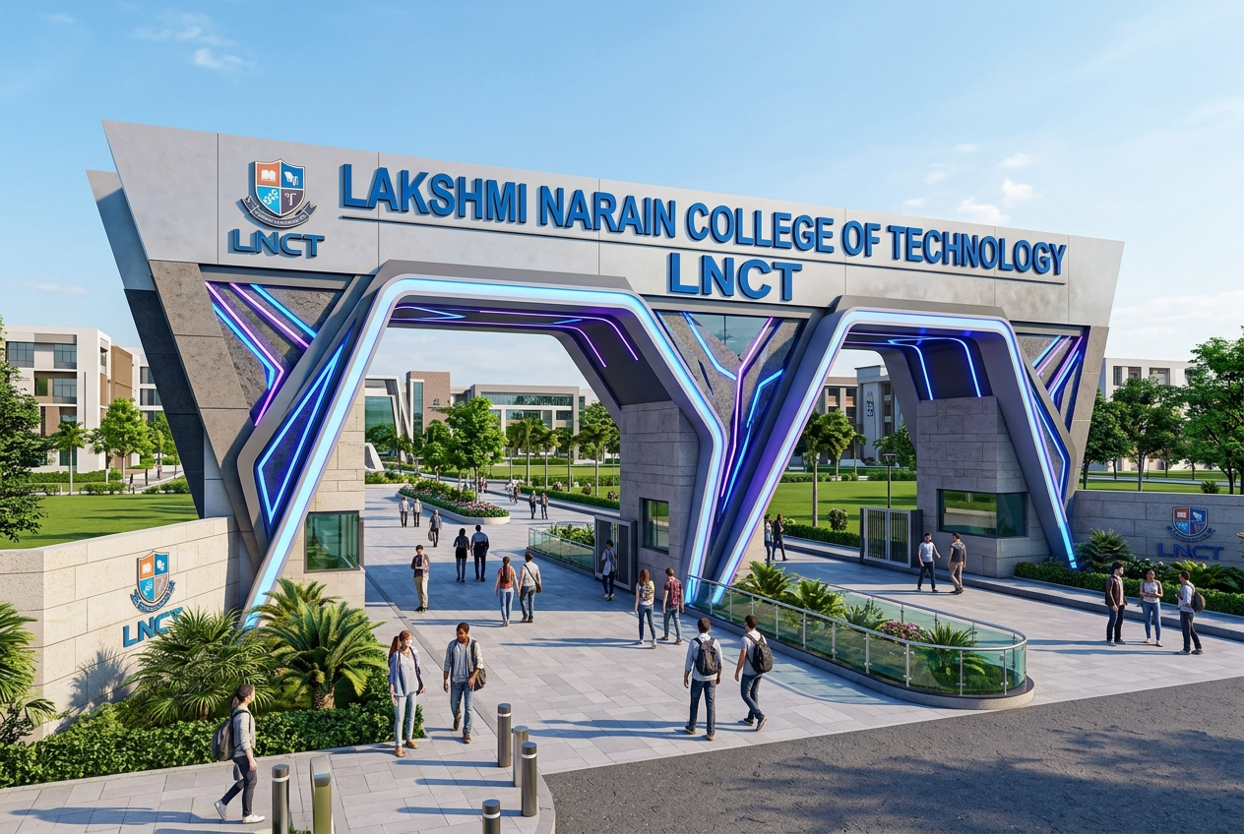
IMPLEMENTATION & RISK ANALYSIS
Feasibility & Viability
Feasibility Assessment
Technical Feasibility
- Lightweight client-side build requires no heavy database servers.
- Leaflet maps run smoothly on budget mobile processors.
Operational Feasibility
- Transport coordinators can update bus schedules easily via campusData.js.
- Standardised UI is user-friendly for all university stakeholders.
Risk & Mitigation Matrix
1. Inaccurate timing ETAs due to traffic
- Mitigation: Haversine distance telemetry shows actual physical distances.
2. GPS loss inside structures/basements
- Mitigation: Fallback stop-to-stop simulation clock interpolation.
3. Offline access constraints
- Mitigation: Pre-bundled local JS data runs without network connection.
Platform Limitations
- OpenStreetMap tiles require active internet connection to load.
- Real-time GPS tracking is simulated; hardware device installs on buses are required for live telemetry deployment.

Slide 5

VALUE PROPOSITION & USER MATRIX
Impact & Benefits
Ecosystem Benefits
Students
- Zero transit anxiety, immediate room directions, fast academic search.
Administration
- Modernised digital catalog, simplified student onboarding.
Transport Team
- Operational timing checks and clear stop-level visualizations.
Unique Value Proposition
- Replacing scattered PDF timetables, static maps, and directories with a single, mobile-responsive campus companion.
Credible Feature Comparison Matrix
Feature Capability | Generic Maps | Web Portals | CampusMate AI
Building Search | limited | no | Yes
Bus Tracking | no | static list | Yes
Timetable ETAs | no | static PDF | Yes
Contextual AI | no | no | Yes
Explore Gallery | no | limited | Yes
Mobile Layout | Yes | limited | Yes

Slide 6
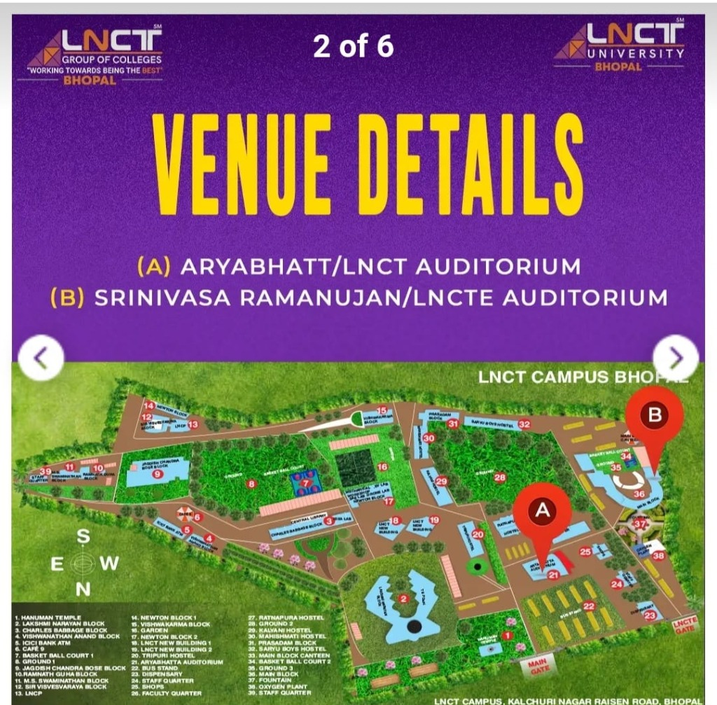
BIBLIOGRAPHY & DEPLOYMENT LINKS
Research & References
Bibliographical References
1. Institutional Information
- LNCT University Transport Department stop timing datasets.
- LNCT 360 Degree Virtual Tour directories and maps.
2. Technical Specifications & APIs
- Leaflet API documentation for markers, routing, and layer controls.
- OpenStreetMap Foundation map tile rendering server guidelines.
- React 19 component lifecycle rendering paradigms and Vite documentation.
3. Mathematical Standards
- Haversine formula specifications for geographic telemetry over spheres.
Project Verification Links
GitHub Remote Repository
- https://github.com/NidhiRajput06/Campusmate_ai
Active Local Wi-Fi Server Link
- http://192.168.1.9:5173/ (Exposed on Wi-Fi for mobile)

