Slide 1
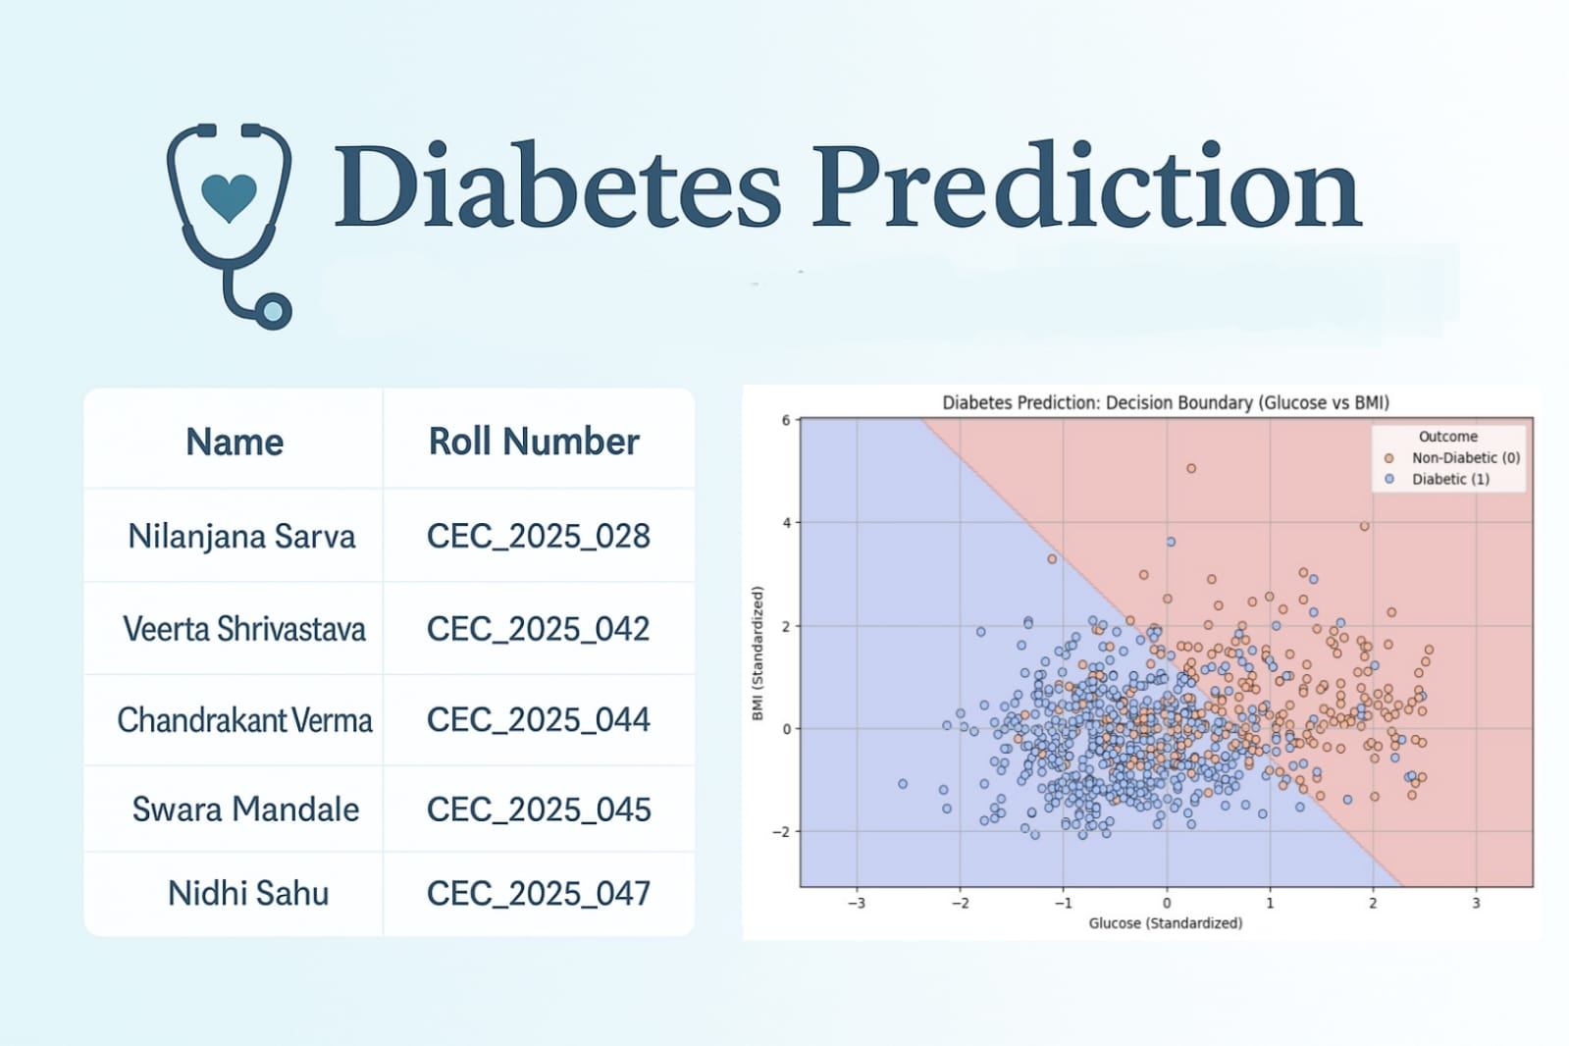

Slide 2
Introduction
Problem Statement: Diabetes is a chronic disease affecting millions worldwide. Early detection is crucial to prevent complications and manage the condition effectively.
Why We Chose This Topic: Diabetes is a growing global health concern, and we wanted to explore how data-driven approaches can assist in early detection and intervention using machine learning.
Objective: Develop a predictive model to determine the likelihood of a patient having diabetes based on medical diagnostic measurements.
Dataset: We used the Pima Indians Diabetes Dataset, a widely used benchmark dataset for binary classification problems in healthcare analytics.

Slide 3
Tech Stack
Python
Numpy
Matplotlib
Pandas
Scikit
Seaborn
Power BI

Slide 4
Data Overview
Total Records: 768
Features: 8
Target Variable: 0 = Non diabetic
1 = Diabetic
Features | Description
Pregnancies | number of times pregnant
Glucose | plasma glucose concentration
Blood pressure | diastolic blood pressure
Skin thickness | triceps skinfold thickness
Insulin | serum insulin level
BMI | body mass index
Diabetes Pedigree Function | diabetes risk based on family history
Age | In years

Slide 5
Data Preprocessing
Handling Missing Values: Certain features had zero values, which are not physiologically plausible. These were treated as missing and imputed with the median of respective columns.
Features Imputed:
Glucose
Blood Pressure
Skin Thickness
Insulin
BMI
Standardization: Applied Standard Scaler to normalize feature values, ensuring each has a mean of 0 and standard deviation of 1. This step is crucial for algorithms sensitive to feature scaling.
Data Splitting: Divided the dataset into training and testing sets using an 80/20 split:
Training Set: 614 records
Testing Set: 154 records

Slide 6
Data Preprocessing
Features | N | Min | Max | Mean | S.D
Pregnancies | 768 | 0 | 17 | 3.85 | 3.370
Glucose | 768 | 44 | 199 | 121.66 | 30.438
Blood pressure | 768 | 24 | 122 | 72.39 | 12.097
Skin thickness | 768 | 7 | 99 | 29.11 | 8.791
Insulin | 768 | 14 | 846 | 140.67 | 86.383
BMI | 768 | 18 | 67 | 32.46 | 6.875
Diabetes Pedigree Function | 768 | 0 | 2 | 0.47 | 0.331
Age | 768 | 21 | 81 | 33.24 | 11.760
Diabetes Prediction | 768 | 0 | 1 | 0.27 | 0.447

Slide 7
Insights
The dataset is imbalanced in terms of diabetes prediction (only 27% positive).
Health indicators like glucose, BMI, and insulin show wide variability, suggesting a mix of healthy and high-risk individuals.
Variables such as insulin and skin thickness may have skewed distributions due to high maximum values.
Mean BMI being in the obese range aligns with the relatively high diabetes rate.

Slide 8
Model Selection
Model Choice: Logistic Regression
Why Logistic Regression?
It’s a simple, interpretable, and effective algorithm for binary classification tasks like predicting diabetes (0 = Non-Diabetic, 1 = Diabetic).
It calculates the probability of the outcome using the logistic (sigmoid) function, making it ideal for health-risk prediction.
Logistic Regression was chosen for its speed, low computational cost, and baseline performance before exploring more complex models.

Slide 9
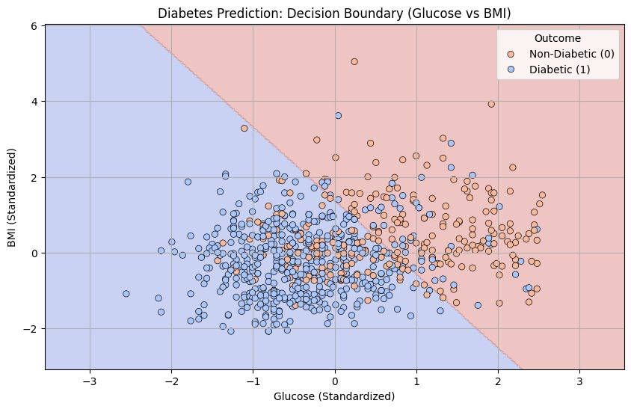
Training the model
The model learns the weights for each feature (like Glucose, BMI, Age, etc.) that best separate diabetic and non-diabetic patients.
Logistic Regression internally uses maximum likelihood estimation to fit the best hyperplane between the two classes.

Slide 10
Correlation Analysis
Pregnancies & Age: 0.544 – Older women tend to have had more pregnancies.
Skin Thickness & BMI: 0.543 – Logical, as higher BMI often corresponds to more fat under the skin.
Glucose & Insulin: 0.419– Elevated glucose often corresponds with elevated insulin due to insulin resistance.
BMI & Blood Pressure: 0.281 – Obesity increases blood pressure.
Weak or Non-significant Correlations:
Insulin & Blood Pressure: 0.045 – Weak and not significant.
Pregnancies & Insulin: 0.025 – Very weak.
Age & BMI: 0.026 – Virtually no relationship.
Diabetes Pedigree Function & Age: 0.034 – Insignificant.

Slide 11
Correlation Analysis Conclusion
Glucose is the strongest individual predictor of diabetes in this dataset.
BMI, age, insulin, and skin thickness also play moderate roles.
All predictors except insulin and pedigree function show positive and statistically significant correlations with diabetes.
The predictors are not highly collinear, which is good for regression modelling.

Slide 12
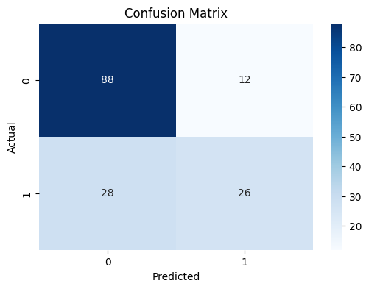
Model Evaluation
Confusion Matrix
Class 0: True Negatives(TN) and False Positives(FP)
Class 1: False Negatives (FN) and True Positives (TP)

Slide 13
Model Evaluation
Basic Metrics
TP = 26
TN = 88
FP = 12
FN = 28
Total samples = 88 + 12 + 28 + 26 = 154
2. Accuracy
Accuracy = (TP + TN) / Total = (26 + 88) / 154 = 74%
3. Precision (for class 1)
Precision = TP / (TP + FP) = 26 / (26 + 12) = 68.4%
4. Recall (Sensitivity, for class 1)
Recall = TP / (TP + FN) = 26 / (26 + 28) = 48.1%
5. F1 Score (for class 1)
F1 = (2 * Precision * Recall) / (Precision + Recall) = 56.5%

Slide 14
Model Evaluation
Interpretations:
Model performs well at identifying class 0 (negative class) with 88/100 accuracy.
Model struggles with class 1 (positive class) — it misclassifies 28 actual positives as negatives.
High false negatives (28) are concerning especially if class 1 is critical (e.g., diabetic patients being missed).
Recall for class 1 is low, indicating poor sensitivity.

Slide 15
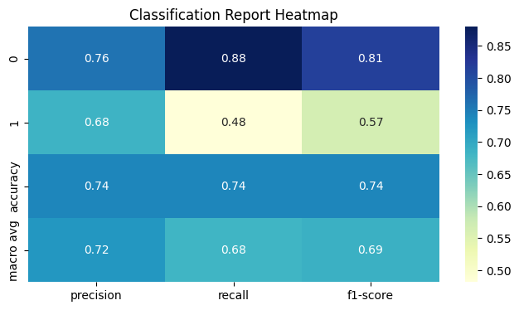
Model Evaluation
1. Precision₀ (for class 0)
Precision₀ = TP₀ / (TP₀ + FP₀) = 88 / (88 + 12) = 76%
2. Recall (Sensitivity, for class 0)
Recall₀ = TP₀ / (TP₀ + FN₀) = 88 / (88 + 28) = 88%
3. F1 Score (for class 0)
F1₀ = (2 * Precision₀ * Recall₀) / (Precision₀ + Recall₀) = 81%

Slide 16
Model Evaluation
Average Metrics
Precision: 0.72
Recall: 0.68
F1-Score: 0.69 Gives equal importance to both classes regardless of how many samples each class has.
Interpretations:
Balanced performance on class 0.
Weak detection of class 1 (low recall = many false negatives).
Macro F1-Score of 0.69 suggests room for improvement, especially in handling minority or harder-to-predict class.
If class 1 represents a critical class (e.g., disease detection), this performance is not reliable enough and needs fixing.

Slide 17
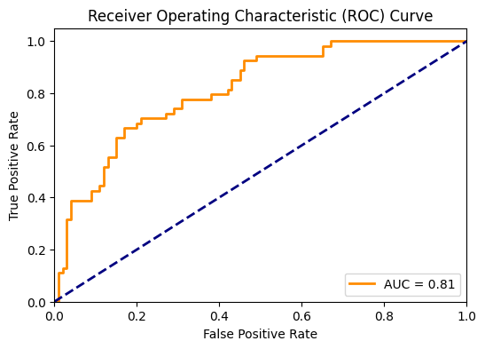
Model Evaluation
AUC (Area Under the Curve) = 0.81
AUC values range from 0.5 (random) to 1.0 (perfect).
An AUC of 0.81 is considered good, indicating the model has a strong ability to distinguish between the two classes.

Slide 18
Model Evaluation
Interpretations:
True Positive Rate is consistently higher than the False Positive Rate, across various thresholds.
The model performs much better than random guessing.
AUC = 0.81 means that:
There is an 81% chance that the model will rank a randomly chosen positive instance higher than a randomly chosen negative one.
Caveats:
Despite a good AUC, recall for class 1 is still low (0.48) — so threshold tuning may be needed.
AUC is threshold-independent. For high-recall or low-FN use cases (like disease detection), you must choose the right threshold, not just rely on AUC.

Slide 19
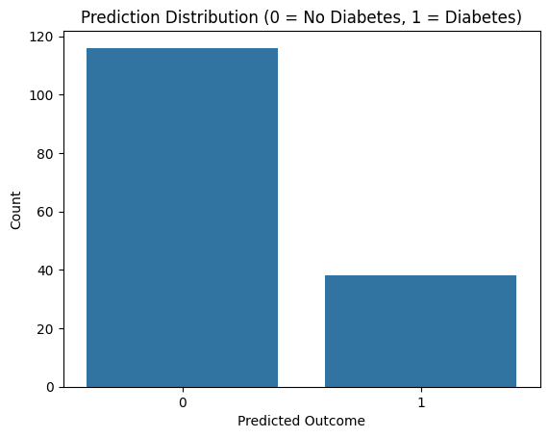
Model Evaluation
Class 0 (No Diabetes): Predicted ~115 times
Class 1 (Diabetes): Predicted ~38 times

Slide 20
Model Evaluation
Interpretations:
Our model predicts “No Diabetes” far more often than “Diabetes”.
This is consistent with your earlier confusion matrix and classification report, where:
Class 0 had high recall (0.88)
Class 1 had low recall (0.48)
The model appears to be biased towards the majority class (No Diabetes), leading to under-prediction of diabetes cases.
Caveats:
Imbalanced predictions indicate that the model might not be adequately capturing the patterns for the minority class (diabetes).
In medical applications, missing positive cases (false negatives) can be critical, so favoring class 0 is risky.

Slide 21
Key Insights
Most predictive features:
Glucose, BMI, and Age strongly influenced diabetes prediction.
Higher glucose levels significantly increased diabetes probability.
2. Model characteristics:
The model was simple (likely Naive Bayes) but effective for basic classification.
Demonstrated good AUC (0.81), suggesting strong class separability.

Slide 22
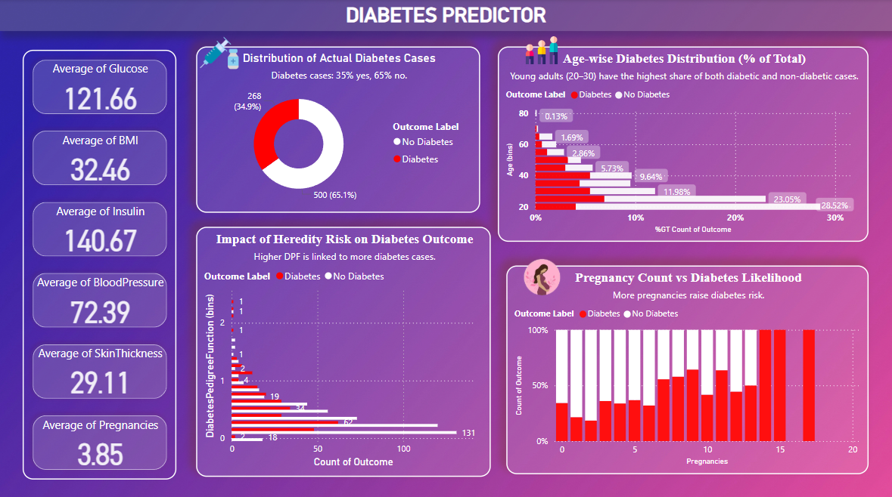

Slide 23
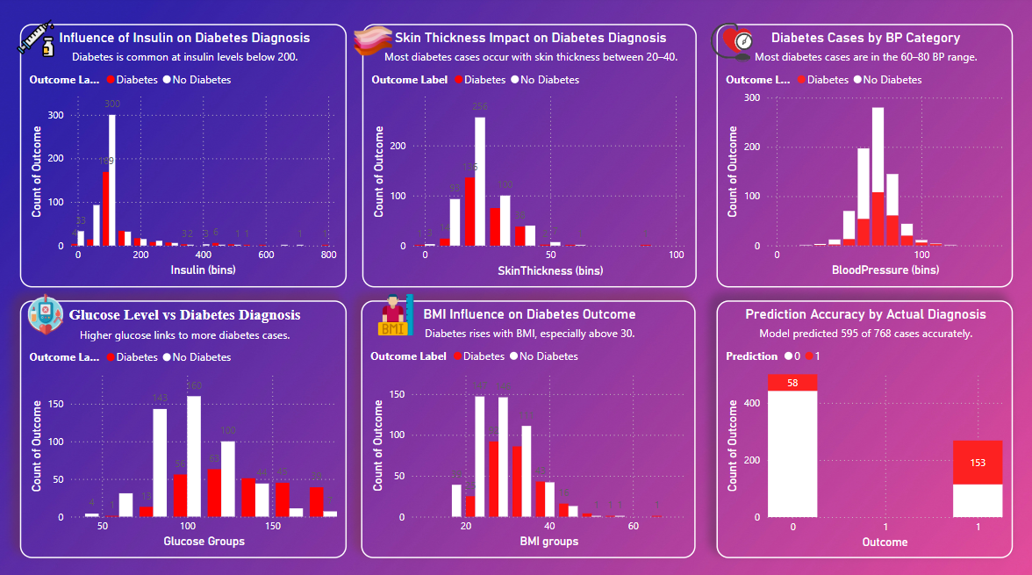

Slide 24
Thank You!

