Slide 1
DETECTION OF DEPRESSION FROM TWEETS

Slide 2
INTRODUCTION
Depression has become a major problem among people in Today’s times and in this pandemic ratio of Depressed people has been increased.
Most of the people suffering from depression are Youth and most of them use social media.
People uses social media to express their views and share their feelings so it is the good way of knowing someone’s state of mind through their posts.
In this Project , Subtext is made from the original text . Through subtext we’ll find the most common words that people write in their posts and will extract the information about the feelings depicts by the words according to sentiments.

Slide 3
LIBRARIES USED
Numpy
NumPy is a python library used for working with arrays.It also has functions for working in domain of linear algebra, fourier transform, and matrices . NumPy stands for Numerical Python.
In Python we have lists that serve the purpose of arrays, but they are slow to process . Numpy aims to provide an array object that is up to 50x faster that traditional Python lists.
Pandas
Pandas is an open-source Python Library providing high-performance data manipulation and analysis tool using its powerful data structures.
Prior to Pandas, Python was majorly used for data mining and preparation. It had very little contribution towards data analysis. Pandas solved this problem. Using Pandas, we can accomplish five typical steps in the processing and analysis of data, regardless of the origin of data — load, prepare, manipulate, model, and analyze.

Slide 4
SEABORN
Seaborn is a library for making statistical graphics in Python. It is built on top of matplotlib and closely integrated with pandas data structures.
Seaborn aims to make visualization a central part of exploring and understanding data. Its dataset-oriented plotting functions operate on dataframes and arrays containing whole datasets and internally perform the necessary semantic mapping and statistical aggregation to produce informative plots.
NLTK(NATURAL LANGUAGE TOOLKIT)
It provides easy-to-use interfaces to over 50 corpora and lexical resources such as WordNet, along with a suite of text processing libraries for classification, tokenization, stemming, tagging, parsing, and semantic reasoning, wrappers for industrial-strength NLP libraries
SPACY
Spacy is a free, open-source library for advanced Natural Language Processing (NLP) in Python.
spaCy is designed specifically for production use and helps you build applications that process and “understand” large volumes of text.

Slide 5
PROJECT DESCRIPTION
Data collected consist of twitter comments having
features selected_text , text and text_id.
Data was preprocessed by adding features like number of words in text , number of words in selected_text and Jaccard_score.
With the help of Jaccard score similarity, It will be find that selected_text is related to text so we can use selected_text for training.
Model need to be trained separately for positive , negative and neutral tweets. Firstly,Overall common words will found and then common words extracted according to sentiments.

Slide 6
PROJECT DESCRIPTION (Contd.)
From all the common words , all the unique positive , negative and neutral words were separated . Analysis of common words needs to be done separately for classification. Now with the help of spacy, these words will be fitted to the model separately.
It will predict the selected_text in terms of common words so that it will easy to extract the hidden message and to know what osomeone want to say clearly.

Slide 7
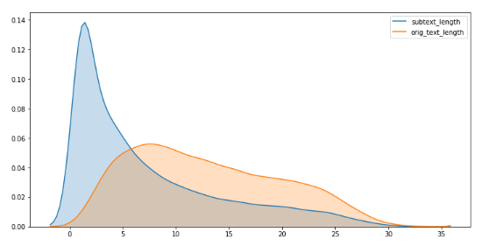
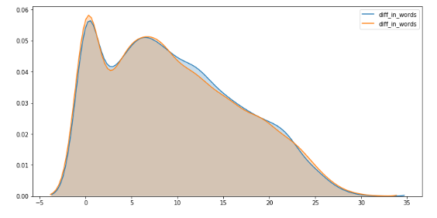
Conclusion From Comparing length of Original Texts And Subtexts
First Graph shows that length of original text of comments is distributed widely but subtext distribution is skewed . Therefore , it will be more easy to use subtext for finding most common words .
Second Graph shows that there is a large variation in difference of number of words of original text and sub text.

Slide 8
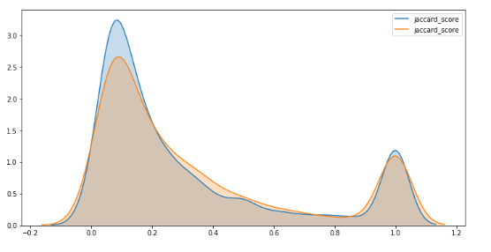
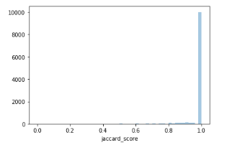
Conclusion From Jaccard Score
First Graph shows Positive and negative tweets have high kurtosis and thus values are concentrated in two regions narrow and high density
Second Graph shows Neutral tweets have a low kurtosis value and their is bump in density near values of 1.

Slide 9
Conclusion From EDA
We can see from the jaccard score plot that there is peak for negative and positive plot around score of 1 .That means there is a cluster of tweets where there is a high similarity between text and selected texts ,if we can find those clusters then we can predict text for selected texts for those tweets irrespective of segment.
For sentence having words less than three , we can use original text instead of subtext as for that clusters of words jaccard score will be high as mentioned above.
This information will be used further in model building and it will improve accuracy of our model.

Slide 10
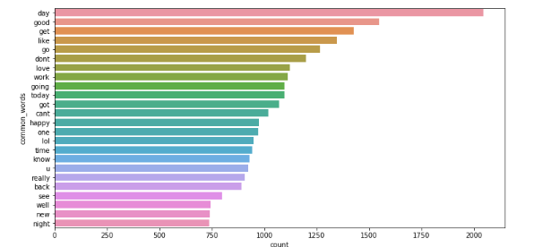
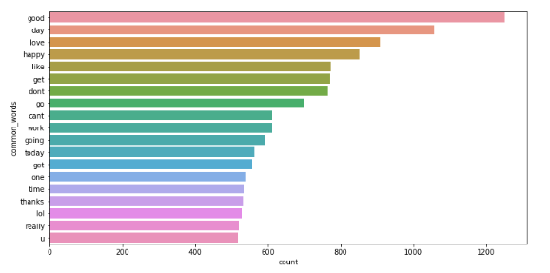
COMMON WORDS
These are the overall common words for selected_text and text.
From both graphs, it is clearly seen that most of the common words in
original text and selected text are similar as selected_text resembles to
Original text to alarge extent.

Slide 11
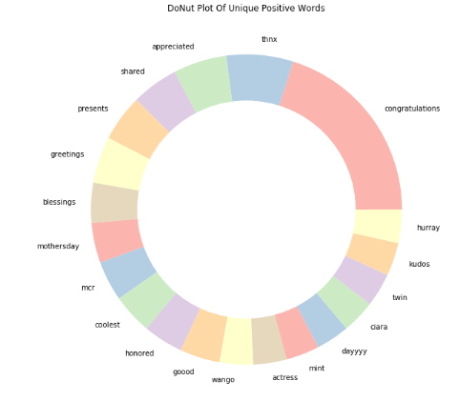
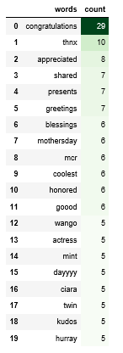
UNIQUE COMMON WORDS
For positive sentiment:-These are the words people use when they’re feeling good.

Slide 12
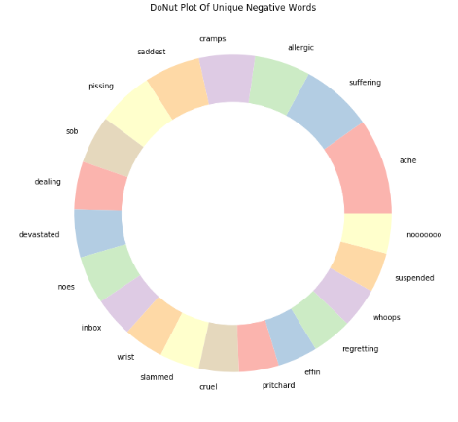
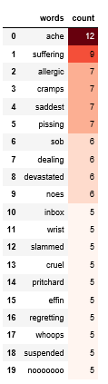
UNIQUE COMMON WORDS
For Negative sentiment:-These are the words people use when they’re feeling sad and depressed.

Slide 13
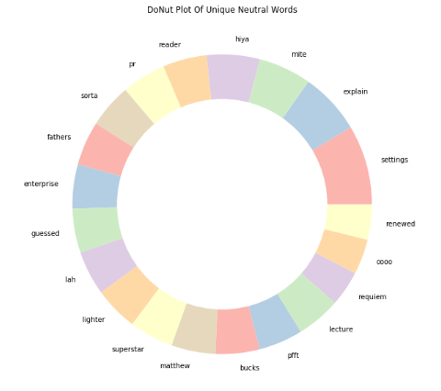
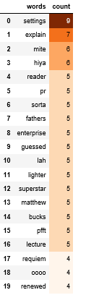
UNIQUE COMMON WORDS
For Neutral sentiment:-These are the words people use when they’re in normal mood.

Slide 14
Modelling With Ner
Model will be trained separately for each
sentiment. For test_data , model will predict selected_text and in test_data sentiments , text and text_id are the features which are already given.
Text will be used as selected_text for all neutral tweets due to their high jaccard similarity
Also text will be used as selected_text for all tweets having number of words less than 3 in text as explained before
It will not preprocess the data because the selected text contains raw text

Slide 15
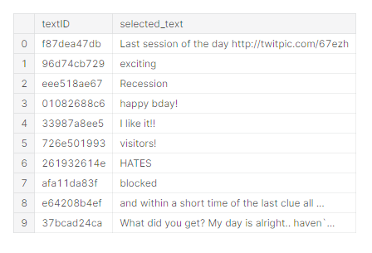
results
As we trained model to predict selected_text, this is how it works. We can see that most of selected_text are small , easy to read and predict the feelings of person.

