Slide 1
Computer Engineering Department
A.P. Shah Institute of Technology
G.B.Road,Kasarvadavali, Thane(W), Mumbai-400615 UNIVERSITY OF MUMBAI
Academic Year 2020-2021

Slide 3
SIGN LANGUAGE RECOGNITION
A Project Report on
Submitted in partial fulfillment of the degree of
Bachelor of Engineering(Sem-VI)
in
Computer Engineering
By
Chirag Hegde (19102035)
Nidhi Singh (19102042)
Nidhi Heniya (19102041)
Ishanee Revankar (19102040)
Under the Guidance of
Prof. Sofiya Mujawar

Slide 4
1.Project Conception and Initiation

Slide 5
1.1 Abstract
Sign language is the only way of communication for people with hearing and speaking inability.
facial expression
body movements for communication.
Sign Language Recognition, recognizes ISL and converts them into human readable english text. Our focus is on recognizing sign language representing 0 to 9 numbers and A to Z alphabets, by training the machines with static images.
It is a machine learning project in which the algorithm used is Convolutional Neural Network.
We have created our own dataset containing about 250 black and white images of each symbol.

Slide 6
We know that Language is a bridge to communicate with each other.
There are about 7100 number of languages spoken by people all around the world.
-but these are spoken languages i.e verbal languages
apart from these, there also exist many non-verbal languages which are not spoken but rather understood by gestures or scripts-
Barielle, Sign Language
Talking about Sign language, it a language used by deaf or people with inability to speak.
According to the reports there are total of 300 different Sign Languages used by around 70 million people in the world and that is huge number.
In India itself there are 6 Crore people who use ISL to communicate.
again a big number
-yet we, here in India, don’t have enough programs that supports SL using technology. Considering, integrating modern technology to any field enhances it and makes it x times more efficient.
So, we in this project are trying work on integrating machine-learning to work on SIGN LANGUAGE DETECTION

Slide 7
1.2 Objectives
The objective of our project is to build a system which recognizes Indian Sign Language.
To detect signs gestured (in ISL).
To convert the detected signs to English language and display them.
To detect signs for numbers 0-9 and alphabets A-Z

Slide 8
1.3 Problem Definition
Detecting the sign language for numbers 0-9 and alphabets in ISL(Indian Sign Language) using Machine Learning.

Slide 9
1.4 Scope
Sign Language Recognition is a machine-learning based project.
Once the user opens web-cam -> signs a gesture -> the sign is recognized -> corresponding detected sign’s text is displayed.
The proposed method uses digital image processing techniques and neural networks for recognizing different signs. In our project we will be focusing on recognizing hand movements for sign language interpretation.
Mainly steps involved in sign language recognition are feature extraction and classification.
Our proposed method uses CNN for gesture recognition.

Slide 10
1.5 Technology stack
The project uses PYTHON language to implement it.
The code is implemented in Visual Studio.
The project is implemented on Windows 64-bit operating system.
Opencv tool is used to create the front end platform
Google colab is used for testing the model

Slide 11
1.6 Benefits for environment & Society
Around 1% of population all around the world uses Sign-Language to communicate and convey. This is almost around 70 million people, which is a very large number. This many people have a way of communication which is not understood by or is known to majority of people in the world.
People are not familiar with Sign Language since it is not that popular or is not given that much of importance, due to which people who use sign-language are at a disadvantage. Since they might not be able to communicate easily.
This project eases this part out, by providing a platform which recognizes sign language and converts it into text , it can be used by abled people to get to know what signs are exactly gestured by a person and can reply accordingly.
Sign Interpreters do the same work, but the issues is they charge money and are not handy.

Slide 12
2. Project Design

Slide 13
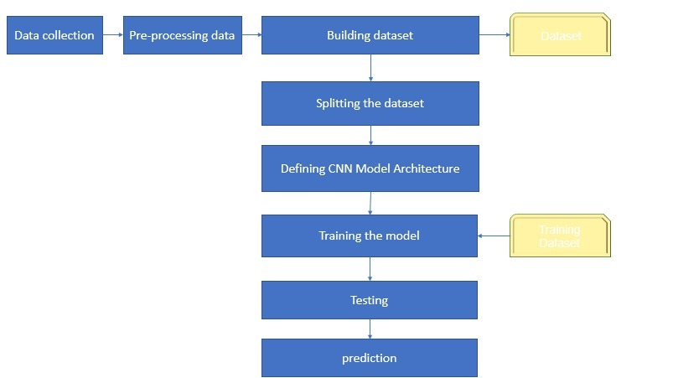
2.1 Proposed System

Slide 14
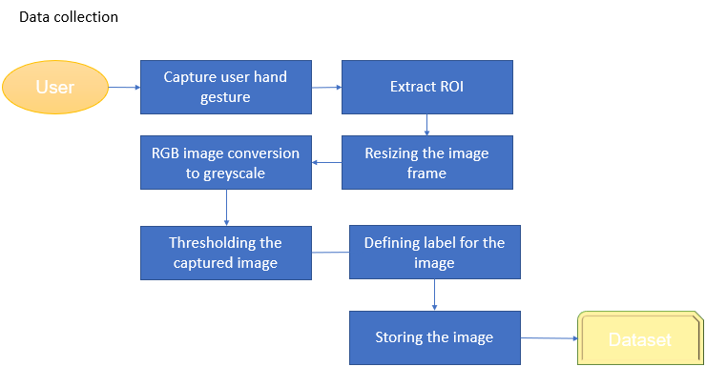

Slide 15
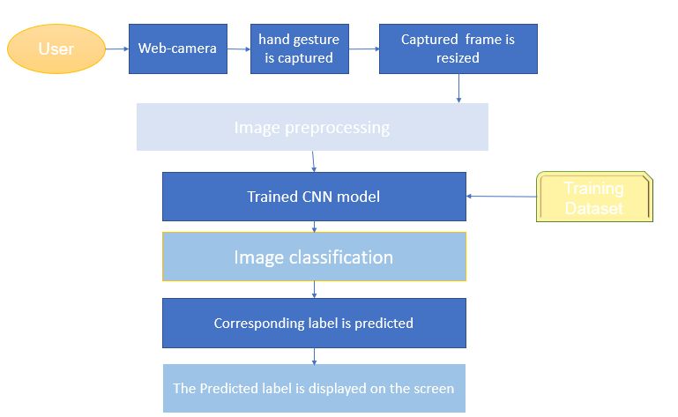
PREDICTION

Slide 16
Pre-conditions
Light background
No source of light should fall on the hands

Slide 17
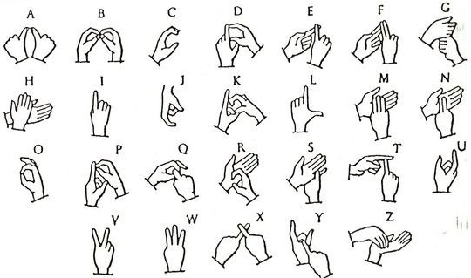
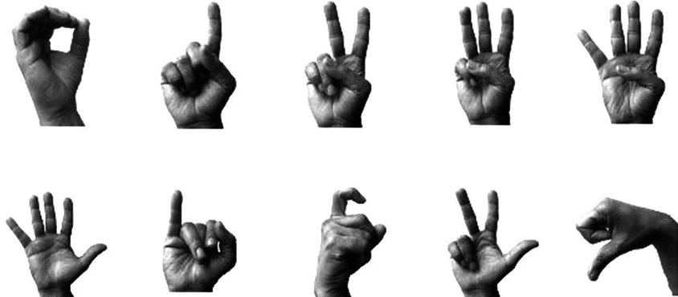
ISL for alphabets
ISL for numbers

Slide 18
3.Implementation

Slide 19
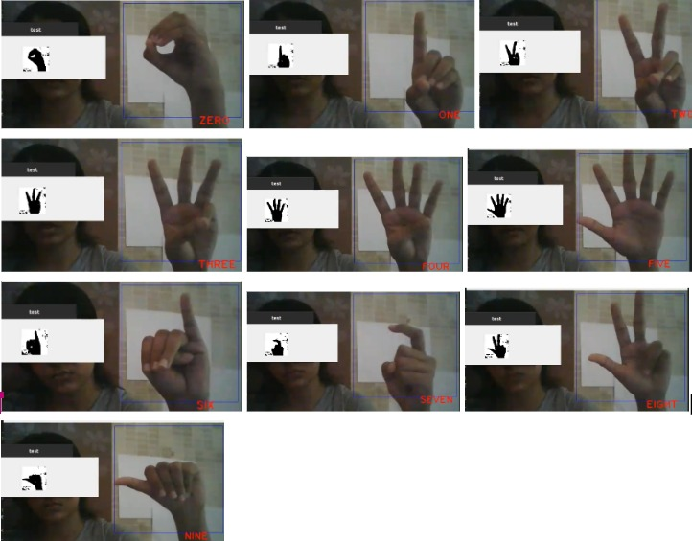
Detection Of Signs Of Numbers 0-9

Slide 20
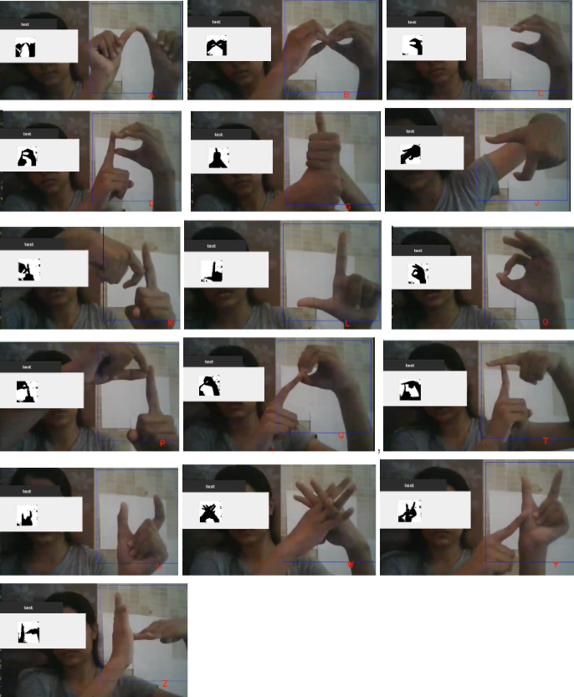
Detection Of Signs Of Alphabets A-Z

Slide 21
LITERATURE REVIEW
Lionel sir has used Microsoft kinect to record video ,CNN to train the model and their dataset consist of about 20 different italian gestures performed by 27 users.
For preprocessing they have applied threshold to image and removed the background.
During training, dropout and data augmentation are used as main approaches to reduce overfitting.
The accuracy on the test set is : 95.68%
False positive Rate:4.13%
The proposed method uses digital image processing techniques and artificial neural network for recognizing different signs.
Dataset of Indian sign language: Alphabet and numerical captured with black background
It uses a skin colour based segmentation with YCbCr colour space.
The training dataset contains 360 images with 10 images of each of the 36 signs.
Recognition accuracy is of 91.11%
Recognizes Indian Sign Language
Dataset : 320 images, 10 each of 32 signs.
For processing : Palm Image Extraction, Sign Detection , Edge Detection

Slide 22
3.1 Conclusion
This project successfully detects the signs and converts it to text.
In future this will be extended to detecting sign language as whole, i.e including greetings and complete sentences.
We are planning to make this system dual-side useful, i.e along with abled people, disabled people too would be able to use it. Guides to ISL and videos for basic greeting and useful signs will be included.
“Reduced communication gap” is to be achieved.

Slide 23
References
[1] Lionel Pigou ( B ) , Sander Dieleman, Pieter-Jan Kindermans, and Benjamin Schrauwen ELIS, “Sign Language Recognition Using Convolutional Neural Networks “,Ghent University, Ghent, Belgium
[2] Adithya V. , Vinod P. R. , Usha Gopalakrishnan,”Artificial Neural Network Based Method for
Indian Sign Language Recognition” ,Proceedings of 2013 IEEE Conference on Information and Communication Technologies (ICT 2013)
[3] P. Subha Rajam Dr. G. Balakrishnan,“Real Time Indian Sign Language Recognition
System to aid Deaf-dumb People”,J.J. College of Engineering & Technology,Trichy, Tamilnadu, India.

Slide 24
Thank You!

