Slide 1
AI-POWERED LIFESTYLE ASSESSMENT
Multilingual Clinical
Dialogue System
Presented by Nidhi Sinha & Sarvesh Parab
Django · Next.js · Groq · scispaCy · ChromaDB
Notes:
Title slide. Introduce the project in one line: an AI assistant that collects lifestyle history during a clinical conversation in the patient's own language and hands the doctor a scored, reviewable summary.

Slide 2
Problem, Solution & Objectives
THE PROBLEM
THE SOLUTION
An AI assistant collects lifestyle information during the doctor–patient conversation in the patient's own language, scores it against a fixed clinical rubric, and gives the doctor a reviewable summary with guideline-backed recommendations.
Many diseases are strongly influenced by lifestyle habits
Doctors have limited consultation time
Patients may forget to mention lifestyle habits
Language barriers make detailed history-taking harder
Lifestyle information is often incomplete
Important health risks may go unnoticed
OBJECTIVES
1
Collect lifestyle info during clinical conversations
2
Analyse habits across 8 lifestyle areas
3
Detect possible lifestyle-related health risks
4
Generate a deterministic Lifestyle Wellness Score
5
Give guideline-grounded personalised advice
6
Give doctors a reviewable, editable summary
Notes:
The gap is not that doctors don't know lifestyle matters - it's that there is no time to ask systematically, and language makes it harder. The six objectives follow from that; objective 4 is the key one: deterministic means the score is computed by a fixed rule table, not generated by the AI.

Slide 3
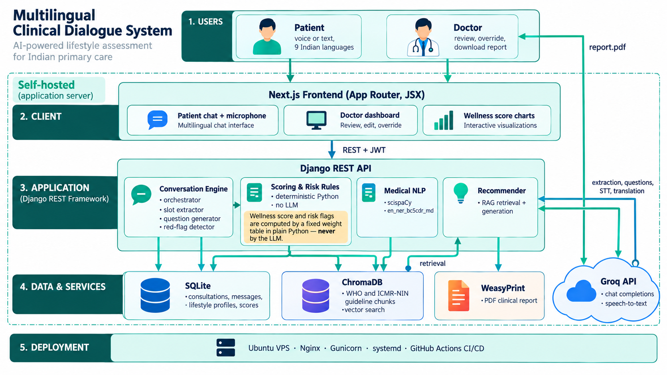
System Workflow & Architecture
1
Patient Speaks
Voice or text, 9 languages
2
AI Asks Questions
One lifestyle area at a time, in the patient's language
3
Patient Answers
Extracted into structured fields with a source quote
4
System Analyses
Score and risk flags computed in plain Python
5
Doctor Reviews
Summary, score, risks, recommendations, PDF
Emergency override
Chest pain, breathlessness, stroke signs or similar stop the questionnaire immediately; the consultation is flagged Escalated and the patient is told to seek in-person care now.
Notes:
Walk the five steps top to bottom, then point at the red box: this is the safety branch - it fires before any lifestyle question and stops the questionnaire entirely. The diagram on the right shows how the Next.js client, Django REST API, Groq LLM, scispaCy NER and ChromaDB guideline store fit together.

Slide 4
Assessment, Risks & Recommendations
The AI asks about 8 lifestyle areas one at a time, extracts structured values from free speech, runs medical NER for symptoms, flags risks and retrieves cited guidelines. Real output below.
CLINICAL SUMMARY
RISK FACTORS DETECTED
AI RECOMMENDATIONS
Symptoms: fatigue (2 weeks), mild headaches, no fever
Poor sleep — 5 hrs/day, below 6-hr threshold
Sedentary lifestyle — no exercise, 9 hrs sitting
High stress
Unhealthy diet — frequent fast food
Low water intake — 1 L/day
Obese (BMI) — BMI 27.0 ≥ Asian-Indian cutoff 25.0
Possible hypertension — 3 contributing factors
Build up to 150 min of moderate activity per week
WHO Physical Activity Guidelines, p.42
Replace fast food with fruits, vegetables, whole grains
ICMR-NIN Dietary Guidelines, p.88
Short yoga / pranayama bouts, 5–10 min several times a day
ICMR-NIN Dietary Guidelines
Increase water intake to 2–3 litres a day
Aim for 7–8 hrs of sleep with a consistent bedtime
Every recommendation is retrieved from a real guideline PDF with its page; no match → general guidance, never an invented citation.
Sleep
5 hrs/day
Exercise
None
Diet
Frequent fast food
Water intake
1 litre/day
Stress
High
Sitting
9 hrs/day
Smoking
No
Alcohol
Occasionally
Wellness Score
34 / 100 — Poor
Notes:
The eight areas: sleep, exercise, smoking, alcohol, diet, water, stress, sitting. Order is fixed but wording adapts. The left panel is real output from the running system - the 34/Poor result is in the seeded demo data and test suite. The page citations on the right are the important part: each recommendation is traceable to a real guideline document.

Slide 5
Technology & Wellness Scoring
Speech Processing
Groq Speech-to-Text API — transcription & translation
Wellness Score: deterministic, not AI-generated
1
The AI only fills in values; the score is a fixed weight table in plain Python — same inputs, same score, auditable line by line.
2
Conversational AI
Groq · openai/gpt-oss-120b — extraction & question generation
Factor | Weight | Full marks when
Sleep | 15 | 7–9 hrs/day
Exercise | 15 | ≥150 min/week
Diet | 15 | Balanced
Stress | 15 | Low
Smoking | 15 | None
Alcohol | 10 | None
Sitting | 10 | Under 6 hrs/day
Water | 5 | 2–3.5 L/day
3
Medical NLP
scispaCy en_ner_bc5cdr_md — symptom & disease NER
4
NLP Processing
Named Entity Recognition + regex unit parsing
5
Knowledge Retrieval
ChromaDB · RAG over WHO and ICMR-NIN guideline PDFs
80–100
Good
60–79
Fair
40–59
Needs attention
< 40
Poor
6
Backend & Frontend
Django + DRF · SQLite · Next.js
Unanswered areas are excluded, not scored as zero; under 4 of 8 answered → no score.
Both ends are bounded: 5 L of water a day is flagged for review, not rewarded.
Notes:
Most likely viva question: the LLM extracts values, Python scores them. If asked why scispaCy and not BioBERT: BioBERT needs PyTorch and several GB of RAM; scispaCy runs on CPU and deploys on a small VPS. Mention that both open ends are bounded and sparse data produces no score rather than a misleading one.

Slide 6
Safety, Impact & Conclusion
SAFETY GUARDRAILS
WHAT WAS BUILT
ADVANTAGES & USES
Never diagnoses or names medication
Red-flag symptoms → emergency escalation
Doctor can override any value; score recalculates live
Every value keeps the patient's words + confidence
Under 4 of 8 answers → no score
Age-matched advice; explicit consent first
Voice & text consultation in 9 languages
8-area assessment with slot-by-slot extraction
Deterministic scoring + 10 risk rules incl. BMI
RAG recommendations cited to WHO & ICMR-NIN
Doctor dashboard with live re-scoring
PDF report with full Indic script support
Preventive care and early chronic-risk detection
Saves doctors' consultation time
Works in the patient's own language
Diabetes, hypertension & obesity care
Cardiovascular disease prevention
Telemedicine and rural multilingual hospitals
Transforming clinical conversation into comprehensive health evaluation
By combining symptoms, lifestyle habits, AI-based risk analysis and cited recommendations, the system supports preventive healthcare and better clinical decisions.
Thank You
Notes:
Have the guardrails ready for 'what if the AI is wrong?': no AI output reaches the patient unreviewed - the doctor can override every value and the score recalculates. 'What was built' turns the deck from a proposal into a result. Close here; if there is time, demo the doctor dashboard with live re-scoring.

