Slide 1

Towards Transparent Crime Prediction: A Random Forest and XAI Approach
Nidhiben Patel

Slide 2
What is XAI and why it’s important?
Explainable AI (XAI) is a set of techniques and processes that make artificial intelligence (AI) systems more transparent and understandable to humans. In simpler terms, it's about making AI less of a "black box" and more of a "glass box" so we can see how it arrives at its decisions. (1)
XAI helps uncover hidden biases in AI models by revealing which factors are most influential in their predictions.
XAI makes AI systems more transparent, interpretable, and trustworthy, which is crucial for their responsible development and deployment.(2)

Slide 3
Research Questions guiding the review.
how to improve the transparency and interpretability of crime prediction models?
How does the integration of XAI techniques improve the transparency of crime prediction models?
What are the specific limitations of existing crime prediction models?

Slide 4
Literature review
Crime Prediction Using Machine Learning and Deep Learning: A Systematic Review and Future Directions(3) 2023
This paper aims to predict crime using machine learning and deep learning techniques. It reviews over 150 articles to provide insights into datasets and methodologies. The goal is to enhance prediction accuracy and assist law enforcement strategies.
Covers crime analysis, spatial analysis, human behavior analysis, and social media analysis and Discusses 40 different datasets.
Limitations:
Data quality issues
Overfitting in some models
Limited discussion on interpretability of deep learning models

Slide 5
Literature review
Artificial Intelligence & Crime Prediction: A Systematic Literature Review(4) 2022
Investigates AI strategies in crime prediction by reviewing 120 research papers published between 2008 and 2021. Identifies crime categories, methodologies, and techniques used, with supervised learning being the most applied..
Categorizes crime analysis types into five aspects: crime analysis, spatial analysis, human behavior analysis, social media analysis, and others.
Limitations:
Time constraints in research
Bias and fairness issues in models
Data availability challenges

Slide 6
Literature review
Machine Learning in Crime Prediction(5) 2023
Evaluates state-of-the-art crime prediction techniques over the last decade, discussing challenges and future work. Reviews 68 machine learning papers focusing on methodologies and datasets.
Covers crime analysis, spatial-temporal crime hotspot prediction, suspect prediction, feature selection, and social media crime prediction.
Future Directions: Recommends focusing on explainable AI, new deep learning models, unsupervised learning, developing new public datasets, cross-country models.
Limitations:
Computational challenges and efficiency issues
Lack of labeled data in real-world scenarios
Limited interpretability of complex models

Slide 7
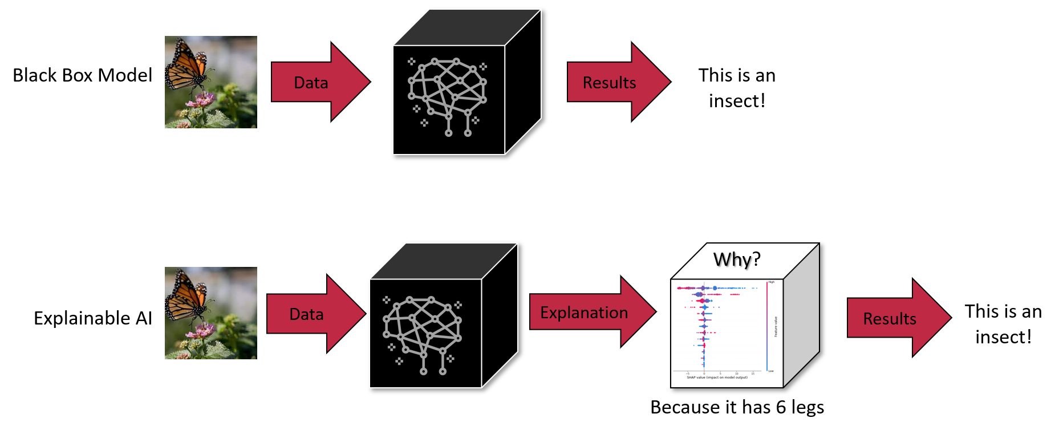
Research Gaps and Significance
Lack of Interpretability
Bias and Fairness
Robustness and Generalizability

Slide 8

Goal
This project aims to address these critical gaps by developing a robust and explainable crime prediction model using Random Forest and Explainable AI (XAI) techniques. By focusing on transparency, data quality, bias mitigation, and handling complex features, our project seeks to create a more reliable and ethically sound crime prediction system. This will enhance decision-making in law enforcement, build trust in AI solutions, and ultimately contribute to safer communities.

Slide 9
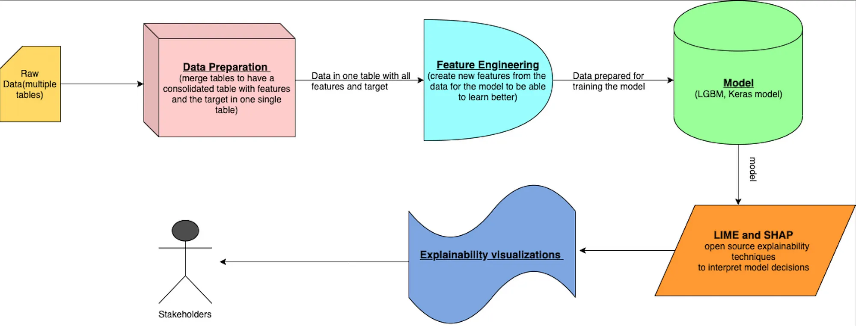
Next Steps(most likely?!)

Slide 10
References
1.https://www.paloaltonetworks.com/cyberpedia/explainable-ai#:~:text=XAI aims to make AI,at their decisions or predictions.
2. https://www.ibm.com/think/topics/explainable-ai
3.10.1016/j.ssaho.2022.100342
4.10.1109/ACCESS.2023.3286344
5.https://doi.org/10.1007/s12652-023-04530-y
6. Image: https://www.markovml.com/blog/lime-vs-shap

