Slide 1
Design and implementation of web scrapping using beautiful soup

Slide 2





INTRODUCTION TO WEB SCRAPING
Web scraping is the process of
from websites. It involves fetching a web page and its content to
gather useful information. This
presentation will cover various
and to help you master web scraping e ectively.

Slide 3




UNDERSTANDING WEB SCRAPING
Web scraping can be deﬁned as the automated method of
from the internet. It is essential for
, market research, and competitive intelligence. Understanding
its and implications is crucial for responsible usage.

Slide 4






COMMON TOOLS AND LIBRARIES
Several tools and libraries facilitate web
scraping, such as
, and
,
. Each has its
and , making
them suitable for di erent scraping tasks. Choosing the right tool is critical
for e cient data extraction.

Slide 5


HTTP REQUESTS EXPLAINED
Understanding is fundamental for web scraping. You need to know how to send requests to a server and handle responses. and
methods are the most common, and knowing their di erences is
essential for successful scraping.

Slide 6
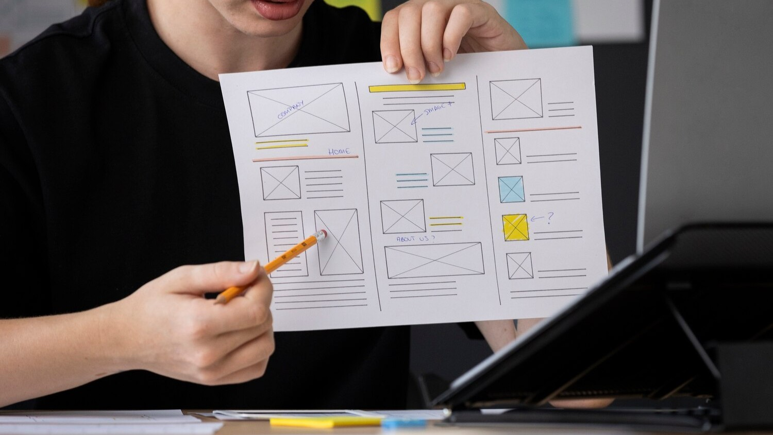

HTML STRUCTURE BASICS
To scrape data e ectively, familiarity with
is necessary. Knowing how to navigate the (Document Object
Model) helps in identifying the right
elements to extract. This knowledge is
crucial for targeting speciﬁc data points on a web page.

Slide 7




HANDLING DYNAMIC CONTENT
Many websites use to load content dynamically. Tools like
or can emulate a browser to scrape such data. Understanding how to handle calls and endpoints is also vital for e ective data extraction.

Slide 8



RESPECTING ROBOTS.TXT
Before scraping a website, always check its ﬁle. This ﬁle indicates which parts of the site can be
crawled or scraped.
is important to avoid legal issues and ensure ethical scraping practices.

Slide 9





DATA CLEANING TECHNIQUES
After data extraction, it’s essential to clean the data for analysis. This involves
removing , handling
, and formatting data correctly.
E ective data cleaning ensures that your analysis is based on and
information.

Slide 10




STAYING ANONYMOUS WHILE SCRAPING
To avoid getting blocked by websites,
consider using and
.
Rotating your IP addresses and mimicking di erent browsers can help maintain . This practice is crucial for scraping multiple pages without detection.

Slide 11




ERROR HANDLING STRATEGIES
Errors can occur during web scraping due to various reasons, such as
or changes in website structure. Implementing error handling strategies,
like and logging
errors, can improve the robustness of your scraping scripts.

Slide 12



BEST PRACTICES FOR WEB SCRAPING
To master web scraping, adhere to best practices such as
, minimizing requests to avoid server overload, and maintaining a
. Following these guidelines will enhance your scraping
e ciency and reliability.

Slide 13


CONCLUSION AND FUTURE TRENDS
In conclusion, mastering web scraping requires understanding various techniques and adhering to best practices. As technology evolves, staying updated on and in web scraping will be essential for continued success in data extraction.

Slide 14
Thanks!

