Slide 1

Project: “an Automated object detector”
Description:
This is a “cloud” based project that involves the integration of IoT devices for the detection of critical events.

Slide 2
INTRODUCTION AND ABSTRACT
INTRODUCTION:
Disasters such as earthquakes, wildfires, and floods require swift and effective response mechanisms to minimize casualties and damage. Traditional surveillance and rescue operations often face challenges like limited visibility, difficult terrain, and delays in data processing. To address these issues, we propose an AI-powered drone surveillance system that leverages cloud computing, real-time video analytics, and automated alert mechanisms to assist emergency responders.
ABSTRACT:
By leveraging AI and cloud technologies, this system enhances disaster response efficiency, reduces human risk, and provides crucial intelligence for faster decision-making. We use AWS lambda for compute, S3 for storage and SNS for notification, Amazon Kinesis for video streams especially SageMaker to build the AI model and so on. This system also ensures scalability and effectiveness.

Slide 3
PROPOSED SOLUTION
Our system integrates autonomous drones equipped with cameras and sensors to capture live footage of disaster-stricken areas. The video streams are transmitted via AWS Kinesis Video Streams and stored in Amazon S3, while metadata is logged in DynamoDB or RDS for structured analysis. AWS Lambda triggers AI models hosted on SageMaker or Fargate, which analyze the footage to detect survivors, collapsed buildings, fires, and other critical events. The processed data is visualized using AWS QuickSight on an interactive dashboard. In case of emergencies, the system automatically sends alerts through SNS (SMS and emails) to first responders. Emergency teams can then access real-time insights via an API-driven dashboard deployed on AWS API Gateway and CloudFront. Additionally, the entire system is backed up using AWS Backup and Multi-Region Deployment to ensure data integrity and availability. By leveraging AI and cloud technologies, this system enhances disaster response efficiency, reduces human risk, and provides crucial intelligence for faster decision-making.

Slide 4
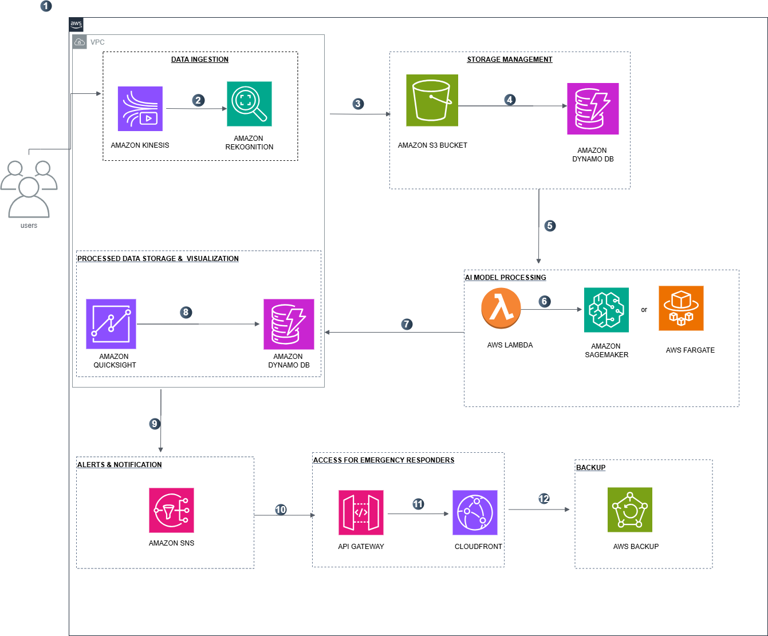
ARCHITECTURE DIAGRAM
DESCRIPTION:
The drones captures images/videos via Kinesis Video streams to AWS.
The footage is stored in Amazon S3 and the metadata is logged in DynamoDb.
Then, the Aws Lambda triggers the AI model in Sagemaker/Fargate to analyze the footage.
The AI model detect the survivors . Now the processed results are stored in DynamoDB and visualized on the QuickSight powered Dashboard.
If a critical event is detected, SNS alerts to the emergency teams.
Emergency team access the dashboard via API Gateway & Cloudfront.
Finally, the data is backed up automatically via AWS Backup.

Slide 5
USE-CASES AND DEPENDENCIES
USE-CASES:
Disaster Search and Rescue Operations:
and Monitoring.
Wildfire detection and monitoring.
Landslide and avalanche detection
Flood Monitoring and evacuation planning.
Real-time Incident alerts for Emergency Responders.
Environmental Monitoring and wildlife Protection.
DEPENDENCIES:
AWS Kinesis for video streaming
AWS Rekognition
AWS S3
DynamoDB
AWS Lambda
Amazon SageMaker/Amazon Fargate
Amazon QuickSight
Amazon SNS
API Gateway
Cloudfront
AWS Backup

Slide 6
CONCLUSION
Thus, from this project we create a cloud surveillance system for disaster recovery. Our system integrates autonomous drones equipped with cameras and sensors to capture live footage of disaster-stricken areas. By this we can locate the survivors in any aspects and alert the emergency teams if any critical system is found. This method will be quick , time saving and also cost effective.

