Slide 1
COMP 3311 Database Management Systems
Lab 2
Oracle Database, SQL*Plus and SQL Developer

Slide 2
Lab Topics
What is Oracle Database; SQL*Plus; SQL*Plus script file.
How to connect to Oracle Database using Oracle SQL Developer.
How to create and execute SQL*Plus script files in Oracle SQL Developer.
How to create, modify and list the contents of an Oracle Database table.

Slide 3
Why Oracle Database?
Oracle Database is one of the most widely used commercial DBMSs; you are likely to use it at some point in the future.
Other relational DBMSs are very similar to Oracle Database.
You should be able to program with any other relational DBMS if you are familiar with Oracle Database.

Slide 4
Oracle Database
The first commercially available relational DBMS.
The CSE labs provide Oracle Database 19c.
Earlier versions can also be used for the course.
You can download the free Oracle Database Express Edition (XE) to install on your own computer from
https://www.oracle.com/database/technologies/xe-downloads.html
Requires registration/login; only Windows, Linux available. (Sorry Mac users; you should complain to Oracle.)

Slide 5
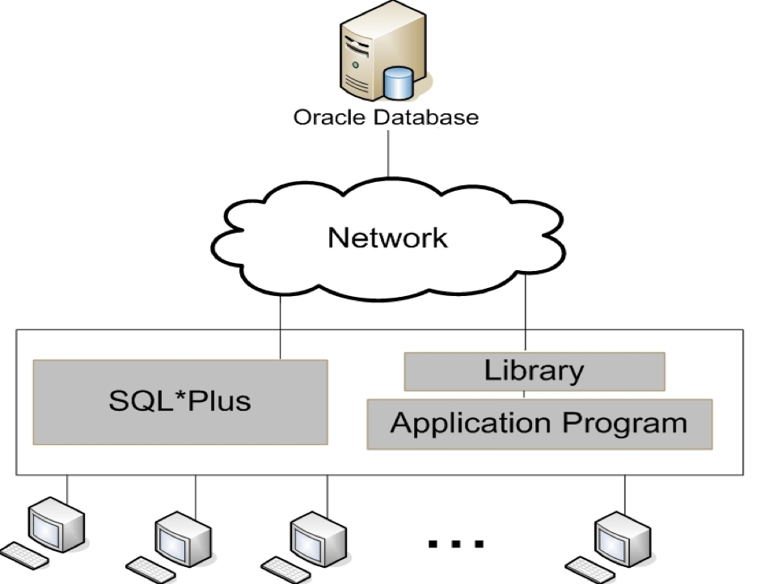
The Oracle Client/Server Model
Clients accept SQL statements/ commands from users and send them to the Oracle Database server over a network.
The Oracle Database server executes the queries and returns the results to the clients, which then deliver the results to the user.
The Oracle Database server for this course is dbsvr1.cse.ust.hk.
The database resides on a server and is managed by Oracle Database.
Clients access a database through various interfaces.
The Oracle Database server can be accessed directly only from the computers in Lab 4 (room 4210). From other computers, including other CSE labs, it needs to be accessed through the HKUST VPN (see http://itsc.ust.hk/apps/vpn/ for how to connect to the HKUST VPN).

Slide 6

SQL*Plus
SQL*Plus is an interactive and batch query tool that enables SQL, PL/SQL, SQL*Plus and operating system commands to be executed.
SQL*Plus allows users to:
format, perform calculations on, store and print query results;
examine table and object definitions;
develop and run batch scripts;
perform database administration.
The SQL*Plus client can be run from SQL Developer or from an OS command line.
SQL statements
SQL*Plus client
Oracle
Database server
Query results
SQL statements
SQL script file

Slide 7
Oracle SQL Developer
Oracle SQL Developer provides a desktop-like interface to the SQL*Plus client allowing users to:
browse, create, edit, and delete tables;
run SQL statements and scripts;
edit and debug PL/SQL code;
manipulate and export data;
view and create reports.
Reminder: Download Oracle SQL Developer from
https://www.oracle.com/tools/downloads/sqldev-downloads.html
Requires registration/login; Windows, Mac, Linux available. Latest version is 20.2 (requires JDK 8 or 11).

Slide 8
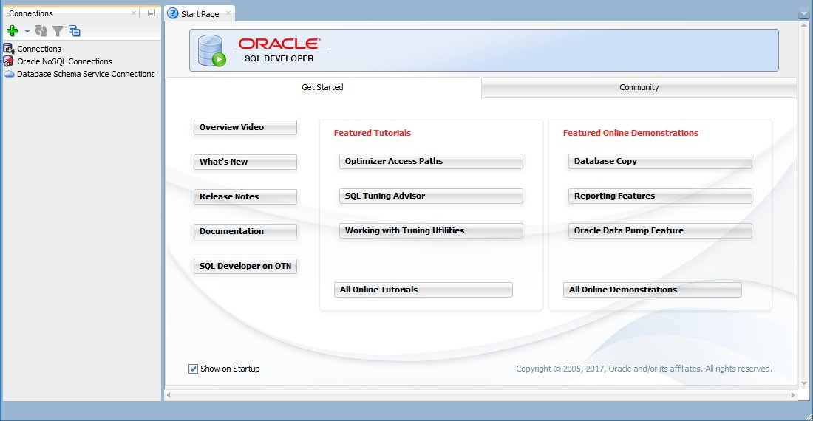
Connecting To Oracle Database Using Oracle SQL Developer (1)
Run the program “sqldeveloper”.
In Lab 4, search for the app “sql” and double click it.
Oracle SQL Developer opens in the Start Page shown above.

Slide 9
Connecting To Oracle Database Using Oracle SQL Developer (2)
Select the green “+” symbol in the Connections navigator (left-side) pane.
New Connection
The New / Select Database Connection dialog appears as shown on the next slide.

Slide 10
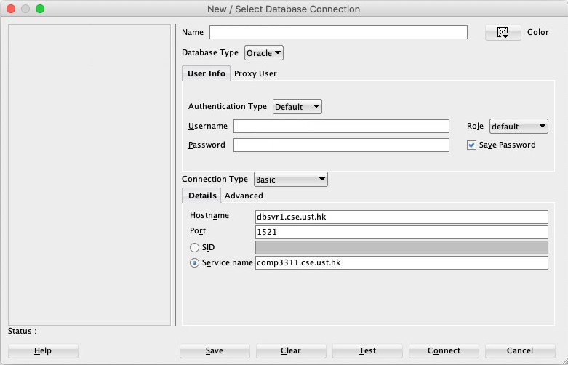
Connecting To Oracle Database Using Oracle SQL Developer (3)
Enter/select the information outlined below in red using your Oracle username and password for the Username and Password fields, respectively.
a meaningful connection name
your Oracle username
Your Oracle username will be sent to you by email and has the form "comp3311stuXXX" where XXX are digits.
your Oracle password

Slide 11
Connecting To Oracle Database Using Oracle SQL Developer (4)
Select the Test button (bottom middle of the New / Select Database Connection dialog) to check that the information entered is correct.
You should see the message Status: Success in the Status field near the lower left of the New / Select Database Connection dialog just above the Help button. Correct any errors.
Select the Save button to save the connection information for future use.
Select the Connect button.
You should see an SQL Worksheet like that shown on the next slide.

Slide 12
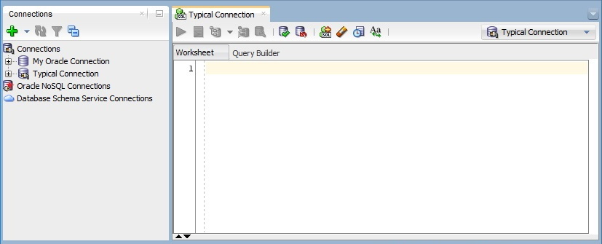
Connecting To Oracle Database Using Oracle SQL Developer (5)
Enter SQL Statement box
SQL Worksheet

Slide 13
SQL Worksheet
An SQL Worksheet is used to enter and execute SQL, PL/SQL and SQL*Plus statements.
There can be multiple worksheets open for a given connection.
You can create an SQL Worksheet by:
right-clicking a connection in the Connections navigator and selecting Open SQL Worksheet,
selecting Tools and then SQL Worksheet.

Slide 14
SQL Worksheet Toolbar
The SQL Worksheet toolbar contains the following buttons (among others).
Run Statement executes a single statement at the cursor or several selected statements in the Enter SQL Statement box.
Run Script executes all statements in the Enter SQL Statement box using the Script Runner.
Commit writes any changes to the database, ends the transaction and clears the Query Result and Script Output tabs.
Rollback discards any changes without writing them to the database, ends the transaction and clears the Query Result and Script Output tabs.
Clear erases the statements in the Enter SQL Statement box.

Slide 15
Opening And Executing A Script File
To open a script file:
select File→Open in the Oracle SQL Developer menu bar or select (the Open button) in the toolbar;
in the Open dialog, navigate to the script file;
double-click the script file or select it and select the Open button.
Alternatively, you can drag and drop a script file onto a worksheet in Oracle SQL Developer.
To execute (run) a script file, select (the Run Script button) shown in the example script on the next slide.

Slide 16
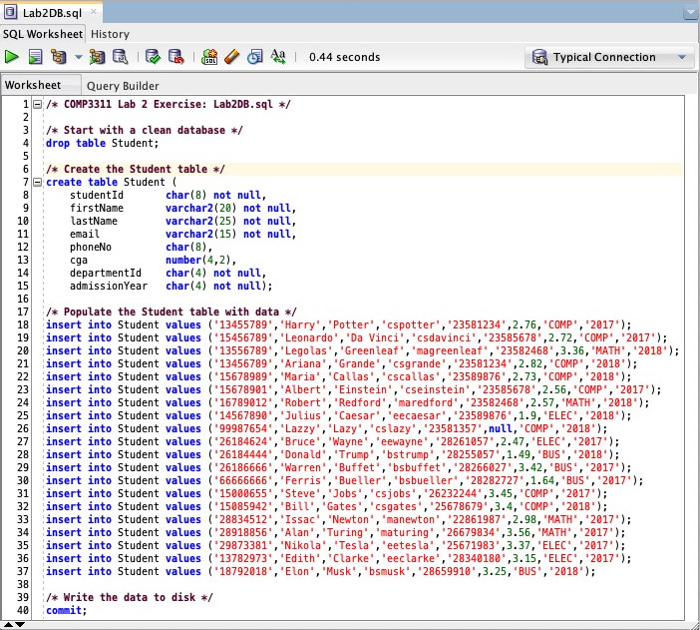
Example Script File
Run Script
Note: When you run the Lab2DB.sql script the first time you will get the error message:
Error starting at line : 4 in command -
drop table Student
Error report -
ORA-00942: table or view does not exist
00942. 00000 - "table or view does not exist"
*Cause:
*Action:
You may safely ignore this message; it is not an error.

Slide 17
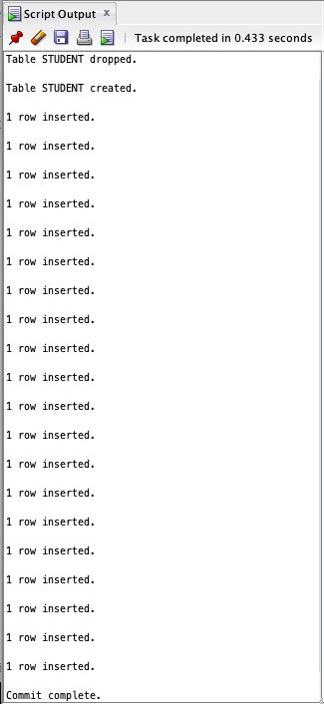
Script Output Tab
The Script Output tab displays the result of executing a script file; its toolbar has the following buttons:
Pin keeps the tab’s contents in the window when another object is selected in the Connections navigator.
Clear erases the tab’s contents.
Note: It is strongly recommended to clear a tab’s contents before running a script again.
Save File saves the tab’s contents to a file.
Print sends the tab’s contents to a printer.
Run Script Output as Script executes the tab’s contents as a script file.

Slide 18
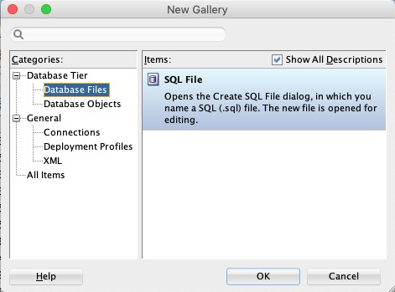
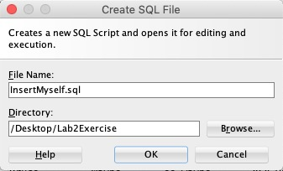
Creating A Script File
Select File→New in the Oracle SQL Developer menu bar or select (the New button) in the toolbar.
In the New Gallery dialog, select Database Files in the Categories pane; select the OK Button.
In the Create SQL File dialog, enter a name in the File Name text box, navigate to or enter the name of the Directory where the script file should be stored; select the OK button.

Slide 19
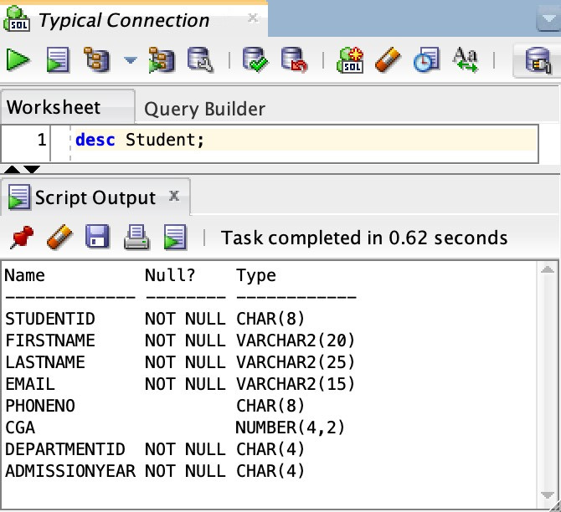
Displaying The Structure Of A Table (1)
SQL command: desc[ribe] <tablename>;
Open a new SQL Worksheet and connect to Oracle Database using your Oracle connection.
Type “desc Student;” in the Enter SQL Statement box.
Select (the Run Statement button).
The Script Output tab displays the result as shown in the figure.

Slide 20
Displaying The Structure Of A Table (2)
The Script Output tab shows:
Name – The name of the attribute.
Null? – Indicates whether a column must contain data.
Type – The data type of the column.
CHAR(s) – A character string of fixed length s.
VARCHAR2(s) – A variable length character string of maximum length s.
NUMBER(p, s) – A number with a total of p digits with s digits to the right of the decimal point.

Slide 21
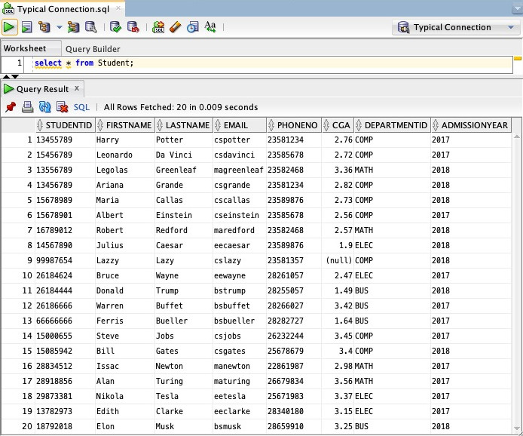
Displaying The Contents Of A Table
SQL command: select * from <tablename>;
In the Enter SQL Statement box, type “select * from Student;” and select (the Run Statement button).
The Query Result tab displays the SQL statement result as shown in the figure.

Slide 22
Query Result Tab
The Query Result tab displays the result of executing a single SQL statement; its toolbar contains the following buttons:
Pin keeps the tab’s contents in the window when another object is selected in the Connections navigator.
Print sends the tab’s contents to a printer.
Refresh executes the SQL statement again to refresh the result.
Delete Persisted Settings delete persisted settings such as any sort order specifications.
SQL displays the SQL statement that produced the result.

Slide 23
Change Oracle Database Password
To change your Oracle Database password, type
alter user <username> identified by “<new_password>”;
in the Enter SQL Statement box and select (the Run Statement button) where <username> and <new_password> are replaced with your Oracle username and your new password. Remember to add a “;” at the end of the SQL statement, because all SQL statements end with a “;”.
The following example changes the password to 123456:
alter user comp3311stu000 identified by “123456”;
NOTE: DO NOT USE SPECIAL CHARACTERS IN YOUR PASSWORD!
Please remember your new password!

Slide 24
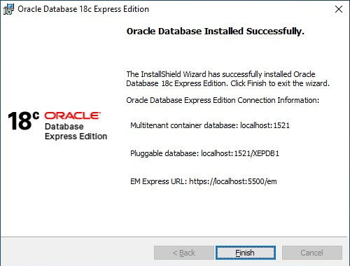
Install Oracle Database Express Edition (XE)
Follow these instructions only if you wish to install Oracle XE.
Download Oracle Database Express Edition (XE) from
https://www.oracle.com/database/technologies/xe-downloads.html
Run setup inside the downloaded folder to install Oracle XE. (Note: Run setup again if the installation fails.)
When installation completes, note the information shown in the InstallShield Wizard dialog as shown on the right for future reference.
In SQL Developer, create a connection to your Oracle XE database as the DBA as shown in the example on the next slide.

Slide 25
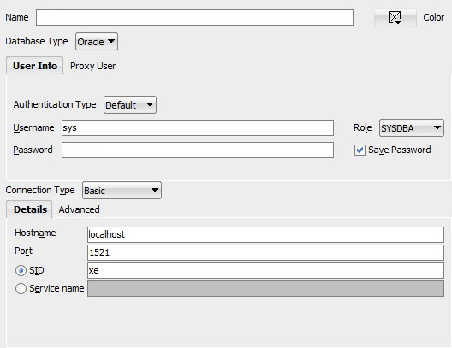
Connect To Oracle Database Express Edition (XE) As DBA Using SQL Developer
Enter or select the information outlined below in red. Leave all other information as shown.
a meaningful connection name
sys
the DBA password created during installation

Slide 26
Create User
To create a database user, run the script file CreateUser.sql as the DBA where you replace the text <username> with the username of the user you want to create and <password> with the password you want to assign to the user.
Create a connection in SQL Developer for the user created in step 5 to create tables and run queries.

