Slide 1
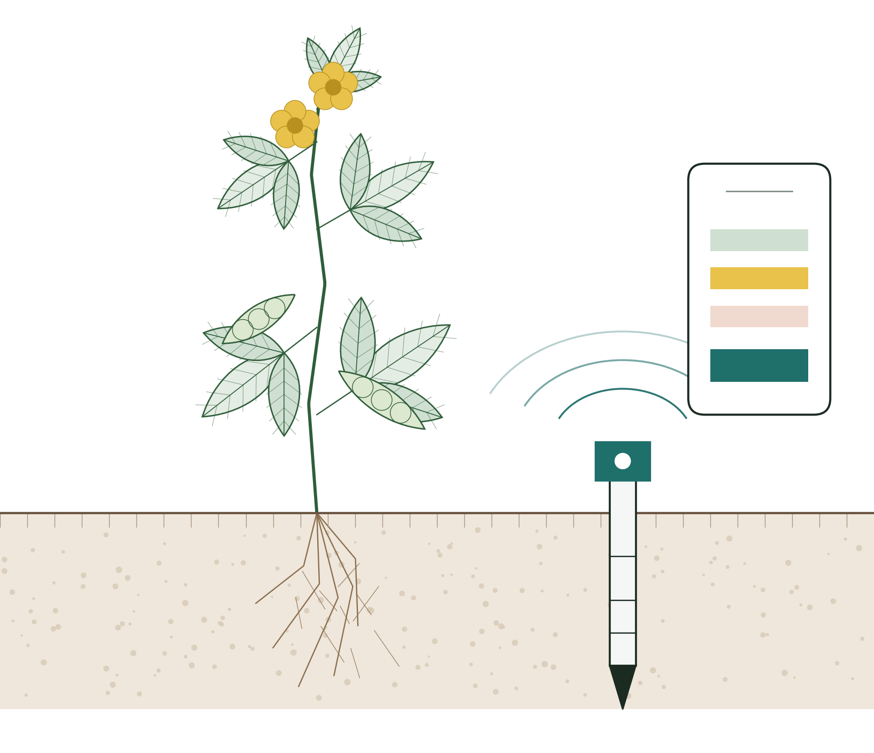
GROUP O
Multi-Site Smart Soil and Environmental Monitoring System
Phase 1 — problem, requirements, feasibility and plan
Prepared for the Department of Agriculture, Plant Sciences
Central University of Technology, Free State · 11 September 2026
Notes:
CAITLIN. Good morning. We are Group O. This is our Phase 1 presentation for the Multi-Site Smart Soil and Environmental Monitoring System, built for the Department of Agriculture, Plant Sciences, who monitor pigeon pea across three sites in the Free State. Eight of us will speak. We will take about thirty minutes and then answer questions.

Slide 2
SPEAKING ORDER
Caitlin Freeman
Eight of us, five parts
1
Caitlin Freeman
Opening and the team
3 min
2
Tiisetso Masita
The stakeholder and how we engaged
3 min
3
Ayatolla Pikwa
The problem and the current process
4 min
4
Machedi Mamello
What is deployed and what it measures
3 min
5
Nido Maphosa
The proposed system
5 min
6
Thobani Mjiyakho
Requirements and how they were derived
5 min
7
Mbasa Tyam
Interpretation and feasibility
4 min
8
Katlontle Seiphetlho
Risk, scope and the plan
3 min
Each of us can answer questions on any part of the work, not only the part we present.
Group O
2
Notes:
CAITLIN. We have split the presentation so everyone speaks, but we prepared it together and any of us can take a question on any section.

Slide 3
THE TEAM
Caitlin Freeman
The delivery team
NM
Nido Maphosa
223039784
CF
Caitlin Freeman
224097774
Technical lead, specification, full-stack
Project manager, frontend
MT
Mbasa Tyam
222056708
TM
Tiisetso Masita
223043636
Backend, frontend design
Specification, frontend
MM
Machedi Mamello
222001607
AP
Ayatolla Pikwa
224135694
Specification
Specification, interface design
KS
Katlontle Seiphetlho
224130045
TM
Thobani Mjiyakho
222088478
Frontend
Specification, software development
Group O
3
Notes:
CAITLIN. Eight members. Every deliverable has one named owner and the Microsoft Project schedule records who is responsible for each task, with contribution evidence in the progress tracker.

Slide 4
01
The stakeholder
A real organisation with sensing equipment already in the ground, engaged entirely in writing.
Tiisetso Masita
3 minutes
Notes:
TIISETSO. I will cover who we are building for and how we worked with them.

Slide 5
THE STAKEHOLDER
Tiisetso Masita
Who we are building for
Organisation
Stakeholder and end user
Department of Agriculture, Plant Sciences
Faculty of Health and Environmental Sciences
Central University of Technology, Free State
Ms Goitsemang Dikane
Plant Sciences, nGAP
Engagement channel
What they do
Ms Mpho Mbele
Departmental Manager: Information Technology
Plant science research and the monitoring of soil and environmental conditions for agricultural benefit
Fifteen 7-in-1 soil sensors are already deployed across three agricultural locations. The equipment exists; the problem is what happens to what it measures.
Group O
5
Notes:
TIISETSO. Ms Dikane is our stakeholder and the end user — she is in Plant Sciences and works with the crop. Ms Mbele in the IT department is how the written requirements reached us. We chose this project because the equipment is already installed, so the problem is real rather than hypothetical.

Slide 6
ENGAGEMENT
Tiisetso Masita
Engaged in writing, from first contact to approval
19 Aug
Concept and scope discussed
First contact. We described the module and asked whether they had a problem worth solving.
20 Aug
Requirements document received
A written project requirements document covering deployment, parameters, roles, alerts and the demonstration.
26 Aug
Fifteen follow-up questions issued
Sent in writing because a meeting could not be arranged that week.
27 Aug
Written answers returned
Current process, affected users, priorities, data approach and reading fields.
3 Sep
Findings confirmed and approved
“The document can be used as it meets the entry requirements as the end user.”
Every requirement in our specification traces to one of these written sources. All five are attached as appendices.
Group O
6
Notes:
TIISETSO. We kept everything in writing deliberately. It means we have evidence rather than recollection. The approval on 3 September is the last line — she confirmed the document meets the entry requirements of the end user.

Slide 7
02
The problem
Fifteen sensors are producing measurements continuously. None of it reaches the people who need it.
Ayatolla Pikwa
4 minutes
Notes:
AYATOLLA. I will explain how the organisation works today and what that costs them.

Slide 8
THE PROBLEM
Ayatolla Pikwa
Data is being produced. Nobody can read it.
How the organisation works today
What that costs them
Soil is sampled once, at the start of the planting cycle, and sent to a laboratory.
That single result determines fertiliser for the whole season.
Between those points no continuous measurement is reviewed.
Conditions are assessed by physically visiting each of the three sites.
Change is noticed late
Low moisture or unusual nutrient levels are found when they become visible, not when they occur.
Three sites cannot be watched
Physical inspection across three locations is not frequent enough to be useful.
Equipment failure is invisible
A sensor that has stopped reporting looks the same as one reporting normal conditions.
Group O
8
Notes:
AYATOLLA. Her words when we asked which problem causes the greatest difficulty: delayed identification of significant change across the three locations. Everything we specified follows from that sentence.

Slide 9
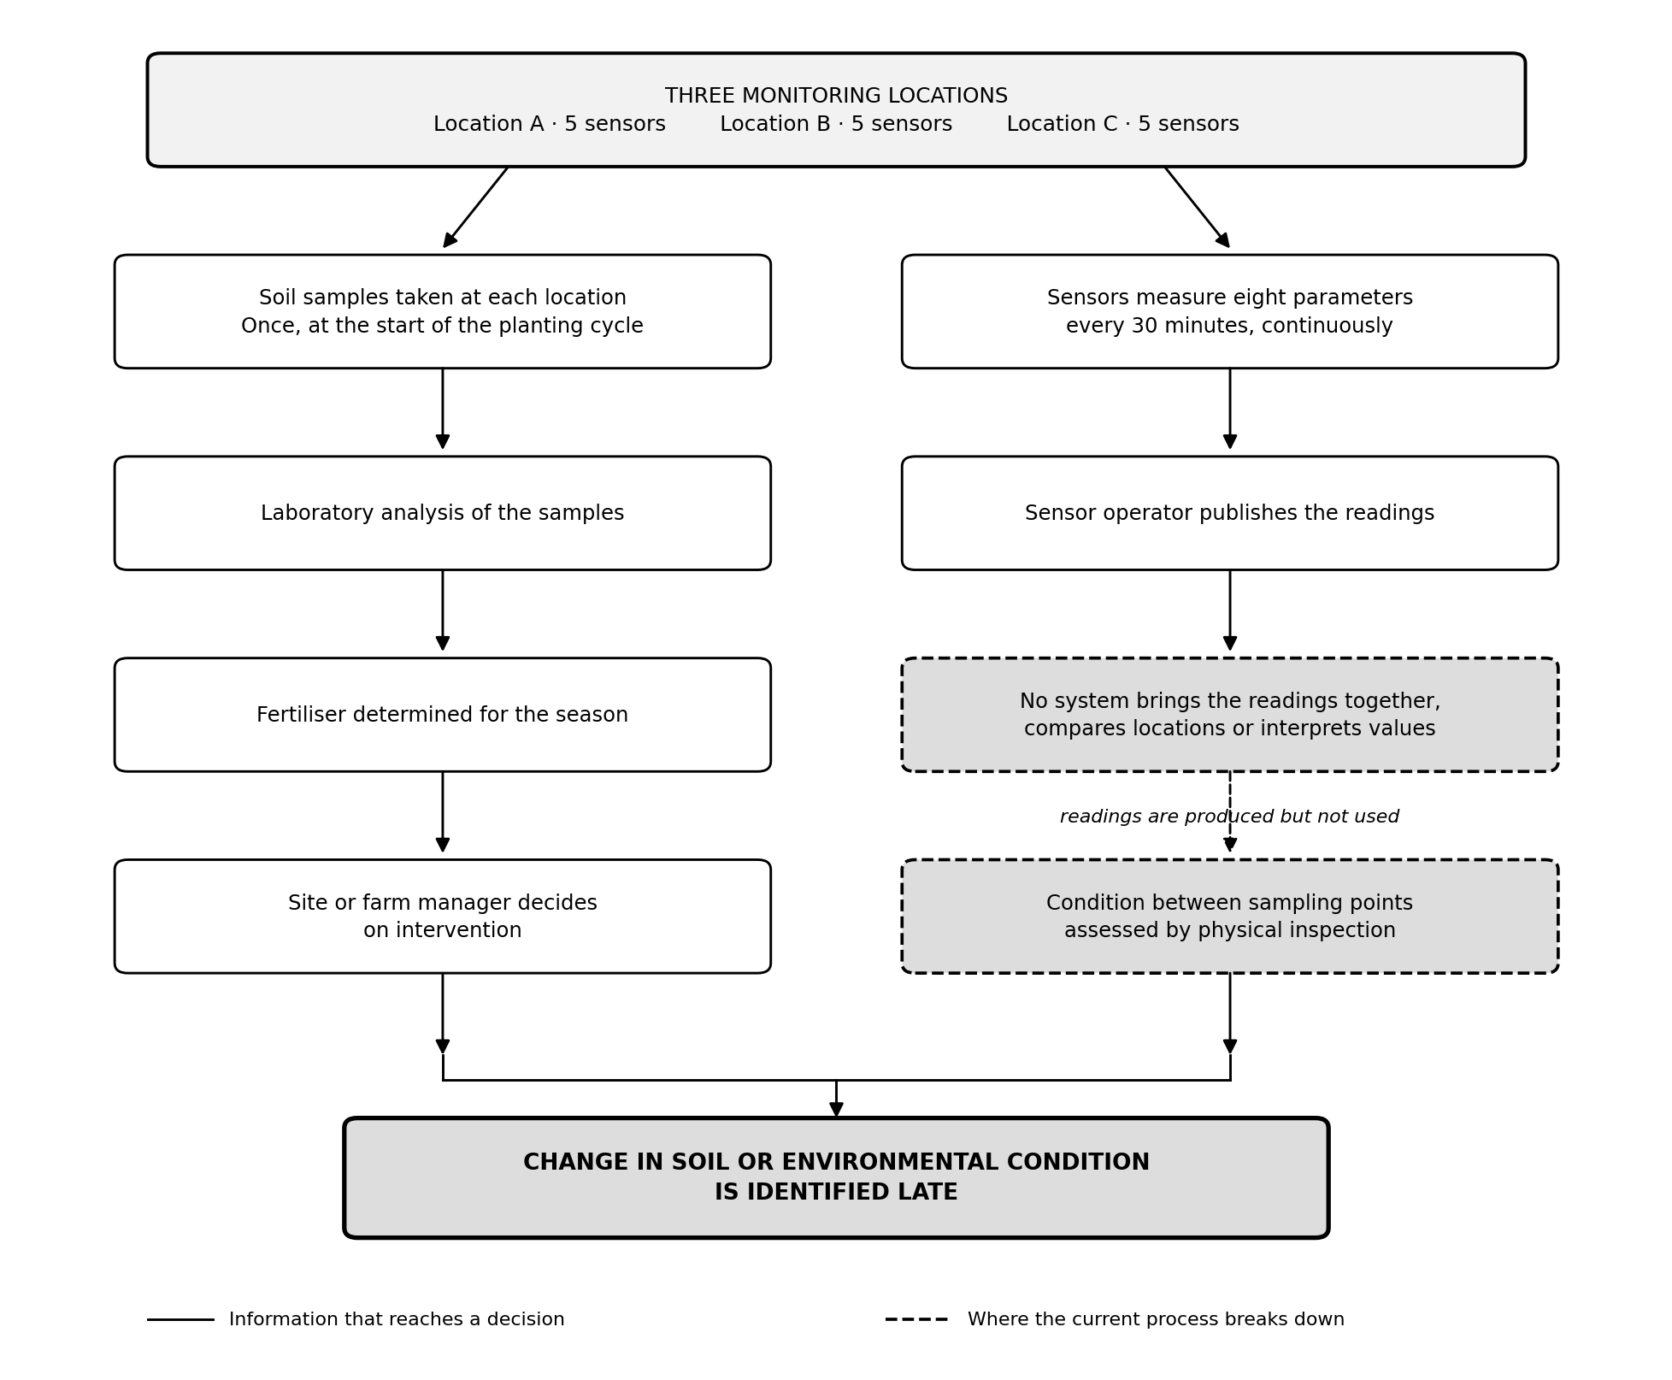
CURRENT PROCESS
Ayatolla Pikwa
Where the information stops
Group O
9
Notes:
AYATOLLA. Two paths. On the left, lab sampling reaches a decision, but it happens once a season. On the right, sensors measure every thirty minutes and the data stops at a dead end. Both converge on the same outcome. This diagram is section 2 of the specification.

Slide 10
STATEMENT
Ayatolla Pikwa
The problem statement
The organisation currently uses single-point laboratory soil sampling and physical inspection to assess soil condition across three agricultural locations. This results in significant changes being identified late, while measurements capable of revealing those changes are produced continuously by fifteen deployed sensors and are not accessible in any usable form.
Current situation
Sampled once per cycle; sensor readings not presented in a usable form
Problem
Significant change in soil and environmental condition is identified late
Affected users
Site or farm manager, agricultural staff, field workers, researchers
Consequences
Delayed response to low moisture and unusual nutrient levels; equipment failure unnoticed
Need
A central system that organises readings and identifies what needs attention
Group O
10
Notes:
AYATOLLA. The specification breaks this into the five required elements. Each one is answered from her written responses, not from what we assumed.

Slide 11
03
What is deployed
Fifteen devices, three locations, seven soil parameters, a reading every thirty minutes.
Machedi Mamello
3 minutes
Notes:
MACHEDI. I will cover the physical deployment and what each sensor actually measures.

Slide 12
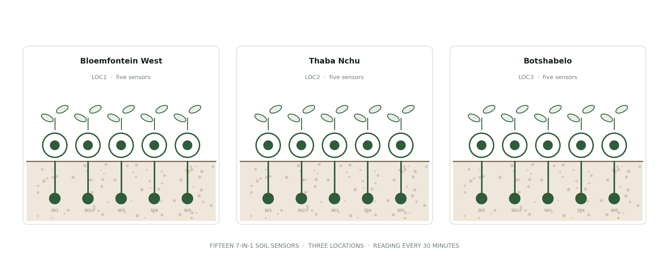
DEPLOYMENT
Machedi Mamello
Fifteen sensors already in the ground
Group O
12
Notes:
MACHEDI. Five sensors at each of three locations. Each carries a unique identifier so a reading can always be linked back to the sensor and the site that produced it — LOC1-S01 through LOC3-S05.

Slide 13
MEASUREMENT
Machedi Mamello
Seven parameters, every thirty minutes
7
30
720
12
Soil parameters
per reading
Minutes between readings
Readings per day
across all sensors
Months of history
retained
Soil temperature
Soil moisture
Electrical conductivity
pH
°C
%
dS/m
—
Nitrogen
Phosphorus
Potassium
Each reading is linked to a sensor, a location and the time it was taken.
mg/kg
mg/kg
mg/kg
Group O
13
Notes:
MACHEDI. Seven parameters, not eight. An earlier draft of our specification recorded humidity as an eighth. Her requirements document defines seven, so we removed it and recorded the correction as entry C04 in the change log. That is the kind of thing we would rather catch ourselves.

Slide 14
04
The proposed system
One system on one database, reached from a phone in the field and a browser at a desk.
Nido Maphosa
5 minutes
Notes:
NIDO. I will cover what we propose to build, how the parts fit together, and the one decision that changed our architecture.

Slide 15
AIM AND OBJECTIVES
Nido Maphosa
What the system is for
To bring soil and environmental measurements from fifteen sensors across three locations into a single system, interpret them against ranges set for each site, report the condition of the equipment, and present the result to authorised users on a phone and on the web.
Store
every reading for all fifteen sensors, without duplication
Present
the current condition of each location and each sensor
Compare
measured values against ranges configured per location
Report
battery level, sensor status and time of last communication
Alert
when a value leaves its range or a sensor stops reporting
Retain
readings over time and show them as graphs
Restrict
access according to the user's assigned role
Enable
administrators to manage locations, sensors, ranges and users
Group O
15
Notes:
NIDO. Eight objectives, each traceable to something in her requirements document. Note the fifth — alerting on a sensor that stops reporting was one of the things she specifically asked for.

Slide 16
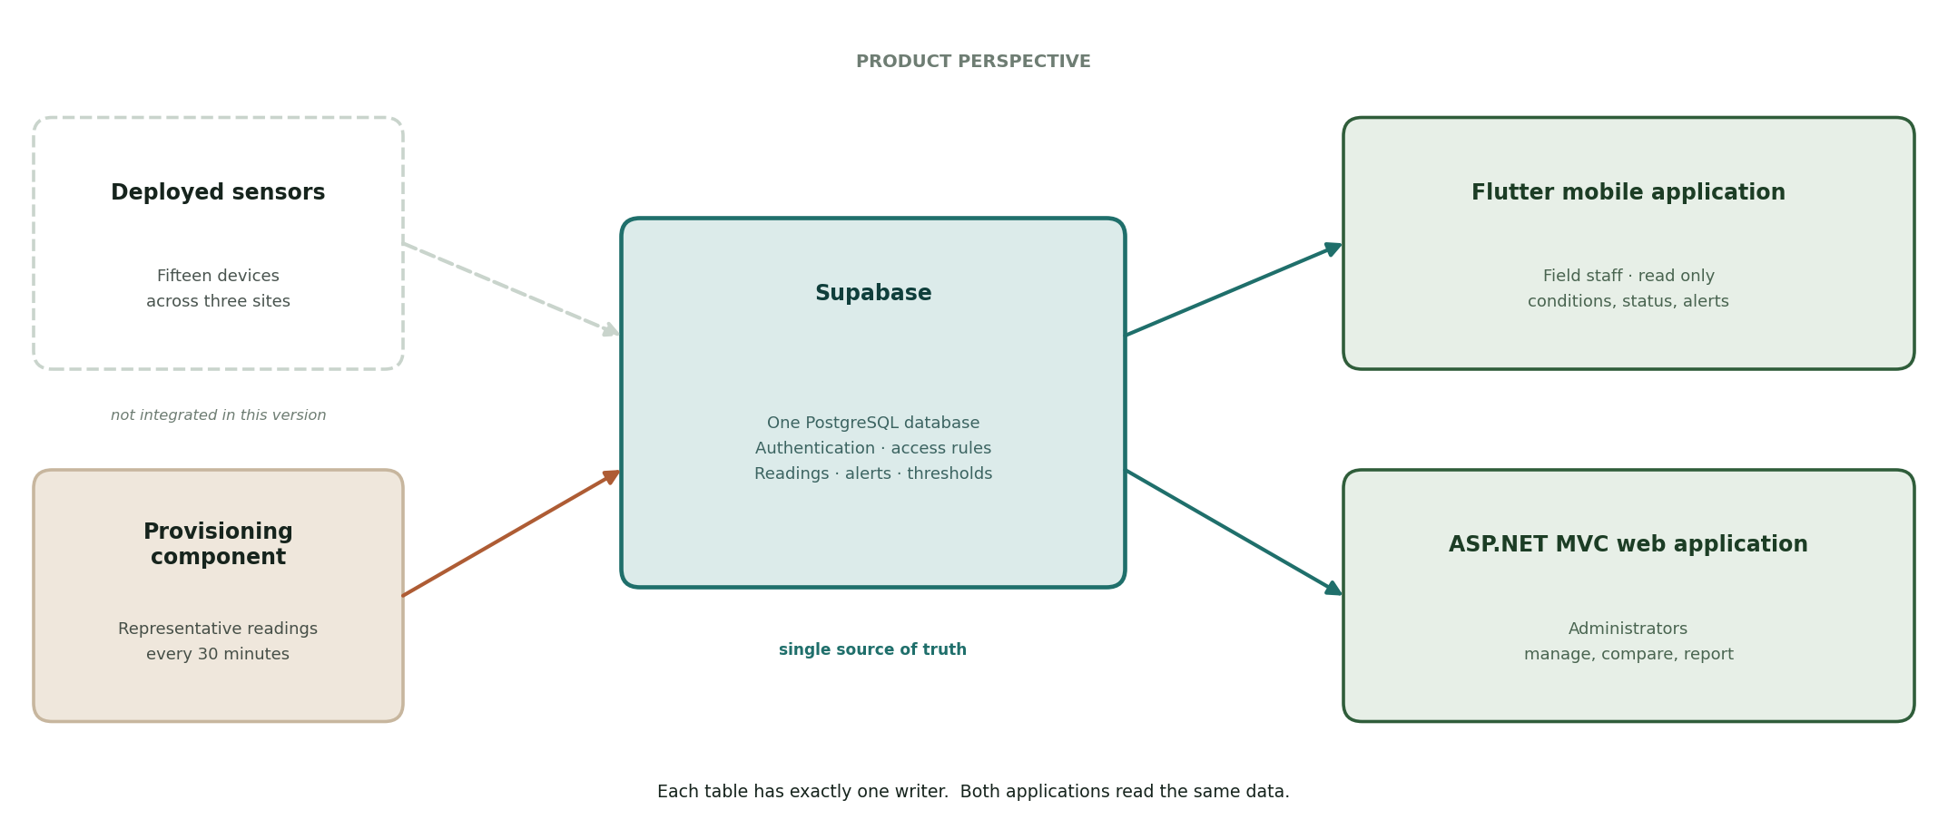
ARCHITECTURE
Nido Maphosa
One system, three parts, one shared database
Group O
16
Notes:
NIDO. Both applications connect to the same Supabase project and read from the same tables. Separate databases are not permitted. The dashed box on the left is the live sensor integration, which is not part of this version — I will come to that in two slides.

Slide 17
DATA OWNERSHIP
Nido Maphosa
Every table has exactly one writer
This prevents the most common failure in a system with two front ends: two versions of the same information.
Data
Written by
Read by
Readings
Provisioning component only
Both applications
Sensor status
Provisioning component only
Both applications
Alerts
Backend, generated automatically
Both applications
Locations
Web application only
Both applications
Sensors
Web application only
Both applications
Thresholds
Web application only
Both applications and the backend
Users and roles
Web application only
Backend access rules
The mobile application creates and modifies nothing. It reads.
Group O
17
Notes:
NIDO. If a threshold is changed on the web, the phone reflects it immediately, because there is only one place it lives. This is recorded as integration requirement IR06.

Slide 18
ACCESS
Nido Maphosa
Two roles, confirmed by the stakeholder
A
Administrator
S
Standard User
Full access. Configures how the system behaves.
Read only. Changes nothing.
Manage user accounts and roles
Create and edit the three locations
Register and assign sensors
Set acceptable ranges per location
Generate and export reports
View the dashboard and all three locations
View readings for any sensor
View battery and equipment status
View history and compare locations
View alerts
Site managers, agricultural staff, field workers and researchers all fit within these two roles. More can be added later if the organisation needs them.
Group O
18
Notes:
NIDO. She confirmed two roles are sufficient for this version. Restricting configuration matters — a threshold changed by one person alters the alerts everyone else sees.

Slide 19
DATA APPROACH
Nido Maphosa
The decision that changed our architecture
“For the current prototype, you may use realistic dummy sensor data. Firebase integration is not required at this stage.”
— the stakeholder, in writing, 27 August
What it removed
What we do instead
Why it is safe
The live integration with the sensor operator's data store, and with it the one component we could not design until we knew the published format.
A single provisioning component stores realistic readings for all fifteen sensors at the same thirty-minute interval.
That component is the only writer of readings. Replacing it with a live feed later changes nothing else in the system.
Recorded as entries C01 and C02 in the requirements change log, with her written waiver held as evidence.
Group O
19
Notes:
NIDO. This is the single biggest change since we started. It removed our largest technical risk. Because we isolated provisioning behind one component, live integration later is a replacement of one part rather than a rewrite. That isolation is deliberate, not convenient.

Slide 20
05
The requirements
One hundred and thirteen requirements, every one traceable to something the stakeholder wrote.
Thobani Mjiyakho
5 minutes
Notes:
THOBANI. I will cover how many requirements there are, how we derived them, and the order she wants them built in.

Slide 21
REQUIREMENTS
Thobani Mjiyakho
113 requirements across four types
What the four types mean
Functional
what the system must do
Non-functional
rules and conditions it works under
System
what it must be built with
Integration
how the parts join together
Ninety-two are Must Have.
Group O
21
Notes:
THOBANI. Ninety-two of the 113 are Must Have. That is high, but they are the functions covered by the acceptance criteria, so they are what the finished system is judged on.

Slide 22
TRACEABILITY
Thobani Mjiyakho
From what she wrote to what we build
What she wrote
“Alerts for abnormal conditions and inactive sensors.”
1
What we understood
Two kinds of alert: a reading outside its range, and a sensor that has stopped reporting.
2
What we specified
FR51 — generate an alert when a reading falls outside its configured range.
FR52 — generate an alert when a sensor becomes inactive.
3
How it will be tested
AC7 — a value outside its threshold raises an alert visible in both applications.
AC8 — a sensor silent beyond the configured period is reported and raises an alert.
4
Every requirement carries a related stakeholder need. A requirement with nothing in that column would be one we invented.
Group O
22
Notes:
THOBANI. This is the chain we can show for any requirement in the document. Ask us about any one of the 113 and we can point to where it came from.

Slide 23
PRIORITY
Thobani Mjiyakho
The build order came from her, not from us
We asked which functions matter most if development time runs short. This is the answer, and it is now our development sequence.
1
Sign in and access control
2
The three locations
3
All fifteen sensors
4
Current readings
5
Battery and sensor status
6
Historical readings
7
Alerts
8
A dashboard per location
The first four are what a person standing in a field needs before anything else. Reporting and analysis follow.
Group O
23
Notes:
THOBANI. If we fall behind, what gets deferred is already agreed — and agreed by her, rather than decided by us under pressure in October.

Slide 24
ACCEPTANCE
Thobani Mjiyakho
Fourteen things the system must demonstrate
AC1
An authorised user can sign in; an unauthorised user cannot
AC2
The dashboard shows locations, sensors, active, inactive and open alerts
AC3
All three locations are listed and their sensors reachable
AC4
All fifteen sensors are registered and individually identifiable
AC5
All seven parameters display for a selected sensor, with the reading time
AC6
Battery, sensor status and last communication display for each sensor
AC7
A reading outside its range raises an alert visible in both applications
AC8
A sensor silent beyond the configured period is reported and raises an alert
AC9
Readings for a selected sensor and period display as a graph
AC10
An administrator can manage locations, sensors, ranges and users
AC11
A standard user cannot change any configuration
AC12
Conditions at the three locations can be compared in one view
AC13
Data recorded on the web is visible on the mobile application
AC14
Readings can be exported from the web application
These are the practical test of whether the problem has been addressed. All development is planned backwards from this list.
Group O
24
Notes:
THOBANI. Fourteen criteria, each written so it can be shown to be met or not met rather than argued about. This list also drives our schedule.

Slide 25
06
Interpretation and feasibility
How we set the acceptable ranges, and whether this can be delivered in the time we have.
Mbasa Tyam
4 minutes
Notes:
MBASA. I will cover the ranges we set, where they came from, and the feasibility assessment.

Slide 26
INTERPRETATION
Mbasa Tyam
The stakeholder did not give us acceptable ranges
So we researched them, and stated their limits honestly.
pH
5.0 – 7.0
Department of Agriculture pigeon pea production guideline
Soil temperature
18 – 35 °C
Same guideline — but it gives air temperature, not soil
Electrical conductivity
below 2 dS/m
Above 2 dS/m is classed slightly saline
Soil moisture
20 – 60 %
Varies by growth stage — a fixed band will over-alert at flowering
Nitrogen, phosphorus, potassium
configurable
No universal range exists; set from their own laboratory results
Every value is configurable per location and records the basis it was set from. The system compares readings against ranges — it does not give agronomic advice.
Group O
26
Notes:
MBASA. This is where we are most exposed, so we lead with it rather than waiting to be asked. We would rather state the limits of these values than present researched numbers as though the stakeholder had confirmed them.

Slide 27
CALIBRATION
Mbasa Tyam
And she settled it
“The calibration and setting of range measurements can also be amended later on once the platform has been established. We shall revisit the pipeline and amend where necessary; for now I believe the document can be used as it meets the entry requirements as the end user.”
— Ms Goitsemang Dikane, 3 September 2026
What this settles
Why it costs nothing
What happens next
Our researched values are an agreed starting point rather than an assumption we made alone.
Ranges are stored in the backend and configured per location, so refining them later needs no code change.
The pipeline is revisited with her once the system is running and real readings can be compared against the ranges in use.
Recorded as section 15.2 of the specification and as change log entry C14.
Group O
27
Notes:
MBASA. This was the one genuinely open question in our specification and her reply closed it. It also confirms a design decision we had already made — putting the ranges in the database rather than in the code.

Slide 28
FEASIBILITY
Mbasa Tyam
Feasible, with one real constraint
Technical
Feasible
Operational
Feasible
Economic
Feasible
Frameworks already used in coursework
Users read information; they enter nothing
Free tiers; no hardware to buy
Legal
Feasible
Ethical
Feasible
Schedule
With changes
No real personal information handled
Explicit boundary against giving advice
Three development weeks, three components
Scope is the answer to the schedule constraint. We plan backwards from the fourteen acceptance criteria and finish the shared database before any parallel development starts.
Group O
28
Notes:
MBASA. Five of six are feasible outright. Technical moved from conditional to feasible once the live integration was waived. Schedule is the one needing changes, and the change is scope control applied before development starts rather than during it.

Slide 29
07
Risk, scope and the plan
Twelve risks, the functions we set aside, and where the project stands today.
Katlontle Seiphetlho
3 minutes
Notes:
KATLONTLE. I will cover the risks we are carrying, what we cut from scope, and the schedule.

Slide 30
RISK PROFILE
Katlontle Seiphetlho
Twelve risks, rated and owned
How we score them
Likelihood and impact are each rated one to three. Multiplying gives a score out of nine.
7 – 9
High
1 risk
4 – 6
Medium
9 risks
1 – 3
Low
2 risks
Each has a mitigation, a contingency and a named owner.
Group O
30
Notes:
KATLONTLE. Twelve risks across the eight required categories. A risk is something that has not happened yet — anything already gone wrong is an issue and is recorded separately in the progress tracker.

Slide 31
HIGHEST RISKS
Katlontle Seiphetlho
The three we watch most closely
R01
9 · High
What we are doing about it
Development time is insufficient
Plan backwards from the criteria. Sequence the backend first. One named owner per component.
Three weeks for fourteen acceptance criteria across three components.
R02
6 · Medium
What we are doing about it
Components fail to integrate
Agree field names in writing before building. Get one path working end to end early.
Parts that work alone but not together would fail the integration requirement.
R04
6 · Medium
What we are doing about it
Threshold values prove unsuitable
Values agreed as a starting point with the stakeholder. Every one configurable.
Alerts that fire when nothing is wrong would undermine the whole system.
Group O
31
Notes:
KATLONTLE. R01 is the only High. R04 has come down since her reply on the third — the ranges are now an agreed starting point rather than our own guess.

Slide 32
SCOPE
Katlontle Seiphetlho
What we set aside, and why
Keep
Simplify
Postpone
Remove
13 functions
2 functions
9 functions
2 functions
Everything covered by the acceptance criteria: access control, dashboards, locations, sensors, readings, equipment status, thresholds, alerts, history, comparison, administration, export.
Push notification becomes in-application alerts for the first version. Live dashboard becomes refresh on view.
Offline mode, map view, code scanning, biometric sign-in, site photographs, weather overlay, dark mode, home screen widget, language selection.
Advanced analytics and prediction. The stakeholder identified both as suitable for a later version.
Nothing was deleted quietly. All fourteen changes are recorded in the change log with their reasons.
Group O
32
Notes:
KATLONTLE. The one to flag is push notification. She asked for it; we are delivering in-application alerts first and adding push once the core functions work. We told her that in writing rather than quietly shipping less than she asked for.

Slide 33
THE PLAN
Katlontle Seiphetlho
Where we are and what comes next
Phase 1
Problem, requirements, feasibility, risk and plan
Complete
18 Aug – 11 Sep
Phase 2
Architecture, UML, database design, interface prototypes
Next
14 – 25 Sep
Phase 3
Build, integrate, test, evaluate and demonstrate
Planned
28 Sep – 30 Oct
Submitted with this presentation: the specification with five appendices, the baselined Microsoft Project schedule, the project progress tracker, the source repository and the Supabase project.
Group O
33
Notes:
KATLONTLE. Phase 1 delivered on schedule. The Microsoft Project file is baselined, so progress is measured against the original plan rather than a moving target, and every task carries a named member.

Slide 34
GROUP O
The requirements are agreed. The plan is realistic. We are ready to design.
113
12
6
14
requirements agreed
risks managed
feasibility areas assessed
acceptance criteria set
Questions
Notes:
CAITLIN. The specification was confirmed by Ms Dikane on 3 September and she stated it meets the entry requirements of the end user. We are asking for approval to proceed to system architecture and design. We will take questions — and any of the eight of us can answer on any part of the work.

