Slide 1
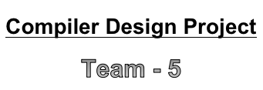
Lexical and Semantic Analysis
of
Descriptive answers in Exams
to understand
Student knowledge
Presented by,
Sarikaa.S - 2018103058
Niranjana.S - 2018103570
Nidya.M - 2018103046

Slide 2
Abstract
Students’ writing in exams can provide better understanding into their thinking than multiple-choice questions. However, time and resource constraints often prevent teachers from using writing assessments in most of the courses. We looked over the use of computer software to analyze student writing and to understand their conceptual knowledge. These analyses help to see the conceptual understanding of the students and their difficulties explaining these topics and their ideas. This suggests that computerized lexical analysis may be useful for automatically categorizing large numbers of student descriptive answers. Lexical analysis provides teachers better insight into student thinking and a whole-class perspective that are difficult to obtain from multiple-choice questions or reading individual responses.

Slide 3










Literature Survey
Author, Publication, Year
Methodology
Advantages
Limitation
V.Nandhini,P.Maheswari
“The Journal of Super
Computing”,2018
Syntactical based feature extraction technique
P Nikam, M Shinde, “IJCSE”,2015
Pattern and graph matching
Shwetha M patil, “IJERT”,2014
Full Natural Language Processing
K Meena, R Lawrence,“ICCTIDE”,2016
Latent Semantic Analysis(LSA)
D R Tetali, T Sowmya, L Ramana,”IJETER”,2017
Keyword matching

Slide 4
Issues in the survey that lead to the PROBLEM STATEMENT
The LIMITATIONS prevailing in the existing systems are :
  Less accuracy
  Lack of detailed report
  Reducing marks for Grammatical errors which is usually not done in manual evaluation
How shall we maintain accuracy along with fair method for evaluation?
In our proposed method, we extract keywords based on their co-occurence and check the Keyword similarity and at the same time, not reducing marks for the grammatical errors. This produces the final report along with the marks awarded.

Slide 5
Block Diagram
Grammar Check
and Parsing
Keyword
extraction
Spell check
Text file
Tokens
Document
Keywords
Keyword
matching and
mark allocation
Report
generation
Answer
DB
List of marks
Keyword DB

Slide 6
Modules
1. Module 1 - Spelling check
2. Module 2 - Grammar check and Parsing
3. Module 3 - Getting the input using Rake’s algorithm
4. Module 4 – Mark Allocation and keyword counting
5. Module 5 - Evaluating and Output module

Slide 7
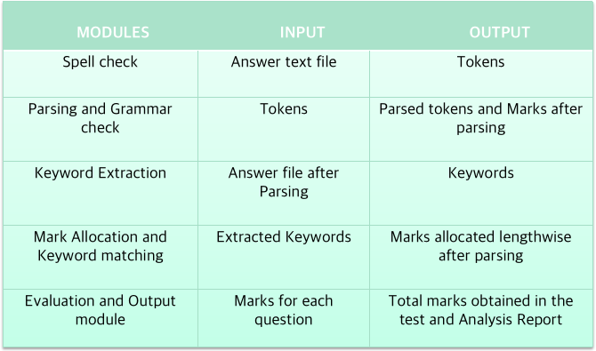
MODULES – INPUT AND OUTPUT

Slide 8
Pseudo Code
MODULE 1 & 2
>>> import language_check
>>> tool = language_check.LanguageTool('en-US')
>>> text = u'A sentence with a error in the Hitchhiker’s Guide tot he Galaxy'
>>> matches = tool.check(text)
>>> len(matches)

Slide 9
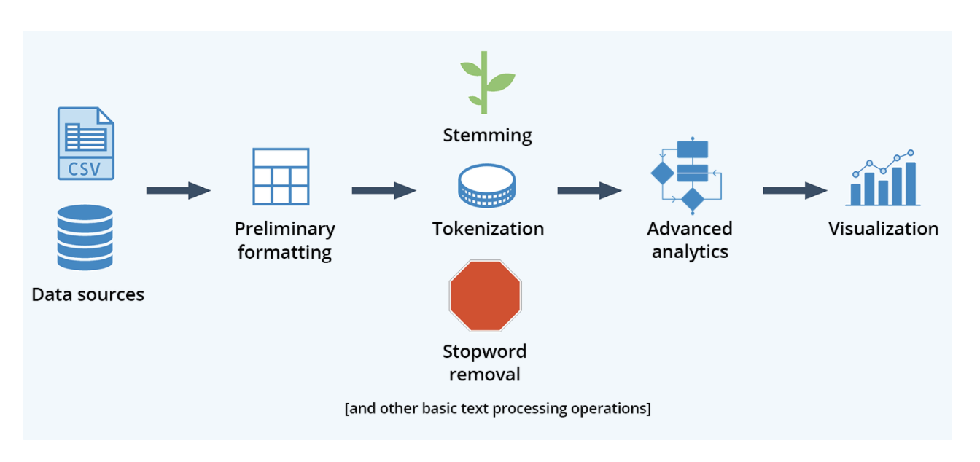
Pseudo Code
MODULE 3

Slide 10
Pseudo Code
MODULE 4
totmark[5] = {0,0,0,0,0,0}
tkinkter geometry() {
// how the gui is going to be formatted
}
nex() {
// moves to the next function
if(counter>6)
print “limit exceeded” }
prev() {
// moves to the previous function
if(counter==0)
print “this is the first question” }

Slide 11
Pseudo Code
MODULE 4
enfunc() {
rake() {
//rake algorithm in module 3
}
//spell check
ck form module 1
// grammar check from module 2
count = count + 1 //for errors
// allocate marks as per errors
c = marks3
// count length
len = len +1;
// marks allocation for len
a = marks1
for key in line
for key1 in file
if key == key1
marks2 = mark2 +1
b = marks2
}

Slide 12
Pseudo Code
MODULE 4
finish() {
total = a+b+c
totmark[counter-1] = total
}
showrpt() {
//bar graph using matplotlib
for i in totmark
if 0<=i<=3
print “Not Known”
if 4<=i<=5
print “Vaguely understood”
if 6<=i<=7
print “Moderately understood”
if 8<=i<=10
print “Satisfactory”
}

Slide 13
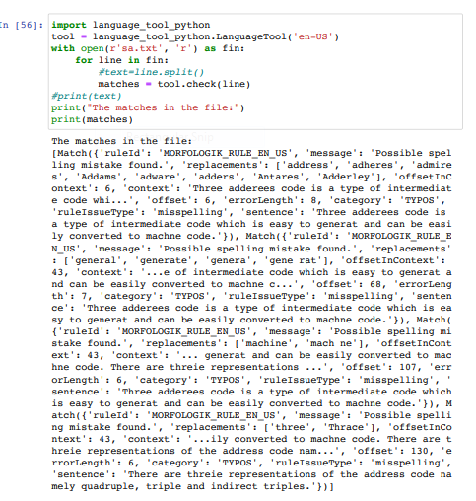
Output module - Module 1

Slide 14
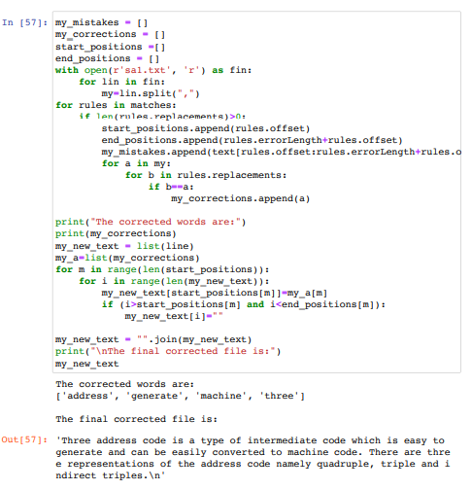
Output module - Module 2

Slide 15
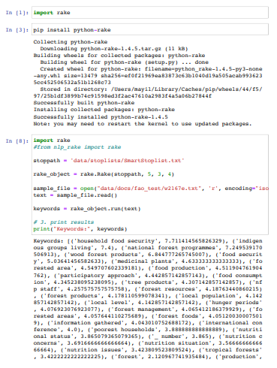
Output module - Module 3

Slide 16
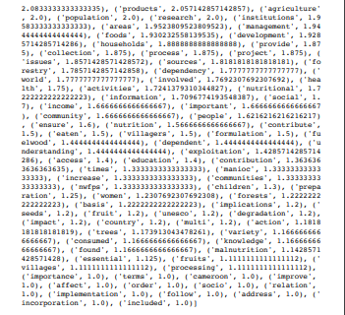
Output module - Module 3

Slide 17
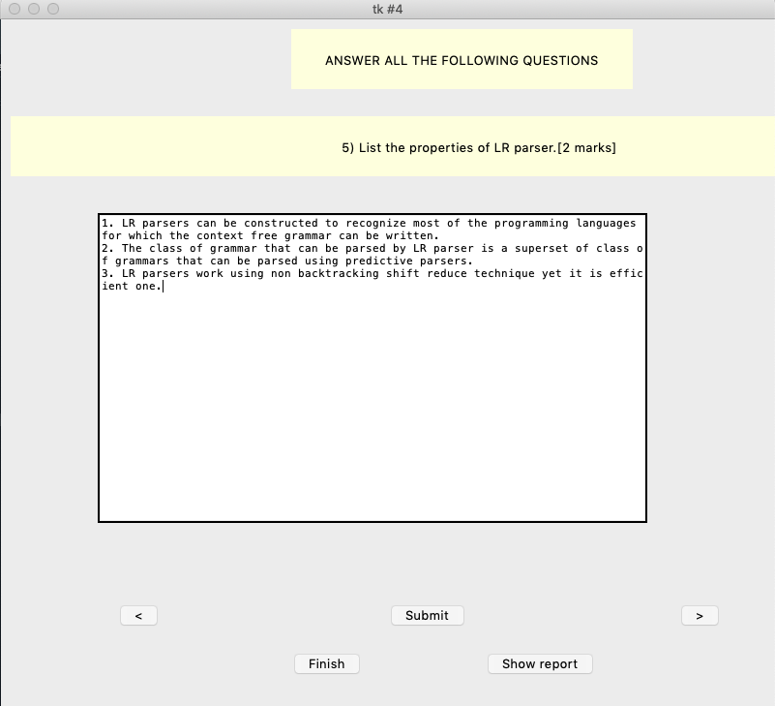
Output module - Module 4

Slide 18
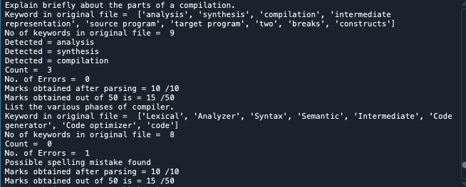
Output module - Module 4

Slide 19
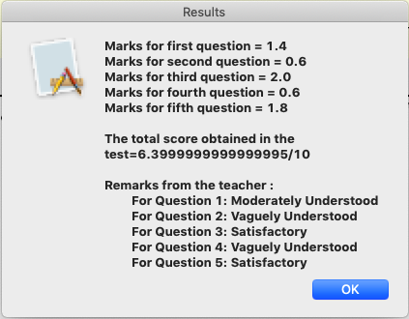
Output module - Module 5

Slide 20
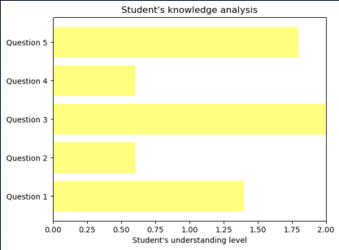
Output module - Module 5

Slide 21
Conclusion
The descriptive assessment gives a good understanding of how the students think than multiple choice questions.
The categories and the custom libraries can be used to visualize the trends in the students’ writing and their conceptual barriers.
The teachers can immediately train the students accordingly to make them understand the concepts well.
Thus, this system will help in improving the students’ concepts and understanding.

Slide 22
References
'Rake's Algorithm' by https://monkeylearn.com/keyword-extraction/Rake’s-algorithm
Hanxiao Shi, Guodong Zhou and Peide Qian (2010), “An Attribute based Sentiment Analysis System”
Papri Chakraborty (2012), “Developing an Intelligent Tutoring System for Assessing Students’ Cognition and Evaluating Descriptive Type Answer”
Mita K. Dalal, Mukesh A. Zave (2011), “Automatic Text Classification: A Technical Review”, International Journal of Computer Applications
'Language Checking' by https://pypi.org/project/language-check/
Rose, S., D. Engel, N. Cramer, and W. Cowley (2010), “Implementation of RAKE - Rapid Automatic Keyword Extraction algorithm”

