Slide 1
180926
Shaozhi Nie

Slide 2
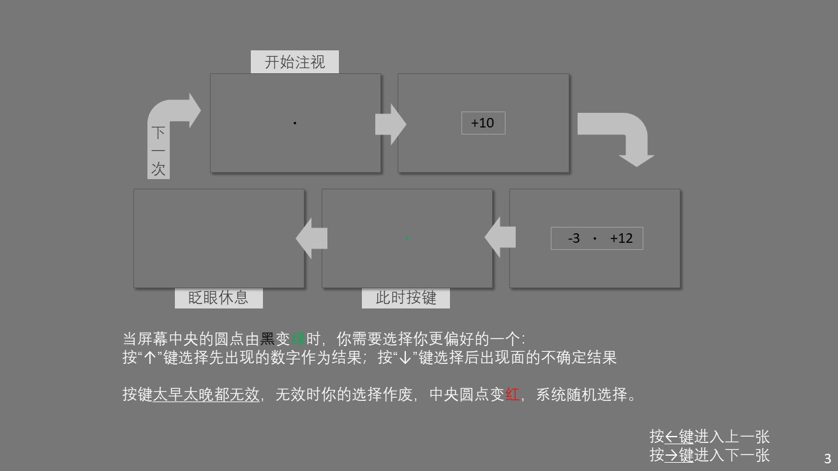

Slide 3
Subject | 1 | 2 | 3 | 4 | 5 | 6 | 7 | 8 | 9
0.5s
Sure reward
Sure reward
1.0s
2.0s
Sure reward
indifference
Expected value
被试2、7由于反应杂乱，在之后的分析中被剔除

Slide 4
Ranova 检验:
模型: time + sign + time*sign
Sure reward:
time: p = . 47928
sign: p = .25486
time*sign: p = .4477
Gamble:
time: p = .37175
sign: p = .44822
time*sign: p = .48647
检验中将time设为nominal variable. 如果设为scale，则有且只有时间效应显著
Ranova 检验:
模型: time + sign + time*sign
Sure reward:
time: p = .00000088838
sign: p = .25486
time*sign: p = .13313
Gamble:
time: p = .0000010549
sign: p = .44822
time*sign: p = .38734

Slide 5

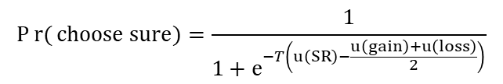
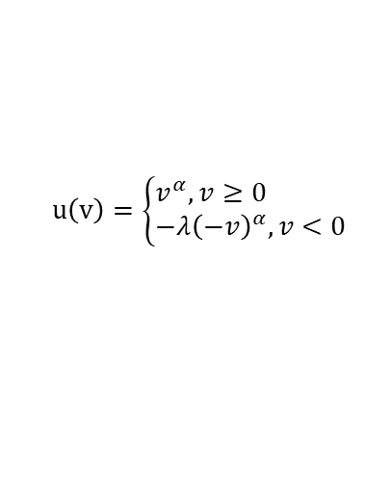
$$u\left(v\right)=\left\{\begin{aligned}&v^{α},v≥0 \\ &−λ{\left(−v\right)}^{α},v<0\end{aligned}\right.$$
$$y=u(x)$$
$$Pr{(}choose sure)=\frac{1}{1+e^{−T\left(u\left(SR\right)−\frac{u\left(gain\right)+u\left(loss\right)}{2}\right)}}$$
Time has no significant effect on
alpha, lambda, temperature.
Alpha 结果与上次不同，lambda的均值大于1（loss aversion）

Slide 6

$$u\left(v\right)=\left\{\begin{aligned}&v^{α},v≥0 \\ &−λ{\left(−v\right)}^{α},v<0\end{aligned}\right.$$
$$y=T∗u(x)$$
$$Pr{(}choose sure)=\frac{1}{1+e^{−T\left(u\left(SR\right)−\frac{u\left(gain\right)+u\left(loss\right)}{2}\right)}}$$
Time has no significant effect on
alpha, lambda, temperature

Slide 7
Series = block
No trend effect of blocks
Even if there was, when talk about times, these effects are balanced.

Slide 8
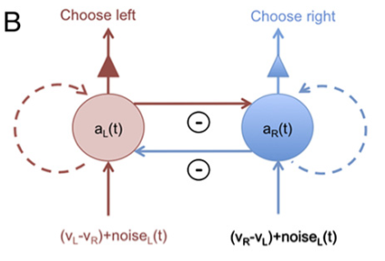
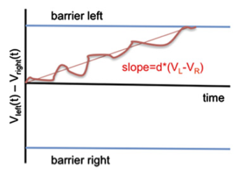
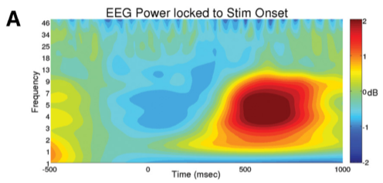
Brain imaging literatures
Hare et al., 2011 fMRI vmPFC DDM, motor
Lim et al., 2011 fMRI vmPFC & striatum visual attention
Hunt et al., 2012 MEG distributed Recurrent
Frank et al., 2015 EEG & fMRI SMA & STN DDM, RL
Recurrent model
DDM
FFT

