Slide 1
Exp. Design & Data
180913

Slide 2
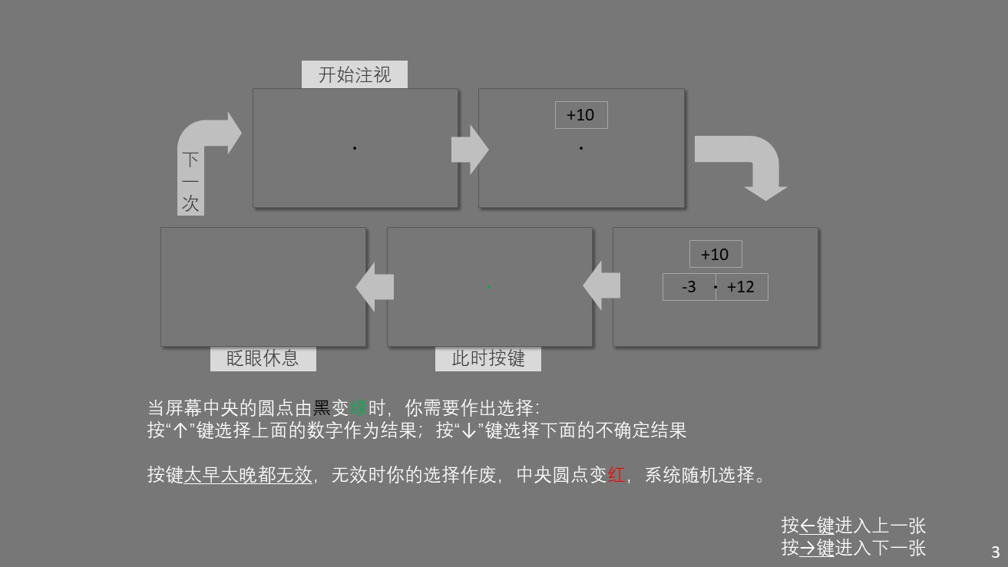
Design
5 conditions
loss
gain
gain
3
6
9
12
15
18
loss
-3
-6
-9
-12
-15
-18
0.5s 1.0s 2.0s
540 trials

Slide 3
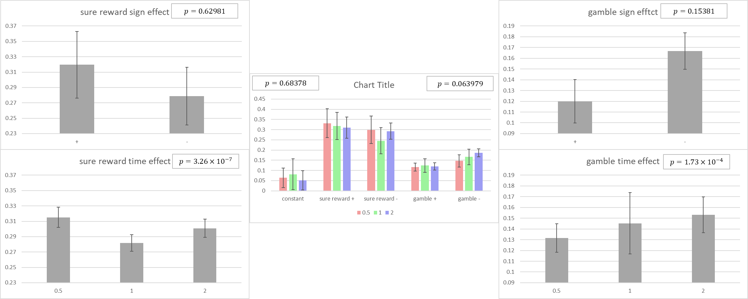
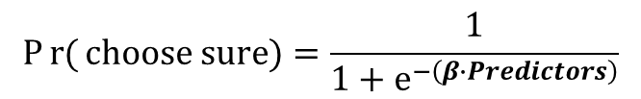
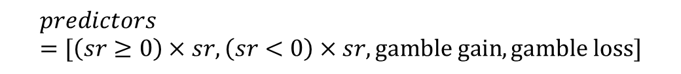
$$Pr{(}choose sure)=\frac{1}{1+e^{−\left(β∙Predictors\right)}}$$
$$predictors=[\left(sr≥0\right)×sr, \left(sr<0\right)×sr,gamble gain, gamble loss]$$
sure reward
time × sign
gamble:
time × sign
看图上不明显，但是RANOVA有显著，不过没有趋势

Slide 4
β值相减，看上去与0没有差异

Slide 5

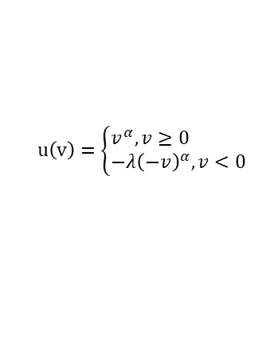
$$u\left(v\right)=\left\{\begin{aligned}&v^{α},v≥0 \\ &−λ{\left(−v\right)}^{α},v<0\end{aligned}\right.$$
Averaged utility function
$$Pr{(}choose sure)=\frac{1}{1+e^{−T\left(u\left(SR\right)−\frac{u\left(gain\right)+u\left(loss\right)}{2}\right)}}$$
p = .0064453
p = .26795
p = .10712
看图上不明显，但是RANOVA有显著，不过看不出趋势

Slide 6
utility functions of subjects

Slide 7
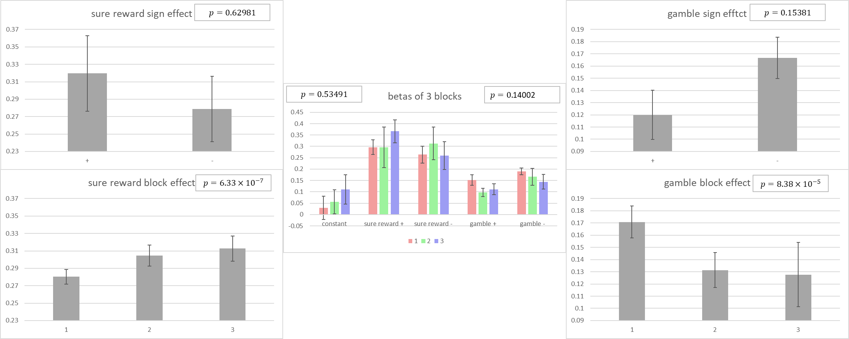
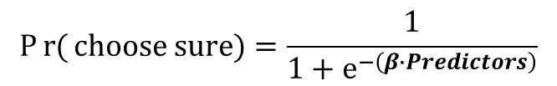
$$Pr{(}choose sure)=\frac{1}{1+e^{−\left(β∙Predictors\right)}}$$
sure reward:
block × sign
gamble:
block × sign
看图上不明显，但是RANOVA有显著，不过没有趋势
Block与时间的对应我平衡过了
出现这种情况我也不知道怎么办

Slide 9
$$u\left(v\right)=\left\{\begin{aligned}&v^{α},v≥0 \\ &−λ{\left(−v\right)}^{α},v<0\end{aligned}\right.$$
Averaged utility function
$$Pr{(}choose sure)=\frac{1}{1+e^{−T\left(u\left(SR\right)−\frac{u\left(gain\right)+u\left(loss\right)}{2}\right)}}$$
1
2
3
p = .072866
p = .19247
p = .22671
比较不同block顺序的效应时，参数的差异消失了

Slide 10
utility functions of subjects
1
2
3

Slide 11
Subject 1 2 3 4 5 6
0.5s
Sure reward
Sure reward
1.0s
Sure reward
2.0s
equivalence
Expected value
Slopes =
0.244929 | 0.341706 | 0.480873 | 0.272258 | 0.364963 | 0.247969
0.603288 | 0.477155 | 0.426591 | 0.269675 | 0.591779 | 0.391802
0.366788 | 0.579322 | 0.222241 | 0.380168 | 0.534743 | 0.503186

Slide 12
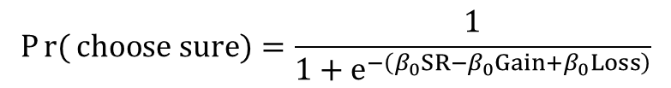
$$Pr{(}choose sure)=\frac{1}{1+e^{−\left(β_{0}SR−β_{0}Gain+β_{0}Loss\right)}}$$
*
n. s.
**
** p < .05
* p < .01
β of SR & gamble loss increase with time

Slide 13
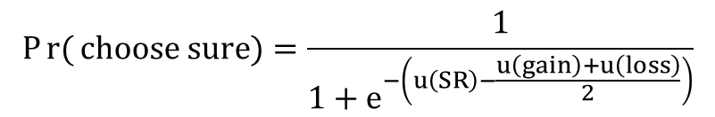
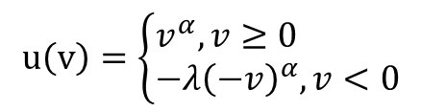
Averaged utility function
$$u\left(v\right)=\left\{\begin{aligned}&v^{α},v≥0 \\ &−λ{\left(−v\right)}^{α},v<0\end{aligned}\right.$$
$$Pr{(}choose sure)=\frac{1}{1+e^{−\left(u\left(SR\right)−\frac{u\left(gain\right)+u\left(loss\right)}{2}\right)}}$$
p = .04951
p = .96423
Less time pressure improves Rationality (α). (Kahneman, 2011)
No effect on loss aversion (λ). (Kirchler et al., 2017)

Slide 14
utility functions of subjects

