Slide 1
Exp. Design & Data
180908

Slide 2
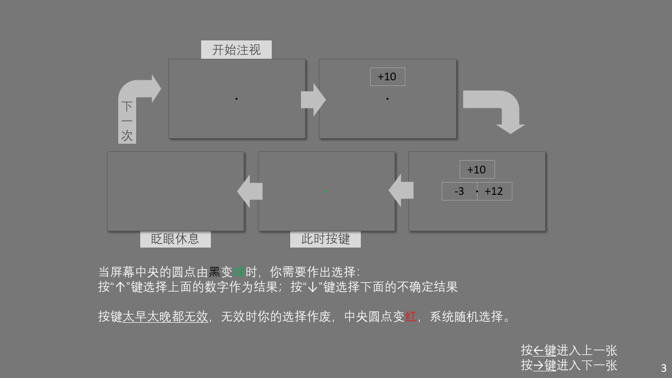
Design
5 conditions
loss
gain
gain
3
6
9
12
15
18
loss
-3
-6
-9
-12
-15
-18
0.5s 1.0s 2.0s
540 trials

Slide 3
Subject 1 2 3 4 5 6
0.5s
Sure reward
Sure reward
1.0s
Sure reward
2.0s
equivalence
Expected value
Slopes =
0.244929 | 0.341706 | 0.480873 | 0.272258 | 0.364963 | 0.247969
0.603288 | 0.477155 | 0.426591 | 0.269675 | 0.591779 | 0.391802
0.366788 | 0.579322 | 0.222241 | 0.380168 | 0.534743 | 0.503186

Slide 4
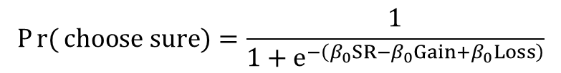
$$Pr{(}choose sure)=\frac{1}{1+e^{−\left(β_{0}SR−β_{0}Gain+β_{0}Loss\right)}}$$
*
n. s.
**
** p < .05
* p < .01
β of SR & gamble loss increase with time

Slide 5
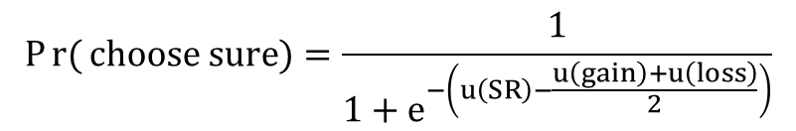
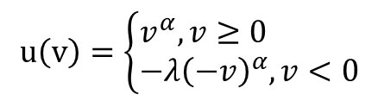
Averaged utility function
$$u\left(v\right)=\left\{\begin{aligned}&v^{α},v≥0 \\ &−λ{\left(−v\right)}^{α},v<0\end{aligned}\right.$$
$$Pr{(}choose sure)=\frac{1}{1+e^{−\left(u\left(SR\right)−\frac{u\left(gain\right)+u\left(loss\right)}{2}\right)}}$$
p = .04951
p = .96423
Less time pressure improves Rationality (α). (Kahneman, 2011)
No effect on loss aversion (λ). (Kirchler et al., 2017)

Slide 6
utility functions of subjects

