Slide 1
Exp. Design & Data
180913

Slide 2
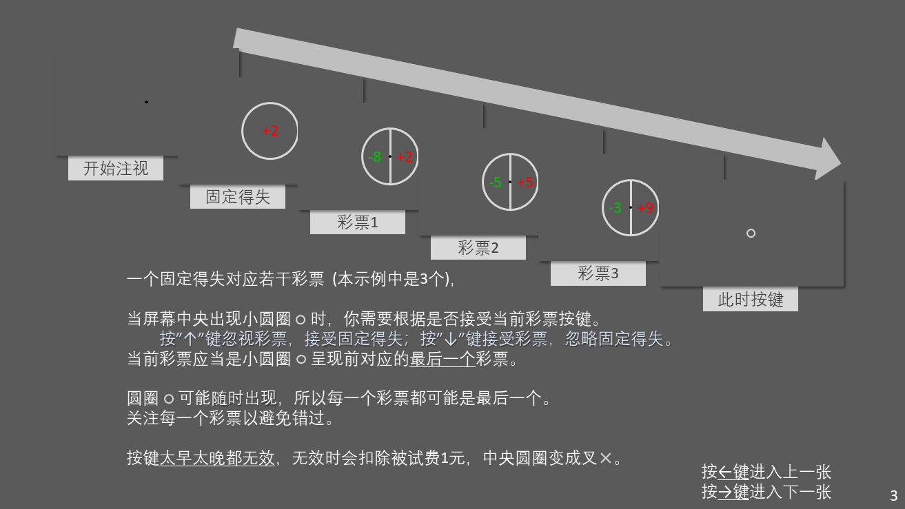
Design
5 conditions (random)
-2
+2
gain
1
2
3
4
…
9
loss
-1
-2
-3
-4
…
-9
7 lotteries (4/5) / exponential (1/5)
324 trials

Slide 3
Choice under each condition for subjects
safe
risky

Slide 4
utility functions of subjects
individuals
averaged

Slide 5
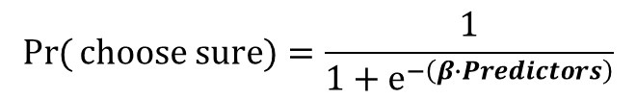
Each subject
$$\operatorname{Pr}{(}choose sure)=\frac{1}{1+e^{−\left(β∙Predictors\right)}}$$
(Betas normalized)

Slide 6
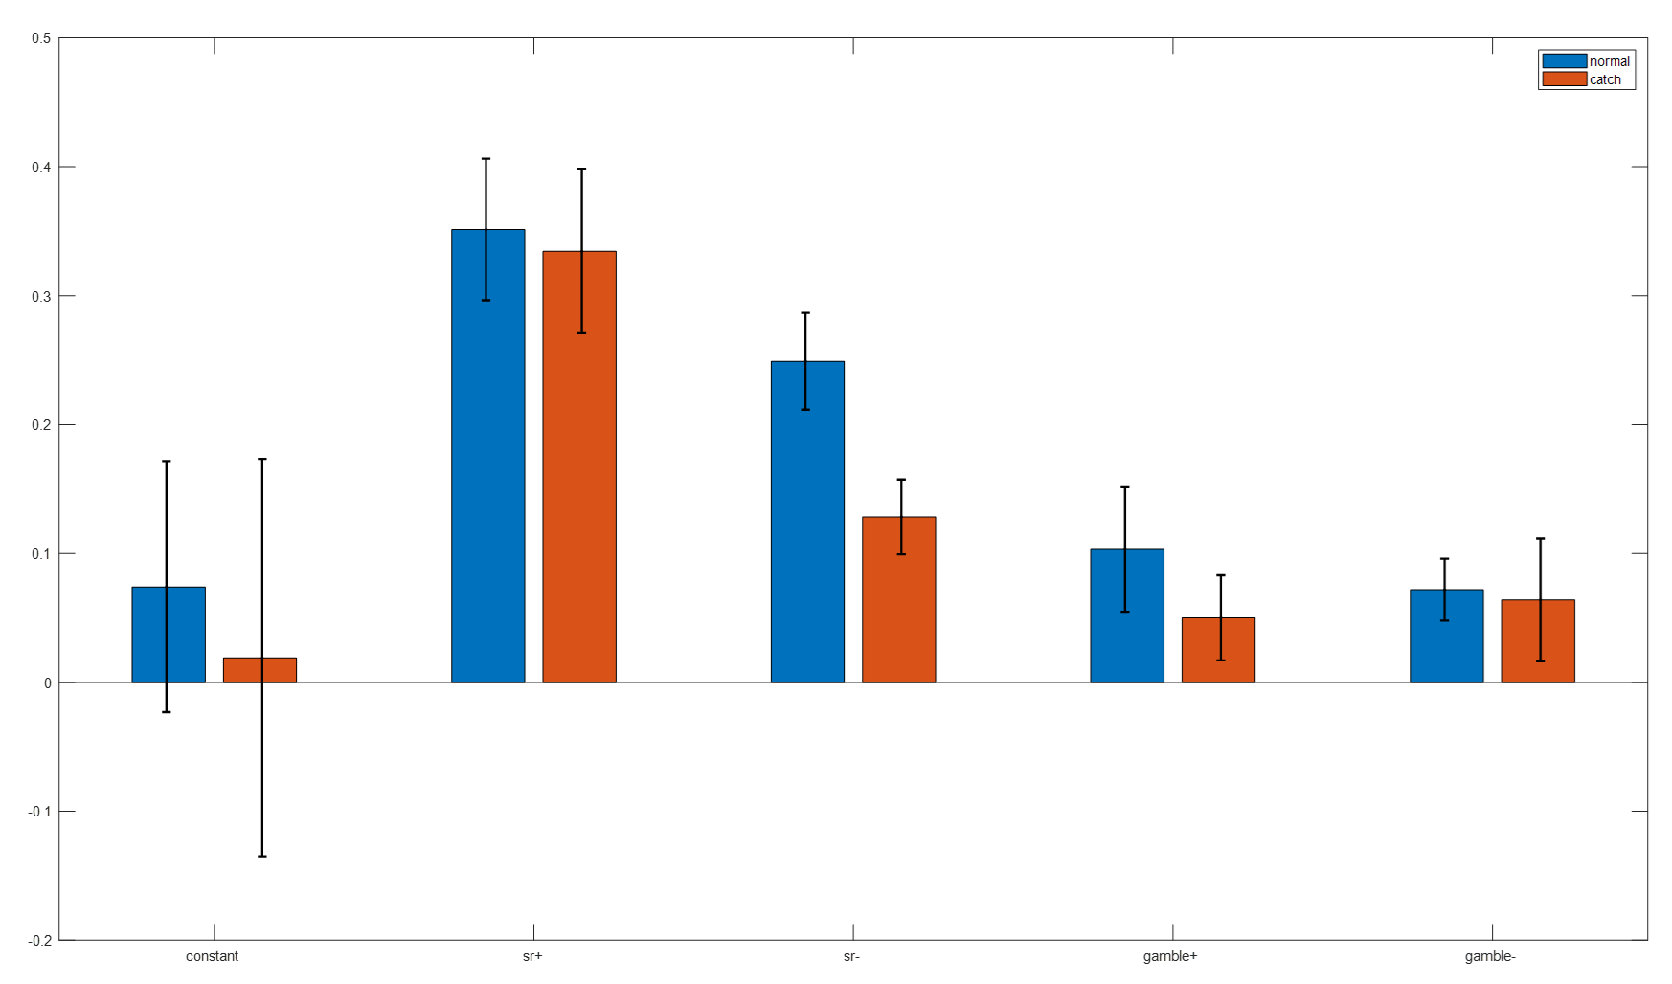
averaged
$$\operatorname{Pr}{(}choose sure)=\frac{1}{1+e^{−\left(β∙Predictors\right)}}$$

Slide 7
Block: averaged
$$\operatorname{Pr}{(}choose sure)=\frac{1}{1+e^{−\left(β∙Predictors\right)}}$$
(Betas normalized)

Slide 8
Serial effect ? For each subject

Slide 9
Serial effect ? averaged

