Slide 1
Exp. Design & Data
181116

Slide 2
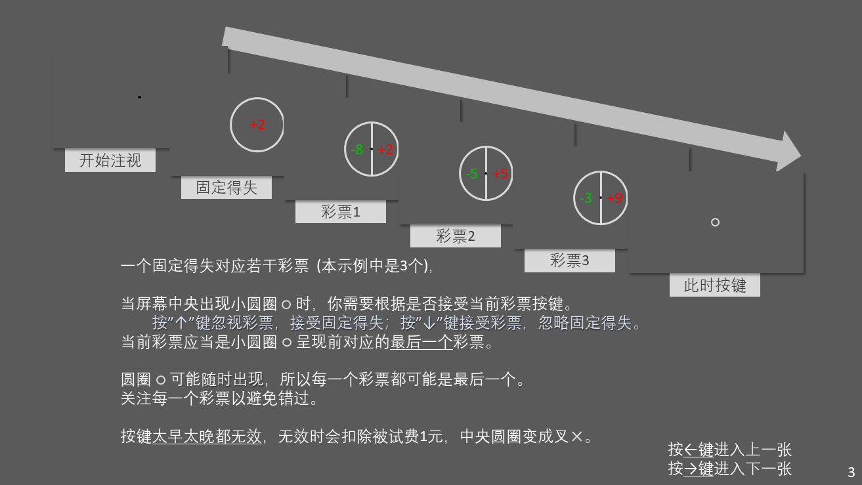
Design
5 conditions (random)
-2
+2
gain
1
2
3
4
…
9
loss
-1
-2
-3
-4
…
-9
7 lotteries (4/5) / exponential (1/5)
Normal
catch
324 trials

Slide 3
Choice under each condition for subjects
safe
risky

Slide 4
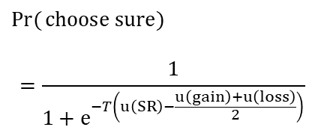
utility functions of subjects
individuals
$$\operatorname{Pr}{(}choose sure)$$
$$=\frac{1}{1+e^{−T\left(u\left(SR\right)−\frac{u\left(gain\right)+u\left(loss\right)}{2}\right)}}$$
averaged
中间一行与底行右图是加上Temperature后的plot,
另外的则没有加

Slide 5
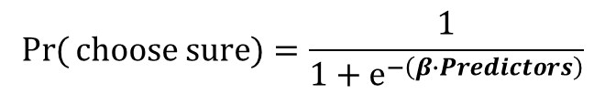
Each subject
$$\operatorname{Pr}{(}choose sure)=\frac{1}{1+e^{−\left(β∙Predictors\right)}}$$
(Betas normalized)
一般的试次中还好，但catch trial有的被试会忽略信息

Slide 6
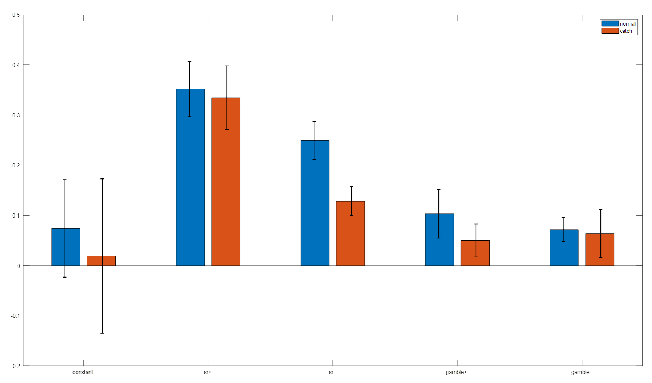
averaged
$$\operatorname{Pr}{(}choose sure)=\frac{1}{1+e^{−\left(β∙Predictors\right)}}$$
平均来看还可以，右下角小图是上次实验相同的结果，对比发现gamble的权重有提高

Slide 7
Block: averaged
$$\operatorname{Pr}{(}choose sure)=\frac{1}{1+e^{−\left(β∙Predictors\right)}}$$
(Betas normalized)
证明block顺序的效应不明显

Slide 8
Serial effect ? For each subject
前6个gambles对决策几乎没有影响

Slide 9
Serial effect ? averaged
前6个gambles对决策几乎没有影响

Slide 10
Reaction time ?
Normal trials
Catch trials
分析的试次取 RT>150 ms, 每列是一个被试

