Slide 1
Application Modernisation
Niel Zeeman @teamfoundation

Slide 2



The Monolith
Payment Gateway
Authentication
Static Site (Glossies)
Order Submission
User
Warehouse (Order fulfillment)
Catalogue
Cart / Checkout
Payment Process
Comms Gateway
History

Slide 3
The Monolith : Legacy ?
It works
No big updates in the last number years
Probably 2/3 tier architecture

Slide 4
The Monolith : Legacy !
Difficult to change
Error prone
Few tests (if any)
Slow
Can’t scale
3rd party integration updated/expensive
Security
It just not cool….
Time/Effort to
change or fix
Time since development started

Slide 5
Modern Applications
Microservices
Containers
Cloud
Serverless
ML / AI
Make it someone else’s problem
Agile/DevOps

Slide 6
The Monolith
Payment Gateway
Authentication
Static Site (Glossies)
Order Submission
User
Warehouse (Order fulfillment)
Catalogue
Cart / Checkout
Payment Process
Comms Gateway
History

Slide 7
The Transition..
Payment Gateway
Authentication
Static Site (Glossies)
Order Submission
User
Warehouse (Order fulfillment)
Catalogue
Payment Process
Cart / Checkout
Comms Gateway
History

Slide 8
The Transition..
Authentication
Payment Gateway
User
History
Static Site (Glossies)
Warehouse (Order fulfillment)
Catalogue
Cart / Checkout
Payment Process
Comms Gateway
Order Submission

Slide 9


The Transition..
Authentication
Authentication
Payment Gateway
User
History
Static Site (Glossies)
Warehouse (Order fulfillment)
Catalogue
Cart / Checkout
Payment Process
Comms Gateway
Order Submission

Slide 10


The Transition..
Authentication
Payment Gateway
User
History
Static Site (Glossies)
Static Pages
Warehouse (Order fulfillment)
Catalogue
Cart / Checkout
Payment Process
Comms Gateway
Order Submission

Slide 11
The Transition..
Authentication
Payment Gateway
User
History
Static Pages
Warehouse (Order fulfillment)
Catalogue
Cart / Checkout
Payment Process
Comms Gateway
Order Submission

Slide 12












The Catalogue
Catalogue
Web
Images
Monitor
Cache
Search

Slide 13
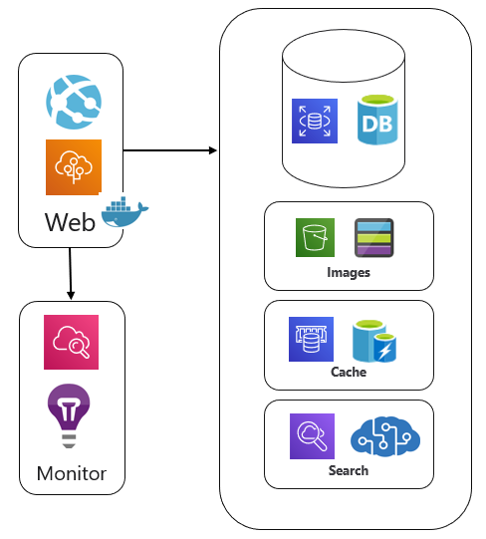
The Transition..
Authentication
Payment Gateway
User
History
Static Pages
Warehouse (Order fulfillment)
Catalogue
Cart / Checkout
Payment Process
Comms Gateway
Order Submission

Slide 14




The Cart
Cart / Checkout
Web
Queue
Monitor

Slide 15
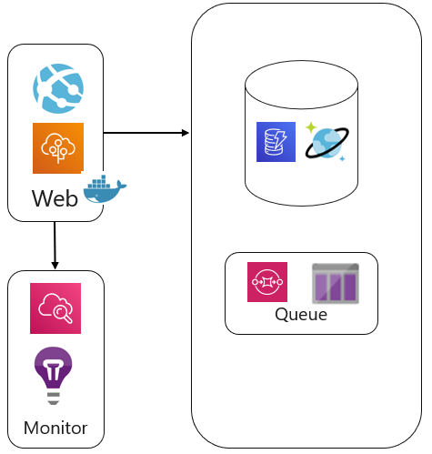


The Transition..
Authentication
Payment Gateway
User
History
Static Pages
Warehouse (Order fulfillment)
Catalogue
Cart / Checkout
Payment Process
Payment Process
Comms Gateway
Order Submission

Slide 16



The Order Process
Order Submission
Warehouse System Interface
Warehouse System
Queue
Communication

Slide 17


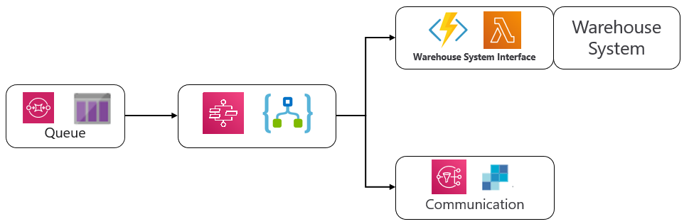
The Transition..
Authentication
Payment Gateway
User
History
History
Static Pages
Catalogue
Cart / Checkout
Payment Process
Comms Gateway
Order Submission

Slide 18
The Transition..
Authentication
Payment Gateway
User
History
Static Pages
Catalogue
Cart / Checkout
Payment Process
Comms Gateway
Order Submission

Slide 19




The Transition..
Authentication
CDN
User
Payment Gateway
History
Static Pages
API Gateway
Catalogue
Cart / Checkout
Payment Process
Comms Gateway
Order Submission

Slide 20






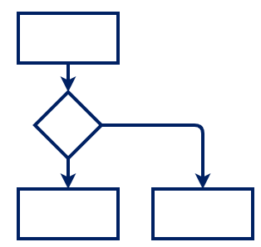











The Transition..
CDN
Auth
Global Access Point
Web
Queue
Workflow
Gateway
Functions
3rd Party

Slide 21










The Transition..
CDN
Auth
Global Access Point
Web
Queue
Workflow
Gateway
Functions
3rd Party
CLI

Slide 22
The Transition..
CDN
Auth
Global Access Point
Web
Queue
Workflow
Gateway
Functions
3rd Party
CLI

Slide 23
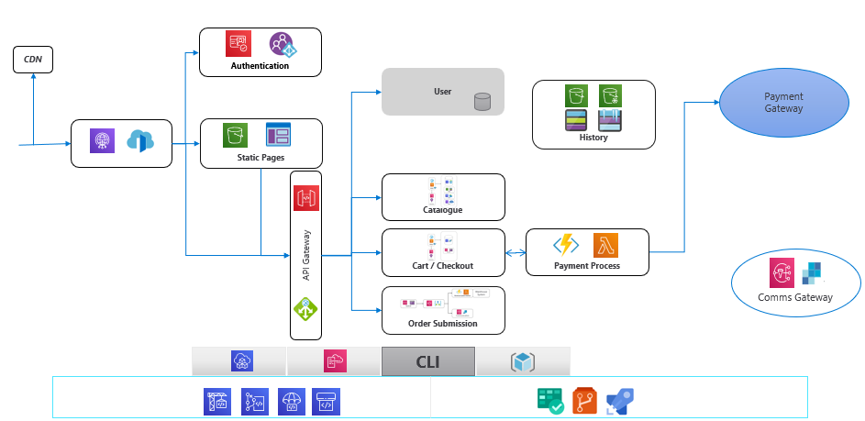
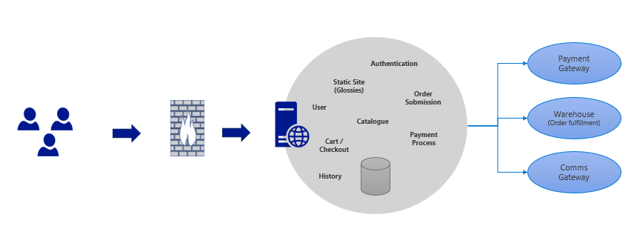
Niel Zeeman @teamfoundation

