Slide 1
GO-RUN
NMDAD 1 – Niel Duquesne
2MMPa PROduce

Slide 2
1. Discovery

Slide 3
Briefing
Joggers
Eigen traject
Kinderen/Hond?

Slide 4
2. Define

Slide 5
Analysis
https://datatank.stad.gent/4/milieuennatuur/parken.xml
https://datatank.stad.gent/4/infrastructuur/hondenvoorzieningen

Slide 6
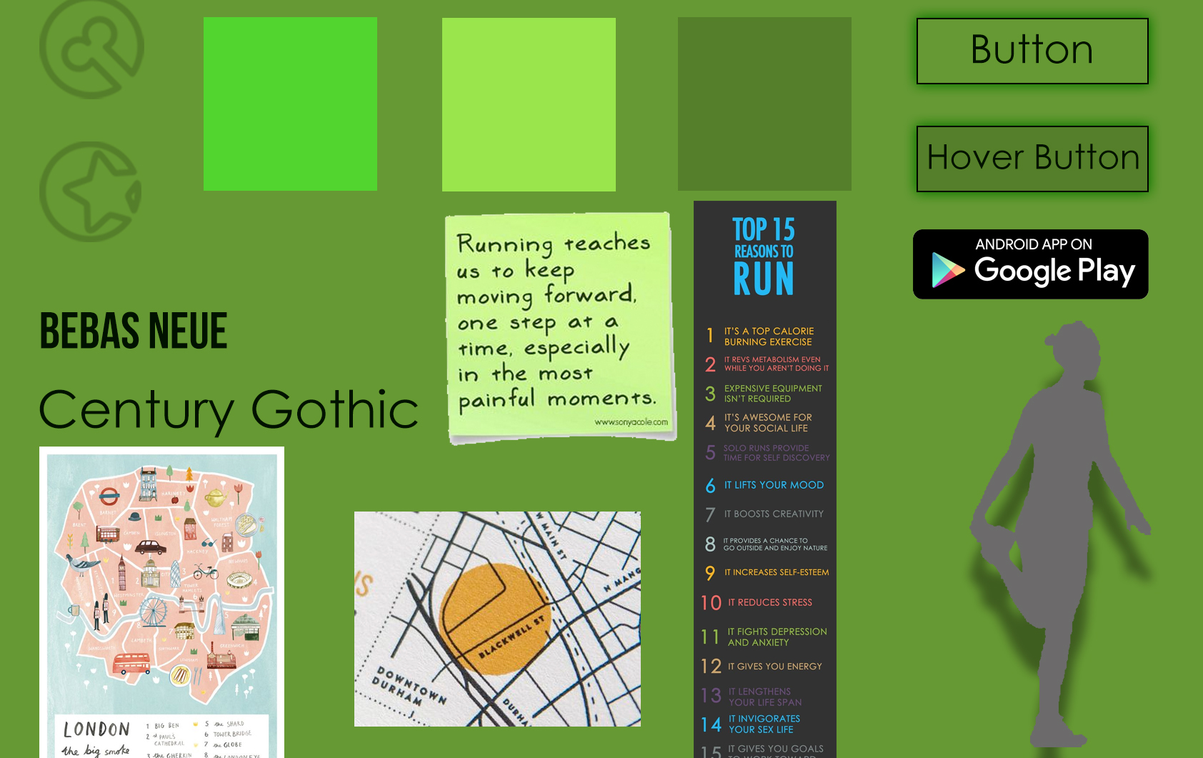
Ideaboard

Slide 7
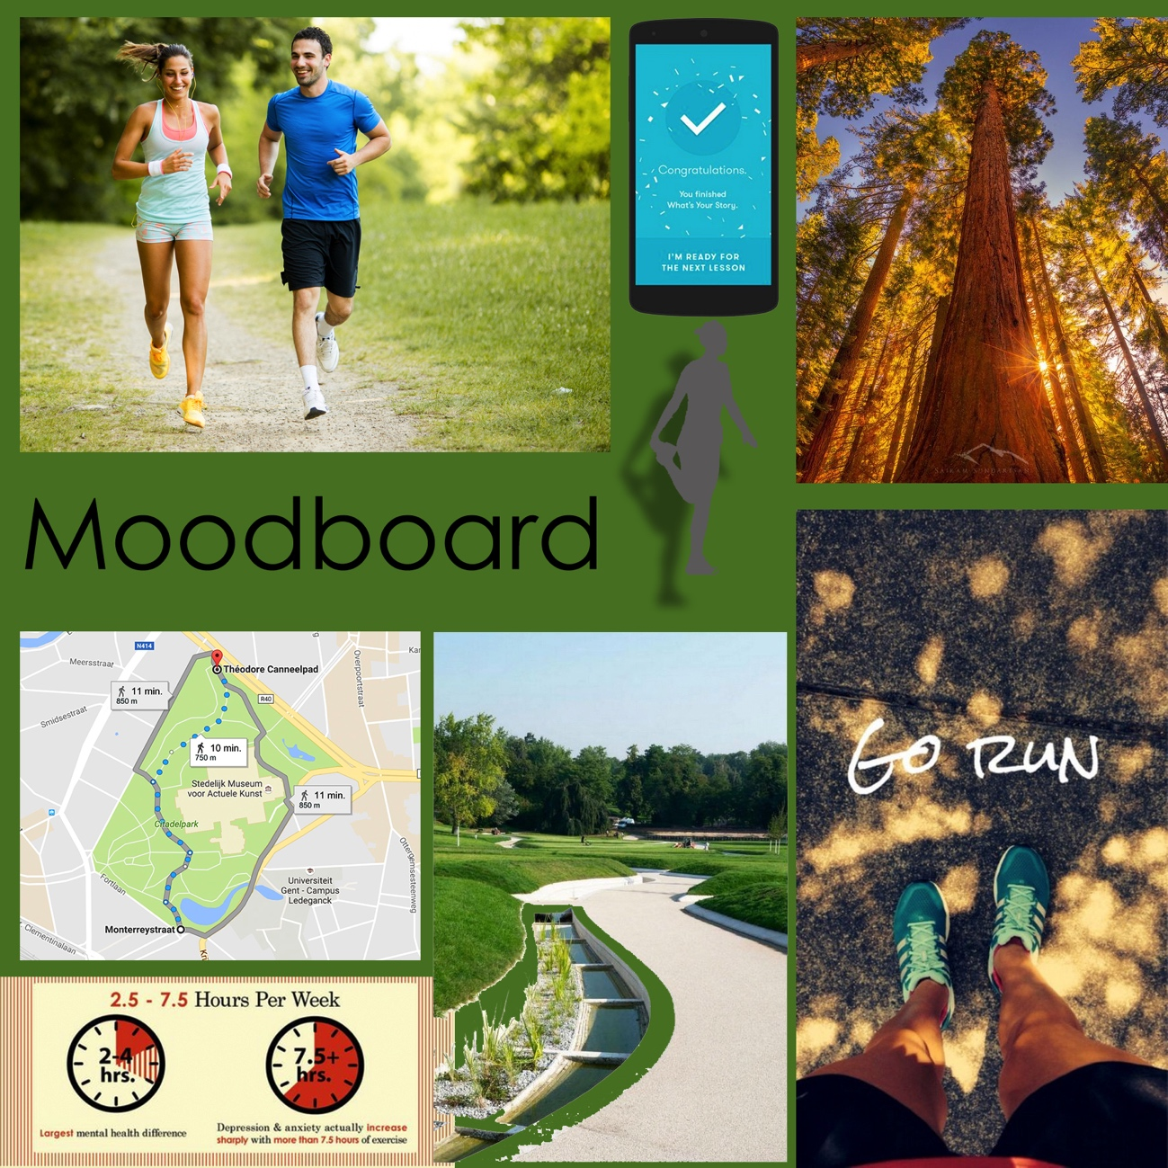
Moodboard

Slide 8
3. Design

Slide 9
Sitemap

Slide 10
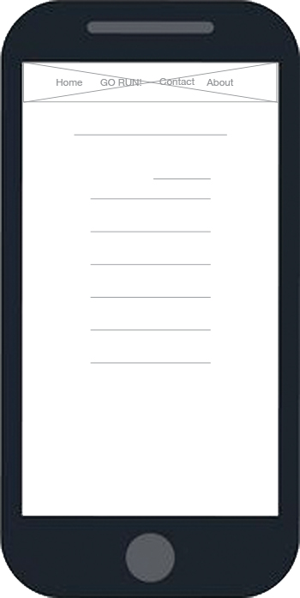
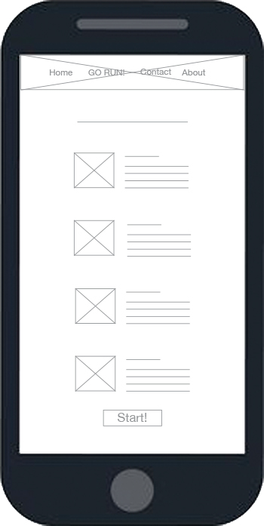
Wireframes Mobile
Home
GO-RUN

Slide 11
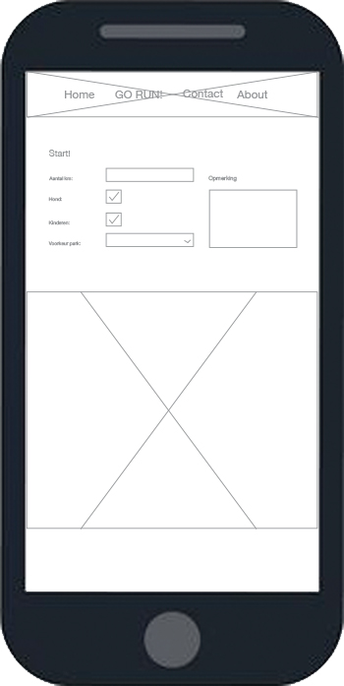
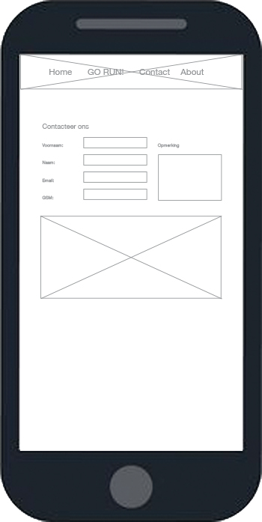
Wireframes Mobile
START
Contact

Slide 12
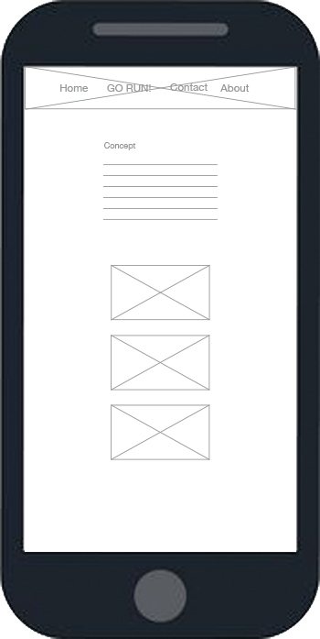

Wireframes Mobile
Concept
About us

Slide 13


Wireframes Desktop
Home
GO-RUN

Slide 14
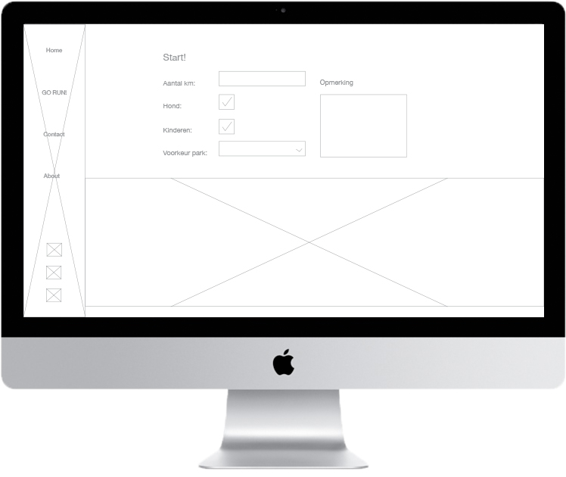
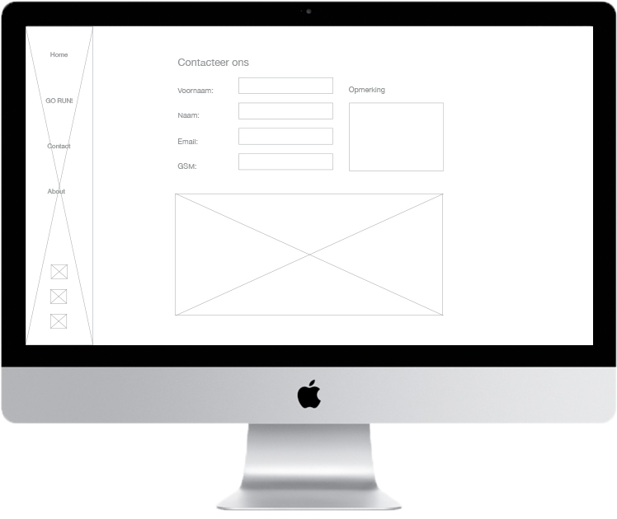
Wireframes Desktop
START
Contact

Slide 15
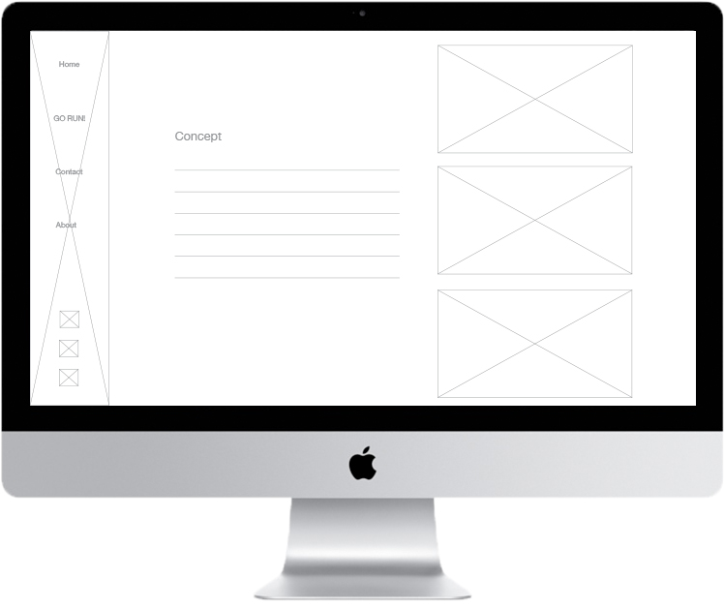
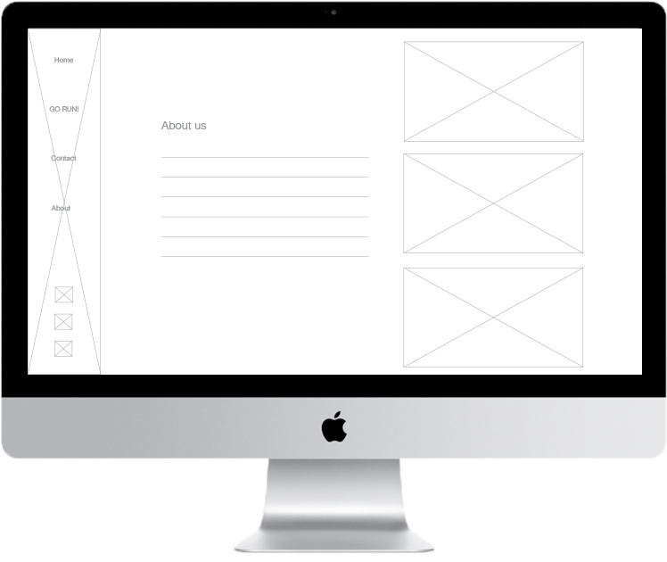
Wireframes Desktop
Concept
About us

