Slide 1



RsienaTwoStep
Relaxing RSiena’s MiniStep Assumption
Jochem Tolsma
www.jochemtolsma.nl
https://jochemtolsma.github.io/RsienaTwoStep
j.tolsma@rug.nl

Slide 2
RsienaTwoStep
Team Science:
Relaxing the ministep assumption
  Marijtje van Duijn
  Christian Steglich
  Niels Vullings
  Andreas Flache
  Tom Snijders
Open Sciece
https://jochemtolsma.github.io/RsienaTwoStep

Slide 3
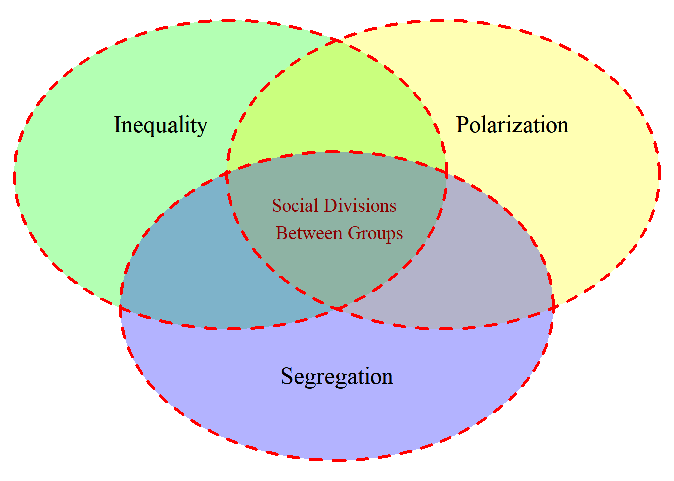
RsienaTwoStep – theoretical motivation
Influence/adoption processes
Selection processes

Slide 4
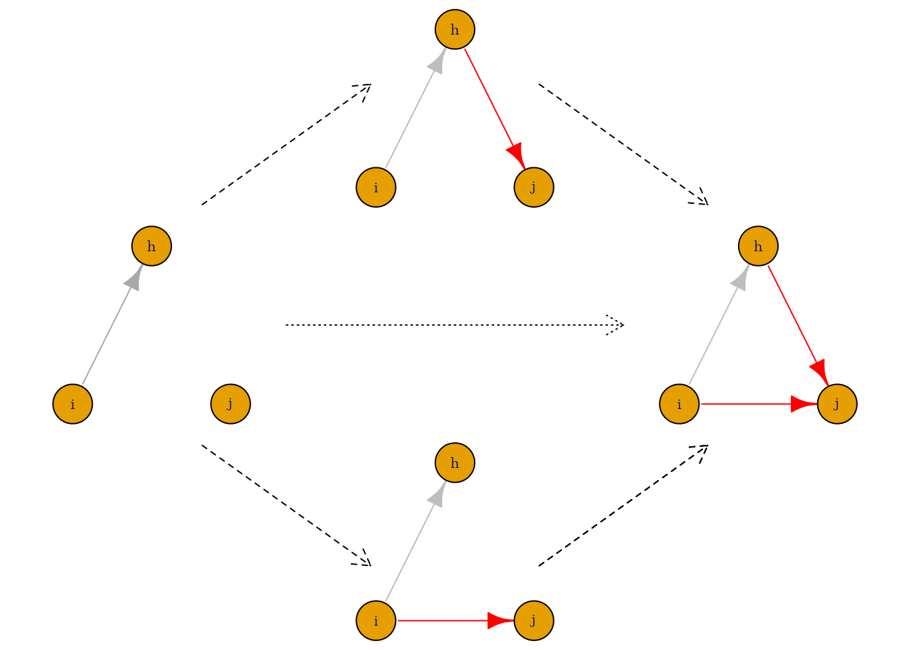

RsienaTwoStep – methodological motivation

Slide 5
RsienaTwoStep – methodological motivation

Slide 6
RsienaTwoStep – methodological motivation

Slide 7
RSiena’s MiniStep
“The Stochastic Actor-Oriented Model can be regarded as an agent-based (‘actorbased’) simulation model of the network evolution; where all network changes are decomposed into very small steps, so-called ministeps, in which one actor creates or terminates one outgoing tie.”
“…it does not necessarily reflect a commitment to or belief in any particular theory of action elaborated in the scientific disciplines.”
“It is assumed that actors change their scores on the dependent variable (tie or behavior) such that they improve their total satisfaction […] with her/his local network neighborhood configuration.”
“Actors only evaluate all possible results in the local network neighborhood configurations that result from one ministep.”

Slide 8
RSiena’s MiniStep
No reactivity: The act of re-affirming, making or breaking an outgoing tie does not trigger a response by the involved alter
No simultaneity (no joint actions): Changes occur one by one
  Hence also no cooporation, coordination, subordination, or negotiation
No maximization of total utility:
  No altruistic behavior: Individual utility is maximized, not total utility
No strategic interaction:
  Very finite time horizon. Agents do not predict how future local network neighborhood may change after:
    Making another ministep him/herself
    A ministep of other agents
  Hence also no investments
  No forward-looking rationality

Slide 9
RSiena’s MiniStep
No reactivity: The act of making or breaking an outgoing tie does not trigger a response by the involved alter
Tom Snijders implemented a new modeltype in RSiena: ‘ReactiveStep’
  The act of making or breaking an outgoing tie triggers a response by the involved alter

Slide 10
RsienaTwoStep – Relaxing RSiena’s MiniStep Assumption

Slide 11
RsienaTwoStep – goal
The goal of RsienaTwoStep is:
to provide a method to assess the extent to which results obtained by RSiena::siena07() depend on the validity of the MiniStep assumption.
to test hypotheses concerning selection and influence processes under different theoretical assumptions regarding the ‘Theory of Inter-Action’
to improve the chances to reach model convergence (the larger the network the less likely the ministep assumption is)
to generate hypotheses regarding the ‘Theory of Interaction’.
to test hypotheses regarding the ‘Theory of Interaction’.

Slide 12
RsienaTwoStep – goal
The SAOM of RsienaTwoStep as ABM:
Generate hypotheses regarding the ‘Theory of Interaction’.
  When and why do different Theories of Interaction make emergent network properties (e.g. segregation, polarization) more likely to occur?
  Identify ‘critical assumptions’
The ‘Mechanism of Interaction’ or the Data Generation Process is unobserved!

Slide 13
RsienaTwoStep – capabilities
RsienaTwoStep:
Closely follows the logic of RSiena under different Theories of Interaction
Co-evolution of networks and behavior
Only uniplex directed networks
Only twostep, no three-steps or many-steps
Estimation of networks is slow.

Slide 14
RsienaTwoStep – Theory of Interaction
RSiena:
  MiniStep: one actor one step
  ReactiveStep: one actor one step – step triggers a response
RsienaTwoStep
  MiniStep: one actor one step
  TwoStep: two actors one step – at the same time
  SimStep: one actor two steps – at the same time

Slide 15
TwoStep versus MiniStep
TwoStep versus MiniSteps
note: Dashed arrows represent ministeps (long dash) or twostep (short dash); solid arrows represent initial ties (grey) or created ties (red)

Slide 16
TwoStep versus MiniStep
TwoStep versus MiniSteps
note: Dashed arrows represent ministeps (long dash) or twostep (short dash); solid arrows represent initial ties (grey) or created ties (red)

Slide 17
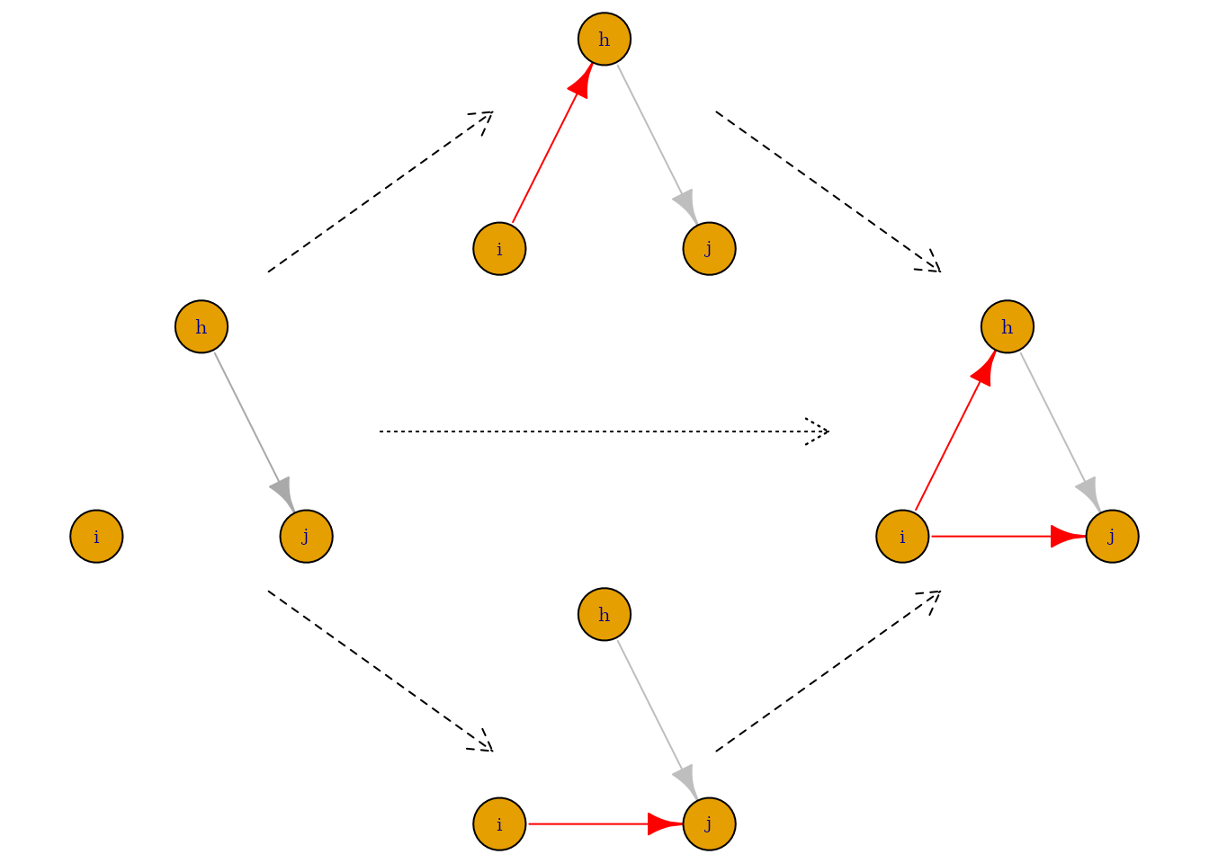
SimStep versus MiniStep
SimStep versus MiniSteps
note: Dashed arrows represent ministeps (long dash) or simstep (short dash); solid arrows represent initial ties (grey) or created ties (red).

Slide 18
SimStep versus MiniStep
SimStep versus MiniSteps
note: Dashed arrows represent ministeps (long dash) or simstep (short dash); solid arrows represent initial ties (grey) or created ties (red).
Notes:
Correct sequence?
Rsiena: no social interdependence

Slide 19
RsienaTwoStep – Theory of Interaction
TwoStep
  Simultaneity: Two random agents may make a ministep at the same time
  TwoStep Strict coordination: Agents connected at T1 may make a ministep at the same time
  TwoStep Weak coordination (network evolution only):
      Only specific twosteps are considered to be the results of coordination:
        Those of agents who were connected at T1
        Those of agents who became connected at T2
Notes: Connection at T1/T2 can be user-defined based on path length and tie-direction
Twostep is closely related to one-step network foresight (talk Károly Takács)
Adopting something together, crossing the threshold together (talk Francesco Renzini)

Slide 20
RsienaTwoStep – Strict coordination (connected at T1)

Slide 21
RsienaTwoStep – Strict coordination (connected at T1)
Red agents can initiate the twostep

Slide 22
RsienaTwoStep – weak coordination (connected at T1 or T2)

Slide 23
RsienaTwoStep – weak coordination (connected at T1 or T2)
Red agents can initiate the twostep
And all networks that result from the two ministeps

Slide 24
RsienaTwoStep – weak coordination (connected at T1 or T2)
Red agents can initiate the twostep – but only some twosteps are seen as coordinated twosteps

Slide 25
RsienaTwoStep – weak coordination (connected at T1 or T2)
Red agents can initiate the twostep – but only some twosteps are seen as coordinated twosteps

Slide 26
RsienaTwoStep – relaxing the ministep assumption
RsienaTwoStep is able to mix ministeps, (a specific type of) twosteps and simsteps in one simulation/estimation with given probabilities.

Slide 27

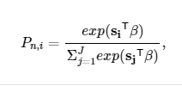
RsienaTwoStep – Evaluation function
Evaluation function:
with s_{i} a vector of the value of each network statistics for network i given agent n. β is the vector of parameter values. Hence, s_{i}^{T}β is the value of the evaluation that agent n attaches to network i.
Choice function:
With P_{n,i} the probability that actor n chooses network i.

Slide 28


RsienaTwoStep – Evaluation function
When modelling TwoSteps, the evaluation function is simply the sum of the evaluation function of the two actors involved for the respective possible local network neighborhood configurations after the twostep. Thus the evaluation function becomes:
Where n and m indixes the involved actors. Note that the evaluated network i is the same but the value of the statistics s_{i} may be different for the two actors.
The corresponding choice function then becomes:
The dyad nm is now the decision agent. Am I wrecking Colaman’s boat?

Slide 29
RsienaTwoStep – Evaluation function
The dyad nm is now the decision agent and aim to maximize their joint evaluation.
This is an assumption!!
Other options (not implemented in RsienaTwoStep):
Actor n dominates m, actor n decides and maximizes its own evaluation (i.e. coercion)
Actor n dominates m, actor n decides and maximizes/minimizes difference in evaluation
Actor n and m need to reach consensus

Slide 30
RsienaTwoStep – Evaluation function
When modelling SimSteps, the evaluation function is simply the evaluation function of the actor involved for the respective possible local network neighborhood configurations after the SimStep.

Slide 31
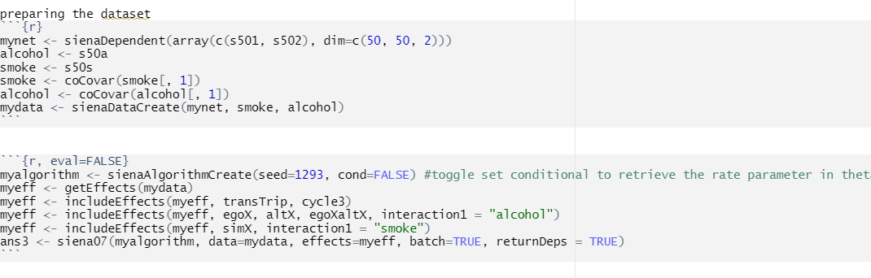
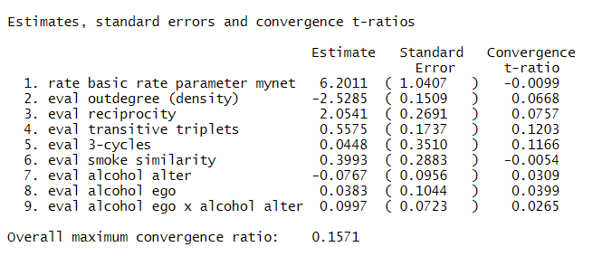
Results – Estimation Example
excerpt from "Teenage Friends and Lifestyle Study"

Slide 32
RsienaTwoStep – Estimation example
 | ministepª |  | simultaneity^{b} |  | weak coordination^{c} |  | strict coordination^{d} |  | simstep^{e}
 | Estim | SE | Estim | SE | Estim | SE | Estim | SE | Estim | SE
rate | 6.230 | 1.007 | 6.002 | 0.923 | 6.852 | 1.284 | 5.805 | 0.941 | 5.560 | 0.875
degree | -2.521 | 0.143 | -2.523 | 0.124 | -4.560 | 0.725 | -2.266 | 0.124 | -3.058 | 0.215
recip | 2.046 | 0.282 | 2.014 | 0.252 | 3.205 | 0.567 | 1.666 | 0.265 | 2.575 | 0.395
transTrip | 0.543 | 0.173 | 0.525 | 0.136 | 0.963 | 0.285 | 0.369 | 0.116 | 0.659 | 0.135
cycle3 | 0.058 | 0.316 | 0.049 | 0.297 | 0.285 | 0.598 | 0.052 | 0.256 | -0.027 | 0.439
simX smoke | 0.412 | 0.281 | 0.387 | 0.365 | 0.655 | 0.477 | 0.375 | 0.277 | 0.544 | 0.395
altX alcohol | -0.069 | 0.094 | -0.069 | 0.105 | -0.100 | 0.134 | -0.070 | 0.094 | -0.086 | 0.121
egoX alcohol | 0.038 | 0.093 | 0.044 | 0.108 | 0.034 | 0.141 | 0.049 | 0.079 | 0.074 | 0.128
egoXaltX alcohol | 0.099 | 0.075 | 0.098 | 0.077 | 0.113 | 0.112 | 0.090 | 0.064 | 0.134 | 0.089
ª tconv.max: 0.098
^{b} tconv.max: 0.251
^{c} tconv.max: 0.746
^{d} tconv.max: 1.072
^{e} tconv.max: 0.282

Slide 33
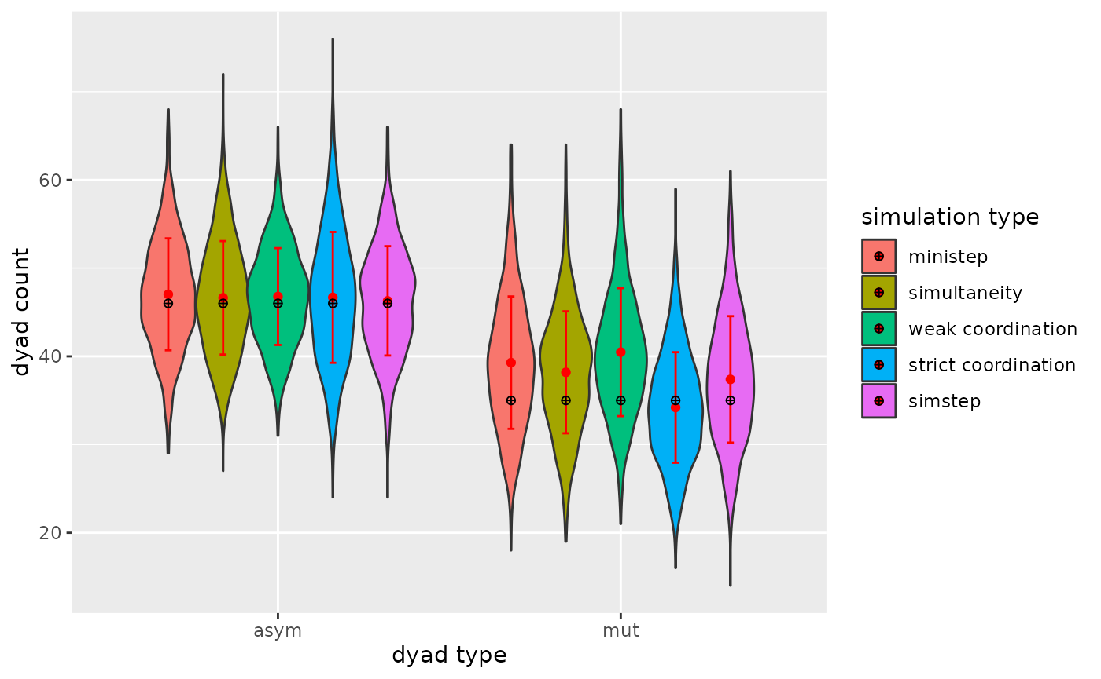
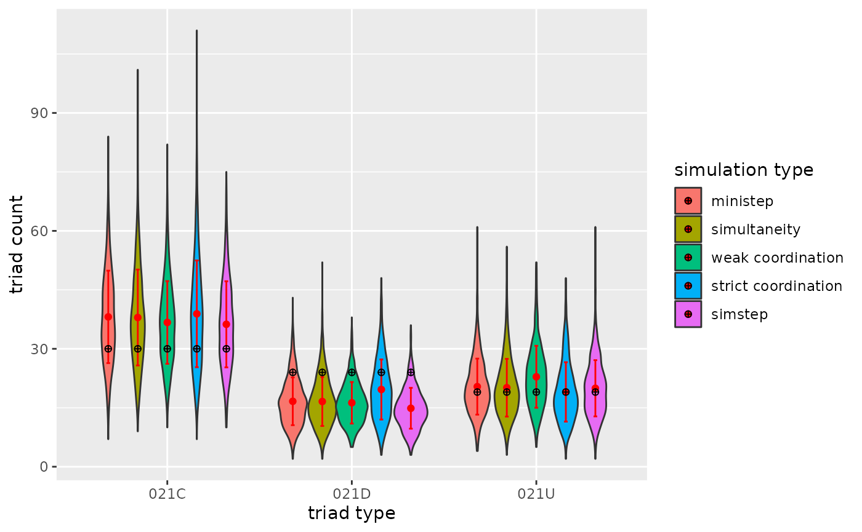
RsienaTwoStep – Estimation example
GOF as test for DGP: Talk of Francesco Renzini?

Slide 34
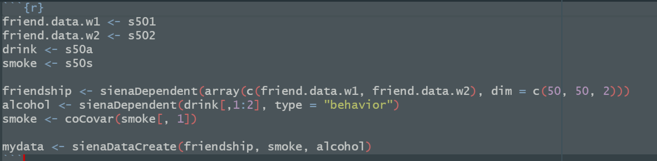
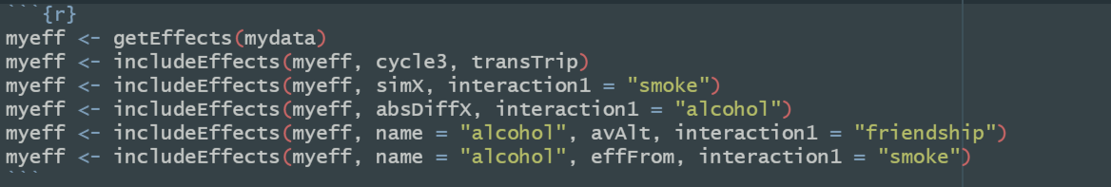
RsienaTwoStep – Simulation example

Slide 35
RsienaTwoStep – Simulation example
stats | simvalue
Rate | 6.000
degree | -2.092
recip | 1.998
transTrip | 0.558
cycle3 | 0.048
simX smoke | 1.000
absDiffX alcohol | -1.000
Rate beh | 6.000
linear | 0.314
quad | -0.333
avAlt friendship | 2.000
effFrom smoke | 0.065

Slide 36
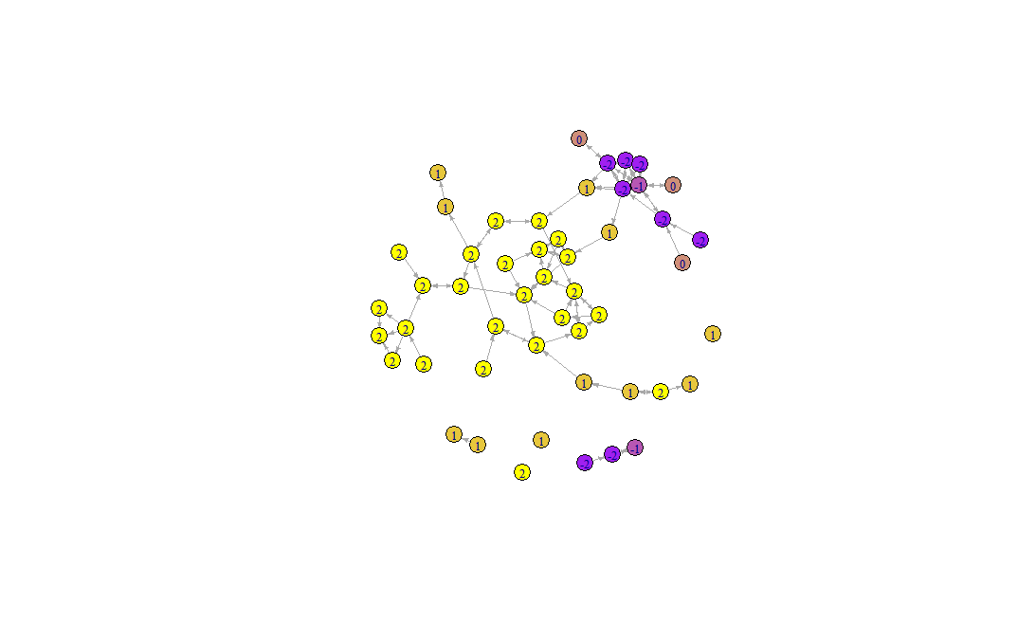
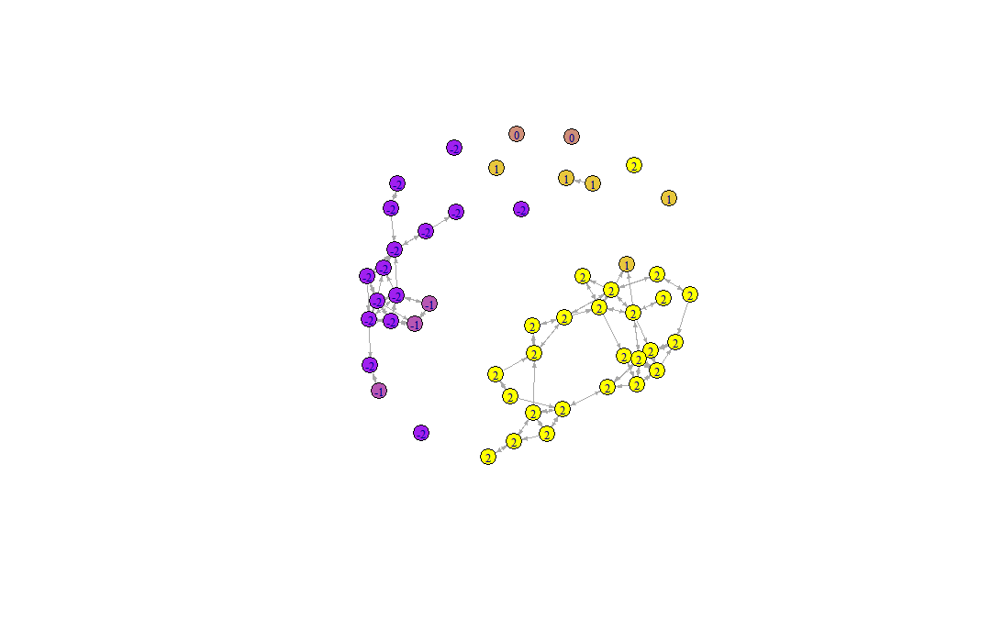
RsienaTwoStep – Simulation example
Ministep
TwoStep: Strict coordination

Slide 37
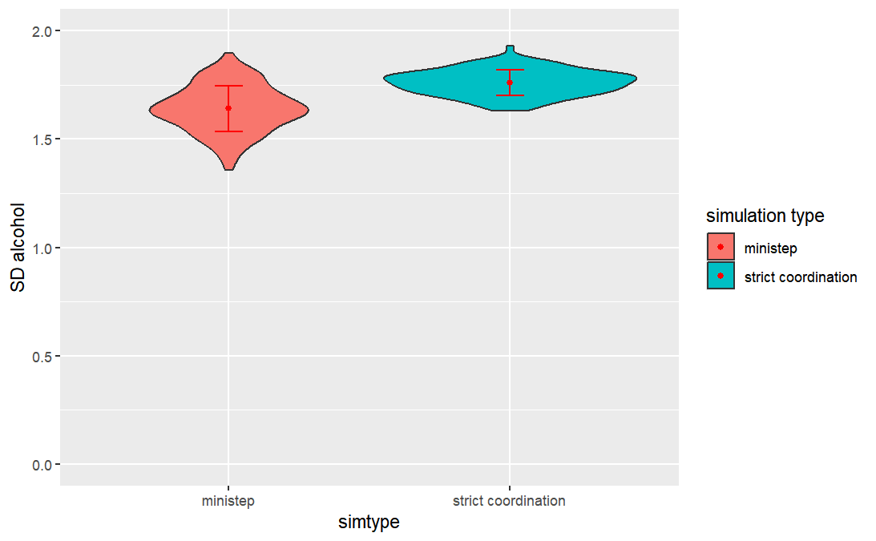
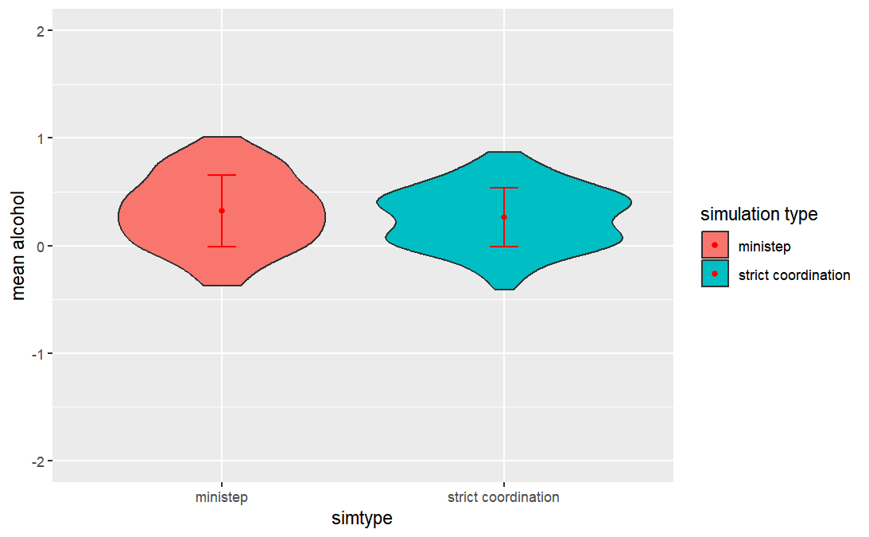
RsienaTwoStep – Simulation example

Slide 38
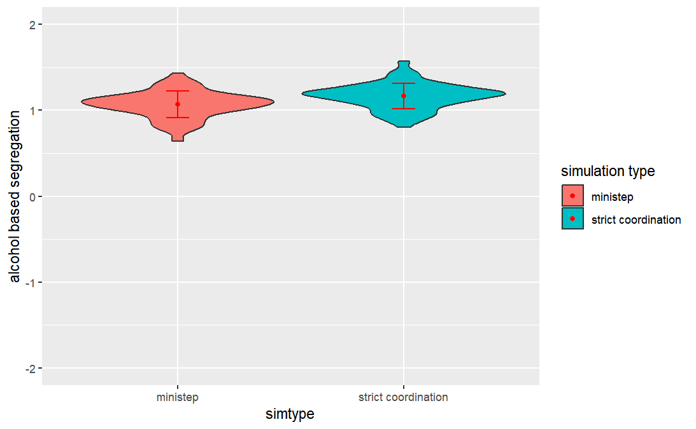
RsienaTwoStep – Simulation example

Slide 39
Conclusions
Estimation:
Some indication that both estimates of network/behavior statistics and GOF may depend on Theory of Interaction.
Naturally only investigated one (probably not the most interesting) dataset and a limited set of network/behavior statistics.
Simulation:
We demonstrate that the Theory of Interaction may impact the severity of polarization and segregation (or at least the speed at which it develops).
Naturally only investigated a very small (probably not the most interesting) slice of the possible parameter space.
If you use the SAOM of RSiena in ABM, be aware that you are making implicit (but probably important) assumptions with respect to the Theory of Interaction

Slide 40
Thank you!
Jochem Tolsma
www.jochemtolsma.nl
https://jochemtolsma.github.io/RsienaTwoStep
j.tolsma@rug.nl

Slide 41
Work in progress
Estimation:
Find a dataset that we could use to make our case:
  Not too big
  Coordination likely

Slide 42
Conclusions
Network development:
Simultaneity: no impact
SimStep: no impact
Coordinated TwoSteps make it more likely that specific network structures develop.
Coordinated TwoSteps (may) cause networks to develop faster.
Coordinated TwoSteps lead to more variance in the structure of simulated networks

Slide 43
Conclusions
Network development:
Simultaneity: no impact
SimStep: no impact
Coordinated TwoSteps: impact
Parameter estimation:
Estimation of network statistics (under the MiniStep) assumption is robust if the ministep assumption is violated…
  …but what is robust?
  …to a lesser extent when actors coordinate selection processes
  …always?

Slide 44
Conclusions
Network development:
Simultaneity: no impact
SimStep: no impact
Coordinated TwoSteps: impact
Parameter estimation:
RSiena estimates: robust
Rsiena MiniStep and RSiena ReactiveStep lead to similar parameters estimates
  …with the exception of the rate parameter
  …suspiciously similar?

Slide 45
Tentative Conclusions
Network development:
Simultaneity: no impact
SimStep: no impact
Coordinated TwoSteps: impact
Parameter estimation:
RSiena estimates robust
Rsiena MiniStep and RSiena ReactiveStep: similar estimates
Thank you!

Slide 46
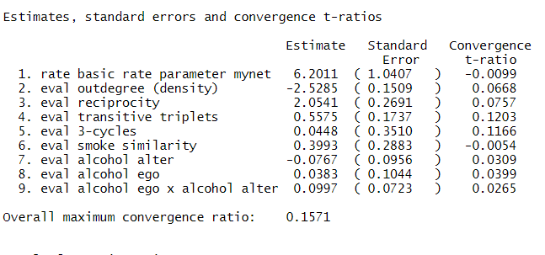
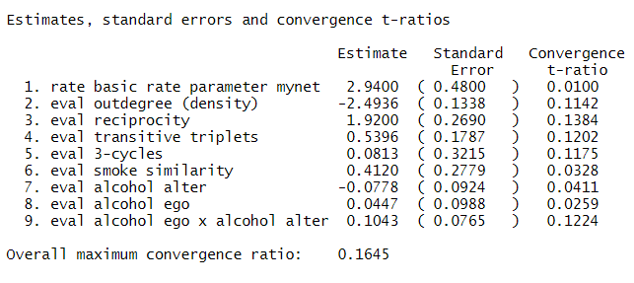
MiniStep vs. ReactiveStep
MiniStep
ReactiveStep

Slide 47
RsienaTwoStep – Evaluation function
TwoStep simultaneity

Slide 48
RsienaTwoStep – evaluation function
TwoStep simultaneity
Suppose our evaluation function only contains statistics for degree and reciprocity.

Slide 49
RsienaTwoStep – evaluation function
TwoStep simultaneity
Isomorphic networks may lead to different evaluation scores:

Slide 50
RsienaTwoStep – evaluation function
TwoStep simultaneity
Isomorphic networks may lead to different evaluation scores:
The same statistic may be counted double: see the example of reciprocity.
RsienaTwoStep – simulation: No problem
RsienaTwoStep – estimation: to keep the interpretation of the network statistics (evaluation function) similar to Rsiena, we may want to distinguish ‘shared network configurations’ from ‘individual network configurations’.

Slide 51
RsienaTwoStep – evaluation function
To do:
Degree distribution
Data simuleren waarop rsiena faalt
  Welke statistieken
  Wat is falen:
    Fit model niet (target values)
    Andere estimates
    Homophily
  Toets op stricte coordinatie: path length 1.
  egox en altx simuleren in de hoop dat rsiena samex terugschat.
  samex simuleren en terugschatten
  Zien netwerken er na simulatie niet vreemd uit. – te vol, te veel/weinig segregatie
Evaluatiefunctie
  Nu nog niet aanpassen. Dit lijkt op gelijkwaardigheid.
  Indien actoren niks te winnen met coordinatie (allebei meer evaluatie dan zonder coordinatie), dan vervalt het tot ministep.
Coordinatie:
Hoe schatten

Slide 52
RsienaTwoStep – Theory of Interaction
RSiena:
  MiniStep: one actor one step
  ReactiveStep: one actor one step – step triggers a response
  Actors more likely to consider a change (i.e. make ministep) if their situation changed.
RsienaTwoStep
  MiniStep: one actor one step
  Limited Ministep: one actor one step but not all steps are possible/considered
  You are only aware of actors to whom you are (indirectly) connected. Or, actors have limited information and only evaluate possible ministep to actors of whom information is (assumed) available.
  TwoStep: two actors one step – at the same time
  Coordination / cooporation / collaboration
  SimStep: one actor two steps – at the same time
  Strategic behavior / crossing a hurdle

Slide 53
RsienaTwoStep – simultaneity

Slide 54
RsienaTwoStep – simultaneity
Red agents can initiate the twostep

Slide 55
RsienaTwoStep – simultaneity
Red agents can initiate the twostep

Slide 56
RsienaTwoStep – simultaneity
Red agents can initiate the twostep

Slide 57
SAOM – estimation versus simulation
Estimation:
We collect empirical data for at least two time points
We accept ‘fundamental’ model assumptions regarding the Theory of Interaction
We formulate hypotheses regarding the theory of Interaction
We make new auxilliary model assumptions: ‘no Omitted Statistics Bias’
We test hypotheses: which we may not be able to refute given:
  data collected at Time 1
  our assumptions
Simulation:
We generate initial state(s)
We formally construct a Theory of Interaction
We make implementation assumptions (same Theory of Interaction but different code)
We generate hypotheses: which combination of characteristics of initial states and theory of interaction might

Slide 58
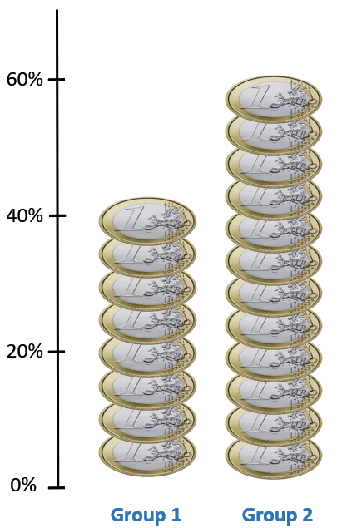
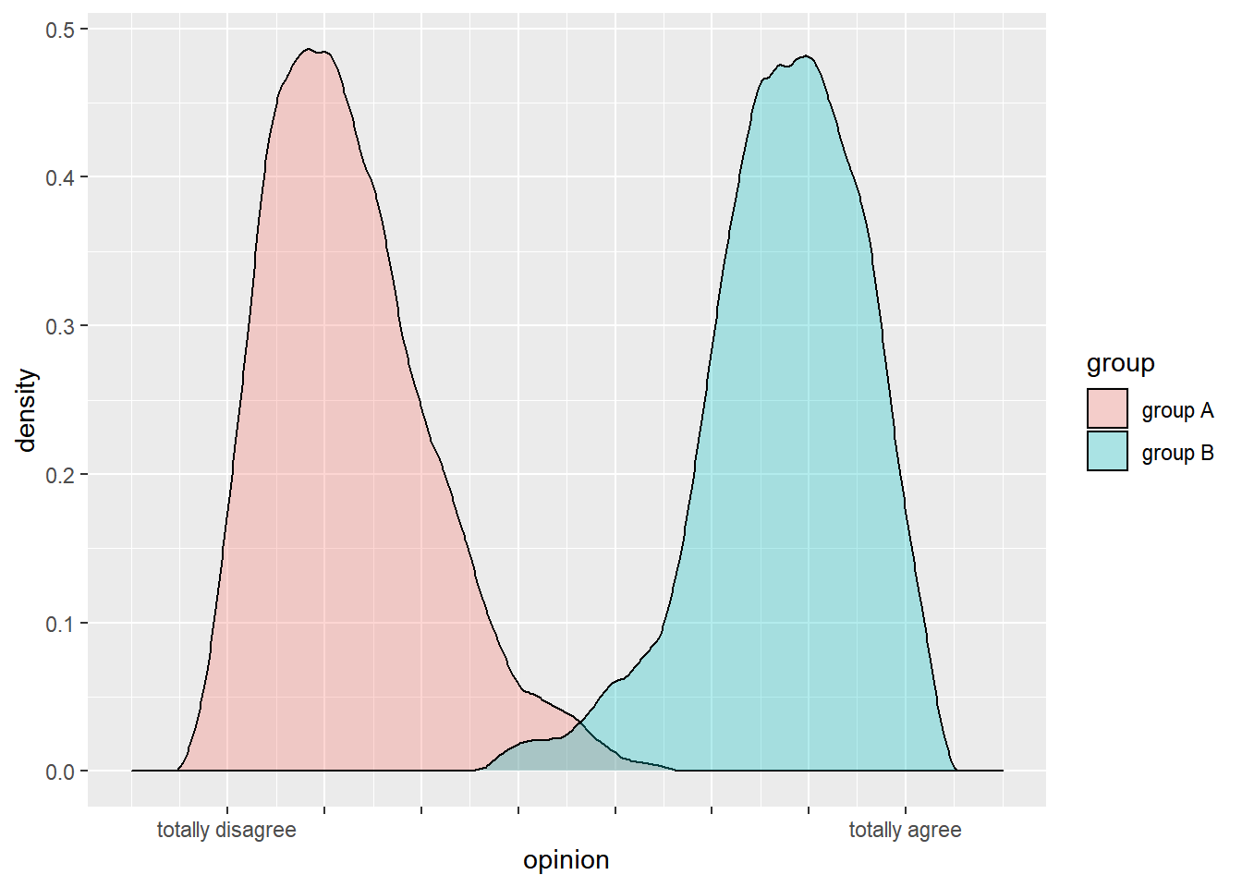
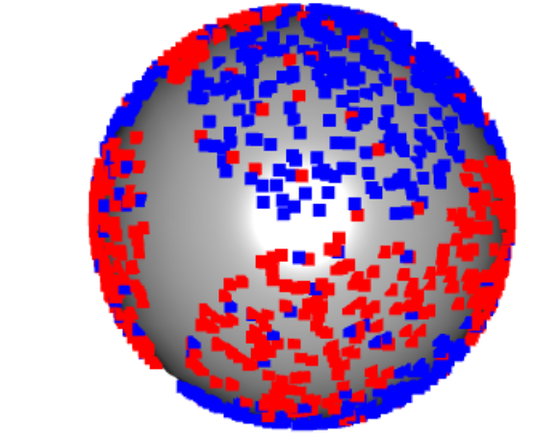
RsienaTwoStep – theoretical motivation

