Slide 1



RsienaTwoStep
Relaxing RSiena’s MiniStep Assumption
Jochem Tolsma
www.jochemtolsma.nl
https://jochemtolsma.github.io/RsienaTwoStep
Jochem.tolsma@ru.nl

Slide 2
RsienaTwoStep
Team Science:
Relaxing the ministep assumption in selection processes (network evolution):
  Marijtje van Duijn
  Christian Steglich
Incorporating reactivity in RSiena
  Tom Snijders: ReactiveStep
Relaxing the ministep assumption in influence processes (behavioral evolution):
  René Veenstra
  Andreas Flache
  Tibor Zingora
Open Sciece
https://jochemtolsma.github.io/RsienaTwoStep

Slide 3


RsienaTwoStep – methodological motivation

Slide 4
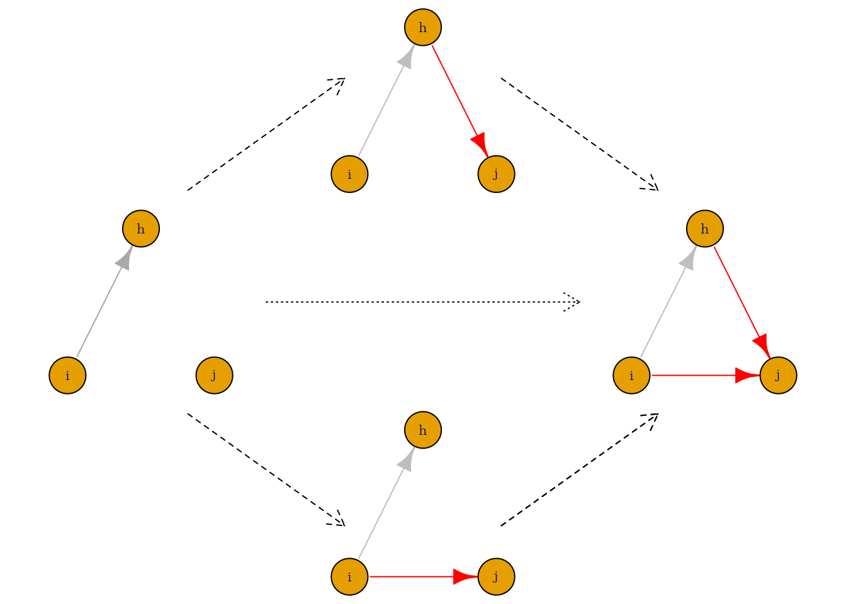
RsienaTwoStep – methodological motivation

Slide 5
RsienaTwoStep – methodological motivation

Slide 6
RsienaTwoStep – methodological motivation

Slide 7
RSiena’s MiniStep
“The Stochastic Actor-Oriented Model can be regarded as an agent-based (‘actorbased’) simulation model of the network evolution; where all network changes are decomposed into very small steps, so-called ministeps, in which one actor creates or terminates one outgoing tie.”
“…it does not necessarily reflect a commitment to or belief in any particular theory of action elaborated in the scientific disciplines.”

Slide 8
RSiena’s MiniStep
No reactivity: The act of re-affirming, making or breaking an outgoing tie does not trigger a response by the involved alter
No simultaneity: Changes occur one by one
  Hence, no coorporation, coordination or negotiation
No strategic behavior: Agent does not predict how his/her future local network neighborhood may change after:
    Making another ministep him/herself
    A ministep of other agents
  Hence also no investments

Slide 9
RSiena’s MiniStep
No reactivity: The act of making or breaking an outgoing tie does not trigger a response by the involved alter
Tom Snijders implemented a new modeltype in RSiena: ‘ReactiveStep’
  The act of making or breaking an outgoing tie triggers a response by the involved alter

Slide 10
RsienaTwoStep – Relaxing RSiena’s MiniStep Assumption

Slide 11
RsienaTwoStep – goal
The goal of RsienaTwoStep is:
Robustness check: to provide a method to assess the extent to which results obtained by RSiena::siena07() depend on the validity of the MiniStep assumption.
Hypotheses testing: to test hypotheses concerning selection and influence processes under different theoretical assumptions regarding the ‘Theory of Inter-Action’
  Fixing Theory of Inter-Action, estimating Nework effects.
Theory testing: to test the ‘Theory of Inter-action’.
  Fixing Network effects, estimating theory of inter-action

Slide 12
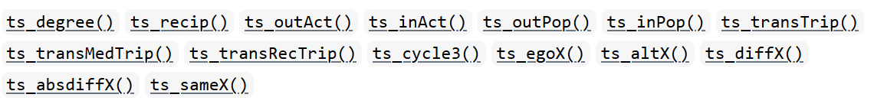

RsienaTwoStep – capabilities
RsienaTwoStep:
Simulates the network evolution following the logic of RSiena under different Theories of Interaction
Only network evolution
‘Limited’ set of network statistics
Only uniplex networks
No estimation of networks yet.
My computers are not fast enough.
My programming skills do not develop fast enough.

Slide 13
RsienaTwoStep – Theory of Inter-action
RSiena:
  MiniStep: one actor one step
  ReactiveStep: one actor one step – step triggers a response
RsienaTwoStep
  MiniStep: one actor one step
  TwoStep: two actors one step – at the same time
  SimStep: one actor two steps – at the same time

Slide 14
RsienaTwoStep – Theory of Interaction
TwoStep
  Simultaneity: Two random agents may make a ministep at the same time
  TwoStep Strict coordination: Only agents who are connected at T1 may make a ministep at the same time:
  TwoStep Weak coordination:
      Only specific twosteps are considered to be the results of coordination:
        Those of agents who were connected at T1
        OR
        Those of agents who became connected at T2
Notes:
Connection depends on path length and tie-direction
Theoretically, weak coordination of RsienaTwoStep and ReactiveStep of RSiena are very close.

Slide 15
RsienaTwoStep – simultaneity

Slide 16
RsienaTwoStep – simultaneity
Red agents can initiate the twostep

Slide 17
RsienaTwoStep – simultaneity
Red agents can initiate the twostep

Slide 18
RsienaTwoStep – simultaneity
Red agents can initiate the twostep

Slide 19
RsienaTwoStep – Strict coordination

Slide 20
RsienaTwoStep – Strict coordination
Red agents can initiate the twostep

Slide 21
RsienaTwoStep – weak coordination

Slide 22
RsienaTwoStep – weak coordination
Red agents can initiate the twostep
And all networks that result from the two ministeps

Slide 23
RsienaTwoStep – weak coordination
Red agents can initiate the twostep – but only some twosteps are seen as coordinated twosteps
Path length set at 1
(weak) coordination

Slide 24
RsienaTwoStep – weak coordination
Red agents can initiate the twostep – but only some twosteps are seen as coordinated twosteps
Path length set at 1
(weak) coordination

Slide 25
TwoStep versus MiniStep
TwoStep versus MiniSteps
note: Dashed arrows represent ministeps (long dash) or twostep (short dash); solid arrows represent initial ties (grey) or created ties (red)

Slide 26
TwoStep versus MiniStep
TwoStep versus MiniSteps
note: Dashed arrows represent ministeps (long dash) or twostep (short dash); solid arrows represent initial ties (grey) or created ties (red)

Slide 27
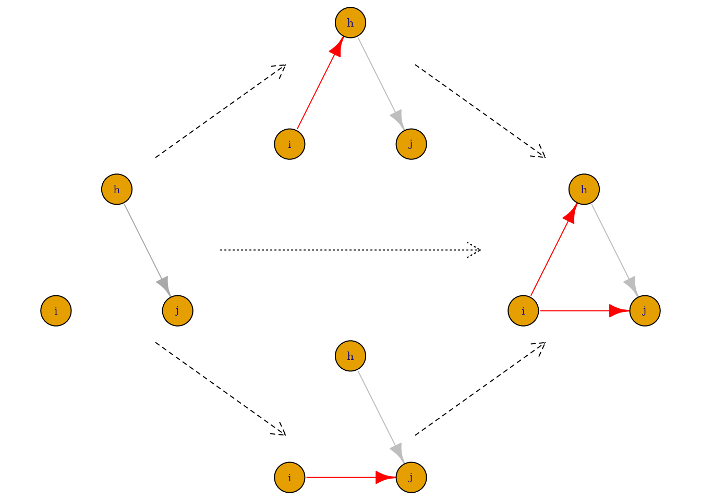
SimStep versus MiniStep
SimStep versus MiniSteps
note: Dashed arrows represent ministeps (long dash) or simstep (short dash); solid arrows represent initial ties (grey) or created ties (red).

Slide 28
SimStep versus MiniStep
SimStep versus MiniSteps
note: Dashed arrows represent ministeps (long dash) or simstep (short dash); solid arrows represent initial ties (grey) or created ties (red).

Slide 29
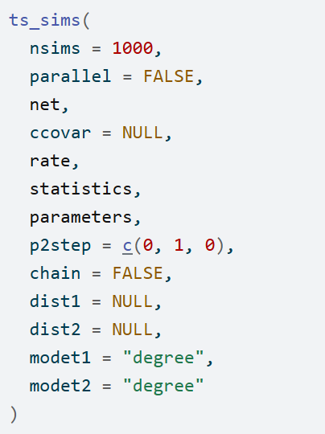
RsienaTwoStep – relaxing the ministep assumption
RsienaTwoStep is able to mix ministeps, (a specific type of) twosteps and simsteps in one network evolution simulation with given probabilities.

Slide 30

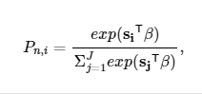
RsienaTwoStep – Evaluation function
Evaluation function:
with s_{i} a vector of the value of each network statistics for network i given agent n. β is the vector of parameter values. Hence, s_{i}^{T}β is the value of the evaluation that agent n attaches to network i.
Choice function:
With P_{n,i} the probability that actor n chooses network i.

Slide 31


RsienaTwoStep – Evaluation function
When modelling TwoSteps, the evaluation function is simply the sum of the evaluation function of the two actors involved for the respective possible local network neighborhood configurations after the twostep. Thus the evaluation function becomes:
Where n and m indixes the involved actors. Note that the evaluated network i is the same but the value of the statistics s_{i} may be different for the two actors.
The corresponding choice function then becomes:
The dyad nm is now the decision agent, maximizing ‘total utility’.
Note: other theoretical flavors are possible: ‘consensus model’, ‘dominant model’ but not yet incorporated in RsienaTwoStep

Slide 32
RsienaTwoStep – Evaluation function
When modelling SimSteps, the evaluation function is simply the evaluation function of the actor involved for the respective possible local network neighborhood configurations after the SimStep.

Slide 33
RsienaTwoStep – workflow
Take estimations results of RSiena as input.
Simulate networks based on these estimates:
  MiniStep
  TwoStep – simultaneity
  TwoStep – weak coordination
  TwoStep – strict coordination
  Simstep
Compare structure of outcome networks
  Dyad census
  Triad census
  Degree distribution
  Network segregation (Moran’s I / EI-index)
Re-estimate simulated networks with RSiena
  MiniStep
  ReactiveStep
Compare network estimates
  Pool results (metafor)
Bhattacharyya distance

Slide 34
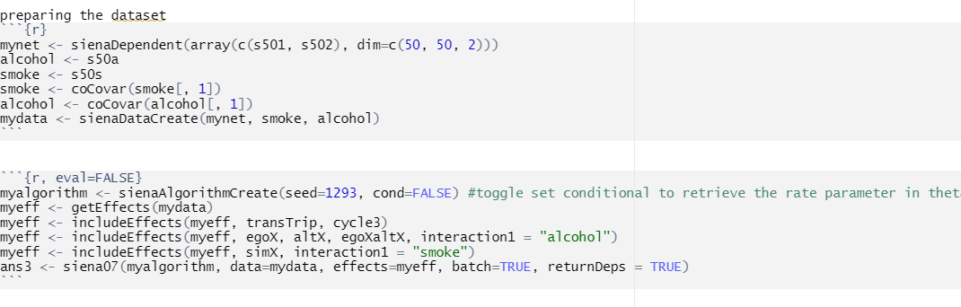
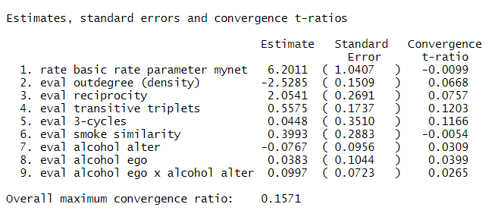
Results – Estimations of RSiena
excerpt from "Teenage Friends and Lifestyle Study"
Set this to something more substantive: 0.8

Slide 35
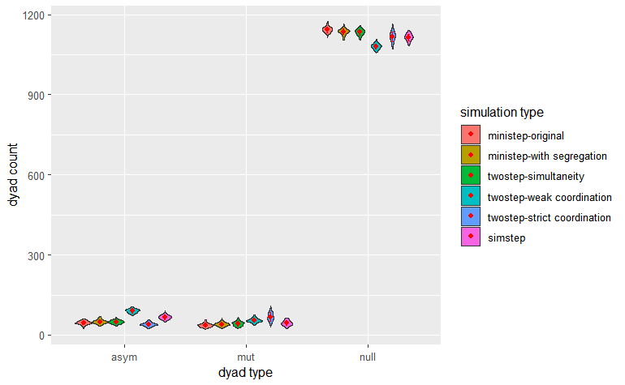
Results – Network structures of simulated networks

Slide 36
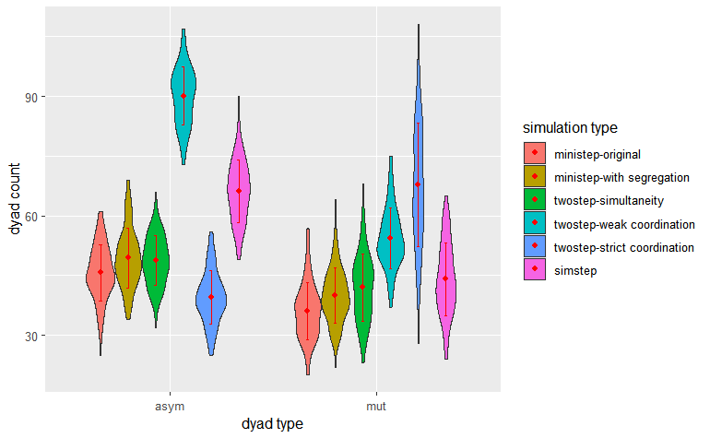
Results – Network structures of simulated networks

Slide 37
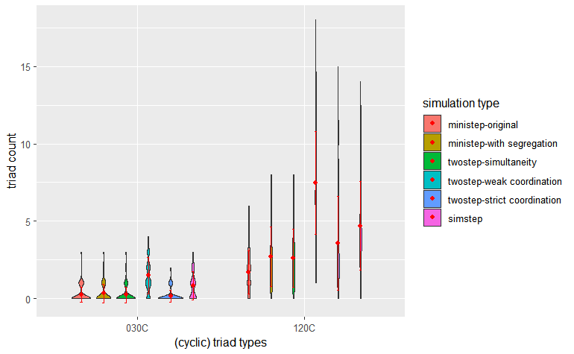
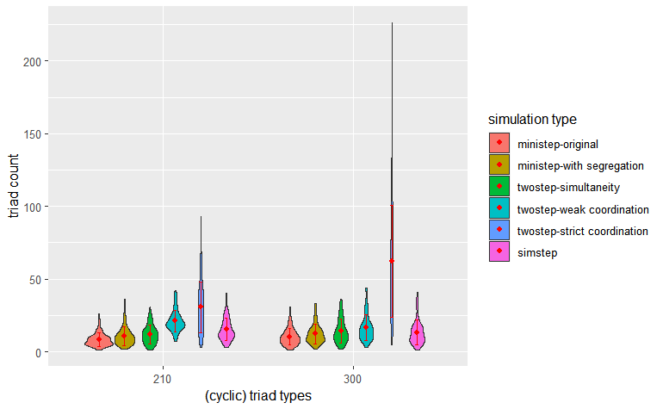
Results – Network structures of simulated networks

Slide 38
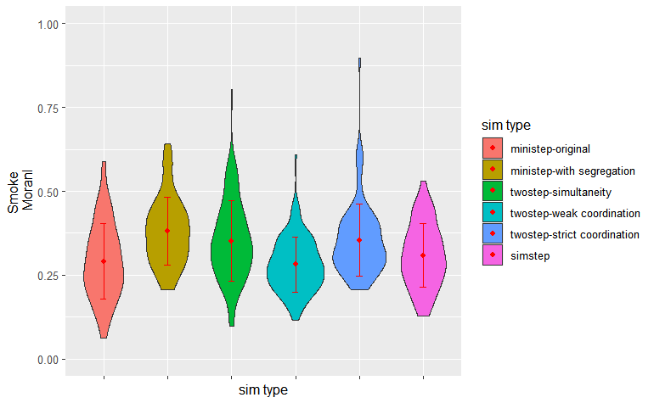
Results – Segregation of simulated networks

Slide 39
Results – Re-estimation of parameters

Slide 40
Results – Re-estimation of parameters

Slide 41
Results – Re-estimation of parameters

Slide 42
Conclusions
Network development:
Allowing for Random TwoSteps (i.e. simultaneity) does not seem to have a large impact…
  …when networks are large and egos do not impact each other’s evaluation of their local neighbourhoods
  …but when networks are small it does make a large impact.

Slide 43
Conclusions
Network development:
Simultaneity: no impact
Allowing for SimStep does not seem to have a large impact…
  …when the development of specific (positively evaluated) network structures do not require making ‘investments’.
    Depends on the network at T1
    Depends on the network statistics

Slide 44
Conclusions
Network development:
Simultaneity: no impact
SimStep: no impact
Coordinated TwoSteps make it more likely that specific network structures develop.
Coordinated TwoSteps (may) cause networks to develop faster.
Coordinated TwoSteps lead to more variance in the structure of simulated networks

Slide 45
Conclusions
Network development:
Simultaneity: no impact
SimStep: no impact
Coordinated TwoSteps: impact
Parameter estimation:
Estimation of network statistics (under the MiniStep) assumption is robust if the ministep assumption is violated…
  …but what is robust?
  …to a lesser extent when actors coordinate selection processes
  …always?

Slide 46
Conclusions
Network development:
Simultaneity: no impact
SimStep: no impact
Coordinated TwoSteps: impact
Parameter estimation:
RSiena estimates: robust
Rsiena MiniStep and RSiena ReactiveStep lead to similar parameters estimates
  …suspiciously similar?

Slide 47
Tentative Conclusions
Network development:
Simultaneity: no impact
SimStep: no impact
Coordinated TwoSteps: impact
Parameter estimation:
RSiena estimates robust
Rsiena MiniStep and RSiena ReactiveStep: similar estimates

Slide 48
Thank you!
Recent papers:
Franken, R., Bekhuis, H., & Tolsma, J. (2023). Kudos make you run! How runners influence each other on the online social network Strava. Social Networks, 72, 151-164.
Feliciani, T., Tolsma, J., & Flache, A. (2023) Ethnic segregation and spatial patterns of attitudes: studying the link using register data and social simulation, Journal of Computational Social Science, -.
Work in progress:
When dyadic dissimilarity drives tie loss among Dutch Students. With: Rob Franken (Galleria II 13.30 to 14.50)
Differences in the Extended Social Networks of Ethnic Minority and Majority Groups in the Netherlands. With Thijmen Jeroense, Bas Hofstra and Niels Spierings (Galleria I 13.30 to 14.50)
The Impact of Scientific Networks on the Publication Careers of Dutch PhDs. With Anne Maaike Mulders and Bas Hofstra (Yesterday)
Jochem Tolsma
www.jochemtolsma.nl
https://jochemtolsma.github.io/RsienaTwoStep
Jochem.tolsma@ru.nl

Slide 49
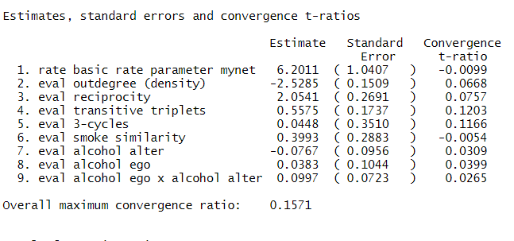
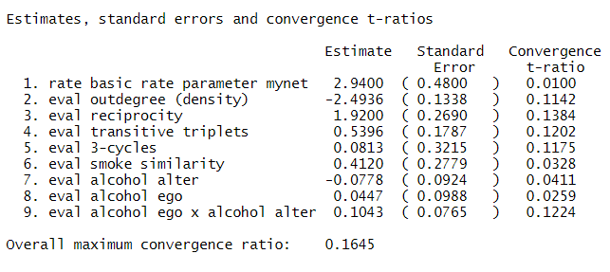
MiniStep vs. ReactiveStep
MiniStep
ReactiveStep

Slide 50
RsienaTwoStep – Evaluation function
TwoStep simultaneity

Slide 51
RsienaTwoStep – evaluation function
TwoStep simultaneity
Suppose our evaluation function only contains statistics for degree and reciprocity.

Slide 52
RsienaTwoStep – evaluation function
TwoStep simultaneity
Isomorphic networks may lead to different evaluation scores:

Slide 53
RsienaTwoStep – evaluation function
TwoStep simultaneity
Isomorphic networks may lead to different evaluation scores:
The same statistic may be counted double: see the example of reciprocity.
RsienaTwoStep – simulation: No problem
RsienaTwoStep – estimation: to keep the interpretation of the network statistics (evaluation function) similar to Rsiena, we may want to distinguish ‘shared network configurations’ from ‘individual network configurations’.

