Slide 1
Fault Tolerant Flight Control

Slide 2
Intent
A fault tolerant flight control system shall be integrated in order to increase reliability of the Control System and help reduce the workload of the Flight Crew in high stress situations resulting from various failure modes.

Slide 3
Users
On board flight control computer/autopilot:
executes algorithm
Flight crew:
Receives stable aircraft and can interact with cockpit control
Maintenance and health management engineers:
Analyse logs

Slide 4
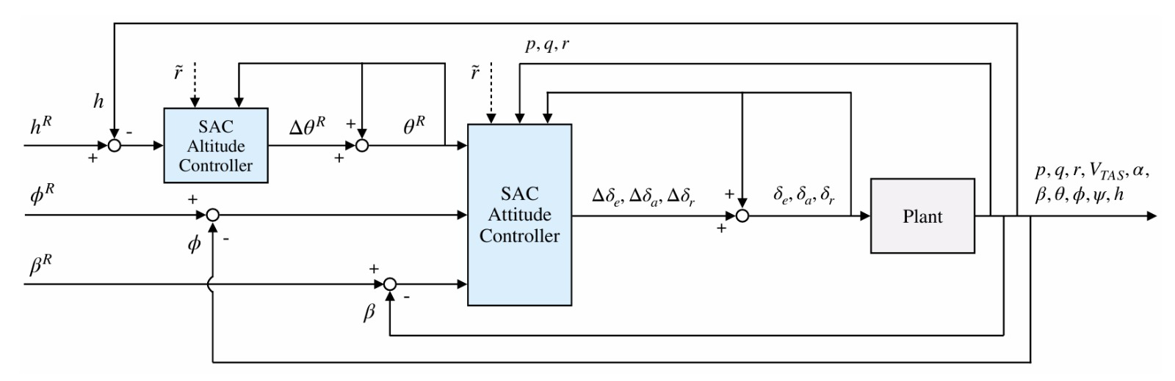
ML Constituents

Slide 5
ML Constituents
Algorithm: Soft Actor-Critic (SAC)
Policy: Multivariate Gaussian with tanh squashing for bounded control
Training: Offline on non-failed dynamics using high-fidelity simulation data

Slide 6
ML Constituents
Inputs
Aircraft state vector:
p,q,r,V, alpha, beta, theta, phi, chi, h
Control surface positions: elevator, rudder, aileron
Guidance reference: h, phi, beta
Outputs
Inner loop attitude controller: delta(elevator, rudder, aileron)
Outer loop altitude controller: delta theta
Reliability estimate? (not included in the paper)

Slide 7
Requirements
REQ1: The system shall provide fault-tolerant flight control by maintaining aircraft stability and command execution in the presence of multiple unexpected failure types, including actuator jams, reduced control effectiveness, structural failures, aerodynamic changes, and sensor noise.

Slide 8
Requirements
REQ1.1: The system shall utilize a model-free, Deep Reinforcement Learning-based (Soft Actor-Critic) control architecture for both attitude and altitude control.
REQ1.2: The system shall implement a cascaded controller structure, where an inner-loop controller manages attitude (pitch, roll, sideslip) and an outer-loop controller manages altitude tracking.
REQ1.3: The system shall deliver robust flight performance under varying initial flight conditions, reference signal shapes, biased sensor noise, and atmospheric disturbances.

Slide 9
Requirements
REQ1.4: The system shall operate at a sufficiently high rate, generating smooth incremental control commands to the aircraft’s elevator, aileron, and rudder.
REQ1.5: The system shall interface with existing aircraft navigation and auto-throttle systems, commanding only control surfaces while leaving airspeed control to external systems.
REQ1.6: The system shall be trained offline on nominal aircraft dynamics and demonstrate robust, adaptive response to failures during online operation without the need for parameter retuning or retraining.
REQ1.7: The system shall generalize its control policy to untrained scenarios, adapting to unmodeled disturbances and maintaining performance without explicit reconfiguration.

Slide 10
Operational Domain
real-time, closed-loop flight control of a jet aircraft
all phases of normal flight
under both nominal and multiple severe failure/disturbance scenarios
using only control surface commands
tested in high-fidelity simulation
intended for experimental research aircraft

Slide 11
Operational Design Domain
Domain Aspect | Scope/Limitations
Aircraft | CS-25 jet, Cessna Citation 500/PH-LAB, clean configuration
Flight Envelope | 2,000–5,000 m altitude; 90–140 m/s speed; typical maneuvers
Failures | Single surface jam, reduced effectiveness, icing, c.g. shift
Disturbances | Sensor noise/bias, discrete gusts (not severe/extreme weather)
Control Surfaces | Elevator, aileron, rudder (no throttle control)
Sensor Assumptions | Realistic noise/bias, no total sensor loss
Update Rate | 100 Hz real-time
Excluded | Severe failures, post-stall, engine-out, extreme environments

Slide 12
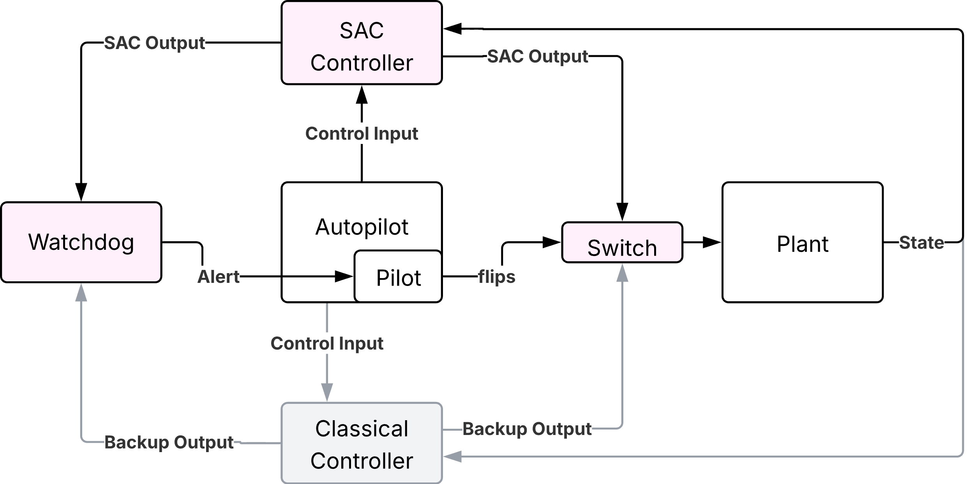
Fault Tolerant Flight Controller

Slide 13
Functional Hazard Assessment
Function | Failure Condition | Failure Effect | Severity
SAC: Maintain Stability | Loss of Function | Aircraft drifts off course; Aircraft deviates from nominal state; increased workload for Crew | Major
 | Unannunciated Loss | Undetected heading drift; increased workload for Crew & ATC | Major
Watchdog: Hallucination Detection & Classical‐Controller Override | False Negative (Missed Detection) | ML hallucination unmitigated; unsafe command applied | Major
 | False Positive Override | Unnecessary switch to classical controller; degraded performance but safe | Minor
Switch to Backup | Failure of Switch | Erroneous SAC is online | Catastrophic

Slide 14
EASA AI Levels
Level 3A Supervised Automation
Human oversight ensures safety. | Pilot has to monitor system, system will alert in case of deviation from classical controller
Significant shift to AI autonomy with user overrides. | SAC can fly autonomously in predefined scenarios
High need for explainability for user overrides. | System outputs must deviate significantly from classical controller for alert -> Pilot Override

Slide 15
Failure Matrix
 | SAC Failure | No SAC Failure
Plant Failure | Hazardous Failure | Potential recovery through SAC
No Plant Failure | No Failure of whole System -> Switch to FCC | No Failure of whole System

Slide 16
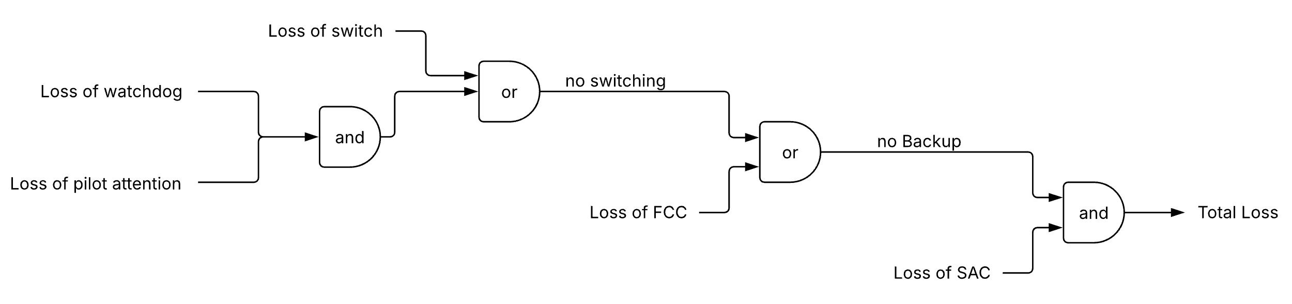
Safety Assessment

Slide 17
Potential Hazardous Scenarios
Function fails to deactivate due to Hardware failure
Soft Actor Critic (SAC) hallucinates and comparison system fails to detect
Pilots fail to switch off SAC when deviation from classic control
Deactivating SAC in a potentially unstable flight condition
In unstable flight condition SAC fails
Pilot misunderstands system intent and disables it prematurely

Slide 18
System Architecture

Slide 19
Functional Hazard Assessment
Function | Failure Condition | Failure Effect | Severity
Maintain Cruise Altitude | Loss of Function | Aircraft drifts from assigned altitude; potential loss of separation or controlled flight into terrain | Catastrophic
 | Unannunciated Loss | Crew unaware altitude hold has failed; delayed recovery action | Hazardous
 | Erroneous Output (over/undershoot) | Oscillatory altitude deviations, increased pilot workload | Major
Maintain Cruise Speed | Loss of Function | Airspeed decays or overspeeds; risk of stall or structural overstress | Catastrophic
 | Unannunciated Loss | Crew unaware of airspeed control failure; delayed throttle intervention | Hazardous
 | Erroneous Output (throttle oscillation) | Speed hunting, increased pilot workload, passenger discomfort | Major

Slide 20
Functional Hazard Assessment
Function | Failure Condition | Failure Effect | Severity
Maintain Cruise Heading | Loss of Function | Aircraft drifts off course; potential separation loss | Hazardous
 | Unannunciated Loss | Undetected heading drift; increased ATC workload | Major
 | Erroneous Output (zig‐zag) | Oscillatory heading deviations; increased crew workload | Minor
Hallucination Detection & Classical‐Controller Override | Failure to Detect ML Hallucination | Erroneous ML commands executed unchecked; could lead into unsafe flight regime | Catastrophic
 | False Positive Override | Unnecessary switch to classical controller; degraded performance but safe | Major
 | False Negative (Missed Detection) | ML hallucination unmitigated; unsafe command applied | Catastrophic
Switch to Backup | Failure of Switch | Erroneous SAC is online | Catastrophic

