Slide 1
How to Play Minesweeper with Reinforcement Learning
An AI approach using Deep Q-Learning

Slide 2
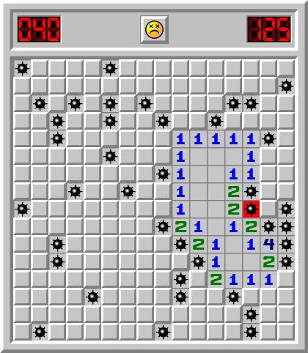
Minesweeper_game_v1.PY Game Environment
Goal is to open every field and avoid the mines
Reward Structure:
+1.0 for winning
+0.3 for choosing a field with at least one opened neighbor
- 0.3 for picking random
-1.0 for picking a mine

Slide 3
Agent.Py Agent Implementation
The agent observes the game, makes a move, and collects rewards.
Stores observations to learn from past games. (state, action, reward, next state, done)
Uses an exploration-exploitation tradeoff (random vs. learned moves)

Slide 4
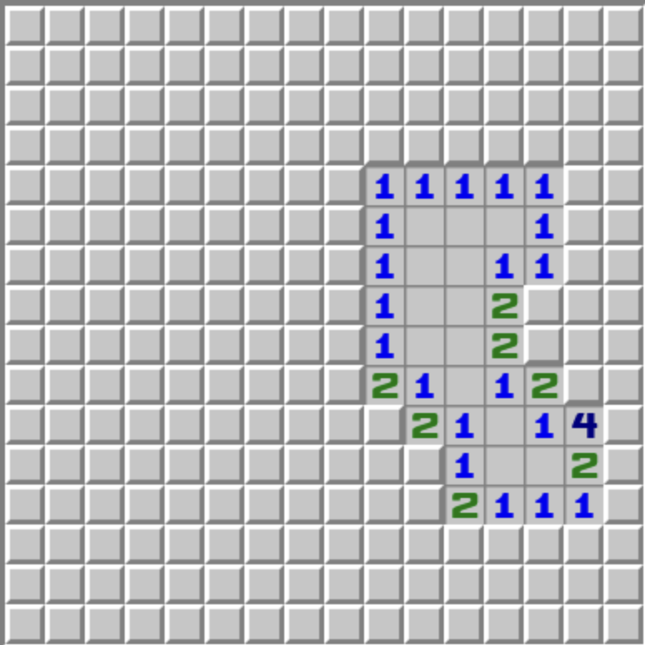
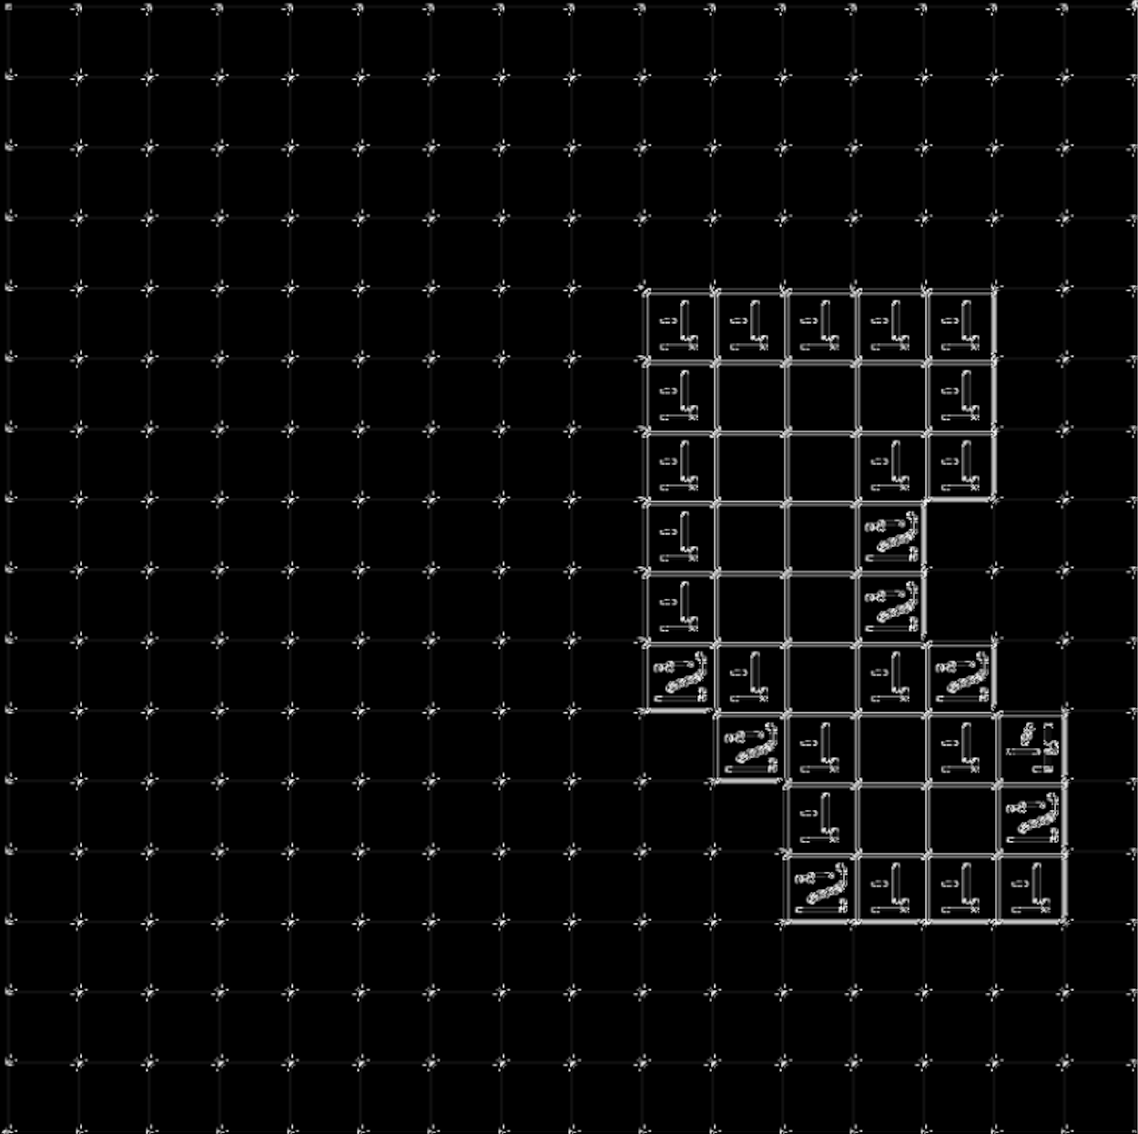
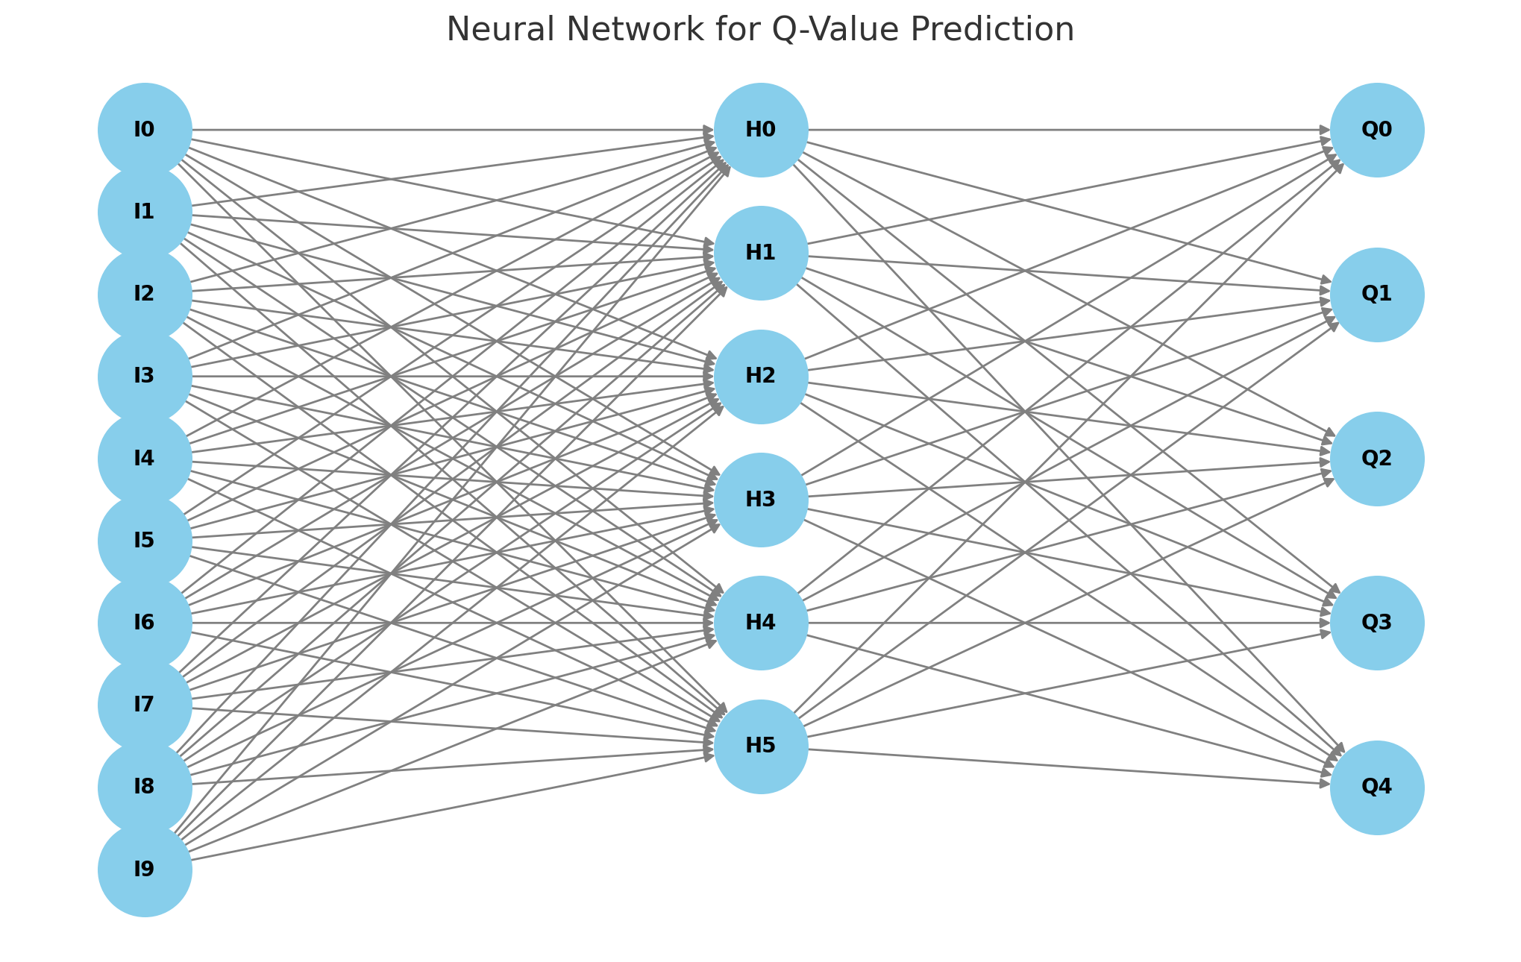
Model.py Deep-Q Neural Network
Converts 2D spatial structure into 1D vector for Neural Network
Input State (Board State)
Convolutional Layer
Flattening Layer
Fully Connected Layer
Output Q-Value for each Action

Slide 5
Model.py Different Architectures & Results
16 Convolutional Layer Size – 3 & 5 Kernels x 1 & 3 Convolutions
64 Convolutional Layer Size – 3 & 5 Kernels x 1 & 3 Convoluitons
128 Convolutional Layer Size – 3 Kernels x 4 Convolutions

Slide 6
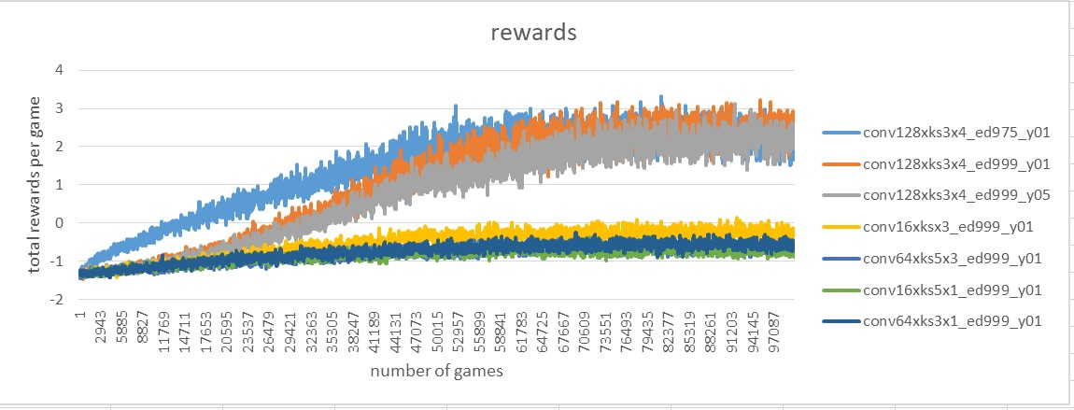
Model.py Different Architectures & Results

Slide 7
Visualisation_pygame_RL.py

