Slide 1
Using R Markdown to Generate Clinical Trials Summary Reports
Radhika Etikala: Senior Clinical Programmer,
SCHARP at Fred Hutch
Xuehan Zhang (Emily): Clinical Programmer I,
SCHARP at Fred Hutch

Slide 2
Introduction
What is the purpose of this paper?
Demonstrate a program to produce a statistical summary report along with explanatory text using R Markdown in RStudio.
What is Rmarkdown?
An authoring framework for data science
A tool within RStudio that allows you to write documents, presentations, or webpages that combine written text with analytical code.
Why Rmarkdown?
It can generate document in different format, such as PDF, Word Documents, HTML, etc
Easy to combine written text with analytical code
Reproducibility
© Fred Hutchinson Cancer Research Center
2

Slide 3
Packages Used in Paper
Packages | Description
Knitr | Package for dynamic report generation R
kableExtra | To build tables and manipulate table styles
sas7bdat | SAS Database Reader
markdown | Markdown rendering for R
rmarkdown | R Markdown Document Conversion
haven | Import and export ‘SPSS’, ‘STATA’ and ‘SAS’ files
tidyverse | Makes data science faster, easier and more fun
janitor | Simple tools for examining and cleaning the dirty data
data.table | Expression of ‘data.frame’
glue | Interpreted string litterals
data.table | Expression of ‘data.frame’
© Fred Hutchinson Cancer Research Center
3

Slide 4
Functions/Options in Rmarkdown
Functions/Options | Description
include = FALSE | prevents code and results from appearing in the finished file.
echo = FALSE | prevents code but not the results from appearing in the finished file.
message = FALSE | prevents messages that are generated by code from appearing in the finished file.
warning = FALSE | prevents warnings that are generated by code from appearing in the finished.
fig.cap = "..." | adds a caption to graphical results.
results="hide" | hide the results/output (but here the code would still be displayed).
© Fred Hutchinson Cancer Research Center
4

Slide 5
Read in SAS Dataset
Read SAS dataset to R environment as a data table
Reading ADAE and ADSL for AE summary report
Getting the Number enrolled from ADSL dataset
adae <- data.table(read.sas7bdat(“R/Pharma/adae.sas7bdat")))
adsl <- data.table(read.sas7bdat(“R/Pharma/adsl.sas7bdat")))
enr_num <- length(unique(adsl$usubjid))
© Fred Hutchinson Cancer Research Center
5

Slide 6
Derived Function for Summarize Data
Rounding function that round X.5 to the higher whole number and -X.5 to the lowest whole number.
x : numbers to round
digits : digits to round (0 to 11) (scaler)
tol_digits : tol_digits for noise to add to x (1 to 12) (scaler)
RoundUp <- function(x, digits = 0, tol_digits = 12){
if (digits < 0 | digits > 11) {
stop('digits must between 1 and 11’)
} if (tol_digits < digits) {
stop(tol_digits must be larger than digits’)
}
sign(x) * round(abs(x) + 10 ^ - tol_digits, digits
)
}
© Fred Hutchinson Cancer Research Center
6

Slide 7
Summarize Data
Creating variable labels
Getting total severity category
Counting one or more Adverse Events per severity Category.
adae[, Aeseve_txt:= factor(AEseve, levels = 1:5, labels = c('Mild', 'Moderate', 'Severe', 'Life-threatening', 'Death’))]
adae_with_total[1:nrow(adae), AEseve_txt := 'Total’]
results_ptid_level <- adae_with_total[, .(
AEsoc = 'Participants with one or more AEs’,
Info = paste0(length(unique(ptid)) , ' (‘, formatC(RoundUp(100 * length(unique(ptid)) / unique(enr_num), 1),
digits = 1 , format = "f"), '\\%)’) ), by = .(Aeseve_txt)
]
© Fred Hutchinson Cancer Research Center
7

Slide 8
Summarize Data
Counting the SOCs per severity category
Counting the Preferred term per each SOC per severity category
Combining All the results into one table
results_AEsoc_level <- adae_with_total[,
.(Info = paste0(length(unique(ptid)), ' (', formatC(RoundUp(100 * length(unique(ptid)) / unique(enr_num), 1), digits = 1 , format = "f"), '\\%)' ) ), by = .(AEsoc,maxseverity) ]
results_AEmdra_level <- adae_with_total[,
.( Info = paste0(length(unique(ptid)), ' (', formatC(RoundUp(100 * length(unique(ptid)) / unique(enr_num), 1), digits = 1 , format = "f"), '\\%)') ), by = .(AEsoc ,AEmdra, maxseverity) ]
results <- rbindlist(list(results_ptid_level, results_AEsoc_level, results_AEmdra_level), use.names = TRUE, fill = TRUE)
© Fred Hutchinson Cancer Research Center
8

Slide 9
Sort Data
Sorting the data by system organ class and preferred term
setDT function converts lists and data.frames to data.tables. Leaving blank space after each SOC term for reporting.
(sorted <- order(results$AEsoc, results$AEmdra, na.last = FALSE)); results[sorted, ]
results_sorted <- setDT(results)[, indx := AEsoc][, .SD[1:(.N+1)], indx][,indx := NULL][!.N]
© Fred Hutchinson Cancer Research Center
9

Slide 10
Dealing with NA
replacing "NA" with spaces
replacing "NA" with specific format
re-ordering the columns using 'setcolorder'
dataset[is.na(`variable_name`), ` variable_name` := ' ‘]
dataset[is.na(` variable_name `), ` variable_name ` := '0 (0.0\\%)’]
setcolorder(results_sorted, c('AEmdra_soc', 'Mild', 'Moderate', 'Severe', 'Life-threatening', 'Death', 'Total'))
© Fred Hutchinson Cancer Research Center
10

Slide 11
Generate Table for Display
Kable: used to add caption, column name, remove space between rows
Add_indent: add indentation for specific rows
Add_header_above: add header above specific columns
Kable_styling: add extra style to table
kable(dataset, longtable=T, booktabs=T, escape=F, linesep = "", caption=("ADVERSE EXPERIENCES(AEs) BY BODY SYSTEM SORTED BY FREQUENCY), col.names = c("Body System", "N", "Incidence"), align = "c")
add_indent(row_num)
add_header_above(c("", "Mild", "Moderate", "Severe", "Life threatening", "Death", "Total"), line=F)
kable_styling(latex_options = c("striped", "repeat_header"),font_size =8,position = "center")
© Fred Hutchinson Cancer Research Center
11

Slide 12
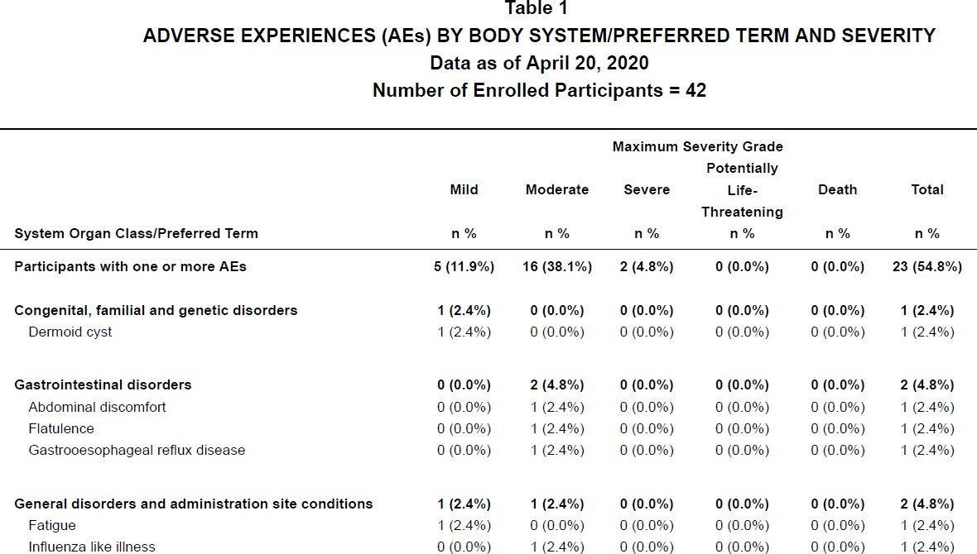
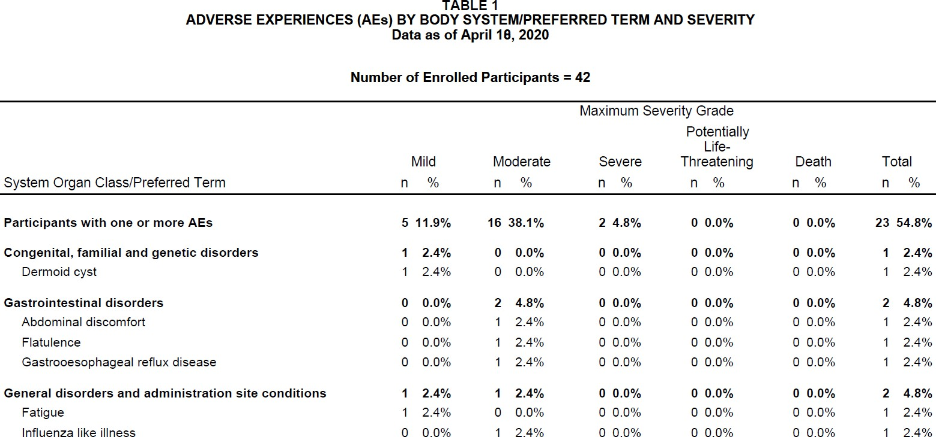
Compare Rmarkdown and SAS Reports
Guess which one Rmarkdown report, which one SAS report?
Report Generated by Rmarkdown
Report Generated by SAS
© Fred Hutchinson Cancer Research Center
12

Slide 13
Useful Resources
R Markdown from R Studio
R Markdown Reference Guide
Introduction to summary tools: https://cran.rproject.org/web/packages/summarytools/vignettes/Introduction.html
KableExtra:http://haozhu233.github.io/kableExtra/awesome_table_in_html.html
Rmarkdown Cheatsheet: https://rstudio.com/wp-content/uploads/2015/02/rmarkdown-cheatsheet.pdf
© Fred Hutchinson Cancer Research Center
13

Slide 14
Contact information
Name: Radhika Etikala, Xuehan Zhang (Emily),
Organization: SCHARP at Fred Hutch
Address: 1100 Fairview Ave N
City, State ZIP: Seattle, WA, 98109
E-mail: retikala@scharp.org, xzhang27@scharp.org
© Fred Hutchinson Cancer Research Center
14

Slide 15
Question?
© Fred Hutchinson Cancer Research Center
15

Slide 16
Thank You!
© Fred Hutchinson Cancer Research Center
16

