Slide 1
Becoming Multilingual
Bella Feng
Associate Director of Biostatistics, KitePharma
R/Pharma2020 Program Committee Chair
R/Pharma Conference 2020, October 13th, 2020

Slide 2
Becoming Bilingual in SAS and R
Bella Feng 8/14/2018

Slide 3
Becoming Multilingual
Bella Feng 10/13/2020

Slide 4
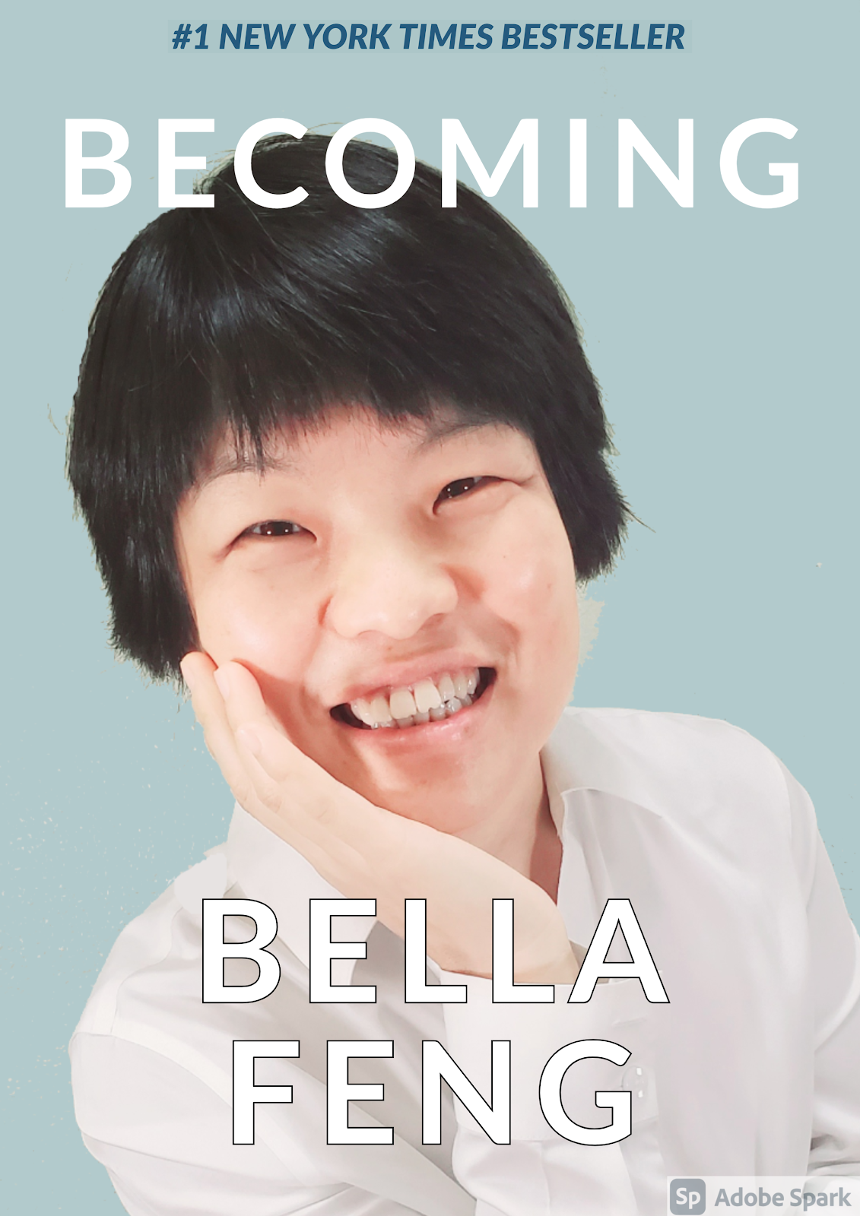


Slide 5


Linguist:
Linguistics is not about how many languages you speak. It’s the study of the structure of language. Modern linguistics believes there is an underlying universal grammar among languages. We study this universal grammar though syntax, semantics, phonology and phonetics…..
How many languages do you speak?
OMG, so boring!
Another student
Bella Feng, the linguist

Slide 6
Programmer:
In pharma, we programmers use SAS to implement SAP, we generate SDTM, ADaM data, and TFLs. Statisticians draft the SAP based on study protocol and CRF, they work with us on the specifications and review the TFLs.
What programming language do you use?
OMG, so boring!
Another guest
Bella Feng, the statistical programmer

Slide 7
Components of the Data Science Pipeline
Data Integration
Data Visualization and Technology
Exploratory Analysis
ML/AI
Kite R Platform
Internal closed clinical studies
Internal ongoing clinical studies
Hospital and health insurance claim data
External studies and RWE database
R Shiny App
R Markdown
R Markdown
R packages
SAS
R
Python
User interface for data extraction
Data Mart
Summary statistics/visualization/ exploratory analysis

Slide 8
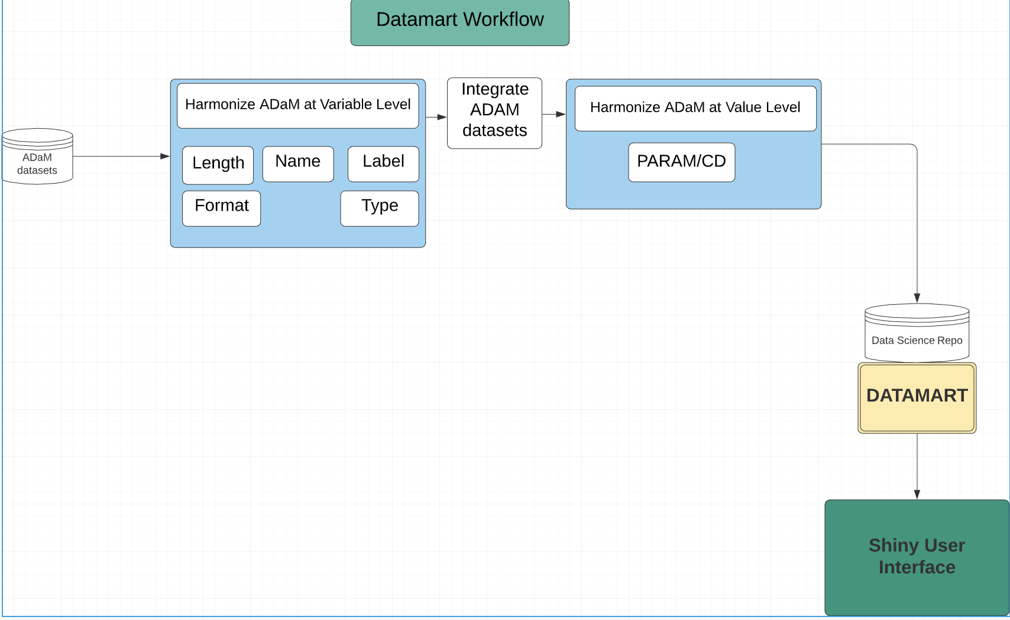
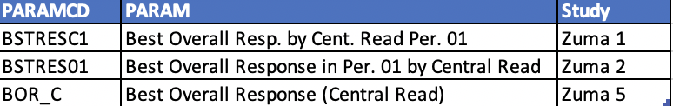
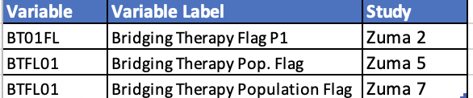
Initial Workflow

Slide 9
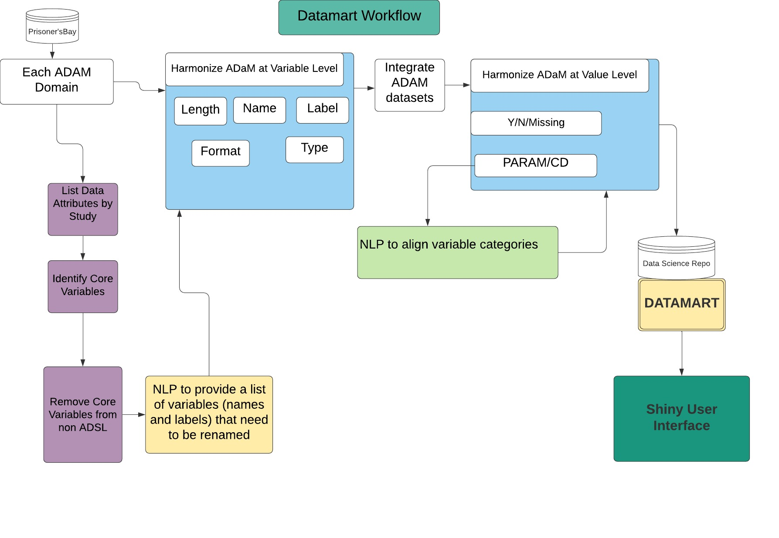
SAS
Python
R/Shiny

Slide 10
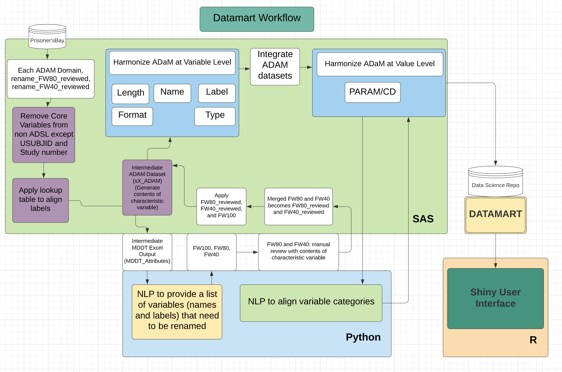

Slide 11
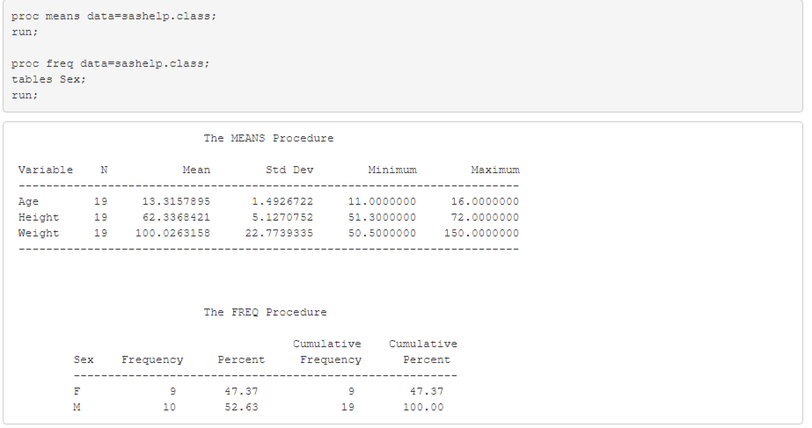
R+SAS
R Platform accessing clinical data
R validation
Rmarkdown and SASMarkdown

Slide 12
R+Python
fuzzywuzzy package
NLP/ML to reduce manual review
Reticulate
Rmarkdown/Python scripts
Importing Python modules
Using Python interactively
Translation between R and Python objects
Flexible binding to different versions of Python

Slide 13
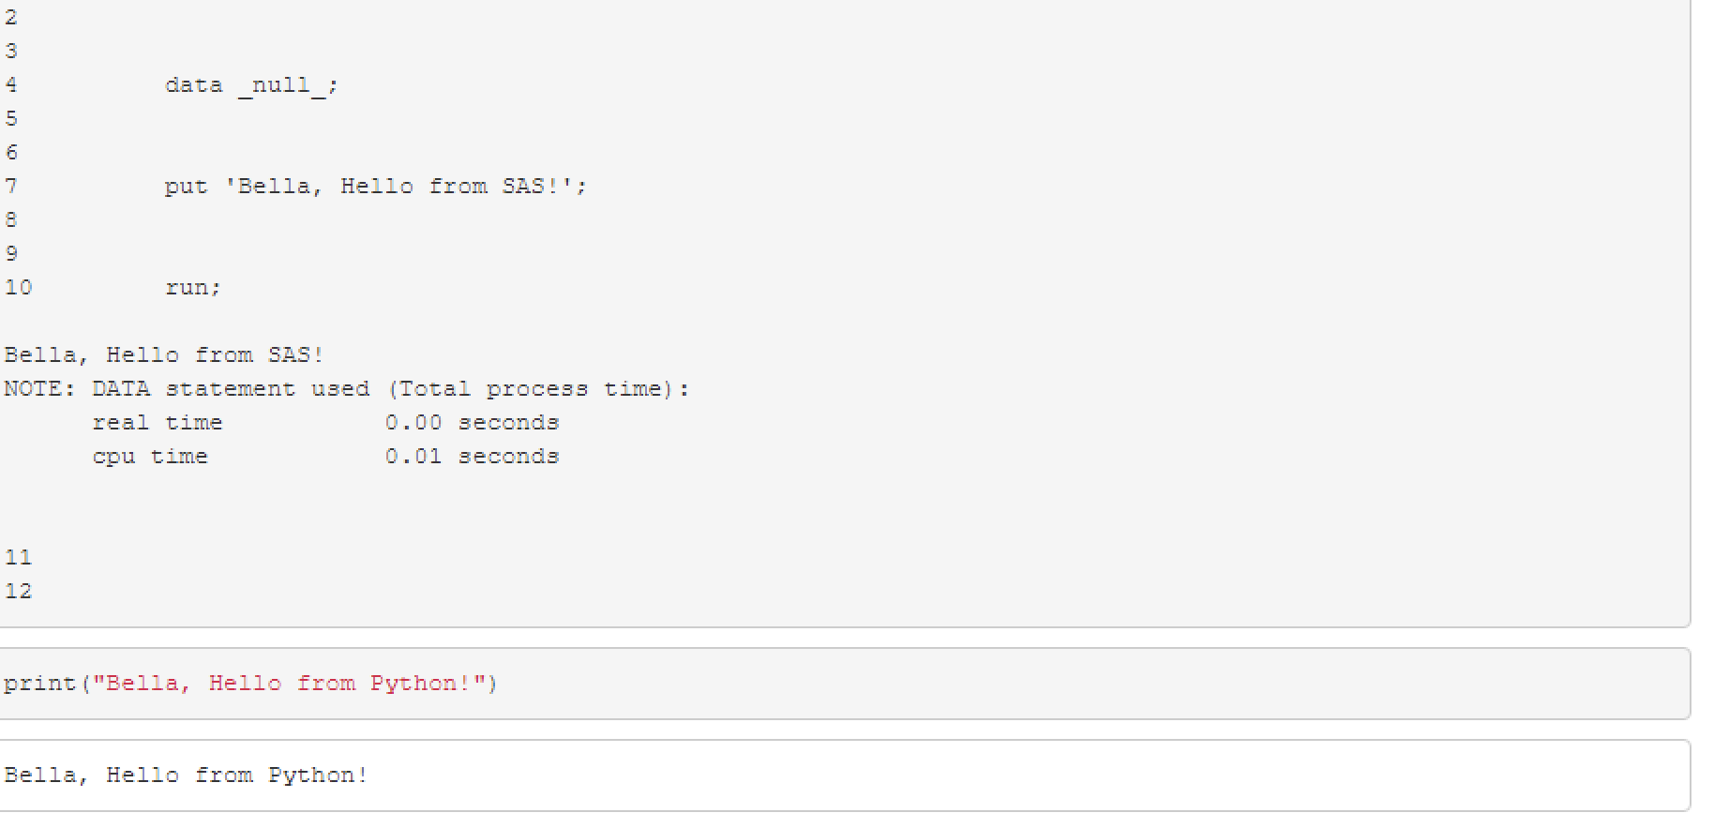
R+SAS+Python

Slide 14
Future:
YES.
Data Scientist? Do you use R, Python or SAS?
OMG, so boring!
Another COVID survivor

Slide 15
Multilingual Team
Statistician
Allen Xue
Qinghua Song
Lei Lei
Data scientist
Bella Feng
Brad Du
Shengchao Hou
Douglas Sanders
Infrastructure/IT
Peter Taing
Ben Lam
Sep Dadsetan
ZS team:
Rushabh Kamdar
Tim Cederquist
Oisin Bates
Photography/Art Team
Liya Feng Wilson

