Slide 1
Using R to Create an End to End Process for Predicting Delays in Recruitment from Covid-19
Christina Fillmore

Slide 2
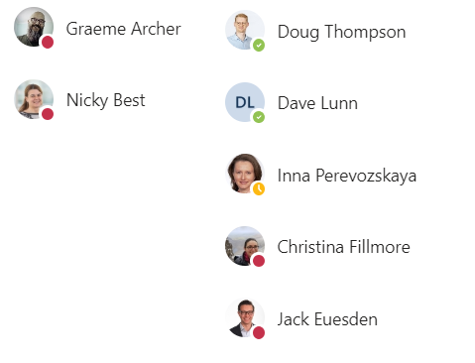



Joint work: The Biostats COVID-19 modelling taskforce
Formed 25 March 2020 from various groups
Team led by Nicky Best, head of the Advanced Biostatistics (ABDA) team
Barbara Suarez is Project Manager
Sponsored by Graeme Archer, NCTS & Biostats LT
Members from ABDA:
Dave Lunn
Inna Perevozskaya
Members from Research Statistics
Valeriia Sherina
Jack Euesden
Members from Statistical Data Science
Doug Thompson
Christina Fillmore
Magda Zwierzyna
Many thanks to Jamie Lorimer from ClinOps for help and insight
A spontaneously-formed team drawn from three different groups, working as a single, ruthlessly-focussed team
Magda Zwierzyna

Slide 3
GSK COVID-19 Biostat Taskforce Objectives
Predict COVID-19 patterns as a function of time
Scraped from external sources
Augmented with our own implementation of the Flaxman (Imperial) model, to permit temporal extrapolations and to examine NPI impact on future death rates
Predict the impact of COVID-19 on recruitment across geographies and time
“Recruitment” measured by the standard metrics: # sites initiated, # patients screened, # randomised
Inputs to this model are Non-Pharmaceutical Interventions (NPIs), which measure the stringency of social exclusion measures, and predicted COVID-19 cases (so the outputs from the first prediction model are inputs to the second)
We will provide predictions under a simplified summary of NPIs (“all removed” “all remain” “switching” etc)
Produce visualisation/summary tools that teams can use

Slide 4

Data Science Workflow
Bringing in the external sources
External Sources
ECDC
Blavatnik
NYT
Web-scraped Information
Internal Sources

Slide 5
Overview of NPIs
Non-Pharmaceutical Interventions
Measured on all Countries and each US State
School closing
Workplace closing
Cancel public events
Restrictions on gatherings
Close public transport
Stay at home requirements
Restrictions on internal movement
International travel controls

Slide 6
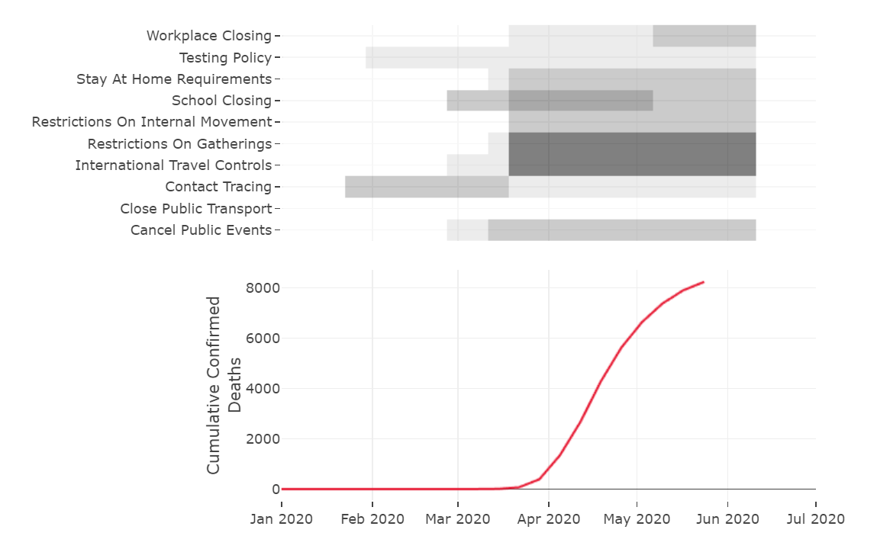
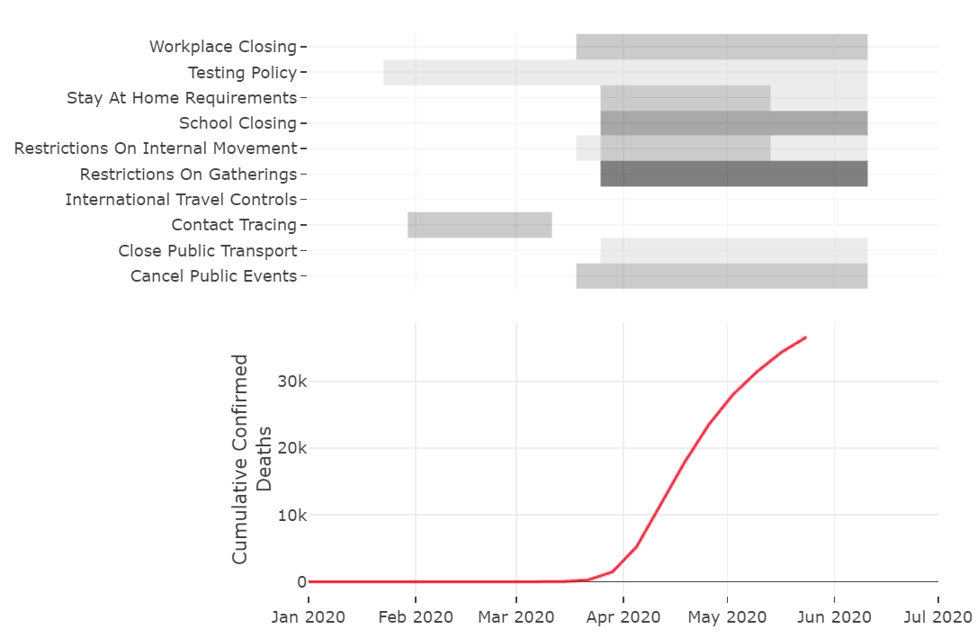
Overview of Government Intervention Strategies
Germany
United Kingdom
The government strategies drive the forecasts of daily deaths/ cases – which then drive government strategies in the future

Slide 7
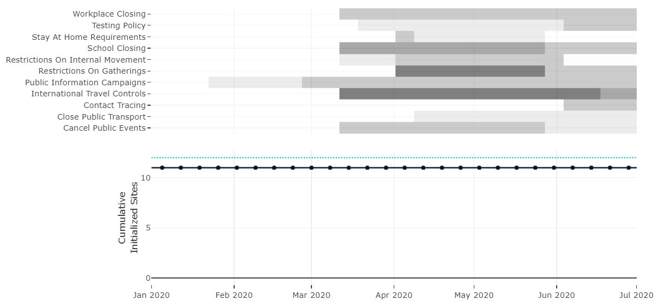
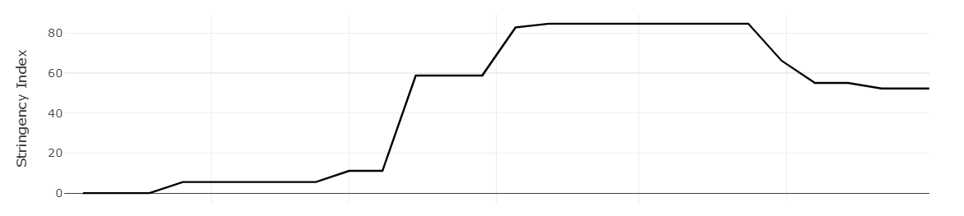
External data: COVID19 statistics
NPI Stringency index (Poland as example)

Slide 8

Data Science Workflow
Creating internal Covid-19 Predictions
External Sources
ECDC
Blavatnik
NYT
Web-scraped Information
COVID-19 Predictions

Slide 9
Forecasting COVID-19
The statistical model that we use to forecast the time-course of the pandemic for any given country is an implementation of the Imperial College Flaxman et al (Nature, 2020) model.
This is a modified SEIR model which utilises real epidemiological data extending back to the beginning of the pandemic.
We needed to make our own internal predictions because clinical trials are run on the scale of months and years rather than days and weeks.
Rather than trying to predict the most likely government response we decided to go with set NPI based scenarios

Slide 10
Government Intervention Strategies for each Country
Forecasting COVID19
Most relaxed government interventions – unlocking
Most stringent government interventions ever observed – relocking
Reactive NPIs – unlock until daily deaths pass some threshold, then re-lock until deaths are below threshold again

Slide 11
Data Science Workflow
Combining Internal and External Sources into a Model Ready Dataset
External Sources
ECDC
Blavatnik
NYT
Web-scraped Information
Data Domain
COVID-19 Predictions
Study Level
Model Ready Dataset
Internal Sources
Study Country
eTrack
Study Country Time
Cumulative Enrolment Report
Assumptions Report

Slide 12
Data wrangling and integration
Preparing input for the models and the interactive applications
Datasets we used:
COVID-19 statistics: deaths and cases per country over time
NPIs per country over time
NPI stringency index per country over time
Recruitment data per study/country over time
Randomized participants
Screened participants
Initiated sites
Pre-COVID19 recruitment plans over time
Derived values and model predictions integrated with the data:
Future predicted COVID-19 deaths and cases
Future predicted NPIs and NPI stringency indexes

Slide 13
Data wrangling and integration
Preparing input for the models and for the interactive apps
Data standardization:
Country vs state-level data
US state-level data require aggregation
Georgia (the state) vs Georgia (the country)
Different country names in individual datasets
Russia -> The Russian Federation
Different approaches to missing values
0s, NAs, missing rows, inferred values
Different approaches to date formatting
Weekly vs daily statistics
Different update cadence
weekly vs biweekly updates
Long datasets vs wide datasets
….
Data transformation:
Deriving new variables or summaries
Filtering
Calculating rates, cumulative values, etc.
Removing duplicates
Deriving missing values
…

Slide 14
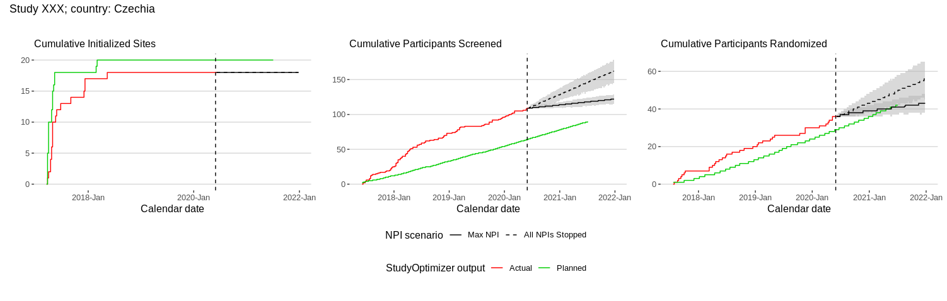
Recruitment modelling with COVID: Data
Key focus: understanding the “gap” between actual and planned recruitment curves
Q: How much of planned/actual gap can be explained by COVID impact ?
Each process measured in terms of weekly numbers, for both planned and actual recruitment
Wish to compare actual to planned recruitment but main focus on understanding the impact of COVID-19

Slide 15
Recruitment modelling with COVID: Data
Recruitment data extracted from StudyOptimizer software
Used for study planning and re-planning
Actual vs planned recruitment from 22 studies across 49 countries
Recruitment comprises 3 main processes:
Site initiation
Screening
Randomization
Recruitment prediction aka Poisson-Gamma Model
Site initiation rate
Subjects screening rate
Subjects randomization rate

Slide 16
Model overview
Each component of recruitment process (initiation/screening/randomization) is characterised by a rate parameter, e.g. number of sites initiated per week
For each process we say:
Actual rate = Planned rate x Multiplier
So, for example, a screening-rate multiplier of 0.5 means that actual screening is progressing at half the planned rate (assuming the same number of sites)
We allow the multiplier to depend on various COVID-19-related metrics, e.g.
Number of cases/deaths
Stringency of government-imposed restrictions
Multipliers are of direct interest (modelled) but main focus is on recruitment milestones (e.g. Last Subject First Visit); that’s what is used in decision -making
Come form COVID prediction model

Slide 17
Predictions
Multipliers vary over time with COVID-19 metrics
Can predict how recruitment will progress under various pandemic scenarios, e.g.
No restrictions going forwards
Maximal restrictions
Restrictions cycle over the next year or two
Primary focus on estimating dates at which recruitment targets achieved, e.g.
Full recruitment, 75%, 50%, etc
Or percentile-based estimates, e.g. we can be 80% confident that we will have achieved 50% recruitment by Aug 2021

Slide 18
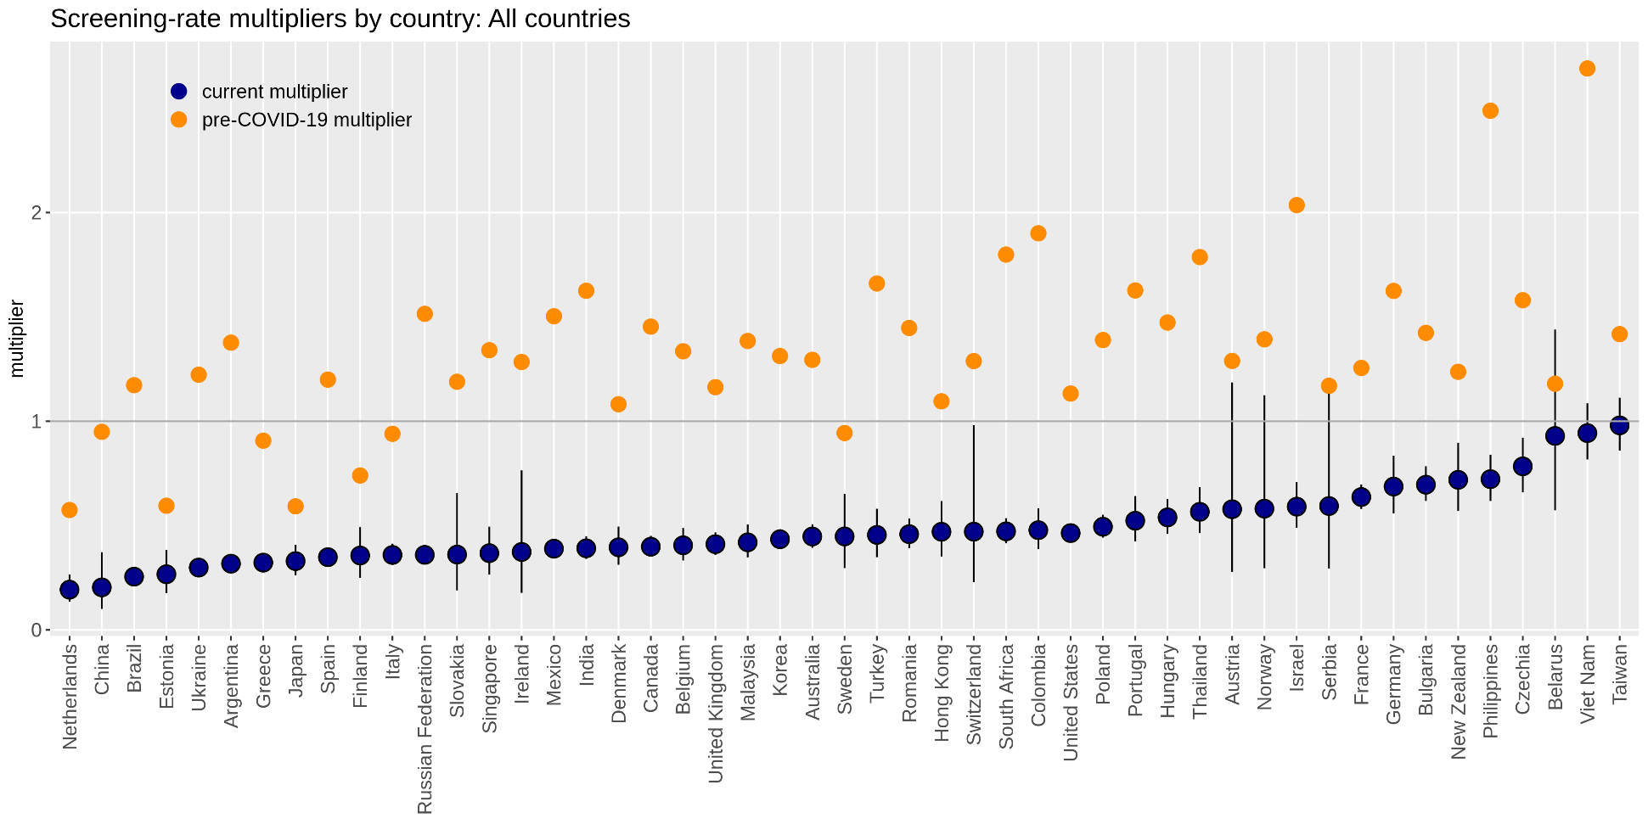
Predicted screening-rate multipliers by country
All countries…

Slide 19



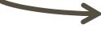
Data Science Workflow
Predictions Complete it was time for an App
External Sources
ECDC
Blavatnik
NYT
Interactive visualization
Web-scraped Information
Data Domain
COVID-19 Predictions
Study Level
Model Ready Dataset
Internal Sources
Study Country
Recruitment Predictions
eTrack
Study Country Time
Cumulative Enrolment Report
Assumptions Report

Slide 20
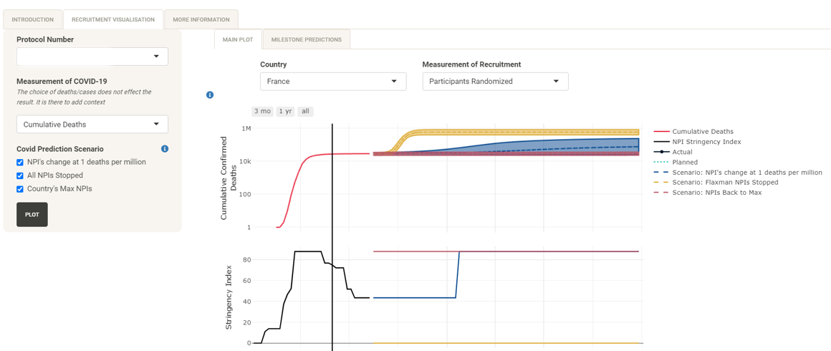
Recruitment App

Slide 21
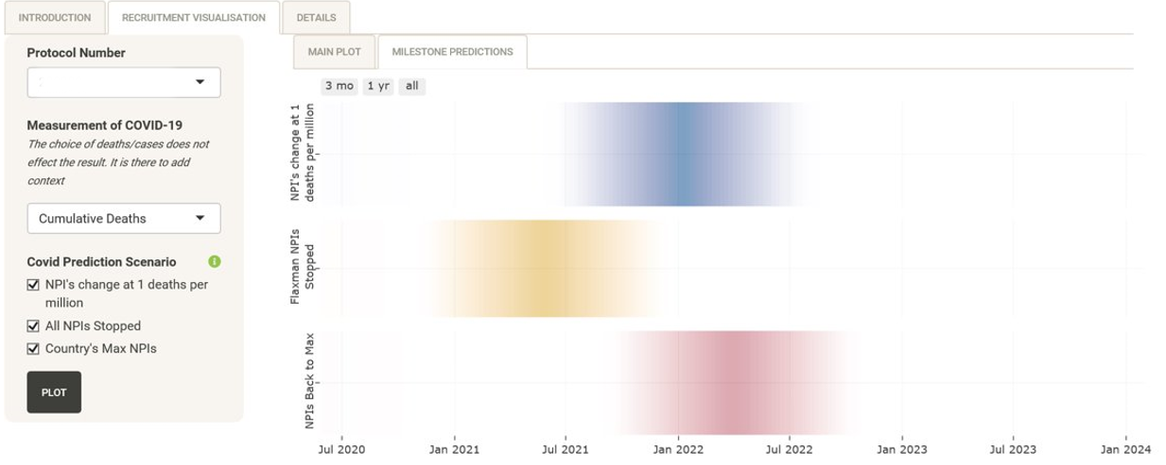
Milestone estimates in Recruitment App
View probability distributions (density strips) for the LSFV visit milestone

Slide 22
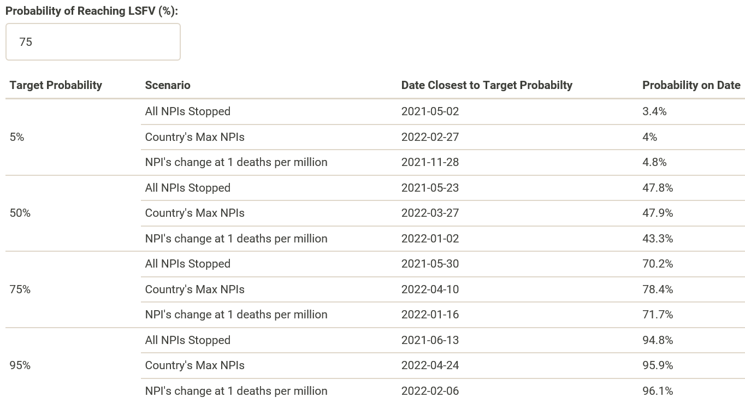
Milestone estimates: decision making
LSFV percentiles
These could be used to set target dates

Slide 23










Drawbacks of working with a single large dataset
Workflow:
Big dataset file copied from the object store
All data loaded into the memory
Additional smaller datasets generated for individual plots
Issues:
Dependency on the object store being alive and well
Time to copy the data and load them into the memory
Ultimate problem: 1) dataset is too big and 2) data are not used efficiently
Application
Data
Object Store
Data
RStudio Connect
Users

Slide 24

Data Science Workflow
To resolve the issue was to convert the data into a SQL database
External Sources
ECDC
Blavatnik
NYT
Web-scraped Information
Data Domain
Interactive visualization
COVID-19 Predictions
Study Level
Model Ready Dataset
Internal Sources
Study Country
Recruitment Predictions
eTrack
Study Country Time
Shiny-Ready DB
Cumulative Enrolment Report
Assumptions Report

Slide 25

Improving data storage by data normalization
Normalized data model for Covid-19 data (simplified)
Recruitment Plan
Study, country, screening rate, …randomized rate
Covid stats
country, date, deaths, cases, …
Study
protocol, title, therapy area, phase, …
Country
Recruitment
country, region, population, …
NPI
Study, country, date, screened, …randomized
county, date, school closing,
testing policy, …
Date
Recruitment pred
date, start date, end date, …
Covid pred
study, country, date, screened pred max NPI,
screened pred no NPI, ..
country, date, cases pred max NPI, cases pred no NPI, …

Slide 26




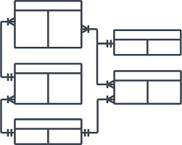

Speeding up dataset preparation with a SQLite database
… because only a small subset of the data is needed to generate a single plot
Give me all recruitment, prediction and NPI data for study XXX in Argentina
RSQLite package
SQL engine
Send query
Get data
Database
Data tables

Slide 27



Database-powered interactive visualization app
Application
Data
Object Store
Data
RStudio Connect
RStudio Connect
Before
After
Users
Users

Slide 28
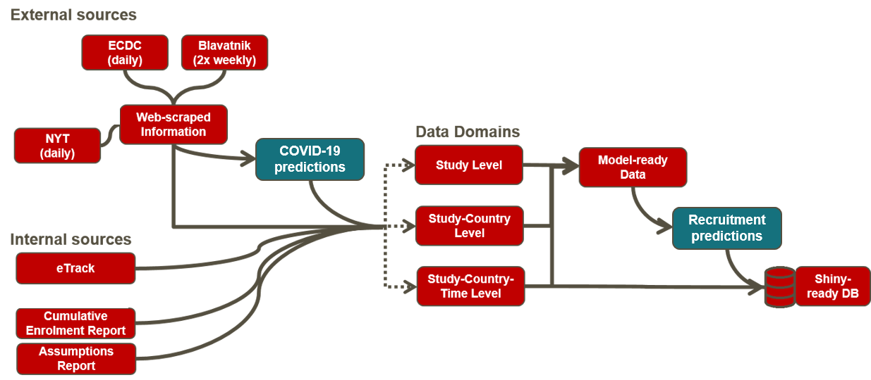
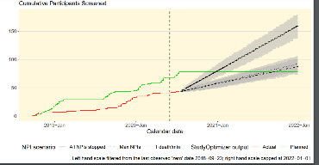
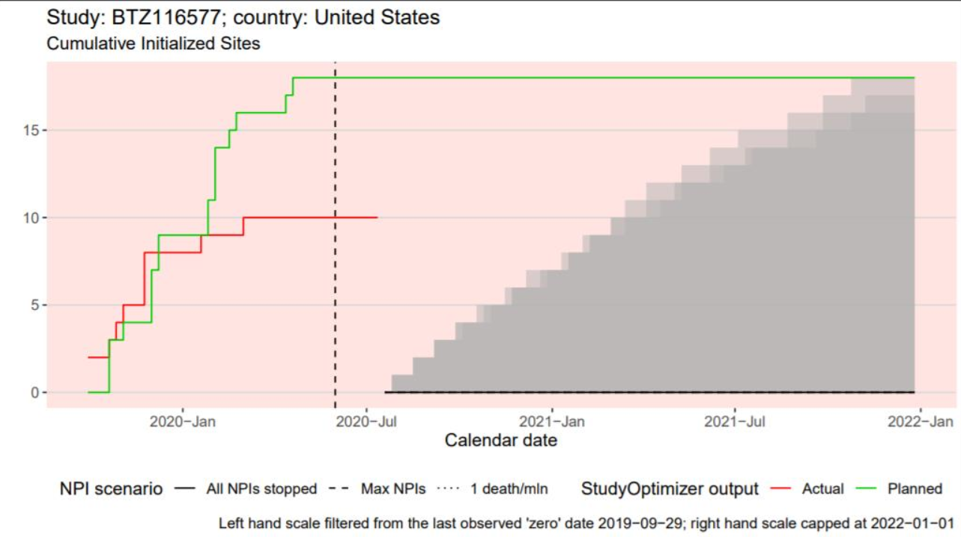
Problem:
We often find data issues at the very end of the process
QA plots
WHERE WE SEE MOST ERRORS
DATA PROCESSING STEPS

Slide 29
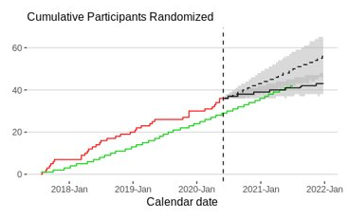
Problem:
We often find data issues at the very end of the process
Possible data errors
Lack of predictions for a given study-country combination
Predictions all equal to 0 (despite higher last observed value)
Non-monotonic predictions (cumulative initialized sites)
…
All these errors can be detected automatically similar to how queries are run on clinical data.
DATA PROCESSING STEPS

Slide 30
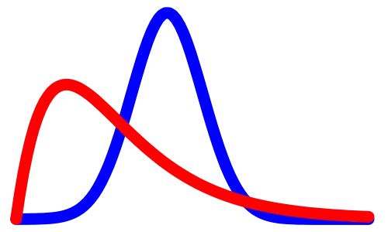


Solution:
Automated data testing to detect data issues as early as possible
TESTING
Predictive modelling
Data
Data
Data
Data
Data
Data
Internal & external datasets
Interactive visualization
Data wrangling
Data integration & storage

Slide 31
Key factors for our success

Slide 32
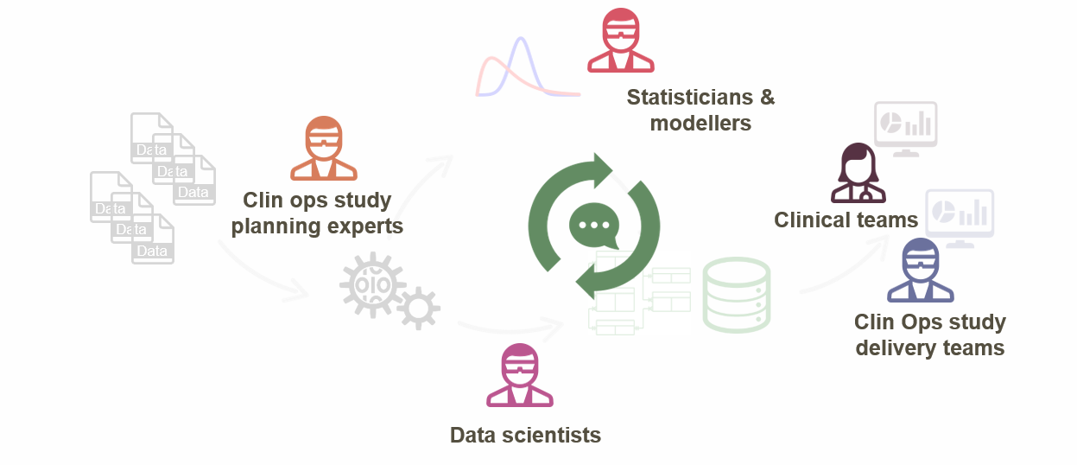
Data science workflow - enablers
People
Diverse expertise
Constant communication
Knowledge sharing
Frequent stand ups
Agile mindset
Shared codebase
Pair programming
Focus, motivation & team work
All of this remotely and across continents!

Slide 33












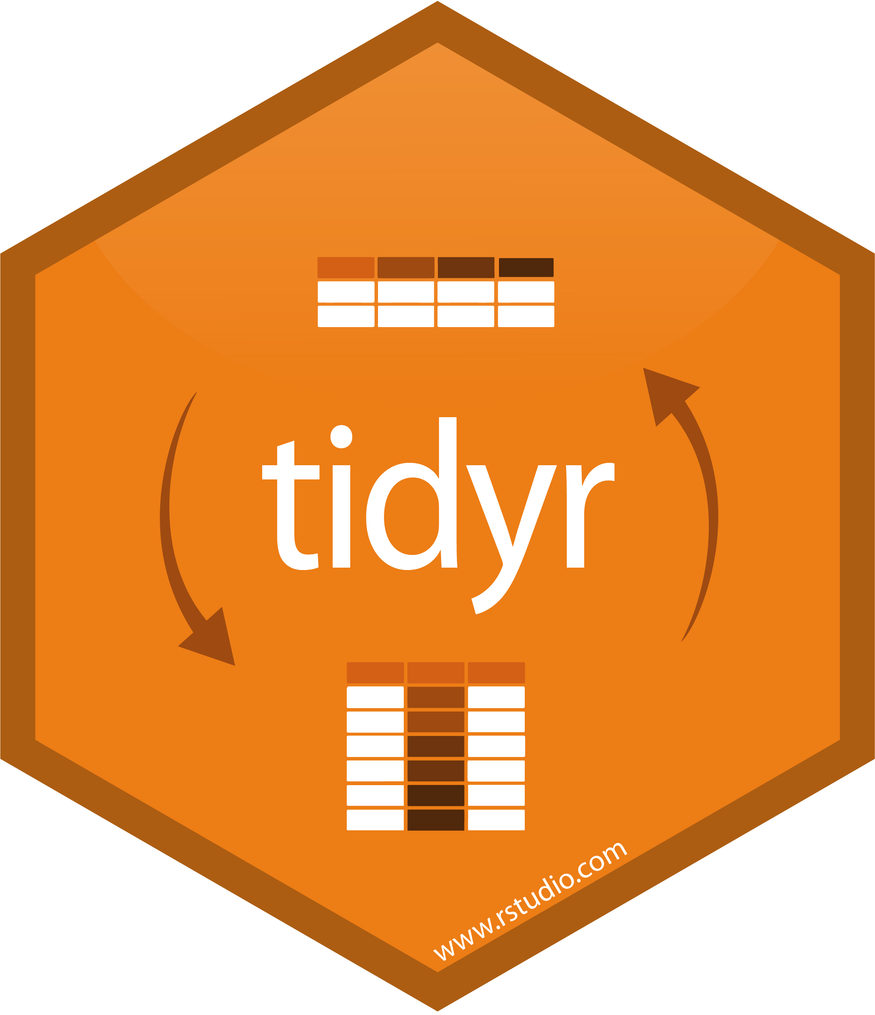






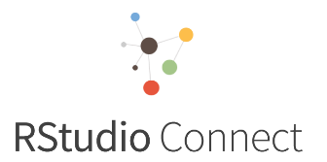
Data science workflow - enablers
Tools and packages
Data wrangling
Modelling
Data and code storage
Visualization
S3 Object Store

Slide 34
Project Lifecycle
Team formed
Recruitment app deployed on WARP
Refined data model and DB backend to Shiny
April | May | June | July | August
Covid-19 app deployed on WARP
Prediction model
added to recruitment app
Full release

Slide 35

It’s a long journey…..
But an exciting one!!!

Slide 36
Summary
Teams have been able to use this app to re-plan studies and bring the new plans to governance
This is the result of intense collaboration within a multi-disciplinary team of statisticians, data scientists and clinical operation professionals over the course of 5 months since pandemic started
It builds on existing well-developed tools and model
The Flaxmen SEIR model is common in epidemiology
The stochastic Poisson-gamma model commonly used for recruitment prediction
The SQL database is common in data engineering
We were able to create this new tool not by a bunch of new innovation, but leveraging existing technology in new ways

Slide 37
Thank you!
Christina Fillmore

