Slide 1
Clinical Reporting Using R at GSK
Michael Rimler
Prog Leader, ClinProg

Slide 2







Clinical Reporting Using R at GSK
18 months in 10 minutes
WHO?
WHAT?
WHEN?
WHERE?
WHY?
HOW?
WHAT’S NEXT?

Slide 3



Who?
QC
PoF
PoC
300 Pr
200 St
Clinical Programming Statistical Data Sciences
Workstreams

Slide 4
What?
SDTM
ADaM
Tables
Figures
Listings
Standard Summary Statistics
Statistical Inference/ Modeling
Independent QC
Conventional Clinical Reporting

Slide 5
When?
PoF
PoC
(TLFs)
Pilot
PoC
(ADaM)
Integrated and Coordinated R Adoption Strategy
SDS
Training
2019
Q1
Q2
Q3
Q4
Q1
2020
Q2
Q3
Q4
2021
Q1
Q2
Q3
Q4
2019

Slide 6








Where?
Working Area for R Programming (WARP)
developers
analysts
CPU
CPU
data analysis /
software development
RStudio Server Pro
management node
centralised R installation
RStudio Package Manager
Slurm workload manager
HPC compute nodes
Slurm
publish
data backends
file shares
relational
databases
viewers
content sharing
RStudio Connect
object store
Hadoop
clusters

Slide 7
Why?
Motivations and Deliverables
Motivations
Deliverables
Expanded Toolset
Right tool for the job
Expanded delivery capabilities
R Markdown, RStudio Connect, Shiny
Upskilling
For delivery (the business)
For retention (the staff)
Recruitment
Closing short run gaps / enabling long run growth
Become an industry leader, not a follower
“R-ready” study teams
For conventional delivery
R Package development team
For process improvement
Shiny development teams
For future delivery products
Support Strategy
R for Submission

Slide 8
How?
PART 3
(Go Live)
R4QC
PART 1
(PoF)
PART 2
(PoC)
PART 4
(PoC)
Q3 2019
Q4 2019
Q2 2019
Central Tools
Training
R4QC
(Parts 3 and 4)
R Adoption
Change Management
Outreach
Production/ Submission/
Other
Q3 2020

Slide 9




What’s Next?
R on Production
Future deliverables (…beyond DTFLs)
R for Support
R for Submission

Slide 10
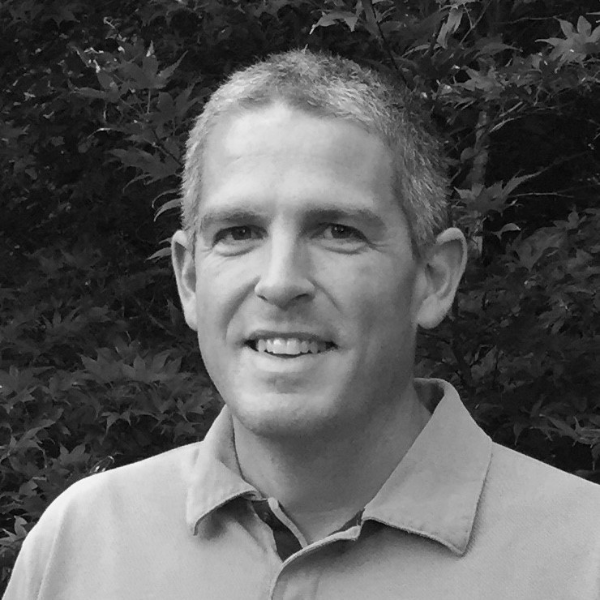
Thank you!!!
Michael Rimler
Programming Leader,
Clinical Programming
michael.s.rimler@gsk.com

