Slide 1
{metashiny}: Build Shiny apps with a Shiny app
R/Phamra
Bo Wang, Novartis
10/13/2020

Slide 2
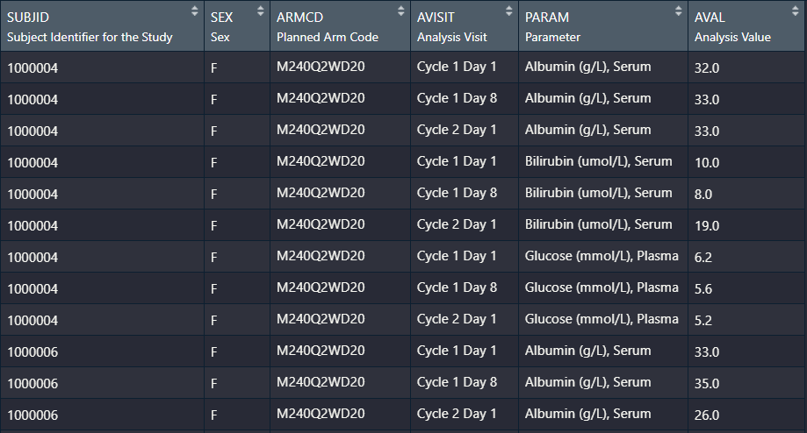
Goal
Build a Shiny app to explore lab parameters/biomarkers over time in study ABC123A2201
Spaghetti plot or boxplot
Color-code by treatment
Paneling by sex (or other patient characteristics) and lab parameter
Get this done within 1 minute

Slide 3
Demo
go/metashiny_demo

Slide 4
Debrief
Handful of plots/analysis repeatedly requested in every Shiny project
Basically the same with small variations (scatterplot, line plot, ANOVA, etc.)
Get 80-90% of the work done without fussing with R/Shiny code
Start from there and reach the 100% goal

Slide 5
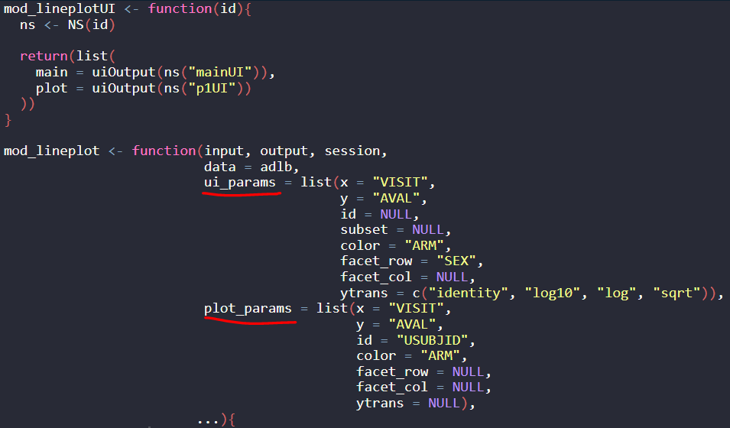
How?
Parametrized Shiny modules:
Question: why not just use Shiny modules?
+ A lot of if statements

Slide 6
Next steps
Expand module library
Add multiple modules into an app (linked modules)
Release to internal users and gather feedback
Trial statisticians, clinicians, etc.
Collaboration!!!
bo-2.wang@novartis.com
Slack R/Pharma Channel

Slide 7
Acknowledgement
Scientific Computing and Consulting (SCC)
Douglas Robinson
Ardalan Mirshani
Mustapha Larbaoui
David Granjon
David Hall
Andrew Wright, Novartis EDB

