Slide 1

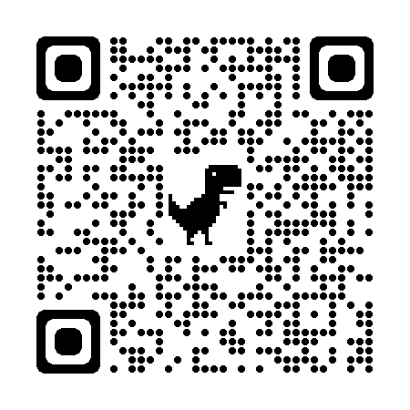

1. Use Make to automate your work
2. Get your setup ready!
Make sure you properly installed make by following the instructions on this page: https://tilburgsciencehub.com/get/make
Remember the structure of a Makefile (let’s call it a recipe):
- Targets: Files that you want to build
- Prerequisites: Files you need to build the targets
- Commands to build: Series of steps to build the targets (indented with a tab!)
1. What is Make?
Make is a tool we use to automate our research projects and make it reproducible. If you update a certain file and want to re-run the project, you can easily do so by simply running “make” in the terminal.
3. A Makefile consists of a set of rules:
targets¹: prequisites²
commands to build³
plot.pdf: plot.R table.csv
R --vanilla < plot.R
Build the plot.pdf (1) using the plot.R script and table.csv file (2). The command line opens R and runs the plot.R script (3)
2. How to use Make
5. Specifying long paths using variables [Optional – but recommended!]
If you noticed in step 4, constantly writing ../../ is quite cumbersome. Therefore, we introduce variables:
TEMP = ../../gen/temp
DATA = ../../data
In the Makefile, refer to these variables using $(VARIABLE) (e.g., $(TEMP)). These variables make your script less prone to errors. The “all” target from step 3 now looks as follows:
all: $(DATA)/reviews.csv $(TEMP)/aggregate_df.csv
The “all” target tells make which files to build. Without this target, make
will simply start running the first rule, followed by the second etc.
3. Place the files in the corresponding folder
First, create a Makefile in each subdirectory of your src folder. You can create a Makefile by opening a new script in R and renaming it to “makefile” (without the .R!). For a project with subdirectories src/data-preparation and src/analysis, the file structure should look as follows:
/src/data-preparation
download.R
clean.R
makefile
1. Has somebody else already written a Makefile?
Check the directory and see whether there is a Makefile (without any file extension!). If it’s there? Sit back, relax, open your command prompt or terminal and type… make
/src/analysis
plot.R
makefile
Don’t forget to create the (sub)directories when referring to them in the respective script
(e.g., type dir.create(“../../gen/output”) and save
an output file as ../../gen/output/{file_name}
Recall: ../../ means go up 2 directories. For temp, you then cd into the gen/temp folder.
2. No Makefile present? Follow the following steps to create one!
The first step is to make a proper directory structure. Below is an example we use in the tutorial:
data → Store raw data files
src → Stores source code to build the project. Within this folder, use subdirectories:
data preparation: Cleaning datasets
analysis: Analyzing cleaned data
gen → Store generated files. Again, use subdirectories to structure your project
temp: Temporary files that still need transformations
output: Final documents (e.g., datasets or tables and figures from analysis)
4. Writing your Makefile(s)
Within the Makefiles, write the necessary rules to run the code. An example for the data-preparation folder could look like this:
all: ../../data/reviews.csv ../../gen/temp/aggregate_df.csv
../../data/reviews: download.R
R --vanilla < download.R
../../gen/temp/aggregated_df.csv: ../../data/reviews.csv clean.R
R --vanilla < clean.R
Besides using R --vanilla, which produces the full output, there are several other ways to call programs, such as:
Rscript file.R → (no output on the screen, unless requested)
python file.py → (executes a python file)
Rscript –e “rmarkdown::render(“file.rmd”) → (build html files from .Rmd files)
6. Finalizing your automation task
Finally, create an overall Makefile that triggers the two Makefiles in their respective subfolder. Place this Makefile in the root directory.
all: analysis data-preparation
data-preparation:
make –C src/data-preparation
analysis: data-preparation
make –C src/analysis
Finally, type make in the terminal and see your project build itself! If you make any changes to a certain script, you only need to type make in the terminal to see your research project being rebuilt again, thus being a very efficient way to automate your work and make it reproducible!
If you have multiple prerequisites,
make sure to separate each by a space!
For more content and cheatsheets, check out the course website!

