Slide 1

Kickstart Workshop Git

Slide 2
Agenda
Introduction
What is Git?
Differences with SVN
Git under the hood
Working with Git
The basics
Collaboration
Advanced
Merging
Workflows
Branches
Centralized workflow
Feature-based development
Gitflow
GitLab/GitHub flow
Trunk-based development
Scaled trunk-based development
Questions?

Slide 3
Introduction

Slide 4
Introduction – What is Git?
Git is a distributed version control system that tracks changes in any set of computer files, usually used for coordinating work among programmers collaboratively developing source code during software development. Its goals include speed, data integrity, and support for distributed, non-linear workflows (thousands of parallel branches running on different computers).
Git was originally authored by Linus Torvalds in 2005 for development of the Linux kernel, with other kernel developers contributing to its initial development. Since 2005, Junio Hamano has been the core maintainer. As with most other distributed version control systems, and unlike most client–server systems, every Git directory on every computer is a full-fledged repository with complete history and full version-tracking abilities, independent of network access or a central server. Git is free and open-source software shared under the GPL-2.0-only license.
From Wikipedia, the free encyclopedia

Slide 5
Introduction – Differences with SVN
 | SVN | Git
Platform architecture | Revision control system | Source code management
 | Centralized | Distributed
Branching structure | Based on directory structure | References to specific commits
 | Complex branching and merging model | Flexibility reduces overall complexity of branching
Ease of use | Easy to start with | Steeper learning curve
Extra benefits | Large files can be handled | Granular control

Slide 6
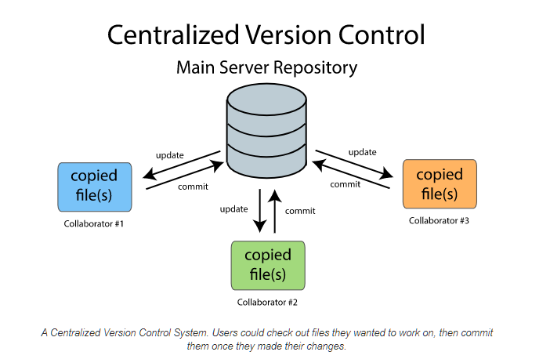
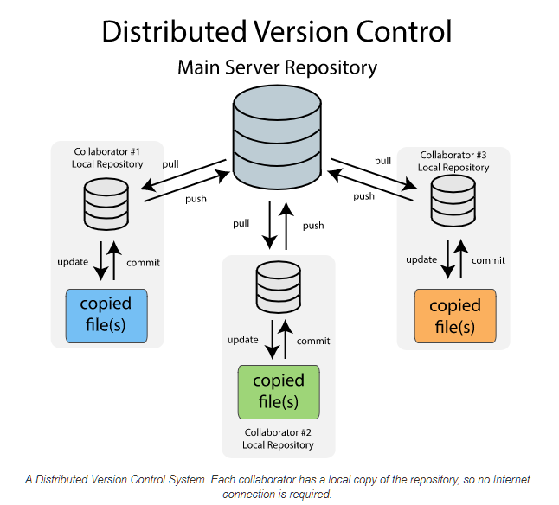
Introduction – Centralized vs Distributed

Slide 7
Introduction – Differences with SVN
Is Git a better VCS than SVN? No, both Git and SVN are competent version control systems with their own strengths and weaknesses.
Why should we use Git over SVN? The flexibility and the feature set offered by Git makes it an ideal platform to integrate with practices like Agile and DevOps.
While Git is undoubtedly the leading platform, SVN should not be discarded without proper consideration. It all depends on the needs of the development environment.

Slide 8

Introduction – Git under the hood
Git stores everything under the .git folder in your repository.
In fact, the .git directory is the repository!
Let’s go down the rabbit hole!

Slide 9
Introduction – Git under the hood
When working with Git, you will never need to go inside .git.
But today we will, in order to learn about how branches are implemented in Git.

Slide 10
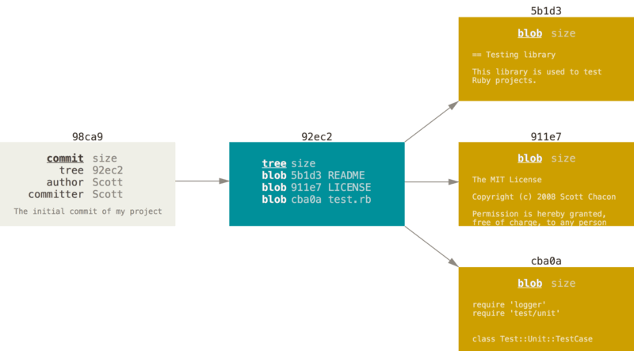
Introduction – Git under the hood
Each commit in Git is stored as a “blob”.
This blob contains information about the author and the commit message.
The blob references another blob that lists the files present in the directory at the time and references blobs that record the state of each file.
Commits are referenced by a SHA-1 hash (a 40-character hexadecimal string).
States of a Git file. Image from the Pro Git book. License CC BY 3.0.

Slide 11
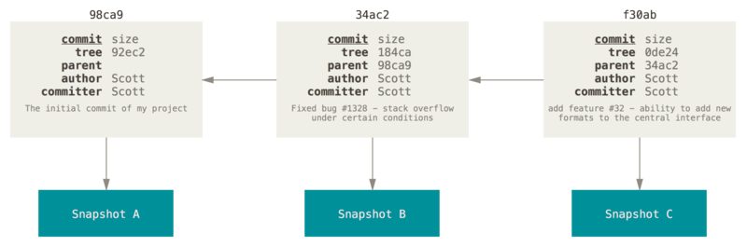
Introduction – Git under the hood
Once you have several commits, each commit blob also links to the hash of the previous commit.
Multiple commits can have the same parent (this is why we can have multiple branches).
The commits form a directed acyclic graph (do not worry if the term is not familiar).
All branches and tags in Git are pointers to commits.
A commit and its parents. Image from the Pro Git book. License CC BY 3.0.

Slide 12
Introduction – Git under the hood
Git is basically a content-addressed storage system
A mechanism for storing information that can be retrieved based on its content, not its storage location.
Content address is the content digest (SHA-1 checksum)
Stored data does not change
When a commit is ‘modified’, new commits are created.
Git doesn’t delete these ‘old commits’ right away, which is why it is very hard to lose data if it is committed once.

Slide 13
Introduction – Git under the hood
and get your hands warmed up… we don't call it a workshop for nothing!
DEMO time

Slide 14
Working with Git

Slide 15
Working with Git – The Basics
The basics for working on a (local) repository:
Init
Add
Delete
Commit
Checkout

Slide 16
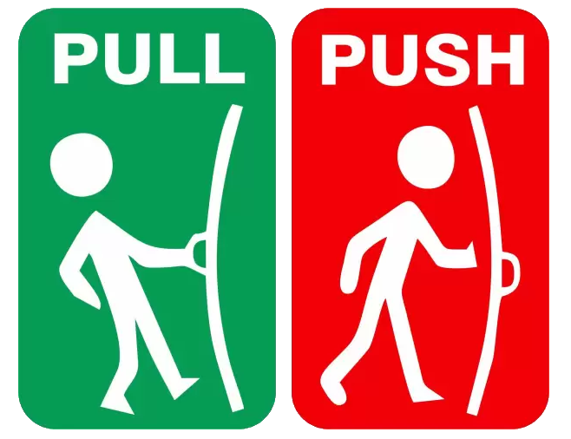
Working with Git – Collaborating
The basics for collaborate on a repository:
Clone
Fetch
Pull
Push

Slide 17
Working with Git – Advanced
Advanced tips and tricks:
Stash
Reset
Revert
Cherry-pick
Prune

Slide 18
Caffeine Break
10 minutes
Defecation allowed; no pull request policy applied on toilet paper today.

Slide 19
Working with Git – Merging
Merge types:
(Standard) Merge
Fast forward merge
Squash & merge
Rebase & merge

Slide 20
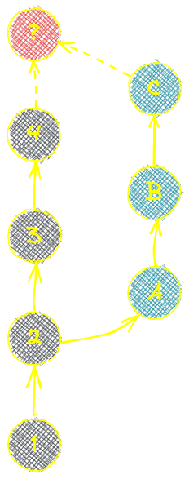
Working with Git – (Standard) merge
All commits are merged back into the main branch in the order they have been committed based on timestamp.
Zipper merge (2, A, 3, B, 4, C).
Will create an extra merge commit (D), a special type of “empty” commit that indicates when the merge occurred.

Slide 21
Working with Git – (Standard) merge
Advantages:
Most descriptive and verbose history.
Allows us to see a graph of when branches were made which can help understanding why changes were made and when.
Allows us to see each commit that made up the eventual merged changes, no loss of granularity.
Disadvantages:
Merge commits are often seen as messy as they are empty and only there for historical reasons.
Can end up having a complex graph of previous branches that’s more difficult to read.

Slide 22
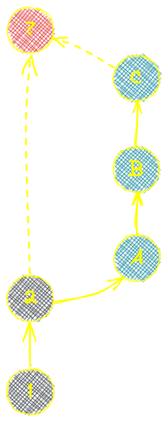

Working with Git – Fast forward merge
No new commits have been made to the main branch.
As if you made the commits directly on the base branch.
Same as a (standard) merge but no extra “empty” merge commit is created.

Slide 23
Working with Git – Fast forward merge
Advantages:
Keeps a very clean commit history.
Allows us to see each commit that made up the eventual merged changes, no loss of granularity.
Disadvantages:
Can only be done when the base branch hasn’t had any new commits, a rarity in a shared repository.
Can be seen as an inaccurate view of history as it hasn’t captured that a branch was created, or when it was merged.

Slide 24

Working with Git – Squash & merge
Squash takes all the commits (A, B, C) in the branch and melts them into one commit (D).
The melted commit is then added to the history.
None of the commits that made up the branch are preserved.

Slide 25
Working with Git – Squash & merge
Advantages:
Keeps a very clean commit history.
Can look at a single commit to see a full piece of work, rather than shifting through multiple commits in the log.
Disadvantages:
Lost of granularity, any useful detail in those commits that made up the branch is lost, as are any interesting decisions, changes in logic etc. captured during the development process.

Slide 26

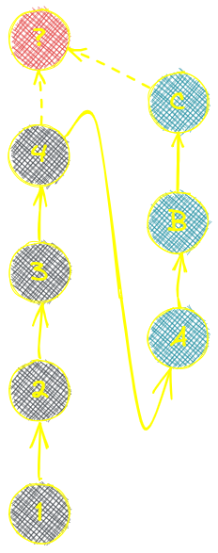
Working with Git – Rebase & merge
A rebase and merge will take where the branch was created and move the pointer to the last commit into the base branch, then reapply the commits on top of those changes.
A rebase enables the fast forward merge (no commits are done on the base branch).

Slide 27
Working with Git – Rebase & merge
Advantages:
Keeps a very clean commit history.
Keeps the individual commit granularity.
Disadvantages:
Can be seen as an inaccurate view of history as it hasn’t captured that a branch was created, or when it was merged.
Difficult to see which commits relate to which branch.
Can cause frustrations when someone else is merging to the base branch right before you get to merge. You have to do a rebase again.

Slide 28
Working with Git – Merge conflicts
Version control systems are all about managing contributions between multiple distributed authors.
Sometimes multiple developers may try to edit the same content.
To alleviate the occurrence of conflicts developers will work in separate isolated branches.
The merge command’s primary responsibility is to combine separate branches and resolve conflicting edits.

Slide 29
Working with Git – Merge conflicts
Merging and conflicts are a common part of the Git experience.
Conflicts in other version control tools like SVN can be costly and time-consuming.
Git makes merging super easy.
Most of the time, Git will figure out how to automatically integrate new changes.

Slide 30
Working with Git – Merge conflict types
Fail to start
Changes in either the working directory or staging area of the current project.
Conflicts with pending local changes.
Stabilize local state first.
Fail during the merge
Indicates a conflict between the current local branch and the branch being merged in.
Conflict with other developer's code.
Git will try to merge but leaves things for you to resolve manually in the conflicted files.

Slide 31
Working with Git – Merge conflicts
Let’s emerge… and solve those conflicts right away!
DEMO time

Slide 32
Working with Git – Best merge strategy?
There is no best strategy, it all depends on the needs of the development environment.
Personally, I tend to lean towards rebase & merge as it preserves all the history whilst keeping things nice and linear in the logs. However, it can be fiddly when working on one repository shared by lots of engineers, whilst dealing with rebase conflicts often requires copious amounts of caffeine!
Most important strategy in a team: Use the same strategy!

Slide 33
Workflows

Slide 34

Workflows – What…?
Speed and agility are crucial when it comes to developing and releasing software in modern software development.
Having a large team of developers working simultaneously, branching and merging code can become messy.
Teams need to have a process in place to implement multiple changes at once.
Having an efficient workflow becomes a priority for these teams.

Slide 35
Workflows – Branches…
…are primarily used to develop features giving developers a separate workspace for their code.
…are merged back to a main branch upon completion of work.
…for features (or bug fixes) are kept apart from each other allowing you to develop and test them isolated.
…protect the mainline of code.

Slide 36

Workflows – Branching strategy…
…is the strategy that development teams adopt when writing, merging and deploying code when using a version control system.
…is essentially a set of rules that developers can follow to stipulate how they interact with a shared codebase.

Slide 37
Workflows – Which one?
Centralized workflow
Feature-based development
Gitflow
GitLab/GitHub flow
Trunk-based development
Scaled trunk-based development

Slide 38
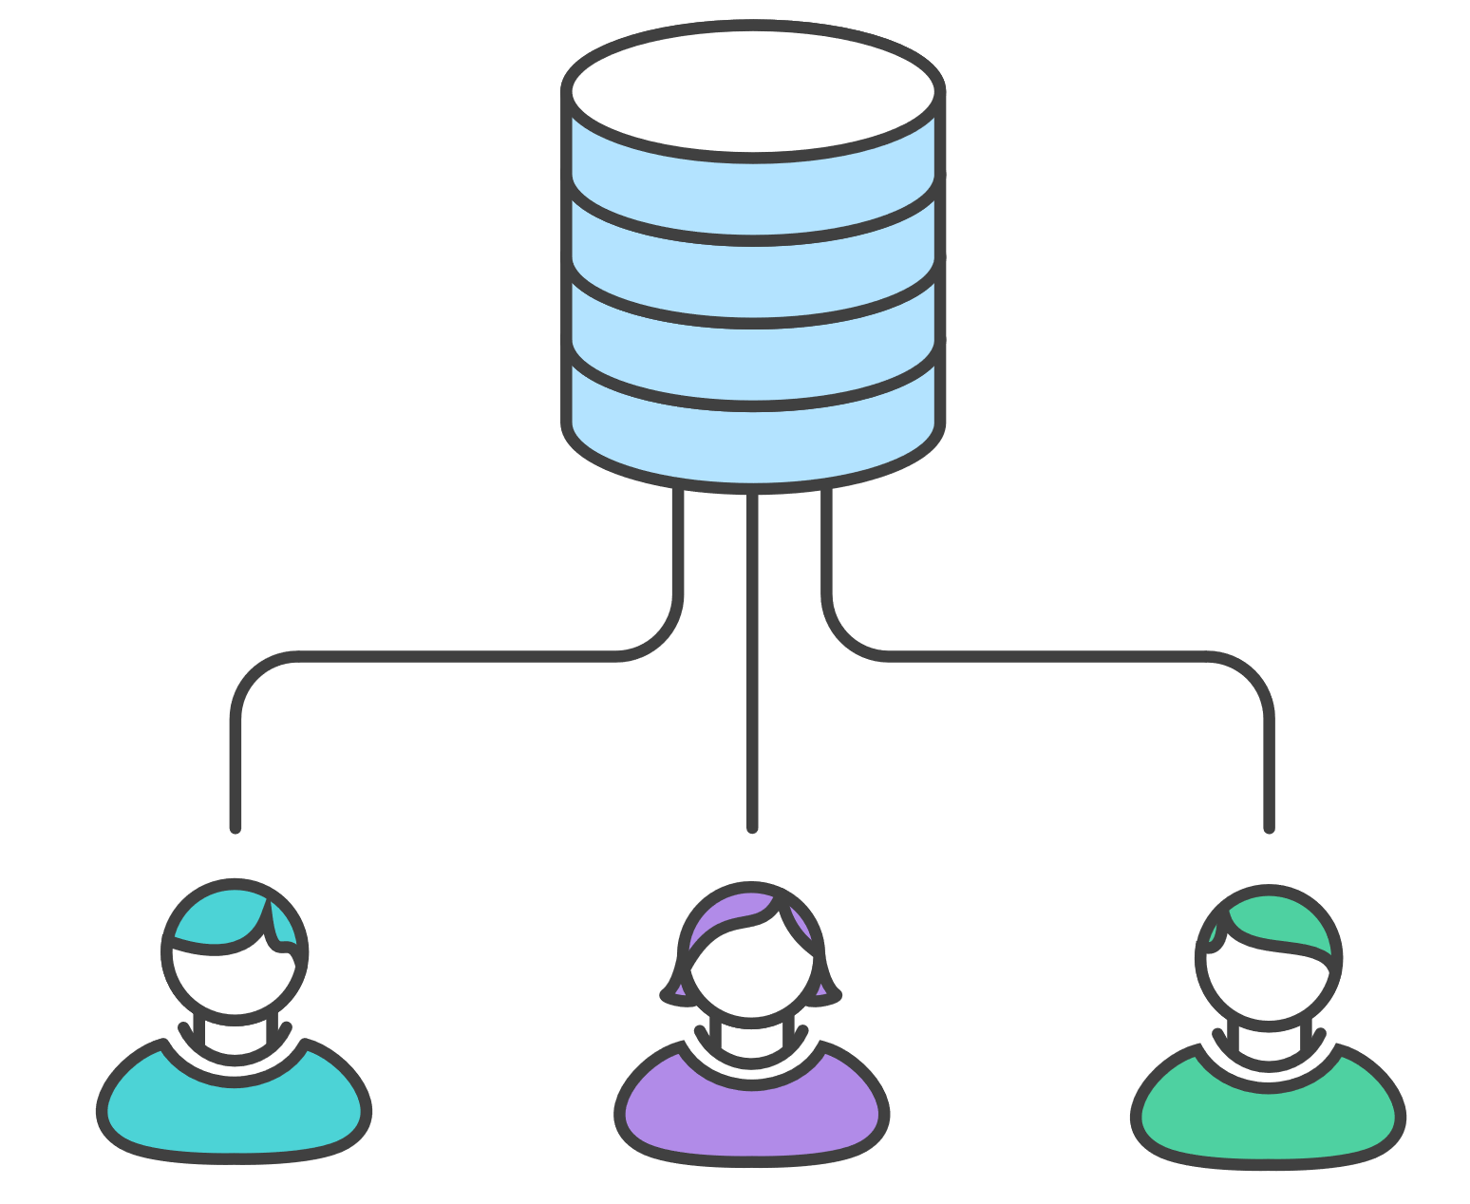
Workflows – Centralized workflow
Great workflow for teams transitioning from SVN.
Centralized workflow uses a central repository to serve as the single point-of-entry for all changes to the project. Instead of trunk, the default development branch is called main. All changes are committed into this branch.
This workflow doesn’t require any other branches besides main.

Slide 39
Workflows – Centralized workflow
Advantages:
Great workflow for teams transitioning from SVN.
Disadvantages:
…

Slide 40
Workflows – Feature-based development
Before developing a feature, the developer checks out a “feature” branch and makes all the code changes there.
The developer creates a merge request with the main branch when the development on the feature is complete.
Depending upon company policy, there might be a code review before merging the feature branch into the main branch.
Most importantly, developers never push code changes directly to the main branch in the feature-based workflow.

Slide 41

Workflows – Gitflow
Advantages:
Allows for parallel development to protect the production code so the main branch remains stable for release while developers work on separate branches.
Various types of branches make it easier for developers to organize their work.
Ideal when handling multiple versions of the production code.
Disadvantages:
Considered to be a bit complicated and advanced for many of today’s projects.
As more branches are added, they may become difficult to manage as developers merge their changes from the development branch to the main.
Due to GitFlow’s complexity, it could slow down the development process and release cycle.

Slide 42
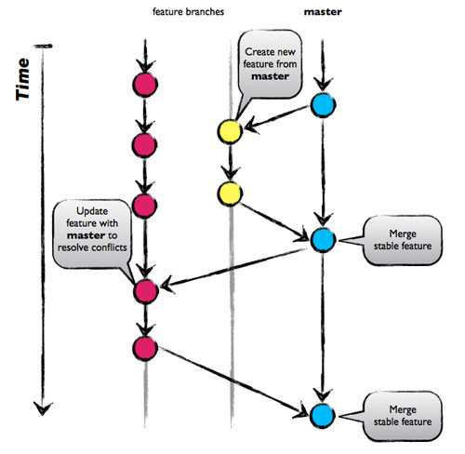
Workflows – GitLab/GitHub flow
Advantages:
Fast and streamlined branching strategy with short production cycles and frequent releases.
Keeps the master code in a constant deployable state and hence can support continuous integration and continuous delivery processes.
Allows for fast feedback loops so that teams can quickly identify issues and resolve them.
Disadvantages:
Not suitable for handling multiple versions of the code.
Lack of development branches makes this strategy more susceptible to bugs and so can lead to an unstable production code if branches are not properly tested before merging.
As teams grow merge conflicts can occur as everyone is merging to the same branch.

Slide 43
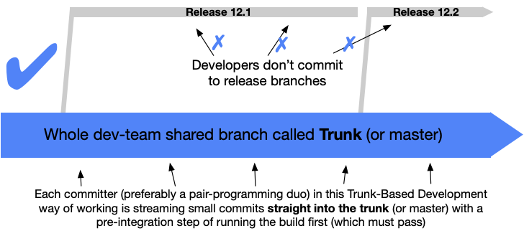
Workflows – Trunk-based development
A branching strategy that requires no branches.
Developers integrate their changes into a shared trunk/main at least once a day.
The shared trunk/main should be ready for release anytime.
This strategy is often combined with feature flags.

Slide 44
Workflows – Trunk-based development
Advantages:
Paves the way for continuous integration as the trunk is kept constantly updated.
Enhances collaboration as developers have better visibility over what changes other developers are pushing.
Eliminates the stress of long-lived branches and hence, merge conflicts or the so-called ‘merge hell’.
Allows for quicker releases as the shared trunk is kept in a constant releasable state.
Disadvantages:
Suited to more senior developers as this strategy offers a great amount of autonomy which non-experienced developers might find daunting as they are interacting directly with the shared trunk.

Slide 45
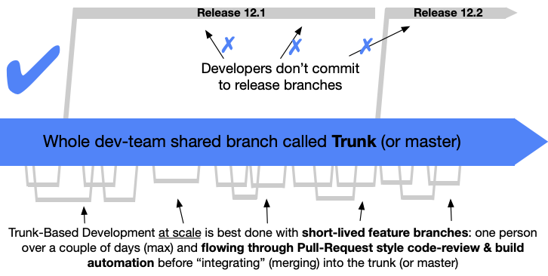
Workflows – Scaled trunk-based development
Emerged from trunk-based development.
More suitable for larger teams.
Allows short-lived feature branches (max couple of days).
The shared trunk/main should be ready for release anytime.
This strategy is often combined with feature flags.

Slide 46
Workflows – Scaled trunk-based development
Advantages:
Paves the way for continuous integration as the trunk is kept constantly updated.
Enables larger teams to do trunk-based development without the continuous rebase risk on every commit.
Allows for quicker releases as the shared trunk is kept in a constant releasable state.
Disadvantages:
Using feature branches can lead to merge conflicts.

Slide 47
Workflows – Best workflow?
There is no best workflow, it all depends on the needs of the development environment.
Personally, I tend to lean towards a mix of the scaled trunk-based development and GitFlow.
Why scaled trunk-based development?
Short-lived feature branches allows developers to integrate changes flowing through pull-request style code reviews and build automation before integrating into the main branch. Key enabler for continuous integration (and continuous delivery).
Why GitFlow?
Only the hotfix part of GitFlow is interesting to me. The release branches enable hotfix possibilities on released versions. Without too much of administration it is clear in the history of the branches where and why hotfixes are developed.

Slide 48
Workflows – Successful workflow!
When evaluating a workflow for your team, it's most important that you consider your team’s culture.
Choose a workflow to enhance the effectiveness of your team.
Choose a workflow which won’t be a burden that limits productivity.
Things to consider:
Does this workflow scale with team size?
Is it easy to undo mistakes and errors with this workflow?
Does this workflow impose any new unnecessary cognitive overhead to the team?
Does it match to the release strategy and architecture of our software?

Slide 49
Questions?
Remarks, shout-outs, tarnations, commit messages or appreciations?

Slide 50

Thank you!
Disclaimer:
All content is gratefully nicked from the world wide web!
An extensive and recommendable git tutorial can be found at:
https://www.atlassian.com/git/tutorials/
…and I want to thank al my patreons who made this awesome workshop possible!

