Slide 1

Kickstart Workshop TDD

Slide 2
Agenda
Introduction – What is TDD?
Theory -
Katas - Let’s code!

Slide 3
Introduction

Slide 4
Introduction – What is TDD?
TDD
=
Test Driven Development
=
Test technique

Slide 5
Introduction – What is TDD?
TDD is …
NOT a testing strategy
NOT a design principle
NOT for UX testing
NOT for performance testing
NOT for solving people problems

Slide 6
Introduction – Values of TDD
Values of TDD
Baby steps instead of large-scale changes
Continuous refactoring instead of late quality improvements
Evolutionary design instead of big design up front
Executable documentation instead of static documents
Minimalist code instead of a gold-plated solution

Slide 7
Introduction – Why TDD?
Why tests first?
If we want to trust our code, we need to be able to trust our tests.
If we want to trust our tests, we need to be able to see them failing.
If we never see our tests fail, we don’t know if our tests are actually testing the right things.

Slide 8
Introduction – Essence of TDD?
It will force us to:
Work in short cycles
Write tested code
Do continuous refactoring
Continuously analyze the requirements (hypotheses)
Producing minimalist and not-gold-plated code

Slide 9
Introduction – When TDD?
We can’t use TDD when:
We don’t have clear expectations of the code we are about to implement
Testing does not make sense or does not bring any benefit
The tests run very slow, allowing only long feedback loops
The design requires visual verification such as UI layout or UX concerns
But when TDD then? → Any other case if you feel like it! ☺

Slide 10
Theory

Slide 11
Theory – A clean test
A master craftsman (e.g. carpenter) finishes any part of a product with the same care as the front.
Software engineering is also about craftmanship where we should write all parts of the software with equal care, whether it is production or test code.
A clean test reads as a story.

Slide 12
Theory – A clean test
Characteristics of a clean test:
Descriptive test name
GivenWhenThen naming convention
ShouldWhen naming convention
Meaningful namings
Structured with the triple A pattern Arrange-Act-Assert
Follows the F.I.R.S.T. principle
Fast
Independent
Repeatable
Self-validating
Thorough

Slide 13
Theory – F.I.R.S.T. principle
Fast A test should be fast and efficient. As the application grows, we will have more and more tests. Therefore, running the as fast as possible is essential.
Independent A test should not depend on the state of any other tests or on external services. It should be standalone to be able to execute it individually and efficiently.
Repeatable A test should be repeatable in any environment. Each test should set up its own data and should not depend on any external factors to run its test. A clean test should be deterministic that always results in the same tests succeeding.
Self-validating A test should validate itself whether the test execution is passed or failed. The self-validating test can avoid the need to do an evaluation manually by us.
Thorough The tests we write shouldcover all happy paths, should cover edge/corner/boundary cases, should cover negative test cases,should cover security and illegal issues.

Slide 14
Theory – Three laws of TDD
The fundamentals of TDD consist of three main rules:
You are not allowed to write any production code unless it is to make a failing unit test pass.
You are not allowed to write any more of a unit test than is sufficient to fail.
You are not allowed to write any more production code than is sufficient to pass the one failing unit test.
TDD is all about frequency of feedback. It forces us to apply baby steps.

Slide 15
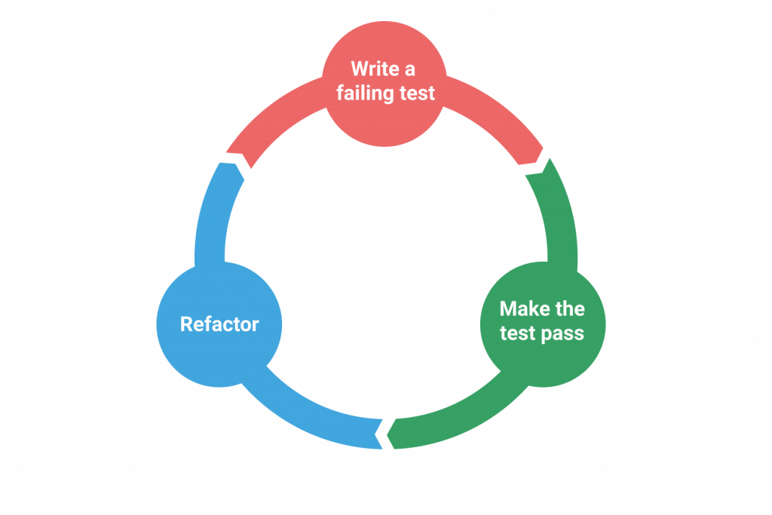
Theory – Red-Green-Refactor cycle

Slide 16
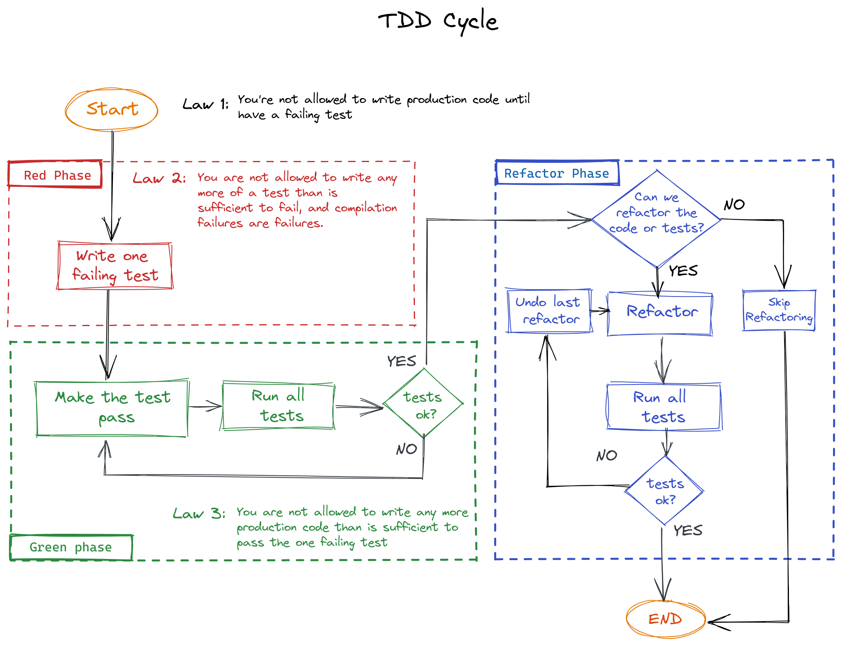

Slide 17
Katas
Greatness comes from practicing.

Slide 18
Kata 1 – FizzBuzz (20 min)
FizzBuzz is one of the most famous coding exercises for beginners.
Requirements:
Write a “FizzBuzz” method that accepts a number as input and returns it as a string.
For multiples of three return “Fizz” instead of the number.
For the multiples of five return “Buzz”.
For numbers that are multiples of both three and five return “FizzBuzz”.

Slide 19
Kata 2 – String calculator (40 min)
Create a simple calculator that takes a string and returns an integer.
Requirements:
The method can take up to two numbers, separated by commas, and will return their sum as a result. So the inputs can be: “”, “1”, “1,2”. And for an empty string, it will return 0.
Allow the add method to handle an unknown number of arguments.
Allow the add method to handle newlines as separators, instead of commas.
Add validation to not to allow a separator at the end.
Allow the add method to handle different delimiters.
To change the delimiter, the beginning of the input will contain a separate line that looks like this: //[delimiter]\n[numbers]
Numbers bigger than 1000 should be ignored, so adding 2 + 1001 = 2

Slide 20
Thank you!
Content of the presentation is used from the TDD manifesto.
And more exercises can be found there.
http://www.tddmanifesto.com/

