Slide 1
Getting Started With PySense

Slide 2
Goals
Understand what PySense is and what it is capable of
Understand how to do a few basic tasks in PySense

Slide 3
What is PySense?
PySense is a Software Development Kit (SDK) in Python for Sisense
Allows Python developers to write software to manage their Sisense
Currently: Writing automation means looking up REST calls and managing communication.
With PySense: We abstract out the REST calls and allow users to write code without knowing the details of the REST API.

Slide 4
Examples of Other SDKs
Looker:
Ruby, JavaScript, Python
Tableau:
C, C++, Java, Python
Power BI:
.NET
Domo
Java, Python

Slide 5
Sisense, REST, and Automation
All communication between the front end and the back end of Sisense is accomplished via REST.
REST (Representational State Transfer) is a protocol that allows us to programmatically tell the server to do something for us, generally either
Get information
Modify information
Add information
Delete information
When you click a button on the UI, you are activating a REST call.
Automation is skipping the button pressing and just making the REST call directly.

Slide 6
PySense is Object Oriented Sisense
Object Oriented Programming (OOP) takes abstract computer elements and models them as objects which are easier for humans to understand.
When you ask Sisense for a dashboard it returns you a JSON blob
When you ask PySense for a dashboard, it returns a dashboard object.

Slide 7
What is PySense actually?
Python library hosted on github at https://github.com/nathangiusti/PySense
Includes
The actual PySense source code with comments
Snippets
Tutorials
Documentation
Sample Scripts
Read me (change log)
Can be installed onto a client machine using standard Python packages (pip)

Slide 8
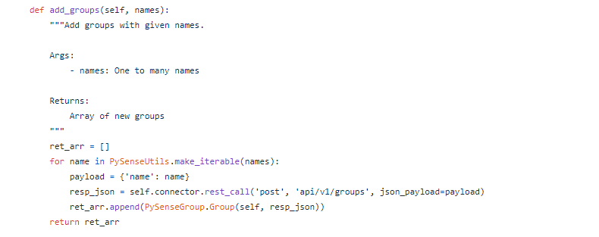
PySense Source Code
PySense source code is hosted on GitHub with comments explaining how to use it.

Slide 9
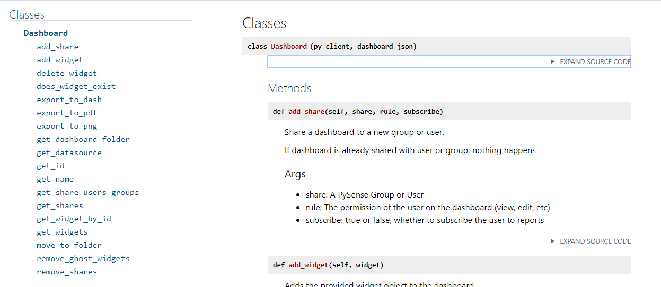
Documentation
Available in a link from the readme on GitHub

Slide 10
Set up Python and PySense
Install Python and an IDE of your choice. (PySense was developed on PyCharm).
Install the PySense library through pip
pip install PySenseSDK
Include PySense in all your scripts:
from PySense import PySense

Slide 11
Python Tip!
When calling functions in python we have required arguments and optional arguments.
Required arguments come first and order matters
Optional arguments come after the required ones. You can add as many optional arguments as are supported.
Look at the call
Email address and role are required and must come first in that order
first_name and last_name are optional and thus are added at the end and can be in any order.
The PySense documentation lists which arguments are required and which are optional
py_client.add_user('user@email.com', 'Data Designer', first_name='John', last_name='Doe')

Slide 12
Hands On
Authenticate with our Sisense server
Create a user and add a security rule
Download our dashboards
https://github.com/nathangiusti/PySense/tree/master/Snippets

Slide 13
Authentication
We must log in to Sisense via API as we would if we were logging in to the web.
Authentication returns us a PySense object which we name py_client
We can do this two ways
Inline:
From file:
SampleConfig.yaml:
py_client = PySense.PySense(‘localhost’, ‘myusername’, ‘mypassword’, )
py_client = PySense.authenticate_by_file('SampleConfig.yaml')
host: 'your_host' username: 'your_username@sample.com' password: 'your_password'

Slide 14
Exercise One
Authenticate with your Sisense server.
Call the get_role_id method and print the role id for any role (Viewer, Admin, etc).

Slide 15

Exercise One Solution

Slide 16
The PySense object
The object created by authentication (py_client) in our example is our connection to our Sisense instance.
The py_client object is where we do things that involve the whole server, for example, adding users or retrieving dashboards and elasticubes.
See documentation for full list of features

Slide 17
Users
To add a user we call the add_user method on our PySense object with the user’s email and role.
Email and role are required but there are additional details we can set like so:
We can also use our PySense object to query for specific users or delete users.
To delete a user, we pass the user to our delete_users method.
py_client.add_user('user@email.com', 'Viewer')
py_client.add_user('user@email.com', 'Data Designer', first_name='John', last_name='Doe')

Slide 18
Exercise Two
Create three new users in your Sisense.
Print out the user’s username.
Delete the users.

Slide 19
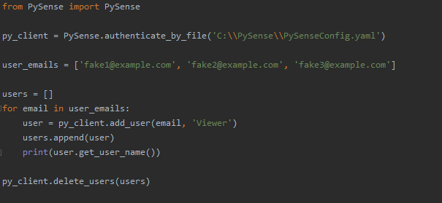
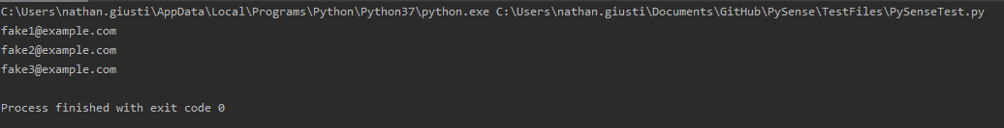
Exercise Two Solution

Slide 20
Data Security Pt 1 (The Elasticube)
Data Security is applied to an elasticube so first we need to use our PySense object to get that cube.
The elasticube variable is the PySense representation of your elasticube.
From elasticube you can do things like export your model, run sql, and of course apply data security.
See documentation for full list of features
elasticube = py_client.get_elasticube_by_name('CubeTitle')

Slide 21
Data Security Pt 2 (Default rule)
Create the default rule:
Default rule of Nothing (recommended)
Default rule for some values
The default_rule contains the rule created. You can check the properties of the rule to ensure everything was created correctly.
If you don’t need to do anything with the rule, you can ignore the return.
default_rule = elasticube.add_default_rule('Dim_Dates', 'BusinessDay', 'numeric')
default_rule = elasticube.add_default_rule('Colors', 'Name', 'text’, members=['Red', 'Blue'])

Slide 22
Data Security Pt. 3 (Creating user/group rules)
We need to get all the users and groups that we need to add to this security rule. The first argument in add security rule is a list of all the users and groups to apply to.
In the following snippet we get our desired users and groups, make them into a list and pass that list to our method
Members is optional, if not there, a Nothing rule is created (unless all members is set).
all_members and exclusionary are optional arguments that can be set to True or False
users = py_client.get_users(first_name=‘Steve') groups = py_client.get_groups(name='PySense’) shares = shares.append(groups).append(users) rule = elasticube.add_security_rule(shares, 'Dim_Dates', 'BusinessDay', 'numeric', members=[1])

Slide 23
Exercise Three
Add a default security rule
Add a security rule for a user on your system.
Print out the table, column, and datatype of your new rules.
Delete the rules

Slide 24
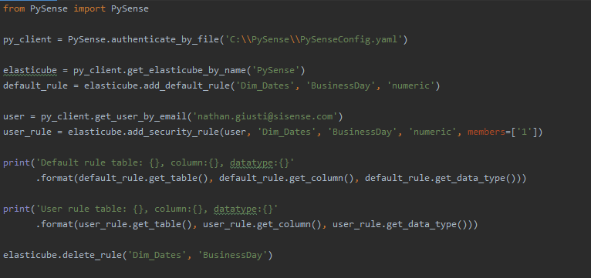
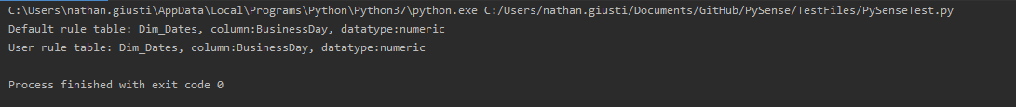
Exercise Three Solution

Slide 25
Downloading our Dashboards
We can get a dashboard by its dashboard id and then download the dash file to a folder.
We could also do this for all our dashboards
Here we get a list of all our dashboards. get_dashboards has optional arguments for filtering by name, folder, etc. See documentation for full list.
For every dashboard in our list, we call the export to dash method and pass in the optional path parameter to tell PySense to save this file to our disk.
If path is left out, the method returns the raw file contents, otherwise, path is returned
dashboard = py_client.get_dashboard_by_id('mydashboardid') dashboard.export_to_dash(path='C:\\MyBackUps\\dashboard.pdf')
dashboards = py_client.get_dashboards() for dashboard in dashboards: dashboard.export_to_dash(path='C:\\MyBackUps\\{}.dash'.format(dashboard.get_id()))

Slide 26
Exercise Four
Get all your dashboards dash files
Save them to a folder
Print the paths to all the dashboards

Slide 27
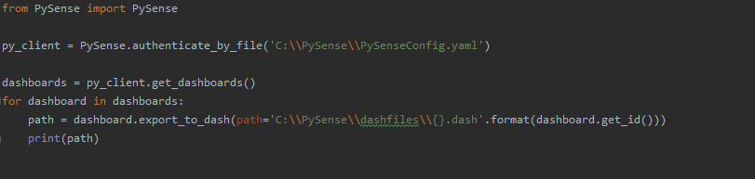
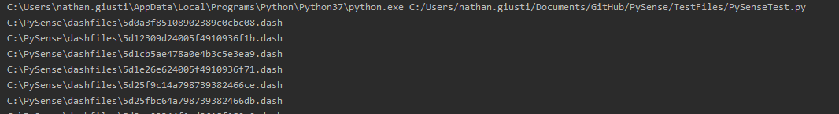
Exercise Four Solution

Slide 28
PySense Tips!
Some methods return arrays, some methods return a single object. This information should be in the documentation, but if you look at function names:
Plural nouns (get_dashboards) always return arrays
Singular nouns (get_elasticube_by_name) always return a single object.
Authenticate via file. You can set up a program to run very easily for multiple servers/clients by just pointing to a different config file.
Use the debug parameter to get a full log of what API calls are being made, along with their contents. You can turn this on and off between individual calls so you only log what you need.
All unsuccessful rest calls throw a PySenseException. You can catch and handle these exceptions to do retries or set up graceful failure conditions.
You can use this for troubleshooting with clients.
Write a program that runs a sql query for every dim table and ensure that the key is unique.
Write a program that delivers a report of what elasticubes are being used by number of dashboards

Slide 29
Fin

