Slide 1
Module 2: Final assigment
Nedap University s06e02
Notes:
1

Slide 2
Planning
Now: 1st April 2021
Wednesday 14th April at 23:59 -> project deadline (based on Git-timestamps)
Thursday 15th April at 14:00 -> tournament
Friday 16th April at 14:00-> presentation

Slide 3

Assignment (1)

Slide 4
Assignment (2)
Reliable file transfer via UDP-based protocol over Wifi
Client-Server app
Protocol > feature-set
Individually

Slide 5
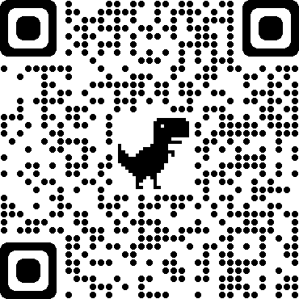
Assignment (3)
https://github.com/nedap/nu-module-2

Slide 6
Advice
Get your PI up-and-running today!
Contact us when you’re having problems.
Plan ahead.

