Slide 1
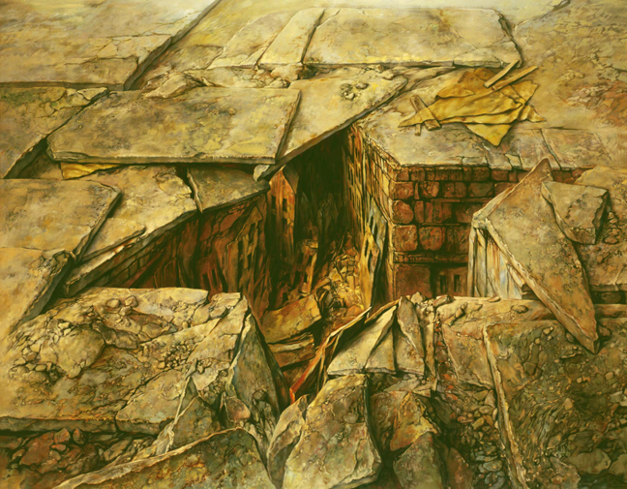
Is the Sho’ah Unique?

Slide 2
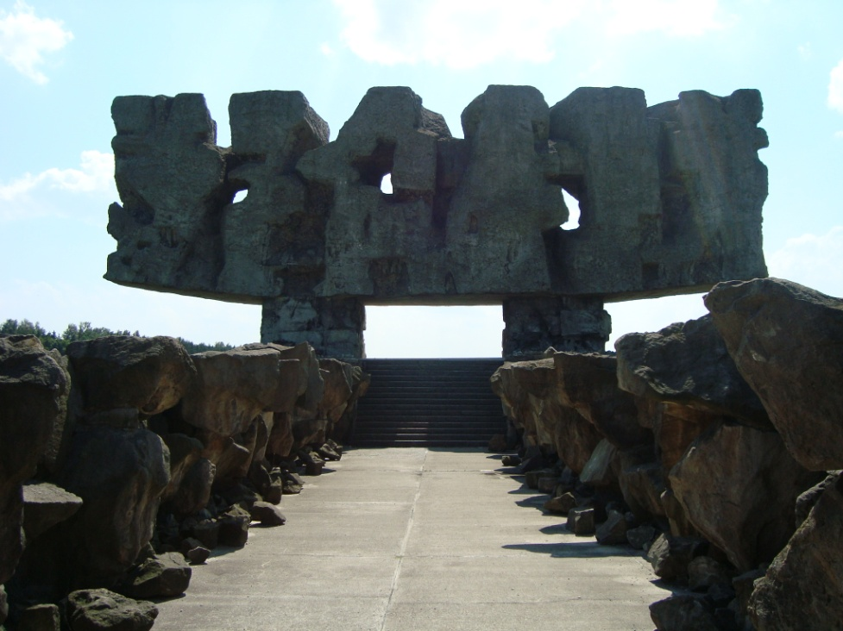
Holocaust or Sho’ah
השואה, HaShoah, "catastrophe"
Holocaust is the transliteration of the Greek word ὁλόκαυστος, which means whole burnt offering, a sacrifice ( holókaustos: hólos, “whole” and kaustós, “burnt”)
Uses religio-sacrificial language to describe the genocide committed by the Nazis.
Sho’ah is the transliteration of the Hebrew word השואה(Ha Sho’ah), which means “the catastrophe”.
Avoids religio-sacrificial language.
Monument at Majdanek by Wiktor Tolkin, 1969.

Slide 3
The Defintion of Genocide
The United Nations “Convention on the Prevention and Punishment of the Crime of Genocide” (1948) defined genocide as:
In the present Convention, genocide means any of the following acts committed with intent to destroy, in whole or in part, a national, ethnic, racial or religious group, as such:
Killing members of the group;
Causing serious bodily or mental harm to members of the group;
Deliberately inflicting on the group conditions of life calculated to bring about its physical destruction in whole or in part;
Imposing measures to prevent births within the group;
Forcibly transferring children of the group to another group.
United Nations. “Convention on the Prevention and Punishment of the Crime of Genocide,” 260 (III), Article I.

Slide 4
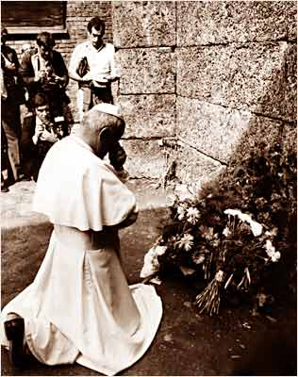
Blessed Pope John Paul II
No one is permitted to pass by the tragedy of the Sho’ah. That attempt at the systematic destruction of an entire people falls like a shadow on the history of Europe and the whole world; it is a crime which will for ever darken the history of humanity. May it serve, today and for the future, as a warning: there must be no yielding to ideologies which justify contempt for human dignity on the basis of race, colour, language or religion. I make this appeal to everyone, and particularly to those who would resort, in the name of religion, to acts of oppression and terrorism.
Blessed Pope John Paul II, On the Sixtieth Anniversary of the Liberation of the Prisoners of the Auschwitz-Birkenau Death Camp, 2005

Slide 5
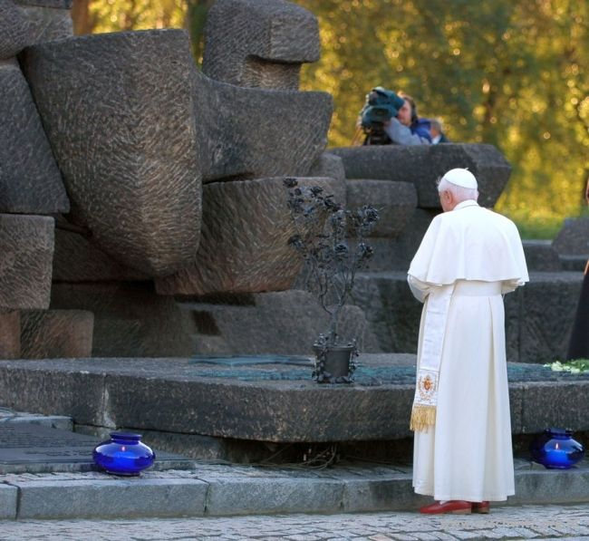
Pope Benedict XVI
“To speak in this place of horror, in this place where unprecedented mass crimes were committed against God and man, is almost impossible - and it is particularly difficult and troubling for a Christian, for a Pope from Germany. In a place like this, words fail; in the end, there can only be a dread silence - a silence which is itself a heartfelt cry to God: Why, Lord, did you remain silent? How could you tolerate all this? In silence, then, we bow our heads before the endless line of those who suffered and were put to death here; yet our silence becomes in turn a plea for forgiveness and reconciliation, a plea to the living God never to let this happen again.”
Pope Benedict XVI, Auschwitz-Birkenau, 2006

Slide 6
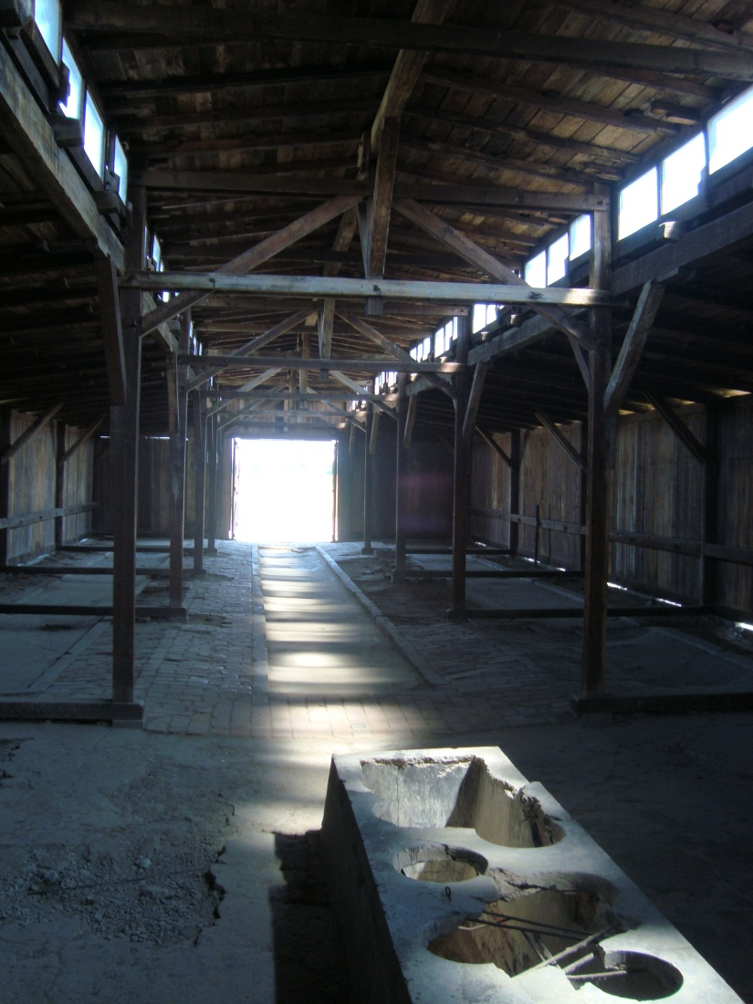
The Problem of Uniqueness
The central question is not whether the Sho’ah is unique, because all genocides are simultaneously unique in their historical situation and analogous in their structure. The central question is whether the Sho’ah is uniquely unique—sui generis.
Singularity precludes universality.
If the Sho’ah is uniquely unique then it is incomparable with other genocides and nothing can be learned from it about the development or prevention of future genocides.
Universality precludes singularity.
If the Sho’ah is not uniquely unique then it is comparable with other genocides, but its significance is diminished, and its contribution to comparative genocide studies is dramatically reduced.

Slide 7
Moral Uniqueness
No one has yet argued for the moral uniqueness of the Sho’ah.
To succeed, this argument would need to prove that the deaths of the victims of the Sho’ah were more valuable than the deaths of other victims of genocide, and therefore, their murder constituted a “greater” evil.

Slide 8
Metaphysical Uniqueness
This argument holds that the Sho’ah was metaphysically unique because it defies historical classification, and the murder of European Jews was so inconceivable that it cannot be captured in language, consequently, there are no lessons to be learned from the event.
Scholars holding this view: Saul Friedlander and George Steiner

Slide 9
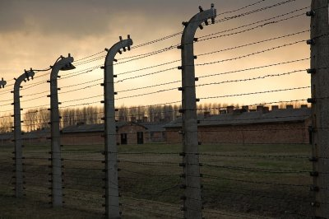
Numerical Uniqueness?
Nazi Germany’s “Final Solution” (1941-1945) – 10,000,000 - 11,000,000
Jews – 6,000,000
Non-Jewish Poles – 3,000,000
Roma/Sinti – 250,000-1,000,000
Disabled – 200,000
Homosexuals – 5,000-15,000
Others deemed “undesirable” – 33,0000
The Genocide Education Project

Slide 10
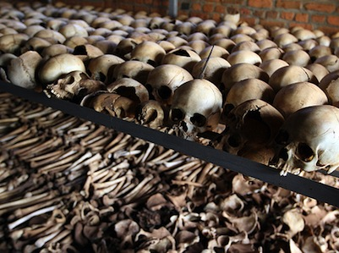
Numerical Uniqueness?
Chinese Genocide by Mao Tse-Tung (1950-69)– 49,000,000-78,000,000
Russian Genocide by Josef Stalin’s Purges and Famines (1932-39) – 23,000,000
Belgian Congo Genocide by Leopold II (1886-1908) – 10,000,000
Rwanda Genocide by Jean Kambanda (1994) – 800,000
The Genocide Education Project

Slide 11
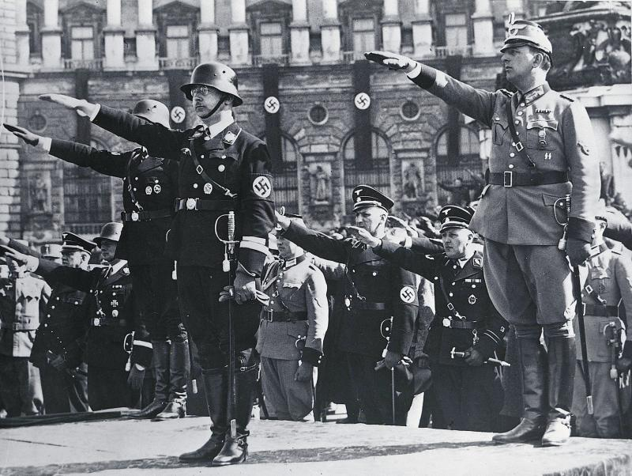
Cultural Uniqueness?
This argument holds that the Sho’ah was a unique form of German genocide that occurred because of a unique form of “eliminationist antisemitism” that shaped German identity.
Scholars holding this view: Daniel Goldhagen

Slide 12
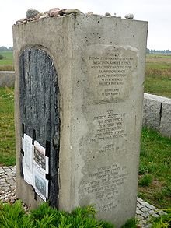
Jedwabne Massacre
On July 10, 1941 the inhabitants of the small town of Jedwabne, Poland murdered 1,600 of their Jewish neighbors prior to the arrival of Nazi occupiers.
Gross, Jan. Neighbors. New York: Penguin Books, 2002.

Slide 13
Political Uniqueness
This argument holds that the Sho’ah is politically unique because no political state had ever officially backed, sanctioned, and facilitated, as a matter of intentional principle and official policy, to physically annihilate every person belonging to a particular group of people.
Scholars holding this view: Eberhard Jäckel

Slide 14
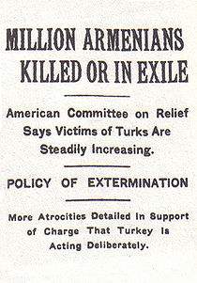
Armenian Genocide
It is estimated that one and a half million Armenians perished between 1915 and 1923. There were an estimated two million Armenians living in the Ottoman Empire on the eve of W.W.I. Well over a million were deported in 1915. Hundreds of thousands were butchered outright. Many others died of starvation, exhaustion, and epidemics which ravaged the concentration camps... In 1918, however, the Young Turk regime took the war into the Caucasus, where approximately 1,800,000 Armenians lived under Russian dominion. Ottoman forces advancing through East Armenia and Azerbaijan here too engaged in systematic massacres. The expulsions and massacres carried by the Nationalist Turks between 1920 and 1922 added tens of thousands of more victims. By 1923 the entire landmass of Asia Minor and historic West Armenia had been expunged of its Armenian population. The destruction of the Armenian communities in this part of the world was total.
From Armenian National Institute armenian-genocide.org

Slide 15
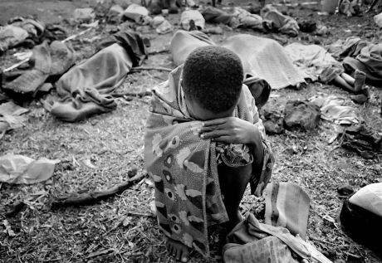
Rwandan Genocide
In 1994, Rwanda's population of 7 million was composed of three ethnic groups: Hutu (approximately 85%), Tutsi (14%) and Twa (1%). Between April and July 1994, at least 500,000 Tutsi were killed when a Hutu extremist-led government launched a plan to murder the country's entire Tutsi minority and any others who opposed the government's policies.
From “Overview Rwanda,” United States Holocaust Memorial Museum website.

Slide 16
Historical Uniqueness
This argument holds that the Sho’ah is a unique historical event because the totality, scale, scope, intent, lethality, and the means employed were unprecedented in history and uniquely different than all other genocides.
Scholars holding this view: Christopher Browning, Stephen Katz, Zygmunt Bauman, and Deborah Lipstadt

Slide 17
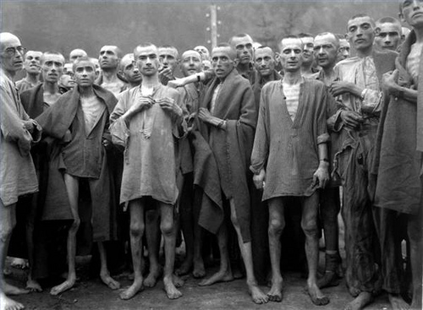
The Sho’ah is Unprecedented
Yehuda Bauer has argued that while all genocides are unique as historical events, the Shoah is unprecedented.
The unprecedented character of the Sho’ah rests on the "pseudo-religious" ideological core that motivated the Nazis to attempt to carry out the total physical annihilation of the Jews, for which the Aremenian genocide is the closest parallel.
A precedent in law provides a principle or rule for interpreting previous cases and deciding future cases.
The Sho’ah sets a precedent for the study of past, present, and future genocides.

Slide 18
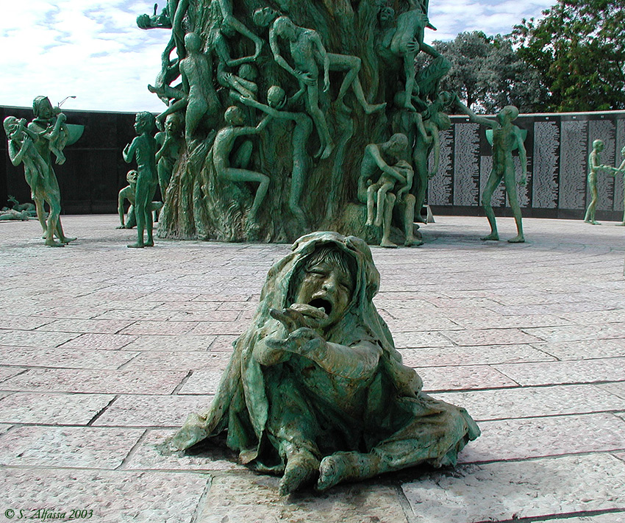
The Sho’ah is Paradigmatic
Barel Lang has argued that the concept of genocide was coined in Sho’ah studies, indicating that the Sho’ah was the most comprehensive and explicit act of genocide and is therefore paradigmatic of all other genocides.
Lang prefers the terms "unexampled" and "unprecedented" instead of "unique“.
The paradigmatic nature of the Sho’ah provides insights into how genocide develops and how it can be prevented.
Sculpture of Love and Anguish, Kenneth Treister, Holocaust Memorial , Miami Beach, Florida

Slide 19
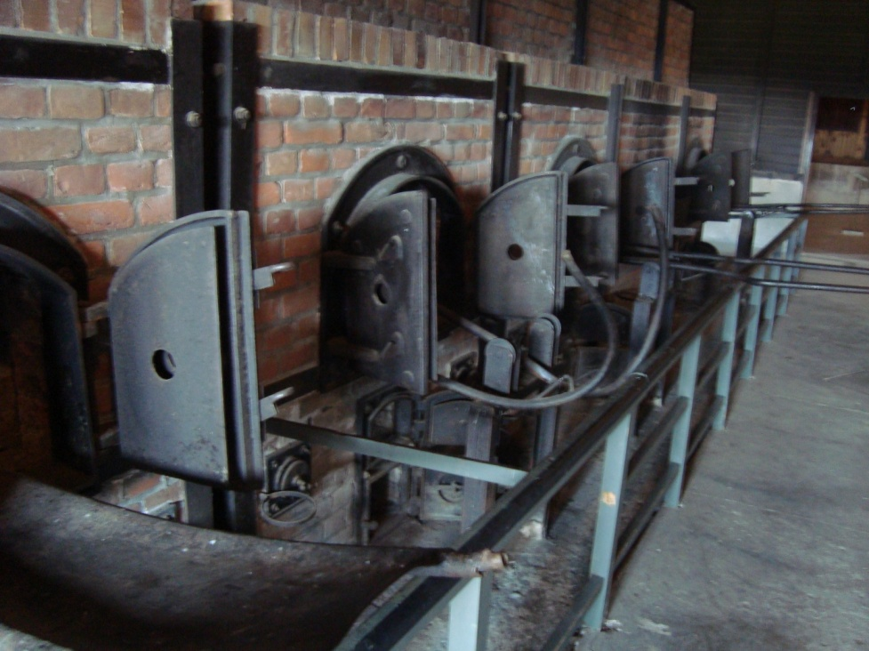
The 8 Stages of Genocide
Gregory H. Stanton, President of Genocide Watch, has defined genocide as “a process that develops in eight stages that are predictable but not inexorable. At each stage, preventive measures can stop it. The process is not linear. Logically, later stages must be preceded by earlier stages. But all stages continue to operate throughout the process.”
Classification
Symbolization
Dehumanization
Organization
Polarization
Preparation
Extermination
Denial
© 1998 Gregory H. Stanton. Originally presented as a briefing paper at the US State Department in 1996.

Slide 20
Stage 1: Classification
Development: All cultures have categories to distinguish people into “us and them” by ethnicity, race, religion, or nationality: German and Jew, Hutu and Tutsi. Bipolar societies that lack mixed categories, such as Rwanda and Burundi, are the most likely to have genocide.
Prevention: The main preventive measure at this early stage is to develop universalistic institutions that transcend ethnic or racial divisions, that actively promote tolerance and understanding, and that promote classifications that transcend the divisions. Promotion of a common language in countries like Tanzania has also promoted transcendent national identity. This search for common ground is vital to early prevention of genocide.

Slide 21
Stage 2: Symbolization
Development: We give names or other symbols to the classifications. We name people “Jews” or “Gypsies”, or distinguish them by colors or dress; and apply the symbols to members of groups. Classification and symbolization are universally human and do not necessarily result in genocide unless they lead to the next stage, dehumanization. When combined with hatred, symbols may be forced upon unwilling members of pariah groups: the yellow star for Jews under Nazi rule, the blue scarf for people from the Eastern Zone in Khmer Rouge Cambodia.
Prevention: To combat symbolization, hate symbols can be legally forbidden (swastikas) as can hate speech. Group marking like gang clothing or tribal scarring can be outlawed, as well. The problem is that legal limitations will fail if unsupported by popular cultural enforcement. If widely supported, however, denial of symbolization can be powerful, as it was in Bulgaria, where the government refused to supply enough yellow badges and at least eighty percent of Jews did not wear them, depriving the yellow star of its significance as a Nazi symbol for Jews.

Slide 22
Stage 3: Dehumanization
Development: One group denies the humanity of the other group. Members of it are equated with animals, vermin, insects or diseases. Dehumanization overcomes the normal human revulsion against murder. At this stage, hate propaganda in print and on hate radios is used to vilify the victim group.
Prevention: In combating this dehumanization, incitement to genocide should not be confused with protected speech. Genocidal societies lack constitutional protection for countervailing speech, and should be treated differently than democracies. Local and international leaders should condemn the use of hate speech and make it culturally unacceptable. Leaders who incite genocide should be banned from international travel and have their foreign finances frozen. Hate radio stations should be shut down, and hate propaganda banned. Hate crimes and atrocities should be promptly punished.

Slide 23
Stage 4: Organization
Development: Genocide is always organized, usually by the state, often using militias to provide deniability of state responsibility (the Janjaweed in Darfur.) Sometimes organization is informal (Hindu mobs led by local RSS militants) or decentralized (terrorist groups.) Special army units or militias are often trained and armed. Plans are made for genocidal killings.
Prevention: To combat this stage, membership in these militias should be outlawed. Their leaders should be denied visas for foreign travel. The U.N. should impose arms embargoes on governments and citizens of countries involved in genocidal massacres, and create commissions to investigate violations, as was done in post-genocide Rwanda.

Slide 24
Stage 5: Polarization
Development: Extremists drive the groups apart. Hate groups broadcast polarizing propaganda. Laws may forbid intermarriage or social interaction. Extremist terrorism targets moderates, intimidating and silencing the center. Moderates from the perpetrators’ own group are most able to stop genocide, so are the first to be arrested and killed.
Prevention: Prevention may mean security protection for moderate leaders or assistance to human rights groups. Assets of extremists may be seized, and visas for international travel denied to them. Coups d’état by extremists should be opposed by international sanctions.

Slide 25
Stage 6: Preparation
Development: Victims are identified and separated out because of their ethnic or religious identity. Death lists are drawn up. Members of victim groups are forced to wear identifying symbols. Their property is expropriated. They are often segregated into ghettoes, deported into concentration camps, or confined to a famine-struck region and starved.
Prevention: At this stage, a Genocide Emergency must be declared. If the political will of the great powers, regional alliances, or the U.N. Security Council can be mobilized, armed international intervention should be prepared, or heavy assistance provided to the victim group to prepare for its self-defense. Otherwise, at least humanitarian assistance should be organized by the U.N. and private relief groups for the inevitable tide of refugees to come.

Slide 26
Stage 7: Extermination
Development: Extermination begins, and quickly becomes the mass killing legally called “genocide.” It is “extermination” to the killers because they do not believe their victims to be fully human. When it is sponsored by the state, the armed forces often work with militias to do the killing. Sometimes the genocide results in revenge killings by groups against each other, creating the downward whirlpool-like cycle of bilateral genocide (as in Burundi).
Prevention: At this stage, only rapid and overwhelming armed intervention can stop genocide. Real safe areas or refugee escape corridors should be established with heavily armed international protection. (An unsafe “safe” area is worse than none at all.) The U.N. Standing High Readiness Brigade, EU Rapid Response Force, or regional forces -- should be authorized to act by the U.N. Security Council if the genocide is small. For larger interventions, a multilateral force authorized by the U.N. should intervene. If the U.N. is paralyzed, regional alliances must act. It is time to recognize that the international responsibility to protect transcends the narrow interests of individual nation states. If strong nations will not provide troops to intervene directly, they should provide the airlift, equipment, and financial means necessary for regional states to intervene.

Slide 27
Stage 8: Denial
Development: Denial is the eighth stage that always follows a genocide. It is among the surest indicators of further genocidal massacres. The perpetrators of genocide dig up the mass graves, burn the bodies, try to cover up the evidence and intimidate the witnesses. They deny that they committed any crimes, and often blame what happened on the victims. They block investigations of the crimes, and continue to govern until driven from power by force, when they flee into exile. There they remain with impunity, like Pol Pot or Idi Amin, unless they are captured and a tribunal is established to try them.
Prevention: The response to denial is punishment by an international tribunal or national courts. There the evidence can be heard, and the perpetrators punished. Tribunals like the Yugoslav or Rwanda Tribunals, or an international tribunal to try the Khmer Rouge in Cambodia, or an International Criminal Court may not deter the worst genocidal killers. But with the political will to arrest and prosecute them, some may be brought to justice.

Slide 28
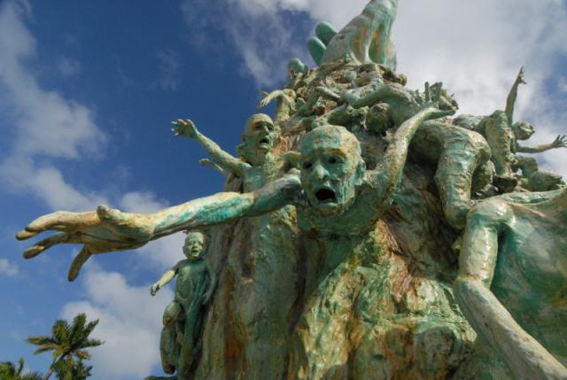
Remember, Confront, Prevent
"Never- will I forget this night, the first night in the camp, it will remain with me as being the longest night in my life.
Never- will I forget the smoke.
Never- will I forget the small faces of the children before my eyes, whose bodies rose up like coils of smoke, into the blue heavens.
Never- will I forget the flames, that consumed my faith forever.
Never- will I forget the silence in the night, that took my lust for life away- for all eternity.
Never- will I forget the moment that killed my God, and my soul and my dreams- which took on the face of the depraved.
Never- will I forget even if I am sentenced to live as long as God: Never!!“
~Elie Wiesel, Night
Sculpture of Love and Anguish, Kenneth Treister, Holocaust Memorial , Miami Beach, Florida

