Slide 1
Does wealth affect health?
Niels van Opstal

Slide 2
Introduction
Correlation health wealth has been shown often.
Causality remains unclear in research.
Could be endogeneous:
health → wealth
wealth → health
… → health & wealth
Goals of thesis: to find a causal effect from wealth on health.

Slide 3
Literature
Pollack et al. (2007)
Analyzed 29 studies on correlation health
Meer, Miller and Rosen (2003), Kim and Ruhm (2012), Apouey and Clark (2015)
IV inheritance (and lottery winnings), no causality
Cai (2009)
Focusses on health transitions, causal effect of wealth on health
Keese and Schmitz (2014)
Indebtedness → worse mental and physical health

Slide 4
Data
Dutch Household Survey

Slide 5
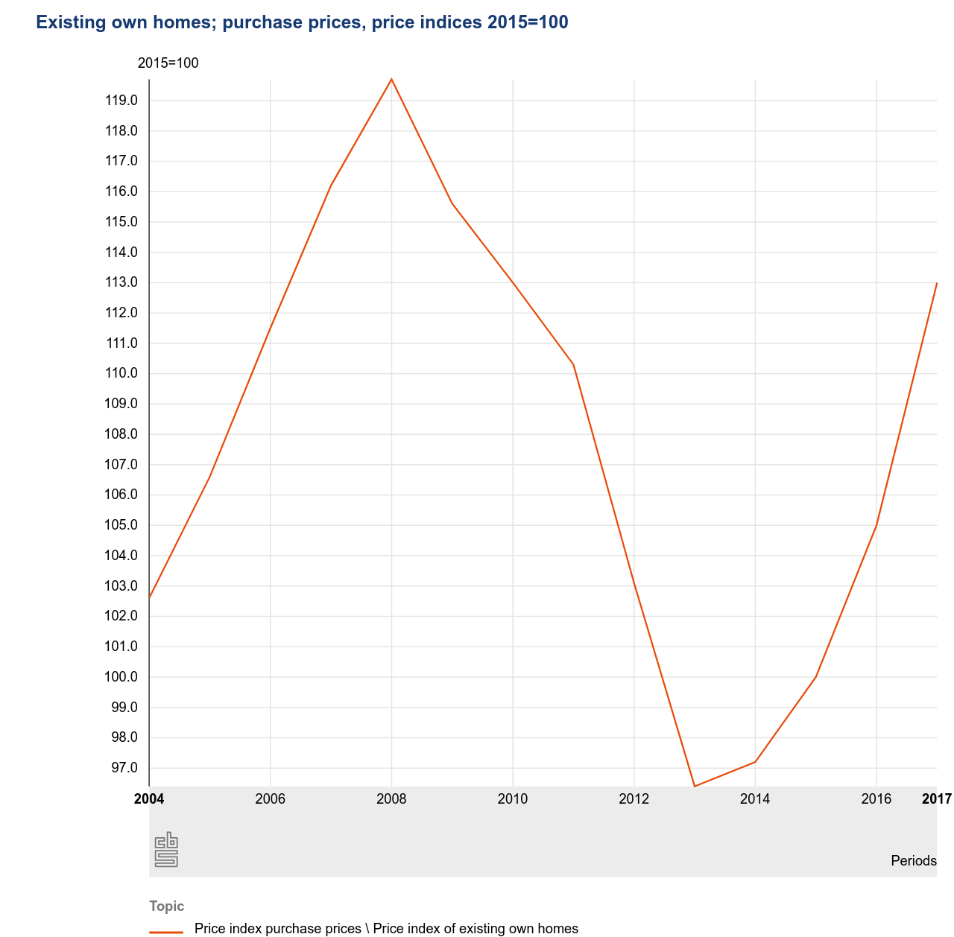
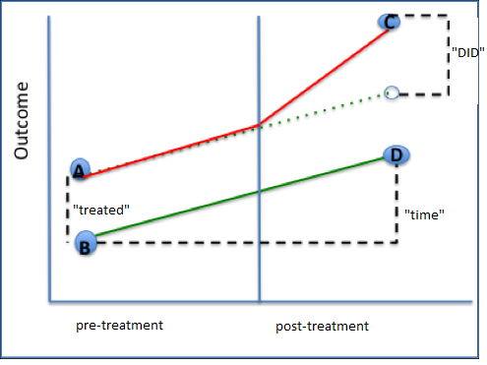
Methods
Difference in differences analysis
Quasi-experiment
Treatment: change in house prices caused by the financial crisis in 2008
Control group: home renters
Treatment group: home owners

Slide 6
Results
 | 2007 - 2013 | 2007- 2017 | 2013- 2017 | 2007- 2013 | 2007 - 2017 | 2013- 2017
VARIABLES | health | health | health | health | health | health
Time | 0.0026 | -0.0265*** | -0.0291*** | 0.0054 | -0.0124 | -0.0173
 | (0.0096) | (0.0096) | (0.0101) | (0.0110) | (0.0109) | (0.0113)
Treated | 0.0190** | 0.0190* | 0.0078 | 0.0173 | 0.0164 | 0.0028
 | (0.0096) | (0.0102) | (0.0108) | (0.0116) | (0.0116) | (0.0123)
DID | -0.0112 | 0.0235* | 0.0347** | -0.0123 | 0.0110 | 0.0234
 | (0.0139) | (0.0138) | (0.0143) | (0.0155) | (0.0149) | (0.0155)
Gender |  |  |  | -0.0124 | -0.0165** | -0.0110
 |  |  |  | (0.0088) | (0.0082) | (0.0085)
Education |  |  |  | 0.0044 | 0.0096 | 0.0070
 |  |  |  | (0.0084) | (0.0080) | (0.0082)
Net Income |  |  |  | 0.0000** | 0.0000*** | 0.0000***
 |  |  |  | (0.0000) | (0.0000) | (0.0000)
Constant | 0.9487*** | 0.9487*** | 0.9513*** | 0.9426*** | 0.9413*** | 0.9450***
 | (0.0065) | (0.0069) | (0.0076) | (0.0087) | (0.0086) | (0.0097)
Observations | 3,458 | 4,024 | 3,864 | 2,586 | 2,881 | 2,671
R-squared | 0.0013 | 0.0070 | 0.0060 | 0.0046 | 0.0100 | 0.0085
Standard errors in parentheses
*** p<0.01, ** p<0.05, * p<0.1

